Slide 1
Math + Fluency = FUN!
Text in the first word that comes to your brain when you hear math fluency.
Go to the website: pollev.com/MOLLYSMITH514
Or text MOLLYSMITH514 to 22333
Molly Smith molly@eoni.com
Oregon Council of Teachers of Mathematics President @mollymathnerd
Teacher in North Powder School District

Slide 2
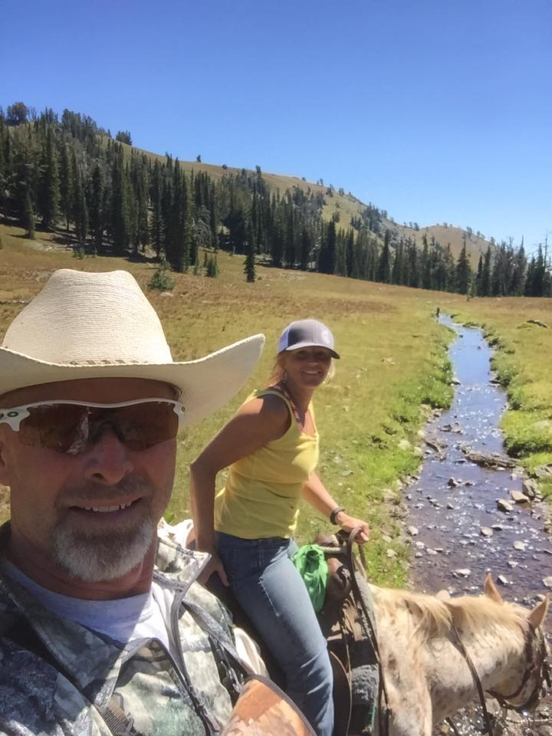
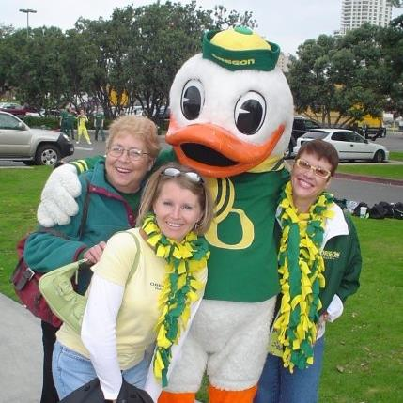
Who am I?
Notes:
I am the person who was not going to be a teacher, as watching my parents both teach at the high school level was enough information for me to set my sights on a different profession. Yes,, here I am, 22 years later of being an educator. I have taught middle school when I looked like a middle schooler, SPED at the elementary, and 2nd and 3rd grades. Currently I am an Assistant Principal and Math Coach at Brooklyn Primary in Baker City, and am also the Oregon Council of Teachers of Mathematics President. This is my cute family, and as you can see, I am the mom of two very busy boys. My husband is a teacher, coach, and Athletic Director, and we love obviously the Ducks and doing most things that deal with the outdoors. My topic today is what it means to have a growth mindset, especially when it comes to mathematics. Even though growth in height stopped for me in high school, my family was always one that believed that we could do anything we set our minds to. It didn’t matter that I was a girl growing up in a town called Halfway, Oregon, nor did it matter that my great-grandparents came from another country. My parents and the people around me believed in me.

Slide 3
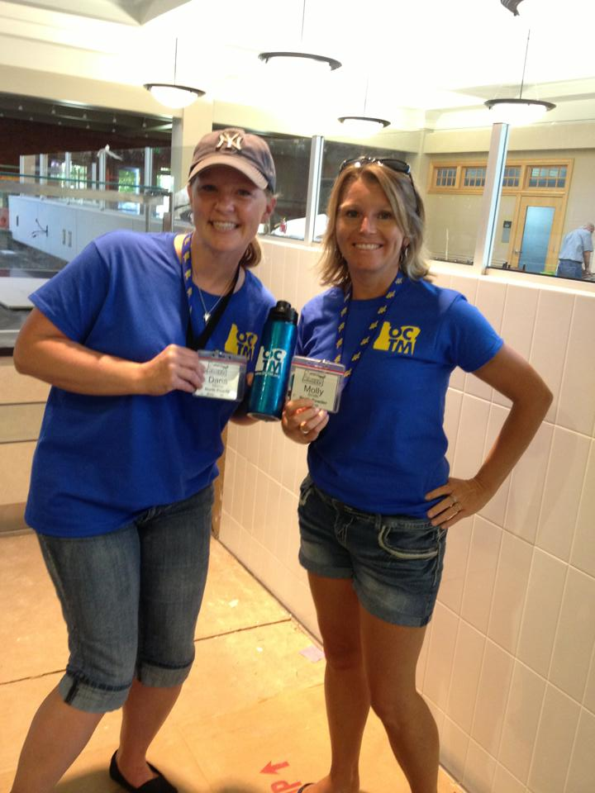
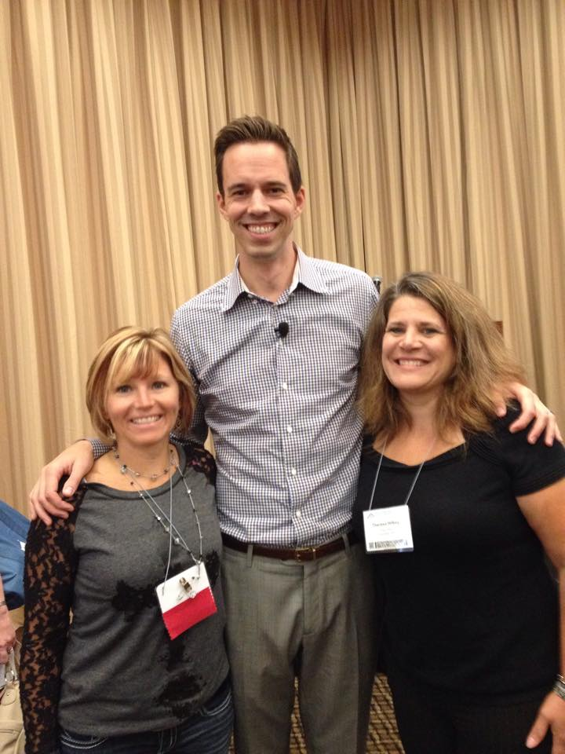
Big math nerd!

Slide 4
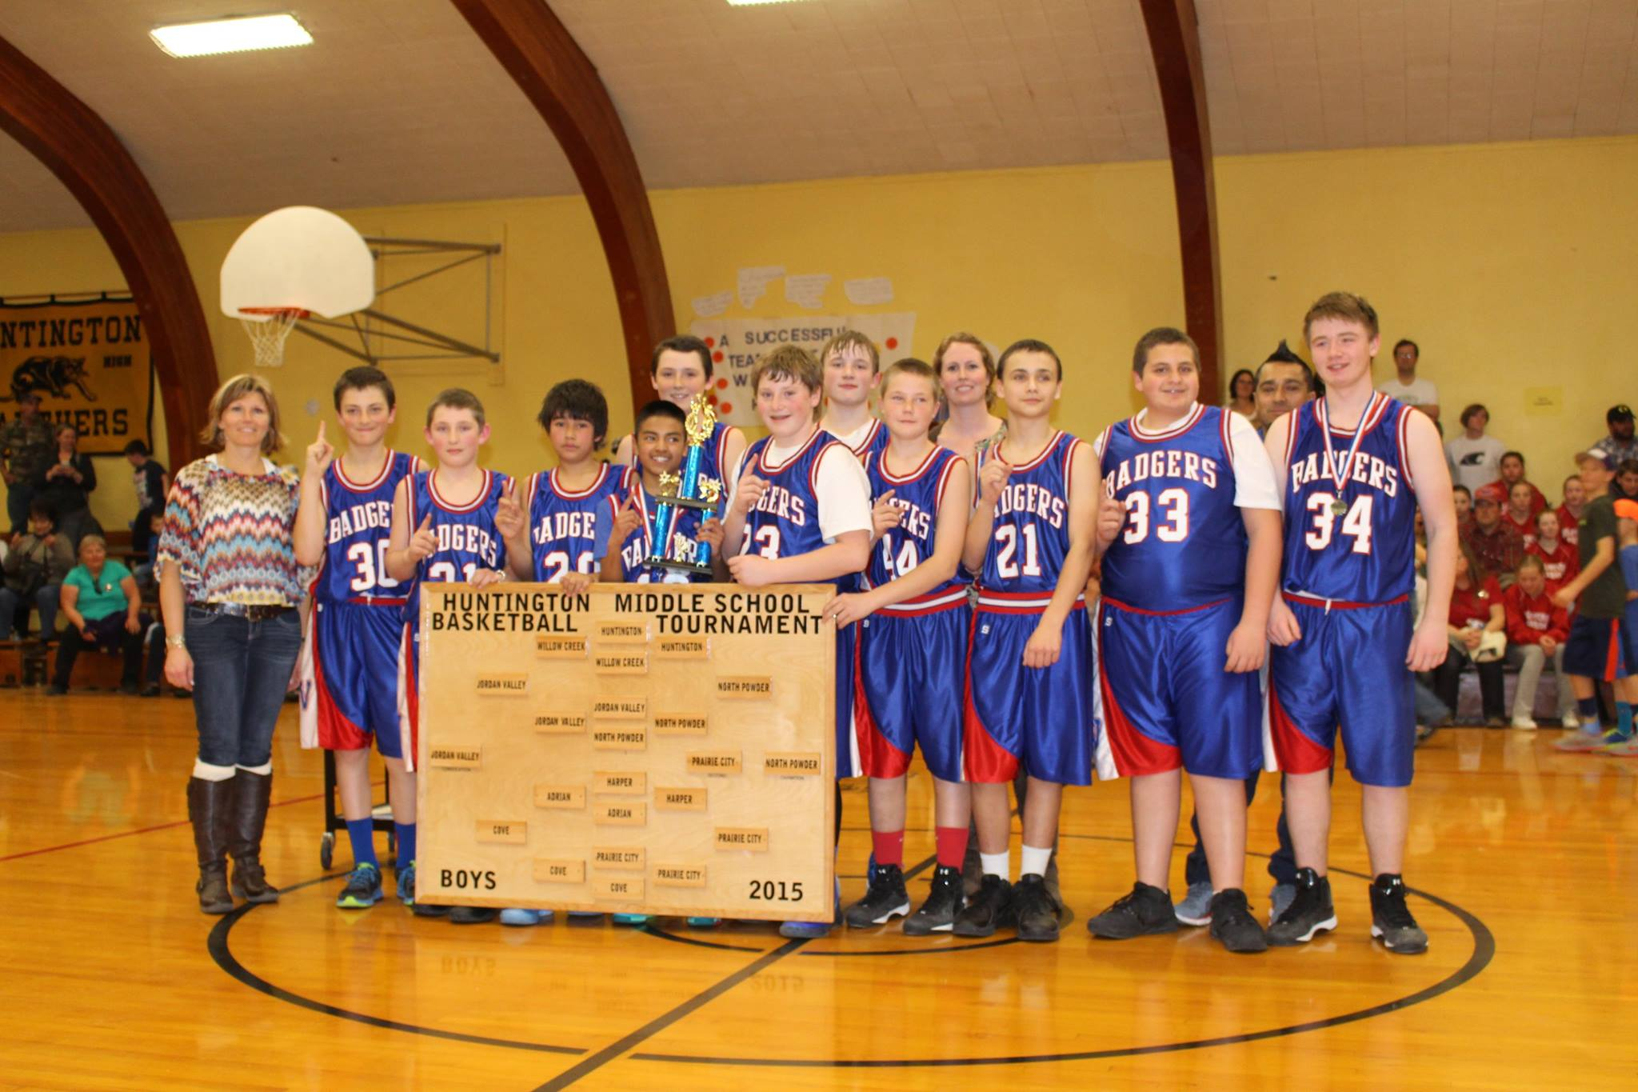
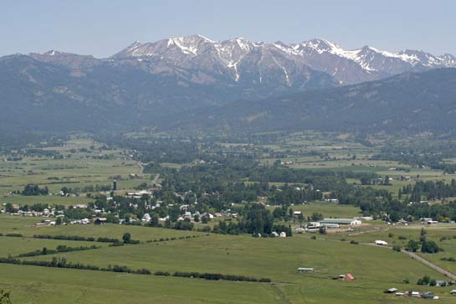
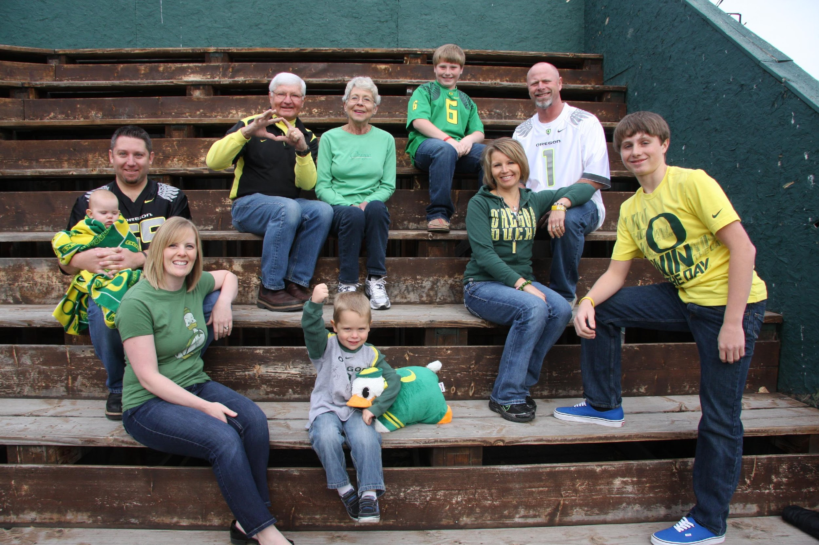
I’m the girl from Halfway who wasn’t going to be a teacher!
Notes:
Halfway, Oregon
Daughter
Wife and Mother
Teacher and life-long learner
President of Oregon Council of Teachers of Mathematics
Math Coach and Assistant Principal
Oregon Duck Lover
Adventurous!

Slide 5
Fluency???

Slide 6
What brings you to this session?

Slide 7
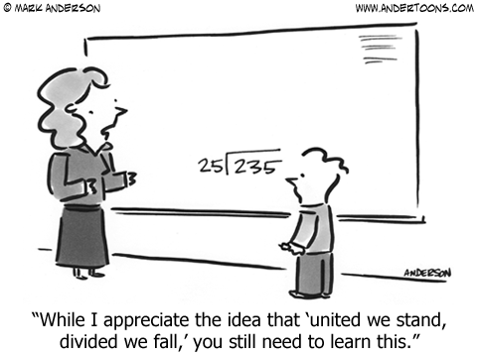
Is this fluency?
Notes:
I want you to think about this math problem. Why do we need to teach this and why do students need to learn this? Or, why don’t we need to teach this and why don’t students need to learn this? Show math book that Fawn gave me.

Slide 8
Objectives
Research
Jo Boaler
NCTM
Instructional Practices
Teaching through strategies
Fluency practices/activities
Practice, practice, practice in engaged activities
IES

Slide 9
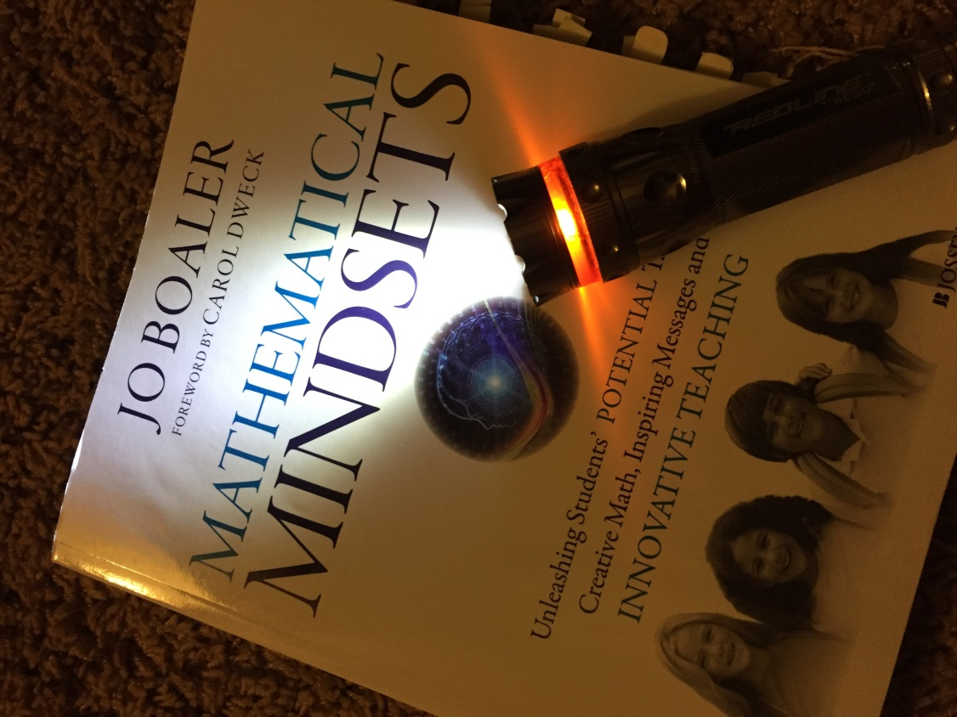
Christmas Break – it was that good!

Slide 10
Define fluency…
Fluency – flexible, accurate, and efficient in solving problems which is based on a deep understanding of the characteristics of properties of numbers and how they work …
Notes:
Unfortunately misinterpretations of the meaning of the word ‘fluency’ in the CCSS are commonplace and publishers continue to emphasize rote memorization, encouraging the persistence of damaging classroom practices across the United States. Mathematics facts are important but the memorization of math facts through times table repetition, practice and timed testing is unnecessary and damaging.

Slide 11
Math Gene?
“The question is not whether all students can succeed in mathematics but whether the adults organizing mathematics learning opportunities can alter traditional beliefs and practices to promote success for all.” NCTM, 2014
Growth Mindset

Slide 12
Standards for fluency…

Slide 13
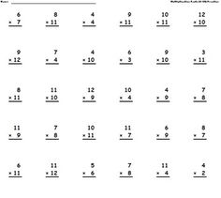
IES/Jo Boaler Research
10 minutes a day
Must teach strategies
Not timed…
From IES:
Use games to teach math concepts and skills and to give children practice in applying them. Games can provide an engaging opportunity for children to practice and extend skills…
Notes:
Teachers who use timed tests believe that the tests help children learn basic facts. This makes no instructional sense. Children who perform well under time pressure display their skills. Children who have difficulty with skills, or who work more slowly, run the risk of reinforcing wrong learning under pressure. In addition, children can become fearful and negative toward their math learning. (Burns, 2000 pg. 57)

Slide 14
Jo Boaler – Fluency without Fear
Fluency without Fear article
Jigsaw by tables – 5 sections
You’ll share out big ideas
Take-aways
Not sure about?

Slide 15
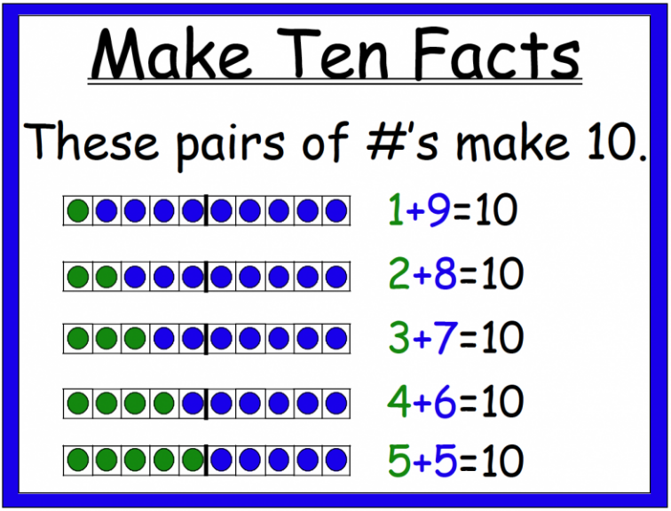
Strategies
Addition Strategies
Subtraction Strategies
Multiplication Strategies
Division Strategies
Thanks to the Math Learning Center

Slide 16
Number Talks

Slide 17
Number Talks
How are students using number relationships to solve the problem?
How would you describe the classroom community and environment?
Which strategies demonstrate accuracy, efficiency, and flexibility?
How are the students’ strategies similar to or different form your strategy?
Kindergarten Number Talk
Second Grade Number Talk
Fifth Grade Number Talk

Slide 18
Dice
Make Ten
Multiply by 8’s
Tic Tac Toe – Get Three Multiples in a Row!
Dueling Dice

Slide 19
Cards
Salute
Making 10’s Go Fish
Addition Grab Two - MM
Who has More/Less? – MM
Up to 10
Nine-Square – MM
A ton of other card games

Slide 20
OTC card games
Skipbo
Phase 10
Spot It
Set
Rook
Memory
Quirkle
Blockus
Pig
Bunko
24

Slide 21
Dot cards

Slide 23
Dot cards

Slide 25
Dot cards

Slide 27
Other games
Four in a Row
Uncover
Spinning Around Addition
Combos
Make Me Equal
I Have/Who Has?
Clever Catch Ball
Make 10
Multiplication Squares

Slide 28
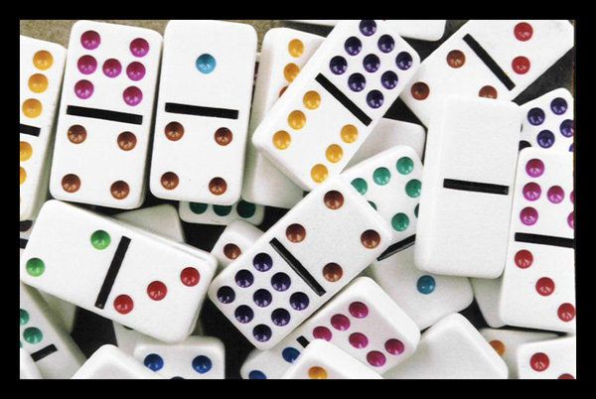
Dominoes
Addition/Subtraction with dominoes
Counting on/back
Making 10
Doubles
Making the sum of ___ pg 44 facts that last
Multiplication with dominoes

Slide 29
No materials
Talk around the table
Start at 0 and count by 2’s
Start at 37 and count by 2’s
Start at 240 and count by 2’s
Count by 10’s starting at 3,237 and stopping at 4, 297.
Count by tenths starting at 6 and ending at 7.9
Representation
Guess my Number
Notes:
Count around the table – Count by 5’s, 10’s, halves, quarters, who will say 100 when counting by 10’s? Count backwards.
Representation – counting on fingers, using common objects, charts, graphs, number lines, drawing pictures, math symbols, etc.

Slide 30
The number of the day - 63
Is it small or is it BIG?
In the stock market?
Books in a library
Pages of homework
Pennies
Reading for 63 minutes
Candy bars
Seconds
What else?

Slide 31
Clickers

Slide 32
Rekenrek
What the Heck is a Rekenrek?
Show 5: How many different ways can you show 5 on your Rekenrek? (repeat with different numbers)
Doubles: How many different doubles facts can you show on your Rekenrek? Record.

Slide 33
Kim Sutton
CD
Number lines with my fun fingers!
Book

Slide 34
Music
Youtube
Doubles doubles
CD’s

Slide 35
Rich tasks
Low Floor High Ceiling Tasks
3 Act Tasks – Graham Fletcher
Notes:
Low floor high ceiling tasks are tasks which most children can access at some entry point, yet offers opportunities for children to extend their thinking and reasoning skills through the choices they make.

Slide 36
Websites
Estimation 180
Would You Rather?
Which One Doesn’t Belong?
Play with your Math
Open Middle

Slide 37
Developing numerical fluency
This requires planning and active engagement that stimulates thinking and fosters the use of strategies. Students should be using the 8 mathematical practices. When applicable, children should be communicating their thinking and recording their thinking.

Slide 38
Other resources…
Jo Boaler – MOOC – How to Learn Math for Students/How to Learn Math for Teachers
Websites
Youcubed
Graham Fletcher progression videos
Books
Van de Walle
Box Cars and One Eyed Jacks
Number Talk
Kim Sutton
OCTM – Monday Math,
Math Nerds in Oregon:
Steve Wyborney
–Ontario School District
Jane Osborne
-Hood River School District

Slide 39
The Oregon Council of Teachers of Mathematics
www.octm.org
Oregon Math Leaders – August 4-5, 2017 – Willamette University
Northwest Math Conference – October 12 – 14, 2017 – Red Lion Jantzen Beach
Membership is cheap! $25 for E-membership or $35 for full membership
Scholarships, TOMT, and great networking with other math nerds!

Slide 40
Assessing fluency…
This is the question of the day!

Slide 41
Fluency
Think about your current practice.
Does it support what the research is showing?
If not, how can you change your practices?

Slide 42
Exit ticket:
What are effective teaching practices pertaining to fluency that you can put into place starting your next day back at school?

Slide 43
Questions/Comments
Molly Smith
North Powder Elementary
molly@eoni.com
541.898.2244

