Slide 1
Core Instruction in Tier 1
The Prevention That Avoids Intervention

Slide 2


Slide 3
Targets
Dedicate a minimum of 90 minutes to Reading
Materials align across years
Explicit instruction works for everyone

Slide 4
RTI Essential Components
Standards of
Practice
Data-Based Decision Making with Decision Rules
Training Coaching
Fidelity
SLD Decision Making
Progress Monitoring
Interventions
Screening
Core
Leadership
Teaming/Data-Based Decision Making
Professional Learning & Support
Culture
Notes:
In the nine features of RTI implementation, this presentation covers the standards of practice of leadership and the core.

Slide 5







Where do these ideas come from?

Slide 6
Why do we need a core?
A core Reading program provides a system of instruction for students as they move through grade levels.

Slide 7
  Core is for all students
  The goal of tier 1 instruction is that 75 to 80% of the students are proficient.

Slide 8
  Core is for all students
  The goal of tier 1 instruction is that 75 to 80% of the students are proficient.
  Instructional strategies
  Materials
  Time

Slide 9
RTI begins with
General Education!
Teachers don’t fail students, systems do.
RTI is a system for differentiation of instruction!
RTI is a system that is predicated on the general education teachers’ skill and knowledge of instruction, assessment, curriculum, and children.

Slide 10

In other words
We cannot solve the herd problem one cow at a time.
We need a system to feed them all well.

Slide 11
How is instruction organized?
A core Reading program has standards of practice across the district and grade levels that provide guidance and clarity as to the expectations for instruction.
Notes:
The standards of practice are the fence that define the reading program

Slide 12
Standards of Practice
Dedicate a minimum of 90 minutes to Reading
because
successful core instruction is the most important thing you can do in RTI.

Slide 13
Struggling readers in core
They need the most instruction.
Need to be exposed to grade level material.
Just because there is a deficit in one area, does not mean there is a deficit in all areas of reading.
If they miss grade level material, they will never catch up.
Interventions are limited in scope.

Slide 14
Why?
Time is precious – protect it!!!
Your core program is written for at least 90/110 minutes (450 minutes/week)
Oregon K-12 Literacy Recommendation
For EL’s core is 90/110 minutes + ELD time

Slide 15
Oregon K-12 Literacy Framework
Provide at least 90 minutes of uninterrupted reading instruction using the core reading program to all students.
Research shows that students need a minimum of 90 minutes of uninterrupted reading instruction with the core reading program. Providing at least 90 minutes of instruction gives students the best opportunity to receive instruction on basic skills they need to be successful readers. The 90-minute reading block must be uninterrupted, meaning there should be no assemblies, lunch count, attendance count, recess, etc., that would interfere with instruction during that time.
Notes:
Put in handouts

Slide 16
Time Done Well Matters Most
Limit interruptions
  Lunch count
  Attendance
  Assemblies
  Limit transitions
Dense
Differentiated
Good teaching methods
Students actively engaged

Slide 17
Core Reading Minutes
This does not include the instruction of writing
  It may include the practice of writing
    Writing in response to reading

Slide 18
Standards of Practice
Materials align across years
because
successful core instruction is the most important thing you can do in RTI.

Slide 19
Why?
Comprehensive program that incorporates all components of reading
  Students have the opportunity to make connections
  Students read text that supports vocabulary, phonics, and comprehension lessons
The whole school has a common language, common goal, and common tools

Slide 20
Materials
Check materials for cultural relevance
  Representation of a variety of groups
Think about how the materials fit the culture and context of your students
  Provide background knowledge as needed

Slide 21
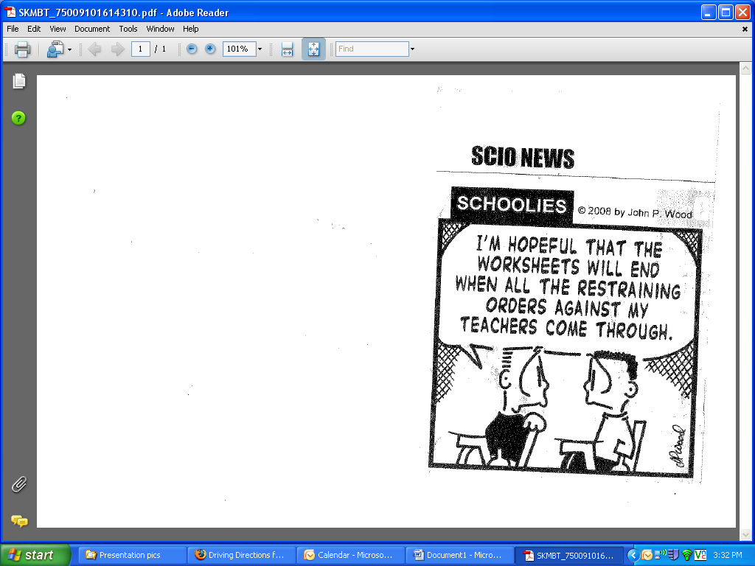
Fidelity to the core
Worksheets Fidelity

Slide 22
What do the Materials Address
The Big 5 of Reading
The scope and sequence
State and common core standards

Slide 23
Reading Skills
Reading Comprehension
Foundational Skills
Vocabulary
Fluency
Accuracy, Prosody & Rate
Phonics and Word
Recognition
Phonemic Awareness
Print Concepts

Slide 24
A Conceptual Framework for Reading/Literacy/Language Instruction
Language Proficiency Instruction
Adapted from Coyne, M., 2011

Slide 25
Scope and sequence
We want to be sure that we know what has and what will be taught.
Mastery of skills looks different at all levels
Repeated opportunities to learn

Slide 26
Differentiation during core
What specific materials are to be used?
  Which ones meet the Big 5 of Reading?
  Which ones meet the State and Common Core?
Who gets feed what?
- Whole Group
- Small Group
- Independent
Practice

Slide 27
Standards of Practice
Explicit instruction works for everyone
because
successful core instruction is the most important thing you can do in RTI.

Slide 28
Explicit instruction is a systematic instructional approach that includes a set of delivery and design procedures derived from effective schools research.
~Ideas That Work

Slide 29
Explicit Instruction is. . .
Engaging
Systematic
Relentless
Anita Archer

Slide 30
Explicit Instruction is Engaging
Frequent responses are elicited
  Things students say
  Things students do
  Things students write
Responses are monitored
Positive and corrective feedback is given

Slide 31
Explicit Instruction is Systematic
Content
  Instruction focuses on critical content
  Skills, strategies, and concepts are sequenced logically
  Complex skills and strategies are broken down into smaller (easy to obtain) instructional units

Slide 32
Explicit Instruction is Systematic
Design of instruction
  Organized and focused
  Goals that can be articulated by students
  Review and build background knowledge
  Review at the end of the lesson
  Scaffolding
  Includes instructional routines

Slide 33
Explicit Instruction is Systematic
Instructional Routines example vocabulary
  Say the word
  Provide a student friendly explanation
  Connect
  Check for understanding

Slide 34
Explicit Instruction is Systematic
Delivery
  Require frequent responses
  Monitor student performance closely
  Provide immediate affirmation and corrective feedback
  Deliver instruction at a brisk pace
  Help students organize knowledge

Slide 35
Explicit Instruction is Relentless
Practice, practice, practice
Practice does not make perfect, perfect practice makes perfect
Practice leads to automaticity
The 3 R’s
  Receive, Respond, Retain

Slide 36
TEACHER RESPONSIBILITY
“I do it”
Focus Lesson
Guided Instruction
“We do it”
“You do it
together”
Collaborative
Independent
“You do it
alone”
STUDENT RESPONSIBILITY
A Model for Success for All Students
Fisher, D., & Frey, N. (2008).

Slide 37
Explicit Instruction is Relentless
I do
We do
You do it together (y’all)
You do
Moving toward mastery
We want students to apply the lessons to the next text they read.

Slide 38
Differentiation during core
What instructional strategies are to be used?
  When is direct instruction necessary?
  When and how do you get more?

Slide 39
Differentiation during core
What instructional strategies are to be used?
  When is direct instruction necessary?
  When and how do you get more?
Explicit
Modeling
Time
Practice
Monitoring and Feedback

Slide 40
Cumulative Review
Dedicate a minimum of 90 minutes to Reading
Materials align across years
Explicit instruction works for everyone

