Slide 1
Striving for Equity in Oregon’s Graduation Outcomes
How can the Graduation Equity Fund (SB 183) support school districts as they strive for equitable outcomes?
April 28, 2017

Slide 2
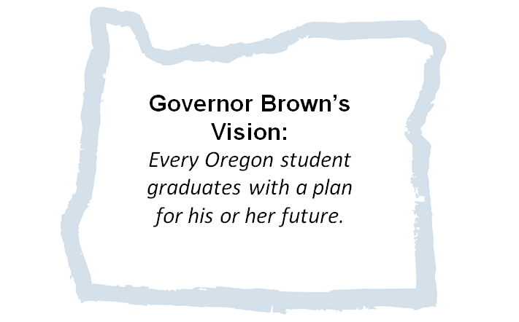
Governor Brown’s Vision:
Every Oregon student graduates with a plan for their future.

Slide 3
83.2%
Oregon 73.8%

Slide 4
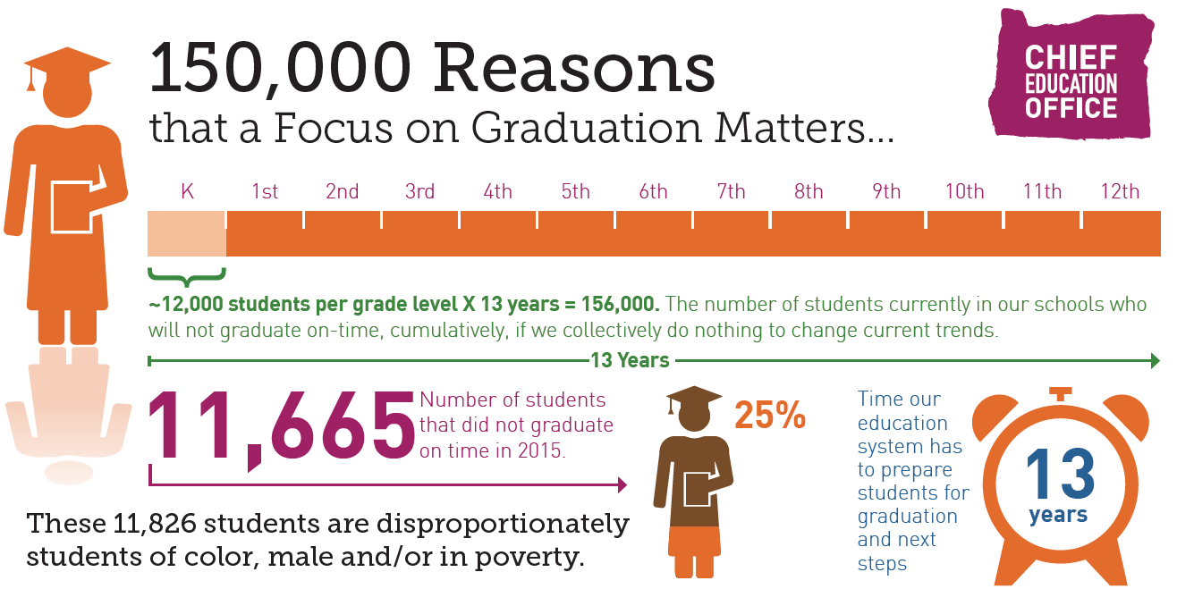

Slide 5
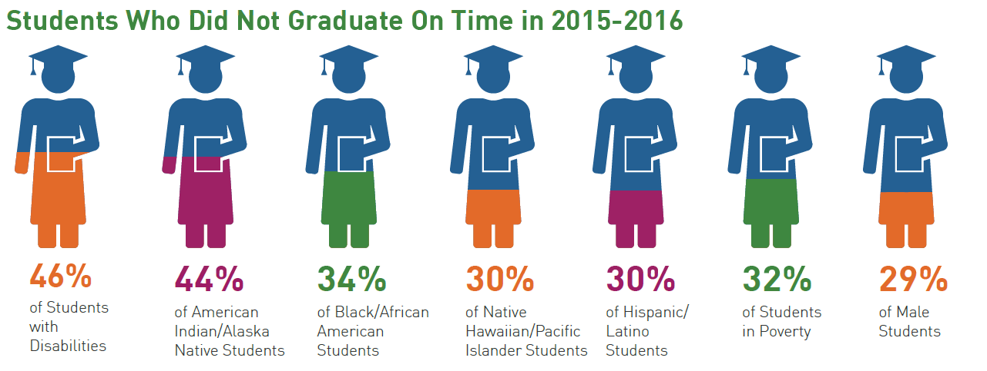

Slide 6
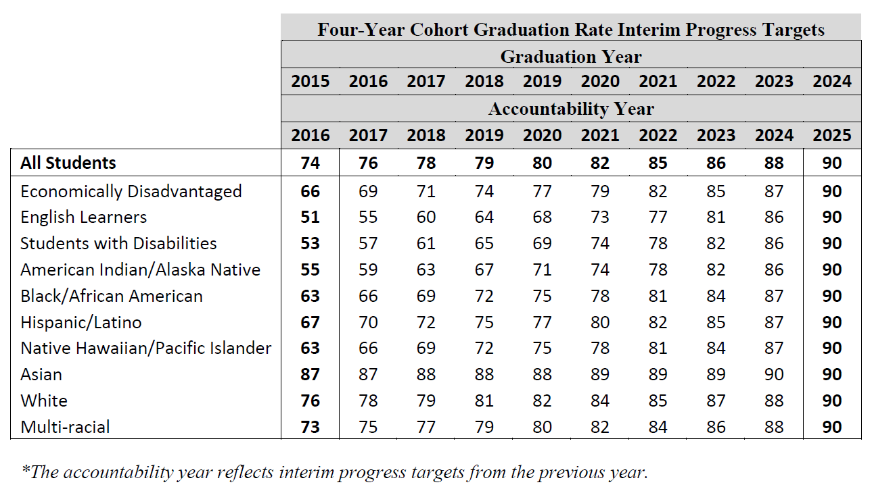
ESSA Graduation Targets

Slide 7
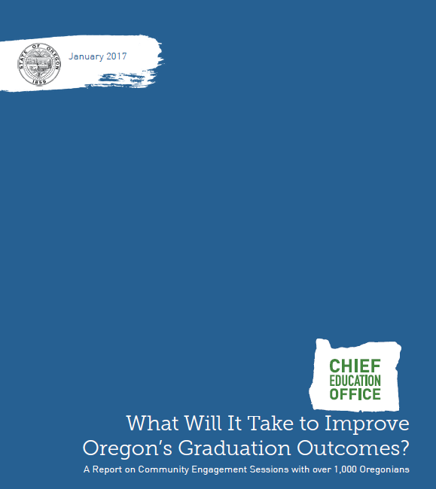

Slide 8
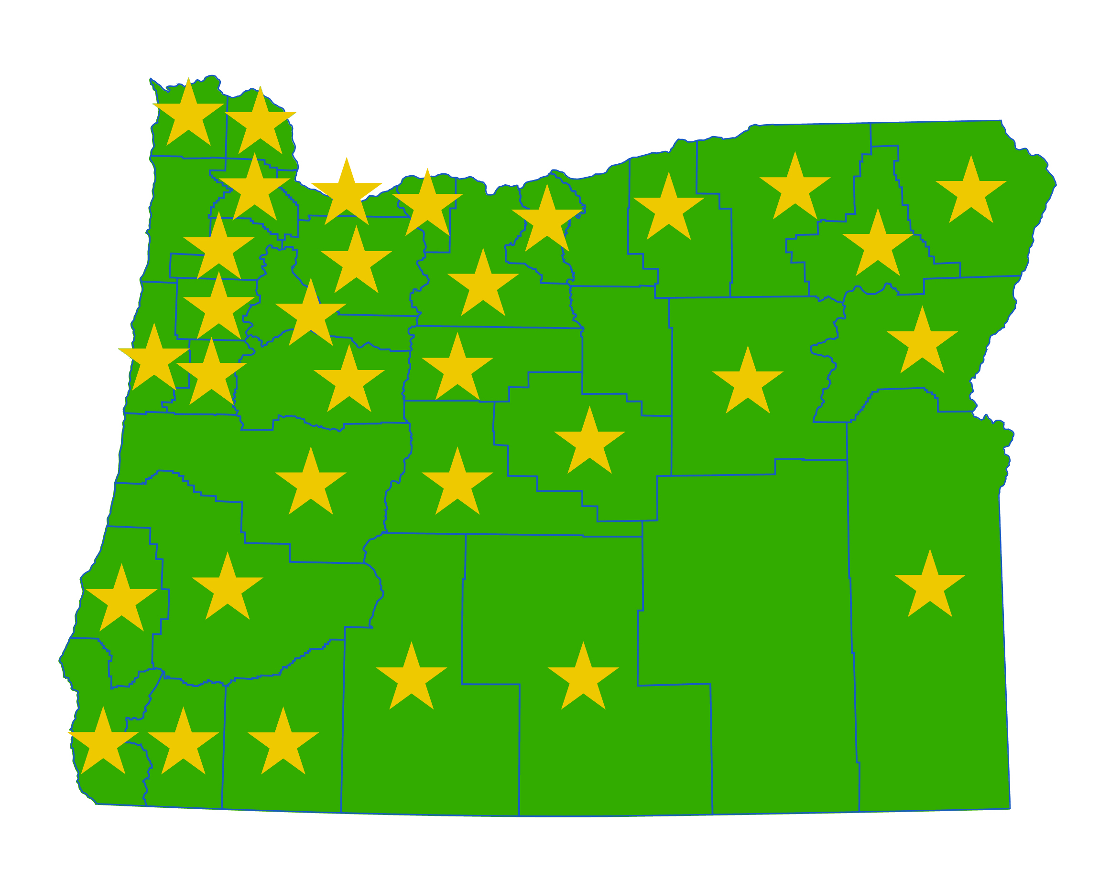
Who did we talk to?
43 groups, 32 counties = over 1,000 Oregonians
Students, parents, educators, community members
What did we ask?
Barriers + supports to high school graduation
How did we collect data?
Education partner visits
Qualitative methods
Group + individual responses
In-person + social media

Slide 9
What did we hear?
A desire for equity and equitable practices
Leveraging assets within the education system –
partnerships with organizations
community involvement/engagement
building and sustaining relationships
The need to get “back to basics”

Slide 10
“Positive relationships with school and community organizations who support youth and families – see their strengths and beliefs and expect them to be successful. Additional supports for culturally specific/responsive community-based organizations who have a strong track record of successful outcomes and positive community relationships with youth families in schools.”
(Education Partner, Portland)

Slide 11
“As a parent, the kids don’t graduate because in our community, many people don’t have the education. So maybe they don’t support or encourage their kids to graduate. So maybe as a coalition, we have the opportunity to teach the parents how to support, and also supporting the parents to help their kids.”
(Parent and Education Partner, Salem-Keizer)

Slide 12
“We’re missing this big time in the schools. Trauma-informed care and mental health care is really missing. To implement trauma-informed care, you go into the model thinking that all kids are dealing with things. All kids are going to be faced with challenges. More kids need help and there are less adults to take care of them.”
(Parent, Medford)

Slide 13
“I love the idea of an early indicator system. I feel one of the largest gaps in our system is between the schools and the families, and this type of system would be a great way to start building and developing positive student-focused/ goal-oriented relationships between the two groups.”
(Educator, Central Oregon)

Slide 14
“We need to bring a lot of value back to humanity in our education system. Every student needs to know they’re important. That every person in school is important. Everybody has value and we’re all in this together. If there were a stronger community spirit for the school, then that would do a lot K through 12. And do a lot in supporting kids in graduating.”
(Parent, Jackson County)

Slide 16
What does this mean?
Effective community-based implementation needs:
A finite approach
A sustained effort
Building a solid foundation with attention to equity, relationships, partnerships, and relevance allows for sustaining policies and future innovation beyond the “basics.”

Slide 17
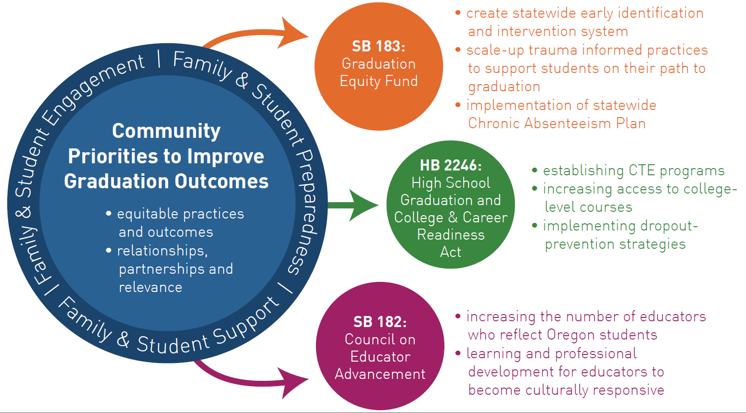
Community Engagement to Action

Slide 18
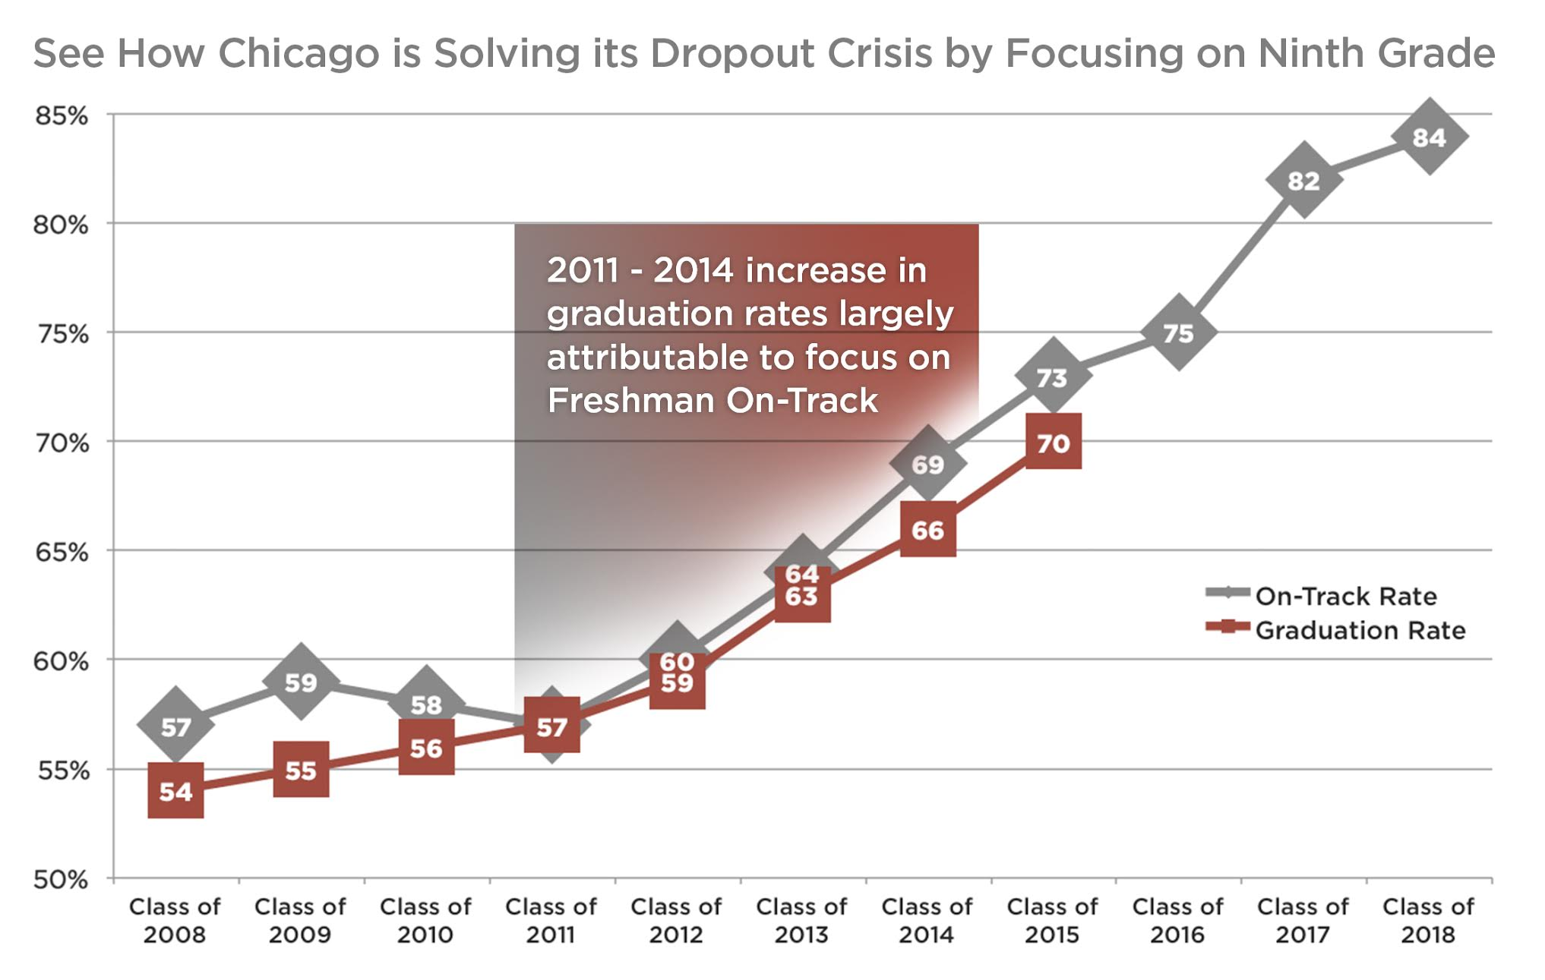
EIIS– What is it?
“We need to bring back the idea of measuring for improvement, not just judging.”
–Dave Conley
An Early Indicator and Intervention System (EIIS) is a collaborative approach among educators, parents, and communities using data effectively to keep students on the pathway to graduation.
Rapid identification of students;
Rapid interventions that are targeted to students’ immediate and longer-term need for support;
Frequent monitoring of the success of interventions; and
Rapid modification of interventions that are not working.

Slide 19
Children and Trauma
Early experiences shape brain architecture.
Even more so between early caregiver and child interactions.
Adverse childhood experiences (ACEs) or toxic stress can derail brain development.
ACEs Category | OHT Survey 2014
Parental Separation or Divorce | 44.3%
Household Substance Abuse (OHT-problem drinker) | 39.1%
Household Mental Illness (OHT- depression) | 35.7%
Not Enough to Eat | 23.7%
No One to Protect Them | 14.9%

Slide 20
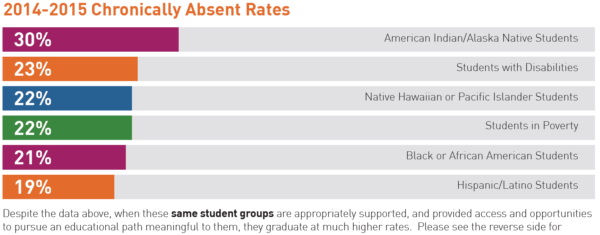
Chronic Absenteeism

Slide 21
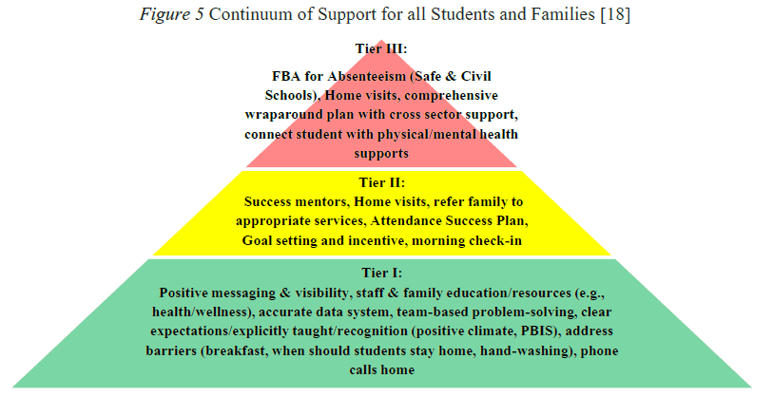

Slide 22
How do we ensure…
EQUITY so that these efforts serve the students who most need the services?
LOCAL and regional engagement, partnerships, relationships, relevance, and ownership?
INNOVATION in designing new supports for students and families.
RESULTS through improved graduation outcomes.

Slide 23
laura.lien@state.or.us
colt.gill@state.or.us
@EdInnovationOR

