Slide 1
Master Schedules: A window to the soul of the school. Spring Conference 2015

Slide 2
Targets
Understand how to build an effective master schedule that supports a multi-tired system of support.
We will discuss the importance and application of consistency in the instructional day, protection of instruction, time for interventions, the use of data, flexibility, collaboration time for staff and how each fits into an elementary master schedule.

Slide 3
Outcomes
Understand how culture and vision impact a master schedule
Identify legal and contractual requirements and how the impact a schedule
Identify key attributes of a strong master schedule
Prioritize what is important in your school and use data to support that decision
Identify methods for collaboration and communication
Evaluate sample master schedules

Slide 4
Notes:
The master schedule is like look at the inner workings of a school. It provides insight into the things that are necessary and also it can show if anything is not working.
Quick write: What would an MRI of your schedule show?
Anyone ever had an MRI? I have had 2 both times it has been stressful and a long process!!!!!

Slide 5
The Master Schedule: A Cultural Indicator
A master schedule should reflect:
Beliefs
Attitudes
Values
Priority of your school
Notes:
Talk time: talk with your team and answer these questions. Look at your schedule, does it reflect your vision for instruction for all? Or something else? Why are schedules important?
1-2 minutes

Slide 6
The Master Schedule: A Cultural Indicator
Does your master schedule:
Maximize resources ?
Connect priorities to actions ?
Focus on coherence ?
Increase student achievement ?
Notes:
What are resources: People, time, materials
What are the priorities of your school? RTI
What does coherence mean? Systematic, consistent
What is the school vision?

Slide 7
How and why?
How the master schedule is constructed is as important as what it contains.
Notes:
Check John Hattie’s work around scheduling
Effect size of RTI John Hattie 1.04 which is tiered instruction
How is your schedule constructed? Is it one person or a team of people? Does it reflect a shared goals/mission/vision? Is there a culture of commitment/team?
Was data used in creating your schedule? Did you think of how leadership plays a role? PD/
Is your schedule student centered or adult centered? Meaning does your schedule take into account the needs of the students or the wants of the teachers?

Slide 8
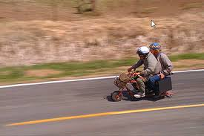
How and why?
Does the schedule drive the school or the school drive the schedule?
Notes:
? What drives your schedule? What needs to drive your schedule? Is it assessment/data? Instruction- RTI?
There are certain things that we have to follow: Instructional minutes, bus schedules, district decisions, etc. What happens during that day reflects what is important to your team. Is your team using data to help determine the importance of what needs to go into your day?
Deep implementation of Response to Intervention (RTI) requires a firm commitment to the concept of increasing instructional time for nonproficient students in an already crowded instructional day. Establishing a multi-tier system of supports (MTSS) providing multiple tiers of intervention—each demanding a chunk of instructional time that does not remove a student from Tier 1 core instruction—can be a daunting scheduling challenge.
Talk time

Slide 9
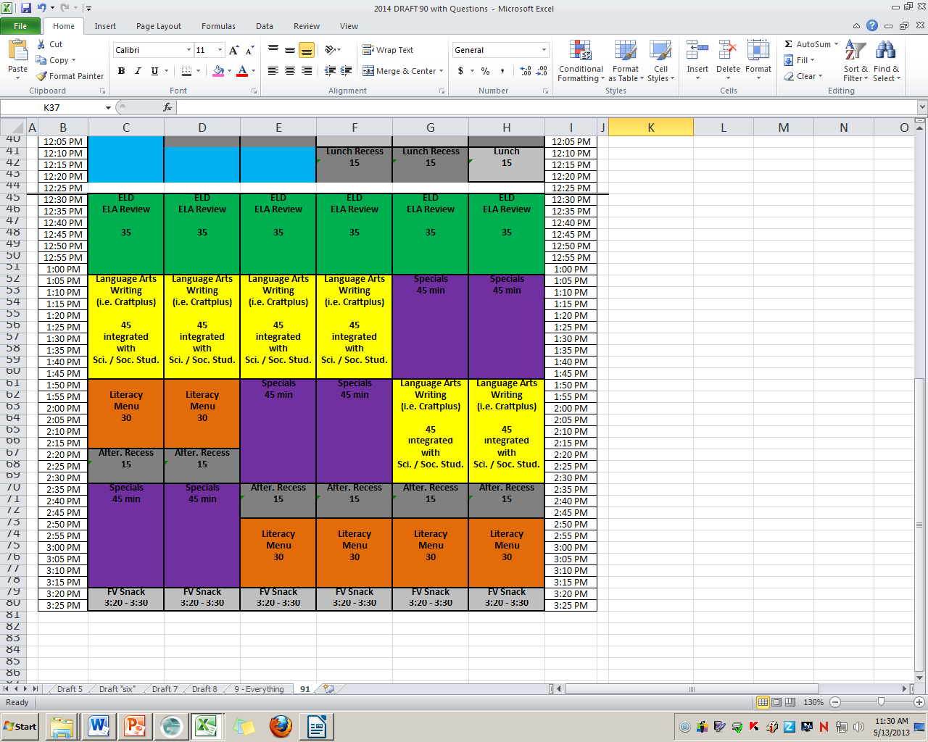
ELD / Language Review 35 min.
Writing
The Lunchroom
& PE gap
Let’s talk about science and social studies
ELD Double
Dose happens here
10 minutes of closing time

Slide 10
‘Alice came to a fork in the road. ‘Which one will I take?’ she asked. ‘Where do you want to go?’ responded the Cheshire Cat. ‘I don’t know.” Alice answered. ‘Then’, said the cat, ‘It doesn’t matter.”
Alice in Wonderland
Notes:
How do you establish a culture that creates answers and visions not confusion? Ask your staff what they think? Ask them what they view their role is, what is their hope for students? What do we as a school hope to be in 10 years? What our our core believes/values? Do they align with the vision of the school? District? This is what drives the master schedule. Once you have established this, it will all start to fall in place.
Ensure that everyone in your building understanding your vision. Make sure that everyone knows what is important and what is expected. Answer questions about why we do the things we do, be transparent.

Slide 11
Things to consider…..
177 instructional days X 6 hours per day=
1062 hours total
Lunch: 118 hours
Recess: 59 hours
Assemblies/other scheduled activities: 20 hours
Transitions: 60 hours per year
Approximately 805 hours per year
Notes:
Instructional days, how many? What are your district’s requirements? What does transition time look like? Do you have effective system in place for classroom procedures?

Slide 12
Now what?
805 hours per year….
Reading Instruction: 265.5 hours per year
Math Instruction: 177 hours per year
442.5 hours per year………
What if they are behind? Interventions……..
35 min per day = 103.25 hours per year
About 259 hours remaining or 85 min.
Music, PE, library, health, science, social studies, computer……..

Slide 13
Legal/ Contractual Requirements
Contracts
Job descriptions
BOLI
Teacher/IA hours
Notes:
Breaks, prep, work day hours,
What district policies are in place regarding the use of other support personnel (ELL teachers/aides, at-risk tutors, title personnel)?

Slide 14
Connecting Priorities to Action
Identify priorities- non-negotiables of instruction
Identify variables- what can be flexible?
Data
Biggest need?
What about time? Resources? Material?

Slide 15
Tight/ Loose
Instructional minutes for ELA/ Math
Other required curriculums
Special Education
ELD
Specials
Interventions
Bus schedules
Lunch room
Computer lab
Music/library
Interventions?
Flexibility?
Notes:
Is there flexibility in how we meet the expected minutes (e.g. requirement of 150 minutes weekly for science instruction can be met by having 30 min. of science daily or 75-min. blocks 2 times per week)?
Length of interventions?
Do we have itinerant staff that is only available on certain days and at certain times? If so, the building administrator needs to be in communication with the administrator who shares the itinerant staff during the development of the schedule.

Slide 16
What about?
Collaboration
Co- teaching/ push in SPED supports
Other duties?
Notes:
Align specials for common prep times
Double prep for learning specialists; How do IEP's stipulate special education teachers need to be utilized during core instruction and intervention? Paraprofessionals?
Other duties? Recess monitoring? PE?

Slide 17
Notes:
There is help!!! How does this help to shape your master schedule? What questions does it help address?

Slide 18
Why do we do this?
Core instruction & those who need more get more
Protected time
Interventions will occur
Data is used to make decisions/drive instructional needs
Flexibility as needed for increased instruction
Collaboration time built in

Slide 19
Sample Schedules

Slide 20
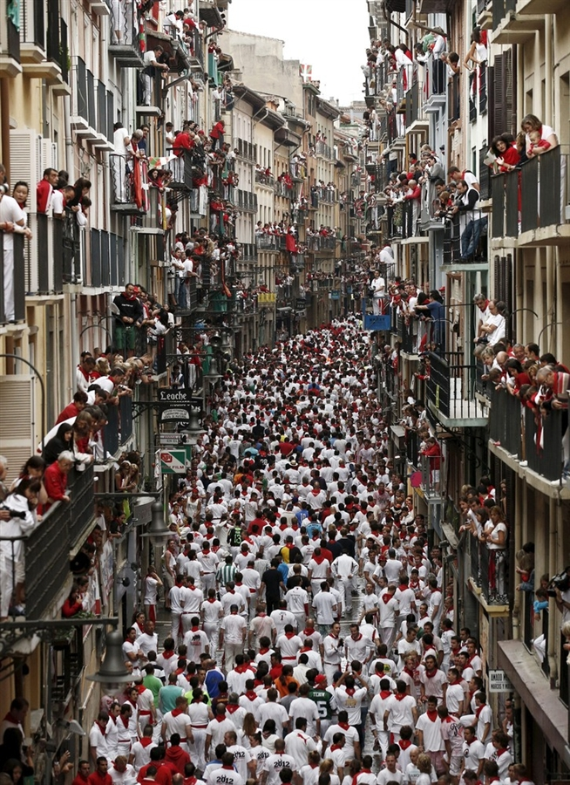
How do we fit it all in?
Notes:
What are our priorities? Things are going to come up that will interrupt our day. We have to be mindful of how much we do. Think about things like assemblies, field trips, classroom parties. We need to walk the talk.

Slide 21
Notes:
What are the priorities?
How do you know?

Slide 22
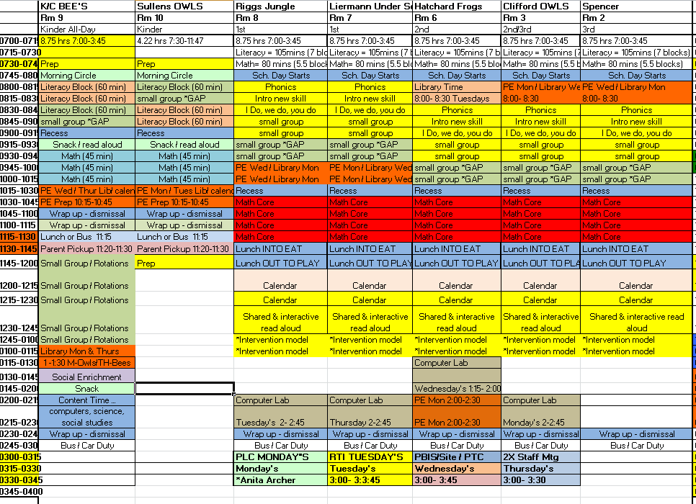
Notes:
For student who need the additional instruction of “more” a time block for it to happen needs to be in the schedule
The best way to do this is to create a “skills” or “intervention” block as part of the daily schedule for all students
Typically 20-30 or more minutes per day
What are other kids doing during this time? No new content can be introduced during intervention blocks, be thinking of enrichment activities for students who are considered “benchmark”. This might be lit circles, additional material from CORE curriculum that does not fall into your non-negotiable.
See attached, note the "big idea" is using the GAP Attack. A targeted intervention designed specifically to target the yellow and red zone kids that have been identified by the 20% meetings and through various other assessments. We also had the teachers do all of there own assessments so they can see first hand what the kids know and don't know.

Slide 23
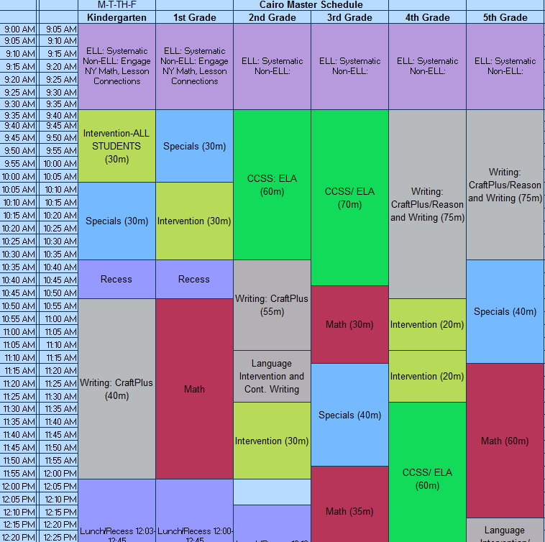
Notes:
Small school and school wide ELD block

Slide 24
Start | Kinder | 1st |  |  |  | 2nd |  |  |  | 3rd |  |  |  | 4th |  |  |  | 5th
8:00 | Prep/Mtg | Prep/Mtg |  |  |  | Prep/Mtg |  |  |  | Prep/Mtg |  |  |  | Prep/Mtg |  |  |  | Prep/Mtg
8:50 | Classrooms Open | Classrooms Open |  |  |  | Classrooms Open |  |  |  | Classrooms Open |  |  |  | Classrooms Open |  |  |  | Classrooms Open
8:55 | Opening Instruction | Opening Instruction |  |  |  | Opening Instruction |  |  |  | Opening Instruction |  |  |  | Opening Instruction |  |  |  | Opening Instruction
9:00 | Reading | P.E. | Morning Math |  |  | Reading Workshop |  |  |  | Everyday Counts |  |  |  | Math |  |  |  | Reading
9:15
9:30 | Reading Workshop | Reading |  |  |  |  |  |  |  | Math
9:45 |  |  |  |  |  | Reading
10:00 | Reading Workshop |  |  |  |  |  |  |  |  |  |  |  |  | Math Workshop |  |  |  | Reading Workshop
10:15
10:30 | Writing | Recess |  |  |  | Recess |  |  |  | Recess |  |  |  | Recess |  |  |  | Recess
10:45 | Recess | Reading Workshop |  |  |  | Lib | Social | Mus | Intervention | Reading |  |  |  | Reading Workshop |  |  |  | Math
11:00 | Math
11:15 |  | Reading - Red Band |  |  |  | P.E.
11:30 | Closing Instruction |  |  |  |  |  |  |  |  |  |  |  |  | Reading
11:45 | Lunch | Lunch |  |  |  | Lunch |  |  |  | Reading Workshop
12:00 |  |  |  |  |  |  |  |  |  |  |  |  |  |  |  |  |  | Writing
12:15
12:30 | Reading | Writing |  |  |  | Number Corner |  |  |  | Lunch |  |  |  | Lunch |  |  |  | Lunch
12:45 |  |  |  |  |  | Math
1:00 |  | Math
1:15 |  |  |  |  |  |  |  |  |  | Writing |  |  |  | P.E. | Music | Lib | Intervention | Health | Science |  | Social
1:30 | Reading Workshop
1:45 |  | Recess |  |  |  | Recess
2:00 | Recess | Lib | Science | Social | Intervention | Writing |  |  |  | P.E. | Social | Mus | Intervention | Writing |  |  |  | Math Workshop
2:15 | Writing
2:30 | Math | Mus |  |  |  | Science |  | Art |  | Lib |  | Sci |  | Science |  | Social |  | P.E. | Tech | Lib | Intervention
2:45
3:00 | Closing Instruction | Closing Instruction |  |  |  | Closing Instruction |  |  |  | Closing Instruction |  |  |  | Closing Instruction |  |  |  | Closing Instruction
3:10 | Duty | Duty |  |  |  | Duty |  |  |  | Duty |  |  |  | Duty |  |  |  | Duty
3:20 | Prep/Mtg | Prep/Mtg |  |  |  | Prep/Mtg |  |  |  | Prep/Mtg |  |  |  | Prep/Mtg |  |  |  | Prep/Mtg

Slide 25
 | Kinder | First | Second | Third | Fourth | Fifth
8:40-8:55 | Breakfast |  | REGULAR SCHEDULE 2013/14 |  |  | rev 6/25/13
8:55 | Beh/Virtue
9:10 | Number Corn | WG Reading | WG Reading | Specials | Math | Math
9:25 | K-W | WG Reading | WG Reading |  | Math | Math
9:40 | SG Reading | WG Reading | WG Reading | SG Reading | Math | Math
9:55 | K-H | WG Reading | WG Reading | SG Reading | Math | Math
10:10 | SG Reading | Break (10 min) | WG Reading | Break (10 min) | RECESS | RECESS
10:25 |  | SG Reading | Break (10 min) | WG Reading | SG Math | SG Math
10:45 |  | SG Reading |  | WG Reading | SG Math | SG Math
10:55 | Math | WG Reading | SG Reading | WG Reading | Writing | Writing
11:10 |  | until 11:15 | SG Reading | WG Reading | Writing | Writing
11:25 |  | RECESS 11:15 | RECESS | WG Reading | Specials | Specials
11:40 | 11:35 Release | Lunch at 11:30 | RECESS | RECESS 11:30 | Specials | Specials
11:45 |  | Lunch | Lunch at 11:40 | RECESS
11:55 |  | Specials?? | Lunch | Lunch at 11:45 | RECESS | RECESS
12:05 |  |  |  | Lunch | RECESS | RECESS
12:10 | Start 12:30 | Writing | SG Math | SG Math | RECESS | RECESS
12:25 |  |  | SG Math | SG Math | Lunch 12:15-12:30 | Lunch 12:15-12:30
12:40 | SG Reading |  | Math | Math | SG Reading 12:35 | SG Reading 12:35
12:55 | SG Reading | Specials | Math | Math | SG Reading | SG Reading
1:10 | 1:15 # Corn |  | Math | Math | WG Reading | WG Reading
1:25 | WG Reading | Number Corner | Math | Math | WG Reading | WG Reading
1:40 |  | NC to 12:10 | RECESS | RECESS | WG Reading | WG Reading
1:55 |  | RECESS | Writing | Writing | WG Reading | WG Reading
2:10 |  | Math | Writing | Writing | WG Reading | WG Reading
2:25 | 2:30 Math | Math | Writing | Writing
2:40 |  | Math | Specials
2:55 |  | Math
3:10

Slide 26
A master calendar

Slide 27
PD and Teaming
Notes:
Why is this important?
How do you use data to plan for what is important?
How often do you meet? Who is the leader? Staff meetings? PBIS Meetings? Do you have a late start/early release?
What are the commonalities? DATA, instructional and engagement strategies
All about teamingwork!!!

Slide 28
Assessment Calendar
Universal Screeners
Progress monitoring- weekly, bi-weekly, monthly
Quarterly writing samples
SBAC
ELPA
Notes:
Universal Screeners, Progress monitoring- montly, weekly; SBAC, ELPA, Other assessments?

Slide 29
Remember…….
Developing an effective schedule is a process, not a moment in time
Involve all stakeholders in the process and/or decisions made
Sometimes hard choices are needed
Sometimes very small changes make all the difference
Monitor for success
Notes:
Schedule the most important things first.
Plan for transitions
Ensure staff availability
Understand restrictions

Slide 30
Summary…
Effective schedules are critical for RTI to succeed
Setting instructional priorities is a first step
There most be time in the day for each priority activity
When changing schedules, remember it is a process
The schedule should foster success for all students

Slide 31
Notes:
The master schedule is like look at the inner workings of a school. It provides insight into the things that are necessary and also it can show if anything is not working.
Our RtI efforts have made us realize that we are maturing into a system that is very interdependent on one another and that sometimes our personal preferences have to be set aside in order for student needs to best be met.

Slide 32
Acknowledgements
Scheduling Considerations for RTI at the Elementary Level
By: Dawn Miller, Ph.D
The Master Schedule: A Culture Indicator
NASSP
Jill Weber

