Slide 1
RTI “Strategery” Strategically Planning to Implement RTI
Notes:
Jenice Intro and why action planning and examples of priorities and action plan 1-11

Slide 2
Targets
Why do you need to strategically plan to implement RTI?
How do you strategically plan to implement RTI?
Identity needs
Set priorities
Develop action plan

Slide 3
ORTIi
Essential Components
ORTIi Essential Components
Vision
Standards of Practice
Communic-ation
Technical & Adaptive Support
Teaming Structures
Data-Based Decision Making
Decision Rules
Ongoing & Embedded:
Training
Coaching
Fidelity
SLD Decision Making
Progress Monitoring
Interventions
Screening/Early Warning System
Core/Coordinated Literacy
Leadership
Teaming/Data-Based Decision Making
Professional Learning & Support
Culture
High Expectations
For ALL Student
Populations
Notes:
Culture: High expectations for all student populations, belief that all student populations can learn, belief that the measurement of how well I teach is how well they learn
Leadership:
Teaming/DBDM: Disaggregate data,
Professional Learning & Support:d
Core: Sheltered instruction, implicit, opportunities to respond,

Slide 4
Notes:
Update- with Jon’s graph

Slide 5
It’s all about the plan!

Slide 6
It’s all about the plan!

Slide 7
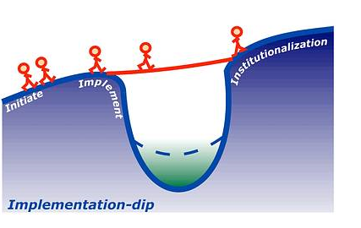
Minimize the Implementation Dip
sustain
Installation
Notes:
Implementation dip… is talked a lot about in the systems change.. It is when staff are learning a new way of doing something….they may be resistant, overwhelmed, lack the skills…. To be able to fluently do the work at first…. This is when the implementation dip occurs… you can think about it like the shark in the water…. We need to be watchful of the shark and to help staff be as proficient as they can be… if you identify the criticial elements to ensure that they are happening it can help to mininmize the implementation dip.
Do you always feel like you are putting out fires??? It is the work.. And the vigilance to it that makes the difference…..

Slide 8
It’s All About Strategery!
Goal
To minimize the implementation dip and to reach effective and sustainable RTI implementation
Resources & Talent
Alignment
Capacity
Who?
District Leadership Team
District Implementation Team
Building Leadership Team

Slide 9
Strategic Planning is the process of setting goals, deciding on actions to achieve those goals and mobilizing the resources needed to take those actions.
A strategic plan describes how goals will be achieved through the use of resources.

Slide 10
Talk Time
Think about a time that you needed to do some strategic planning……
Were you working on the right problem?
Did you have the resources to implement your plan?
Did everyone know what they needed to do?
How hard was it to accomplish your actions?
Notes:
Jenice 1-11

Slide 11
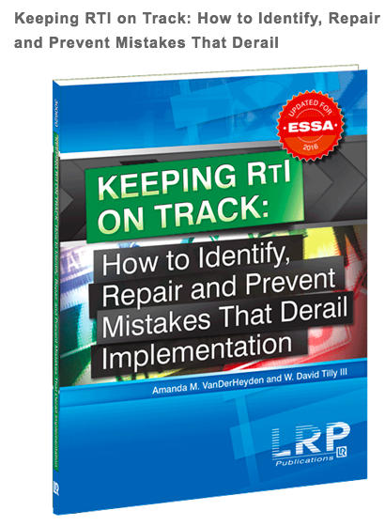
You are not alone in this work!
http://www.oregonrti.org/
ORTIi
http://www.intensiveintervention.org/
National Center on Intensive Intervention
http://www.rtinetwork.org/
RTI Action Network

Slide 12
How can you improve strategic planning for RTI?
Standards of Practice
Professional Learning
Monitoring
Implementation
PBIS
STEAM
Math
Notes:
Shade arrow from red, yellow to green
Lisa 12-31

Slide 13
Standards of Practice
A set of expectations you set to ensure quality performance or care

Slide 14
Standards of Practice for RTI
Goal
To identify the effective practices that staff should use on a consistent basis
Instructional Strategies
Materials
Notes:
goal…purpose….why

Slide 15
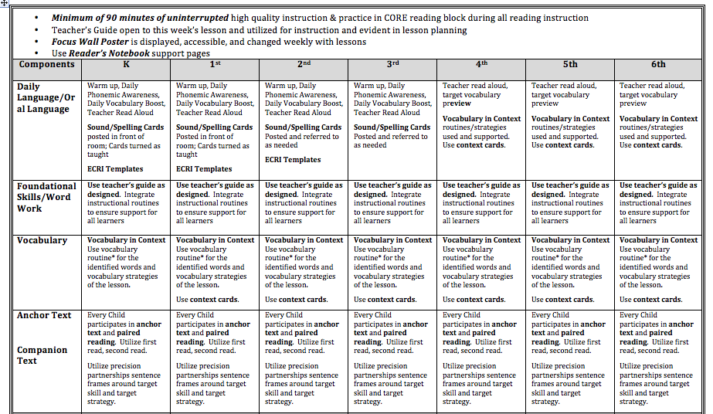
Standards of Practice Example

Slide 16
Talk Time
Review the form
Talk to your neighbor about what surprised or affirmed your thinking.
Does your district utilize Standards of Practice for reading?

Slide 17
Learning is Messy
Notes:
Implementation is messy but to develop fluency we have to begin, we start somewhere and we improve all along the way...We do not wait to start eating until we have perfected eating clean...to get Colby eating indepently he had start holding the spoon, First we

Slide 18
Professional Learning for RTI
Goal
To teach and support staff to consistently and fluently use the skills necessary to implement RTI
Effective instruction
Assessment
Data based decision making
Trainings
PLCs
Coaching
Peer observation
Notes:
Up to 20 times to gain proficiency, you are not fluent at first

Slide 19
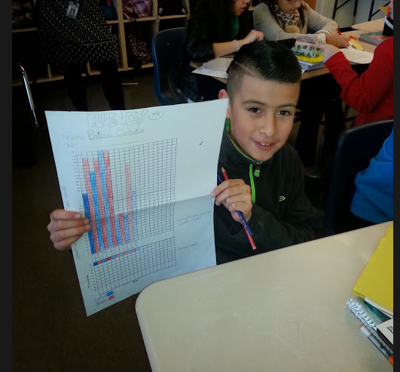
It’s Important to Monitor

Slide 20
Monitoring for RTI
Goal
To determine if staff is consistently and fluently using the practices that been have agreed upon and taught
To identify a plan to provide additional support as needed
Principal walkthroughs
Learning Walks
Instructional rounds
Self Monitoring

Slide 21
How do we strategically plan to implement RTI?

Slide 22
District Run of the Mill
4 elementary schools
Rural community
34% free & reduced lunch
18% ELL
15% Special Ed
RTI Project: first year

Slide 23
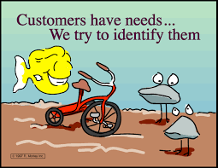
Identifying Needs
Do we identify the needs or just come up with a solution?
How do you currently identify needs for implementation of your RTI system?

Slide 24
District Run of the Mill: Identifying Needs
Notes:
90 minutes-green
Materials-green
Instructional strategies-red
Sheltered instruction-yellow
Professional Learning
Time in core-yellow
Materials-yellow
Instructional –red
Siop-yellow
Monitoring
What will be monitorred-red
Who will monitor-green
How often-red
Siop-yellow

Slide 25
Action Time!
Installation Matrix Activity
Review ORTIi Tier 1 Installation Matrix Core section with your district in mind.
Consider if your district has standards of practice and professional learning:
In place
Partially in place
Not in place
Go place your dots in each section of the Installation Matrix

Slide 26
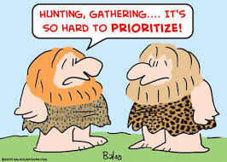
Determine Priorities
What are the most important needs to address?

Slide 27
Run of the Mill District Priorities
Standards of practice
Instructional strategies
Professional Learning
Materials
strategies

Slide 28
District Run of the Mill: Priorities
What is in place
What they need
90 minutes of core with Journeys
Scope & sequence
Pacing guide
Training provided by publisher for Journeys
Materials
Deeper training
Expectations for use of instructional strategies
Choral responses, precision partner talk, vocabulary routine…

Slide 29
For the purpose of today….Priorities
Standards of practice
Instructional strategies
Professional Learning
Materials
Strategies

Slide 30
Baby Steps…

Slide 31
Baby Steps

Slide 32
How do you develop Standards of Practice?
Instructional strategies
Develop a district level team
District admin
Primary and upper representations, Principals, Teachers
Specialists
TOSA’s
Use a decision making system
Think of incidentals
Notes:
Jenice 32-end

Slide 33
Process for Decision Making (standards of practice for instructional strategies)
Review evidenced based practices
Anita Archer Explicit Instruction
Marzano
Hattie
Review examples
Determine what fits for your context
Sticky notes
Chalk Talk
Gallery Walk

Slide 34
How do you plan for professional learning needs (instructional strategies)?
Determine your needs
Walkthroughs
PLCs
Teacher input
Consider audience
Determine how
Direct training
Peer observation
PLC
Coaching

Slide 35
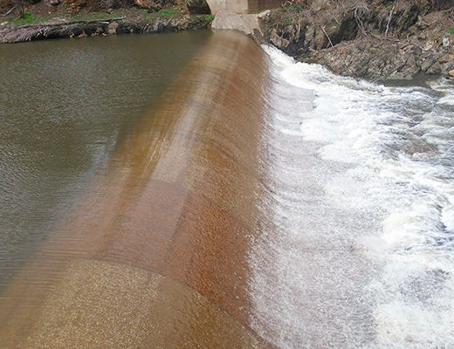
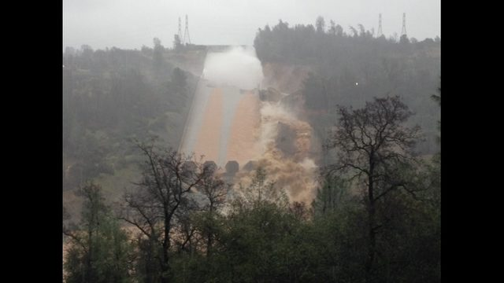
Capacity to Implement
Notes:
Talk about….Resources
Talent

Slide 36
Strategic Action Plan
What do you have the capacity to implement?
What resources do you have to address the needs?
People (internal/external), funds, skills
How will you monitor implementation?

Slide 37
District Run of the Mill
Develop standards of practice for instructional strategies
Train staff on using the evidenced based instructional strategies
Create monitoring plan

Slide 38
Action Time!
Review the Strategic Action Plan
Highlight a strength and star a growth area
Share with a partner

Slide 39
Strategic Action Plan Standards of Practice: Run of the Mill
Goal: Develop S.O.P. for reading instructional strategies for K-5 teachers.
Actions: Assemble team of key stakeholders to design and plan to communicate expectations and instructional strategies
Who: Principals, District Representatives, Primary grade reps., upper grade reps., specialists
Utilize: Current research on evidence-based practice, previous district training and professional learning
Resources Needed: Funding, time allocated, staff or outside experts to support process

Slide 40
Strategic Action Plan PL: Run of the Mill
Goal: train K-5 teachers to build expertise and confidence in implementing S.O.P.
Actions: Provide training on use of materials and instructional strategies
Instructional strategies: active engagement and explicit instruction
When:
Initial training at the end of September
On-going monthly
Resources Needed: Funding, time allocated, staff or outside experts to provide training

Slide 41
Strategic Action Plan PL: Run of the Mill
How much:
Initial: 6 hours
On-going: 2 hours monthly
Who conducts training: Coaches, Principals, Title support
Funding source: Title 2
Resources Needed: coaches, PLC time, materials, teacher time
Proficiency: 80% of teachers implementing by January

Slide 42
Strategic Action Plan Monitoring: Run of the Mill
Goal: Monitor whether K-5 S.O.P. for reading and Instructional Strategies are being implemented in classrooms with proficiency
Actions: Complete walkthroughs with agreed upon form to gather data about implementation materials and instructional strategies
Who: principals, coaches, teachers (self)
When:
Initial Baseline data in October
February and May
Resources Needed: time, feedback forms, agreement to review data collected

Slide 43
Strategic Action Plan Ongoing Support: Run of the Mill
Goal: Provide resources and support for staff to develop proficiency and confidence with materials and strategies.
Actions: provide modeling, video samples, practice time, peer observations, coaching with feedback
Who: coaches, peer partners, principals
When:
Initial support at the end of September
On-going monthly
Resources Needed: Funding, time allocated, staff or outside experts to provide support

Slide 44
Take it one step at a time, but start walking!

Slide 45
Questions?

Slide 46
Review Installation Matrix
With your partner determine review installation matrix and begin action planning
Core
Core Review Meetings
Interventions

