Slide 1
The Problem Solving Process: Data-Based Decision Making
Notes:
Jon starts here

Slide 2
Acknowledgements
Florida Problem Solving & Response to Intervention Project
Heartland Area Education Agency 11

Slide 3
Purpose
Describe the Problem Solving Process as it relates to making data-based decision making about students at multiple levels
For your district, think about what do you need in place to make this happen?
Data systems
Teaming structures
Schedules

Slide 4
Why Problem Solving?
IEP Meetings
We need a consistent decision-making framework
SST Meetings
EBIS Meetings
20% meetings
Attendance/Behavior
meetings
100% meetings
PLC’s
Curriculum meetings
Department meetings
Leadership Team Meetings

Slide 5
The Problem Solving Process
How is it working?
1. Problem Identification
What is the problem?
Improved Student Achievement
4. Plan Implementation & Evaluation
2. Problem Analysis
What are we going to do about the problem?
Why is the problem occurring?
3. Plan Development
Notes:
Jon

Slide 6
Problem Solving Across Levels of Support
Tier 3:
Individual Problem Solving Meetings
FEW STUDENTS
Tier 2/3:
20% Meetings
SOME STUDENTS
What is the problem?
How is it working?
Why is the problem occurring?
Tier 1:
100% Meetings
ALL STUDENTS
What are we going to do about the problem?
Notes:
Sarah

Slide 7
Notes:
Goldfish can live 20 years

Slide 8
Fixed Mindset
Wrong pH
Not enough food
Wouldn’t change the water
Bowl is too small
Room temperature is too cold
Room temperature is too hot
Too much food

Slide 9
She never blamed the fish!
Focus on “the water”-
Instruction
Curriculum
Environment
C
I
E

Slide 10
ICEL
I – Instruction
C – Curriculum
E – Environment
L – Learner
Notes:
This is in the order that we can control, not the order of importance

Slide 11
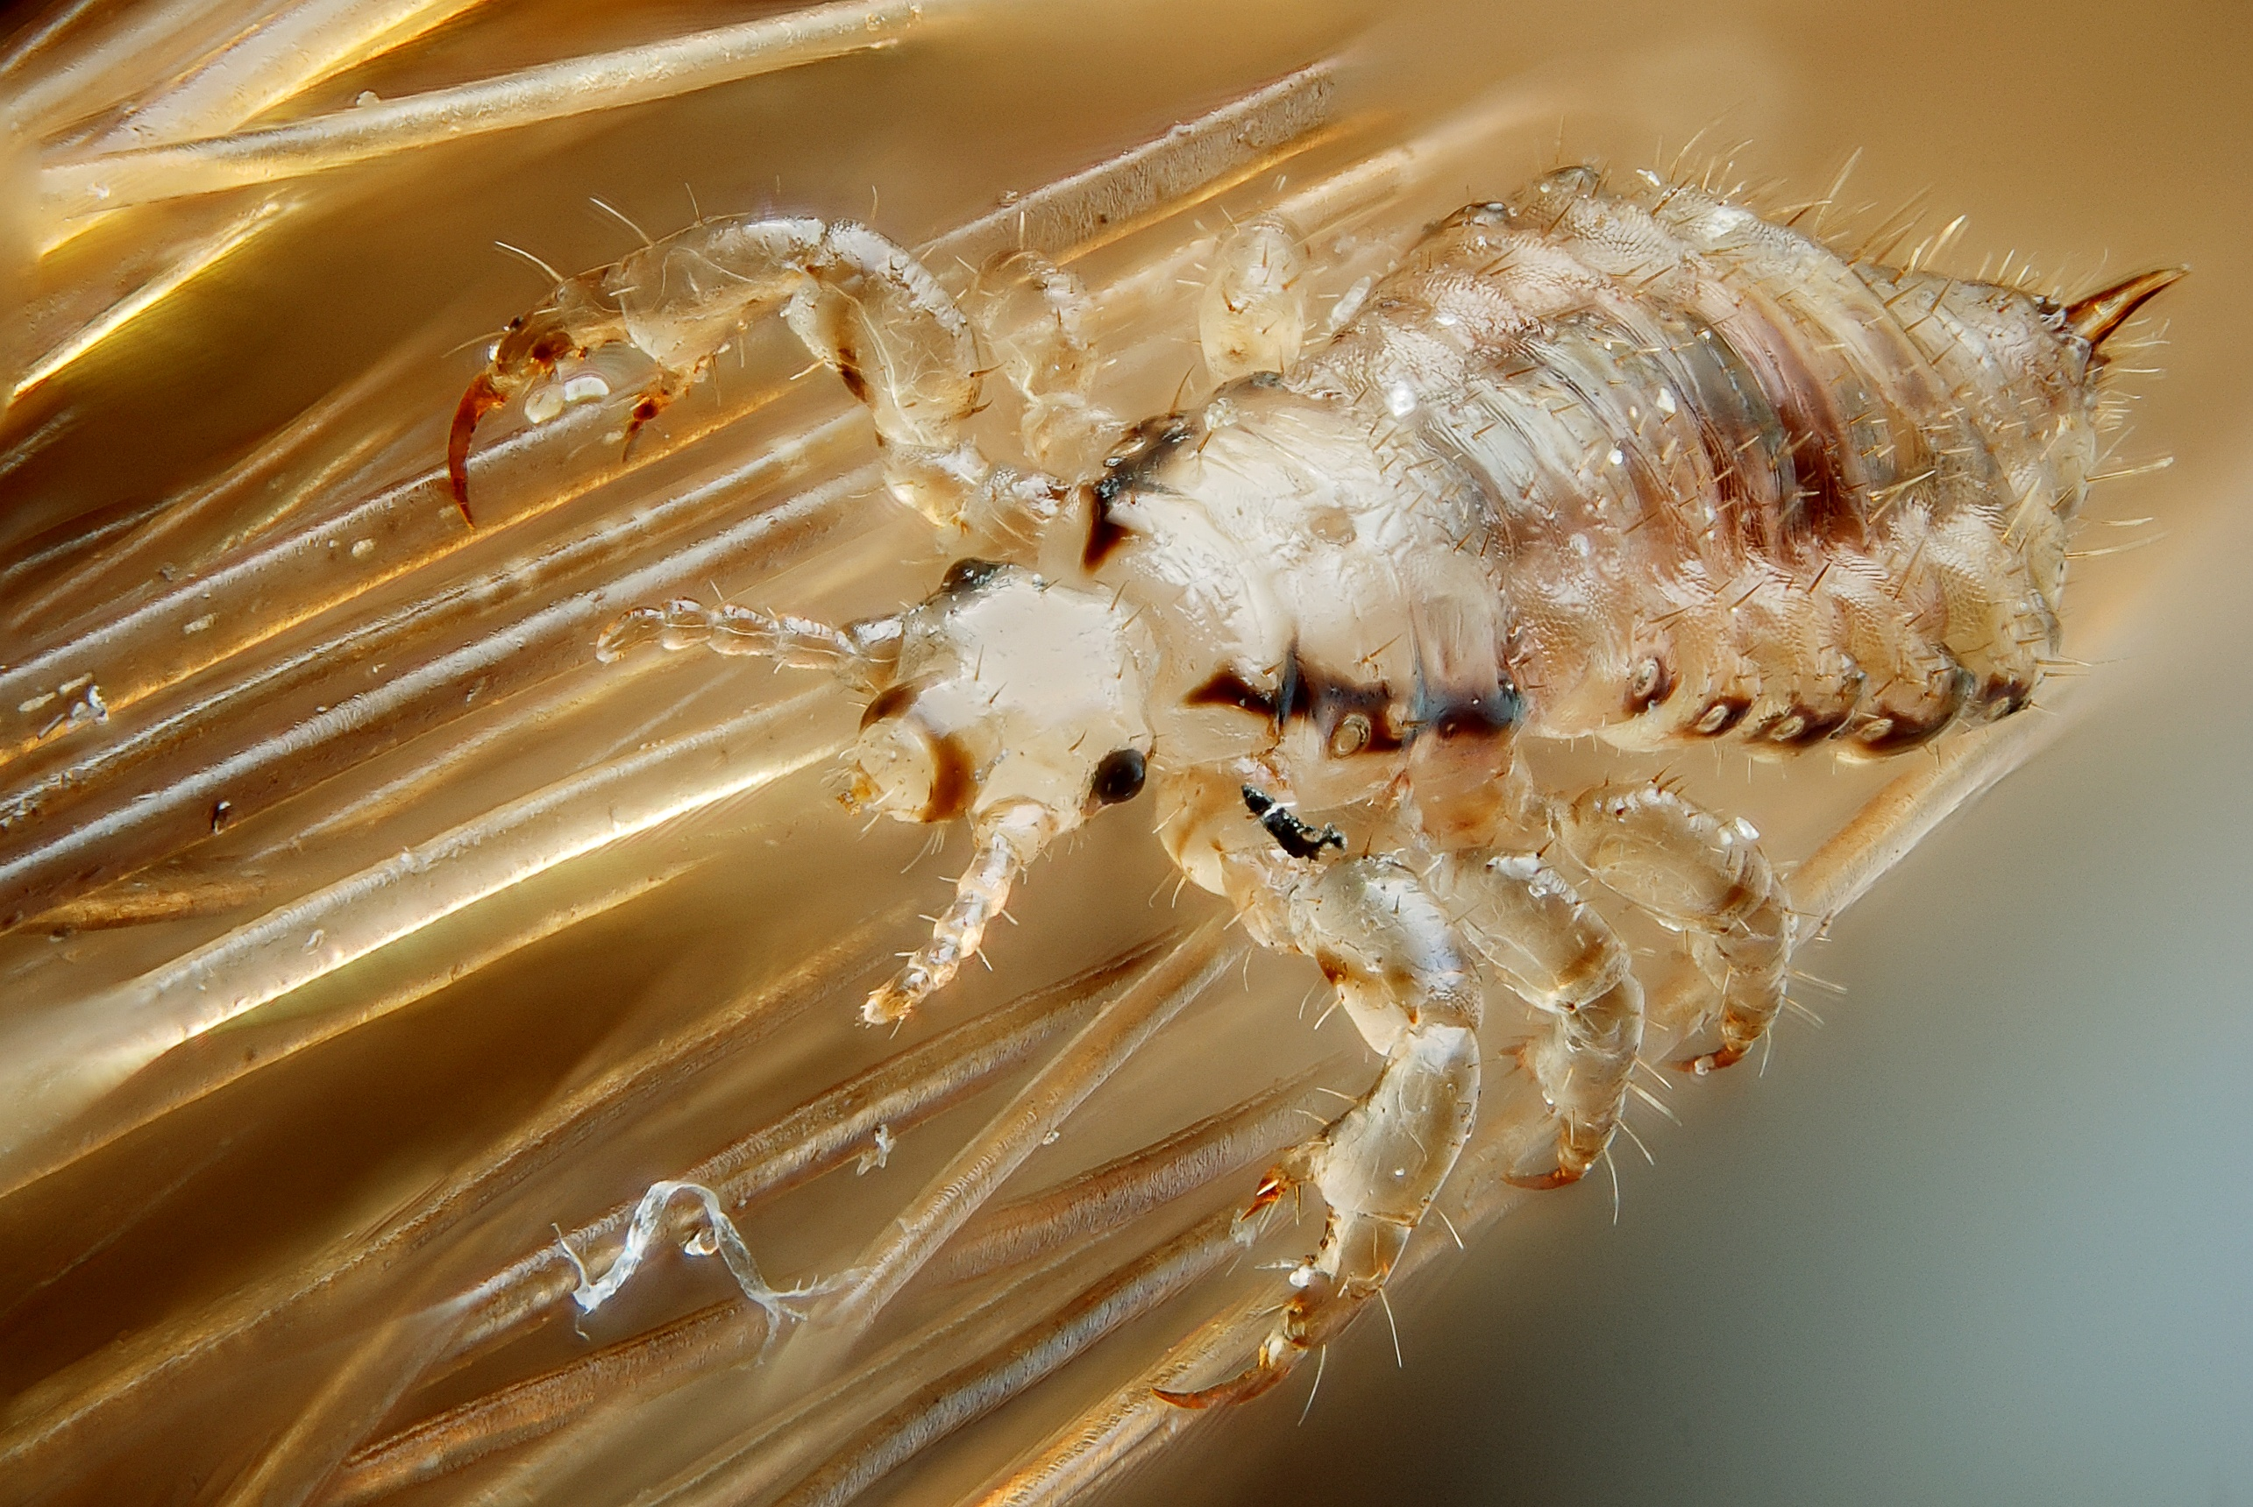
LICE = Fixed Mindset

Slide 12
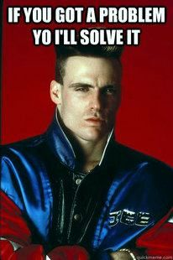
The purpose of problem solving

Slide 13
Step 1: Problem Identification
1. Problem Identification
What is the problem?
Improved Student Achievement

Slide 14
Step 1: Problem Identification
A problem is defined as a discrepancy between:
Expected performance
Problem Definition
Current performance

Slide 15
1. Problem Identification
Do we have at least 80% of our students proficient?
What is the problem?
≥80% of students proficient with core supports
Tier 1:
100% Meetings
ALL STUDENTS
Current % of students proficient with core supports

Slide 16
Decision Rules for “Proficiency”
Defined by District Leadership Team
Tier 1:
Early Warning System

Slide 17
1. Problem Identification
Most students in intervention making adequate progress
Tier 2/3:
20% Meetings
SOME STUDENTS
What is the problem?
Actual % of students in intervention making adequate progress
≥80% of students proficient with core supports
Tier 1:
100% Meetings
ALL STUDENTS
Current % of students proficient with core supports

Slide 18
Group or Individual Problem?
6
0
5
0
4
0
Isaiah
Mary
Goal
3
0
Amy
2
0
1
0
Chase
D
e
c
.
J
a
n
.
F
e
b
.
M
a
r
c
h
A
p
r
i
l
M
a
y
J
u
n
e
S
c
o
r
e
s
S
c
o
r
e
s
S
c
o
r
e
s
S
c
o
r
e
s
S
c
o
r
e
s
S
c
o
r
e
s
S
c
o
r
e
s

Slide 19
Group or Individual Problem?
6
0
5
0
Proficiency
4
0
Goal
3
0
2
0
Amy
Isaiah
1
0
Chase
Mary
D
e
c
.
J
a
n
.
F
e
b
.
M
a
r
c
h
A
p
r
i
l
M
a
y
J
u
n
e
S
c
o
r
e
s
S
c
o
r
e
s
S
c
o
r
e
s
S
c
o
r
e
s
S
c
o
r
e
s
S
c
o
r
e
s
S
c
o
r
e
s

Slide 20
1. Problem Identification
Tier 3:
Individual Problem Solving Meetings
Expected Student Performance
FEW STUDENTS
Actual individual student performance
What is the problem?
Most students in intervention making adequate progress
Tier 2/3:
EBIS Meetings
SOME STUDENTS
Actual % of students in intervention making adequate progress
Tier 1:
100% Meetings
ALL STUDENTS

Slide 21
Talk Time
What is the importance of using data to determine the problem?
What does data look like at each tier of support?

Slide 22
The Problem Solving Process
1. Problem Identification
Improved Student Achievement
2. Problem Analysis
Why is the problem occurring?

Slide 23
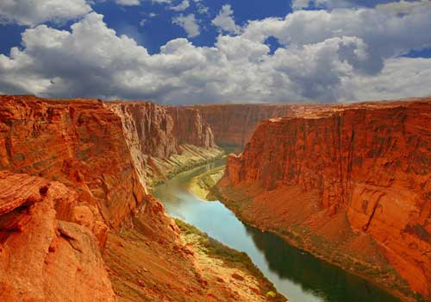
Step 2: Problem Analysis
Problem Identification
Plan Development
The WHY should always drive the WHAT
Problem Analysis

Slide 24
Student Learning
Instruction: | Curriculum:
Environment: | Learner:
How you teach
What you teach
Where you teach
Who you teach
Notes:
Jon

Slide 25
We can control the how, what, and where
We don’t have much control over the who

Slide 26
When it comes to problem analysis, just remember…
ICE, ICE baby
I – Instruction
C – Curriculum
E – Environment
then
L – Learner

Slide 27
What impacts student achievement?
Which ones make sense? Which ones are surprising?
Effective teaching variables | Effect size | Other variables | Effect size
Formative Evaluation | +0.90 | Socioeconomic Status | +0.57
Comprehensive interventions for students with LD | +0.77 | Parental Involvement | +0.51
Teacher Clarity | +0.75 | Computer based instruction* | +0.37
Feedback | +0.73 | School Finances | +0.23
Teacher-Student Relationships | +0.72 | Teaching Test Taking | +0.22
Problem Solving Teaching | +0.61 | Family Structure | +0.17
Direct Instruction | +0.59 | Retention | -0.16
John Hattie, Visible Learning, 2009
Notes:
OECD Study – “ensuring that every child attains a baseline level of proficiency in reading and mathematics seems to do more to create equal opportunities in a digital world than can be achieved by expanding or subsidizing access to high-tech devices and services.

Slide 28
Hypothesis Development
Instruction: | Curriculum:
Environment: | Learner:
?
?
?
?

Slide 29
2. Problem Analysis
Tier 3:
Individual Problem Solving Meetings
FEW STUDENTS
Individual students
Tier 2/3:
EBIS Meetings
Intervention Groups
SOME STUDENTS
Why is the problem occurring?
Tier 1:
100% Meetings
Core
Instruction | Curriculum
Environment | Learner
ALL STUDENTS

Slide 30
When it comes to teaching…
“It is clear that the program is less important than how it is delivered, with the most impressive gains associated with more intensity and an explicit, systematic delivery”
Fletcher & colleagues, 2007

Slide 31
Hypothesis Development
Instruction: | Curriculum:
Environment: | Learner:
Explicit Vocabulary and Comprehension instruction
Pacing
Opportunities to Respond
Standards of practice
Bell to bell instruction
Fidelity to curriculum materials
Teaches skills to mastery
Adequate opportunity for practice and review
Match between skills and learner
Classroom routines and behavior
Partnerships explicitly taught and used
Student engagement
Teacher-student interactions
Group size and arrangement
Transition times minimized
Motivation
Persistence
Self-efficacy
Attendance
Academic skills across domains
Connections with school
Vocabulary/Language skills

Slide 32
Hypothesis Development
What can we do that will reduce the problem (decrease the gap between what is expected and what is occurring)?
Expected performance
Current performance

Slide 33
Talk Time
What do you do to analyze problems in your school?
What is the potential problem with not looking deeply at the problem analysis?

Slide 34
Step 3: Plan Development
1. Problem Identification
Improved Student Achievement
2. Problem Analysis
What are we going to do about the problem?
3. Plan Development

Slide 35
3. Plan Development
Tier 3:
Individual Problem Solving Meetings
FEW STUDENTS
Individual students
Tier 2/3:
EBIS Meetings
Intervention Groups
SOME STUDENTS
Tier 1:
100% Meetings
Core
Instruction | Curriculum
Environment | Learner
ALL STUDENTS
What are we going to do about the problem?
Notes:
Sarah

Slide 36
Step 4: Plan Implementation & Evaluation
How is it working?
1. Problem Identification
Improved Student Achievement
4. Plan Implementation & Evaluation
2. Problem Analysis
3. Plan Development
Notes:
Sarah

Slide 37
4. Plan Implementation & Evaluation
Tier 3:
Individual Problem Solving Meetings
Every 8-12 weeks
FEW STUDENTS
Tier 2/3:
20% Meetings
Every 8-12 weeks
SOME STUDENTS
2-3 times/year
2 times month (PLC’s)
How is it working?
Tier 1:
100% Meetings
ALL STUDENTS
Notes:
Sarah

Slide 38
The Problem Solving Process
How is it working?
1. Problem Identification
What is the problem?
Improved Student Achievement
4. Plan Implementation & Evaluation
2. Problem Analysis
What are we going to do about the problem?
Why is the problem occurring?
3. Plan Development
Notes:
Jon

Slide 39
Tier 1 Problem Solving
This can happen at the school level
Do we have at least 80% of our students proficient within our Early Warning System?
If NO:
Are we implementing coordinated literacy according to our agreements? How do we know?
What can we change?
Instruction, Curriculum, Environment
If YES:
Celebrate the success!
Are we meeting the needs of all of our subcategories of students?

Slide 40
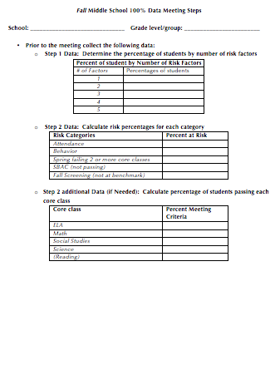
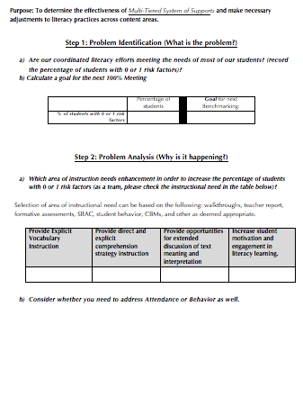
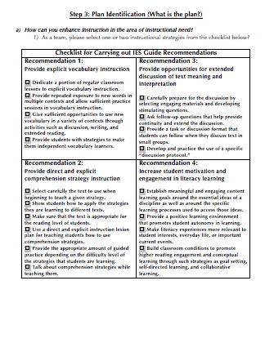
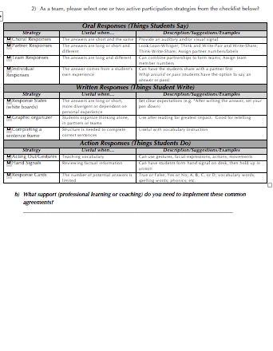
Tier 1 Example: 100% Meeting
Notes:
Have Josh from Bend share out his thinking on this

Slide 41
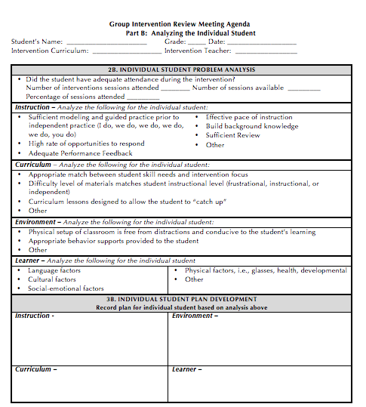
Tier 2/3 Example: 20% Meeting

Slide 42
Problem Solving: Big Ideas
Follow the problem solving steps/questions:
What is the problem?
Why is it occurring?
What are we going to do about it?
How is our plan working?
The steps/questions are the same at each tier
Focus on what we can control (The ICE)
Use data/evidence for all steps at all tiers
Notes:
Jon

