Slide 1
Number Combining
Cary Cermak-Rudolf

Slide 2
Goals and Purpose
Have a deeper sense of the properties of operation
Have an understanding of the different meanings of addition and subtraction
Realize the power these ideas hold for you and your students to be able to enjoy mathematics!!!

Slide 3
Quote
“The properties lean into the meanings of the operations.”
-Carter Stedman-5th grader at Eastwood
What does Carter mean?

Slide 4
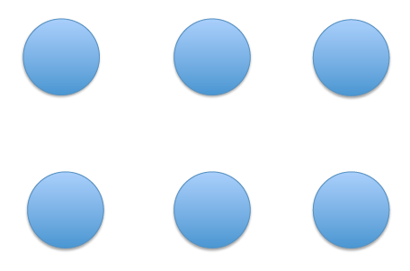
+How many dots to do you see in each rectangle?
+How do you see them?

Slide 7
Where do you see the properties?

Slide 8
Commutative Property of Addition
the order of the addends doesn’t matter because I will get the same sum
2 + 3 = 3 + 2

Slide 9
3 + 8 = 11
The Associative Property of Addition
I don’t have to add from left to right. I can start wherever I want and get the same sum.

Slide 10
3 + 8 = (1 +2) + 8 = 11
The Associative Property of Addition
I don’t have to add from left to right. I can start wherever I want and get the same sum.

Slide 11
3 + 8 = (1 +2) + 8 = 1 + ( 2 + 8) = 1 + 10 = 11
The Associative Property of Addition
I don’t have to add from left to right. I can start wherever I want and get the same sum.

Slide 12
3 + 8 = (1 +2) + 8 = 1 + ( 2 + 8) = 1 + 10 = 11
The Associative Property of Addition
I don’t have to add from left to right. I can start wherever I want and get the same sum.

Slide 13
Why is this important?

Slide 14
If I gave you any three digits to add together, what would be your strategy?
Is your strategy always the most efficient? How do you know?
What do you do in your mind to mentally add numbers that we want all students to do?

Slide 15
How would you combine these addends?
5 + 7 + 2
5 + 6 +2
1 + 2 + 1
3 + 4 + 5

Slide 16
Video
Please excuse the background teaching
Please focus on what does Kira understand?
Please think about what does Kira know about numbers that supports her?
How will this thinking help her when she is doing math for years to come?

Slide 17
Debrief
What does Kira understand?
What does Kira know about numbers that supports her?
How will thinking help her when she is doing math for years to come?
What teachers moves can we make to help our students’ thinking?

Slide 18
How would you combine these addends?
5 + 7 + 2
5 + 6 +2
1 + 2 + 1
3 + 4 + 5

Slide 19
Video
Please excuse the background teaching
Please focus on what does Fernando understand?
Please think about what does Fernando know about numbers that supports her?
How will this thinking help him when he is doing math for years to come?

Slide 20
Debrief
What does Fernando understand?
What does Fernando know about numbers that supports her?
How will this thinking help him when he is doing math for years to come?
What teachers moves can we make to help our students’ thinking?

Slide 21
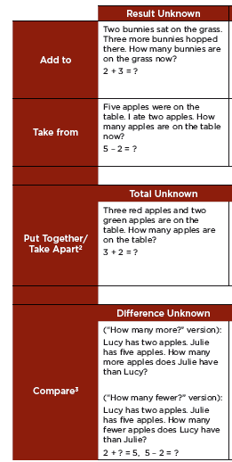
Meaning of the operations

Slide 22
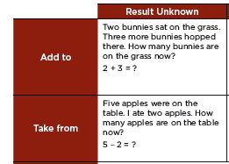
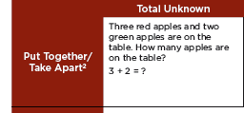
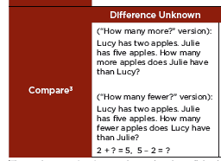
Apples…… How would you represent these problems differently?

Slide 23
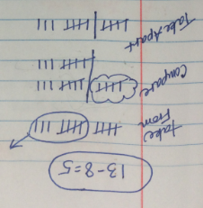
13-8=5
How would you represent this problem with tally marks with the three different meanings of addition?

Slide 24
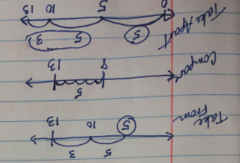
13-8=5
How would you represent this problem with number lines with the three different meanings of addition?

Slide 25
What does the mean to you?
What is your action?
Where do think you will be able to slide this into your work?
How will you help students think about the meaning of the operation? The property of operation?

