Slide 1
Middle School RTIi in TTSD
Katie Beckett, RTI/Literacy TOSA
Instructional Coordinators:
Susan Morgan (Fowler MS), Angela Harkness (Hazelbrook MS),
Amy Curtis (Twality MS)
Tigard-Tualatin School District

Slide 2
Objectives for the Session
An understanding the of process TTSD went through in developing RTIi
A process you can replicate at your school or district
Tools: agendas, protocols and decision rules

Slide 3
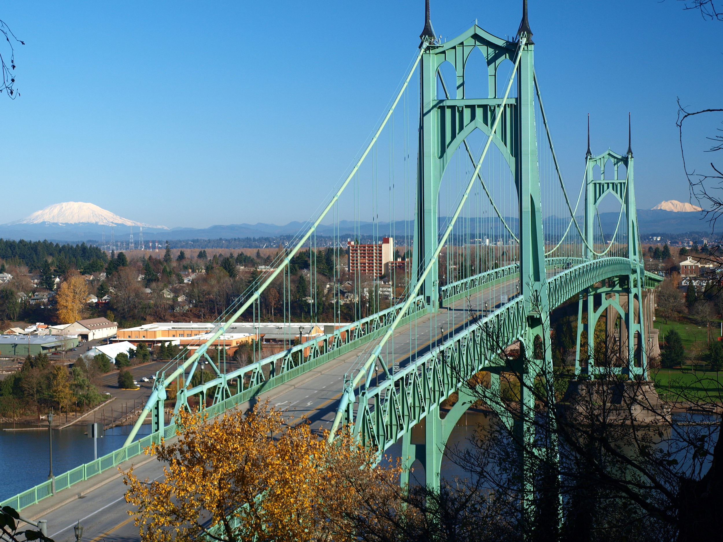
Notes:
Sue

Slide 4
Who Are We?
Fowler Middle School:
793 Student Enrollment
24% ELL
12% SWD
37% Free/Reduced Lunch
Hazelbrook Middle School:
964 Student Enrollment
26% ELL
11% SWD
37% Free/Reduced Lunch
Twality Middle School:
1060 Student Enrollment
24% ELL
10% SWD
34% Free/Reduced Lunch

Slide 5
Other Important Info...
7 period day
45 min periods; 20min Advisory before Per. 1
Core Classes: English Language Arts, Math, Science, Social Studies, PE/Health
Additional Programming:
Electives
English Language Development (National Geographic, English 3D)
Read 180
System 44
Ed Tech (6th grade at Fowler and Hazelbrook)
Additional Reading Class (6th grade at Twality)
Notes:
Sue

Slide 6
Notes:
Notes:
Past
Robust RTI system in TTSD with core curriculum, universal screening, interventions, progress monitoring, data review meetings
Curriculum: Holt Elements of Literature
Screening: DAZE/MAZE
Interventions: Language! And Soar to Success
Progress monitoring: Weekly with DAZE/MAZE
EBIS meetings monthly to review progress monitoring data
Mirrored the Elementary RTIi decision rules
Drift in core curriculum
Teams developed building-specific decision rules to cope with the differences in elem and MS
Progress monitoring data was not sensitive enough to skills taught in intervention, particularly more intensive Language!
Research on Coordinated Literacy - Literacy instruction throughout entire school day and coordination of instructional strategies
ELL and Reading intervention issues
Present
Coordinated Literacy Protocol developed: Identified common offerings and Literacy Instruction in all three schools, reviewed and replaced interventions to System 44 and Read 180 to better be able to differentiate and track student progress, developed protocols for student placement and exit from interventions, adjusted model/schedule to accommodate ELs needing reading support, etc.
Focus on Tier I and how to use the Early Warning System...

Slide 7
Early Warning System in MS
Notes:
Katie

Slide 8
Schoolwide/Districtwide
If 80% of the student population is meeting the ABCEs, then look at the 20% for interventions.
If not, we have to strengthen the core.
100% meetings at the heart.

Slide 9
100% Meetings
Step 1: Summary of Effectiveness
Based on ABCE data, is our System of Support sufficient for most students in our school/grade level/house?
Review previous ABCE data.
Analyze current ABCE data..

Slide 10
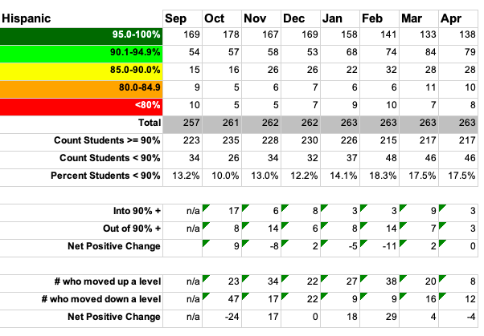
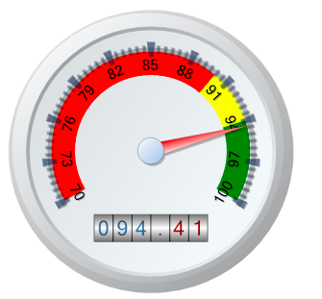
Attendance Data

Slide 11
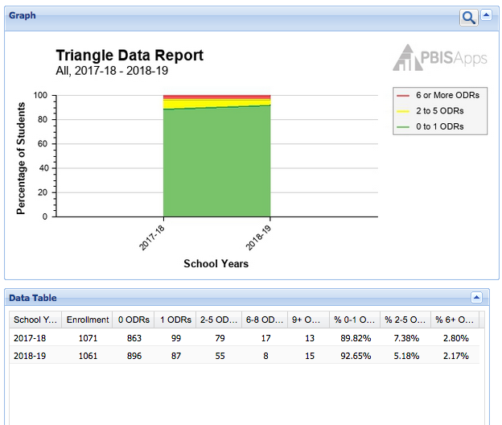
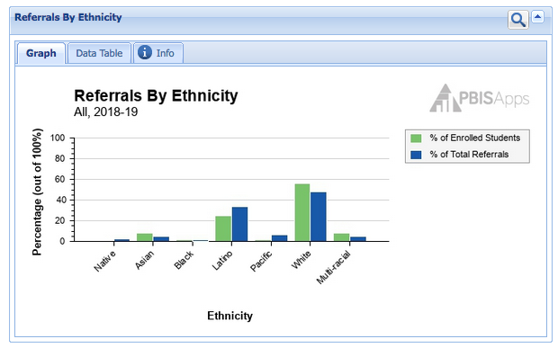
Behavior Data

Slide 12
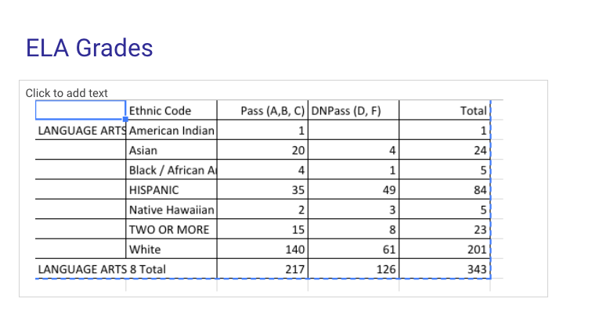
Grade Data

Slide 13
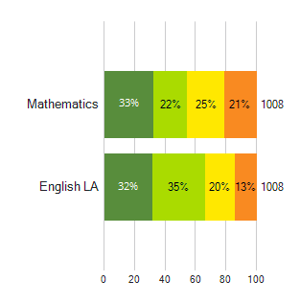
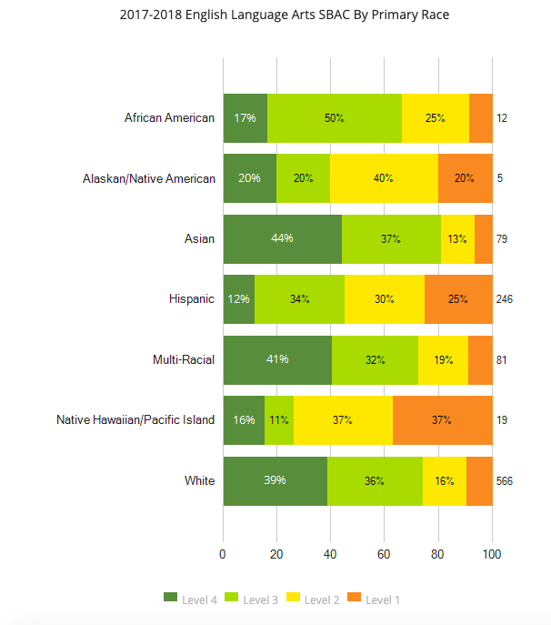
Essential Skills Data

Slide 14
Step 2: Plan for Action
What adjustments are needed to address the target area(s) for improvement?
What common instructional strategy (or strategies) will be used by all teachers?
What common social/emotional/behavior strategy (or strategies) will be used by all teachers?
What professional development is needed to implement this Action Plan?
SAMPLE:
A) RACE paragraph in all areas including math. Science will coordinated with math to use similar language with computation. Come up with a plan for aligning academic vocabulary.
B) 2 to 10: using the focal student chart. Each teacher has a focus group of 4-5 kids. All teachers will greet ALL of the students on the list. Each quarter will change focal students. Continue to work on planning a community builder activity.
C) Vertical alignment for ELA- 6,7,and 8.

Slide 15
Step 3: Collecting Evidence of Implementation
How will we collect evidence of implementation of our Action Plan steps “a” through “c” above?
Instructional:_______________________
Social/Emotional/Behavior: ____________
Professional Development: ____________
SAMPLE: How will we collect evidence of implementation of our Action Plan steps “a” through “c” above?
Instructional:__At monthly team meetings we will review actions X will be in charge _
Social/Emotional/Behavior: ___At monthly team meetings we will review actions X will be in charge
Professional Development: __IC will facilitate time_____

Slide 16
Step 4: Evaluation of Action Plan
Does our new ABCE data demonstrate significant improvement in the targeted area(s)?
If YES: What did we do that worked?
If NO: Did we implement the strategies we agreed to with fidelity?
Instructional: _______________________
Social/Emotional/Behavior: _______________________
Professional Development: _______________________
SAMPLE:
Instructional: Students have been able to write using the RACE paragraph
Social/Emotional/Behavior: ____________________
Professional Development: ____________________

Slide 17
20%

Slide 18
20% Meetings
Purpose
To evaluate the effectiveness of our academic interventions put in place for those students who need it.
What data are we looking at?
Intervention specific data from Read 180, S44, and English 3D classes. We use this data to determine if interventions are working or need to be modified. Specifically, we look at (in order):
Instruction (how you teach)
Curriculum (what you teach)
Environment (where you teach)
Learner (who you teach)

Slide 19
20% Meetings
What are the necessary data needed to hold this meeting?
5-8 weeks worth of progress monitoring (Reading Inventory, Phonics Inventory, MAZE/DAZE) Any other data collected by the classroom teacher (Curriculum Based Measures, Oral reading fluency, other class assessments)
What are the possible outcomes of a 20% meeting?
No change in the program
Make change in instruction
Make a change in the curriculum
Make a change in the environment
Address specific learners’ needs

Slide 20
20% Meetings
What do we hope to gain by holding these 20% meetings?
Shared Ownership of Student Growth
Multiple Perspectives
How often will these meetings take place?
Every 6-10 weeks and at least once per quarter. Research based interventions do not always work immediately. There needs to be enough time and progress monitoring to see possible change.
Notes:
When we first began, some teachers were uncomfortable sharing, very vulnerable and felt exposed
These meetings are not meant to place blame or guilt on specific reading teachers. With multiple perspectives and eyes on one class at a time, hopefully we (all investors) can determine how to create a more beneficial and effective experience for each of our struggling readers.

Slide 21
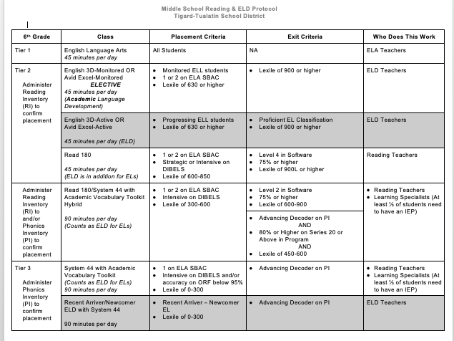
6th Grade Reading Criteria/ Protocol for entry and exit of programs

Slide 22
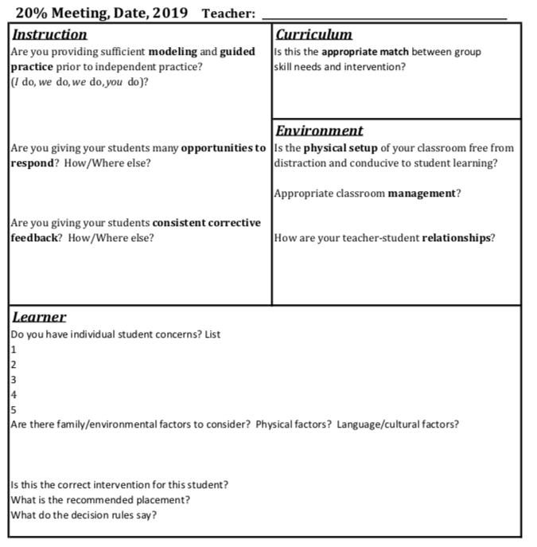
Every 20% meeting follows the same order of review:
Instruction
Curriculum
Environment
Learner

Slide 23
Decision rules for determining “adequate growth” of the cohort:
Are 50% of students on track to meet their growth goal? If yes, move on to discuss students who are not.
If no, ask: Is the program delivered with fidelity? How much time on software? Is the
model correctly implemented? How long are students spending in each segment?
How do you know they are learning what you are teaching? Are rotation expectations taught and are students complying?
Determine a plan for observing and addressing.

Slide 24
We also look at the data from our S44 and English 3D classes. Basic/Functional Reading
# of students total (6-, 7-, 8-)

Slide 25
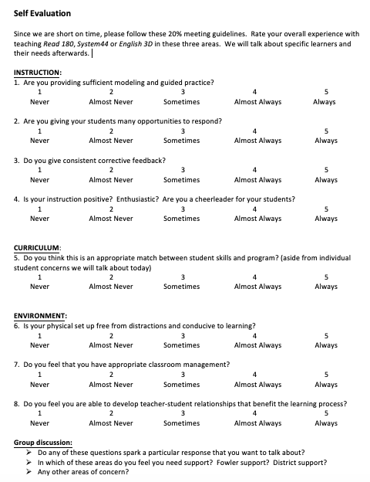
When time is an issue…
In order to stay as close to the 20% meeting rules as possible, teachers complete this form ahead of time.

Slide 26
What Our Reading Intervention Teachers Say:
“I like examining my data deeper than I normally would and using it to change my instruction”
“Kids and parents rely on us to put them in places where they will be successful. If they are continuing to not be successful, it is our job to look deeper”
“It has helped me to see trends and notice that some of my students continue to struggle. This process helps me to see and ask, so now what?”

Slide 29
Contact Information
Katie Beckett (District RTIi/Literacy TOSA) kbeckett@ttsd.k12.or.us
Susan Morgan (Fowler MS Instructional Coordinator) smorgan@ttsd.k12.or.us
Amy Curtis (Twality MS Instructional Coordinator) acurtis@ttsd.k12.or.us
Angela Harkness (Hazelbrook MS Instructional Coordinator) aharkness@ttsd.k12.or.us

Slide 30
Thank you
for attending
our session!
Notes:
thank you, feedback, and contact info?

