Slide 1

Informing RtI Practices for
Mathematics in the
Common Core Era
Arjan Khalsa
STEM Advocate, Activate Learning
@ArjanKhalsa
akhalsa@activatelearning.com

Slide 2
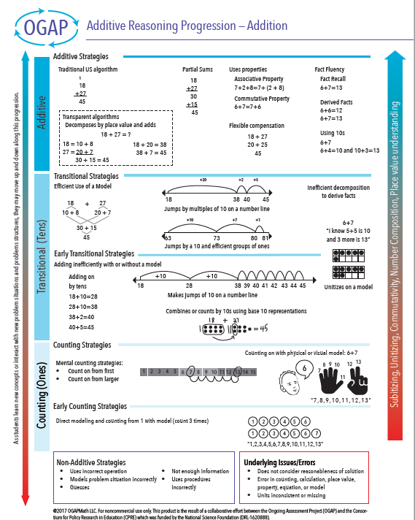
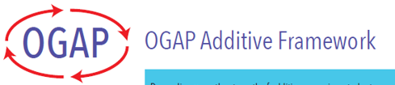
Ongoing Assessment Project (OGAP)
https://ogapmathllc.com/

Slide 3
This is what you are assessing!

Slide 4
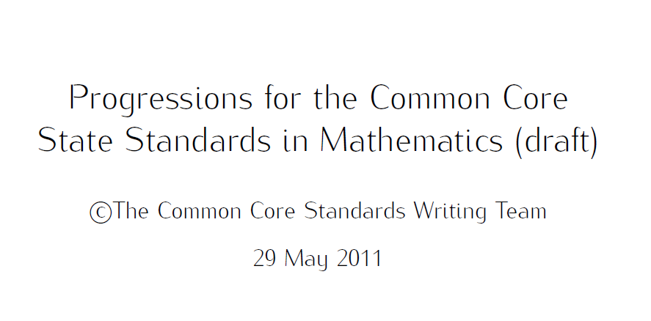
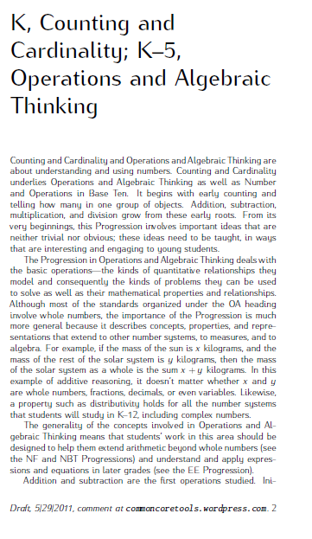
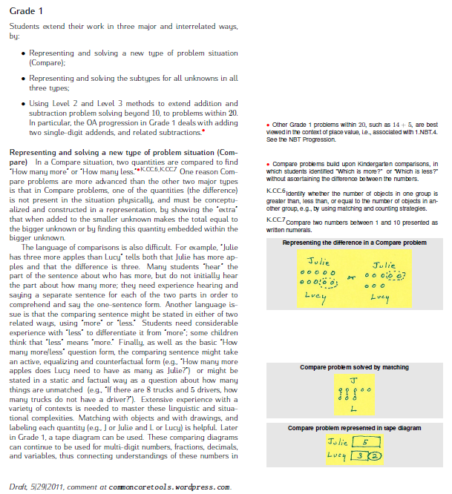
Free, online PDFs
https://commoncoretools.files.wordpress.com/2011/05/ccss_progression_cc_oa_k5_2011_05_302.pdf
http://commoncoretools.me/wp-content/uploads/2015/03/ccss_progression_nbp_k5_2015_03_16.pdf

Slide 5
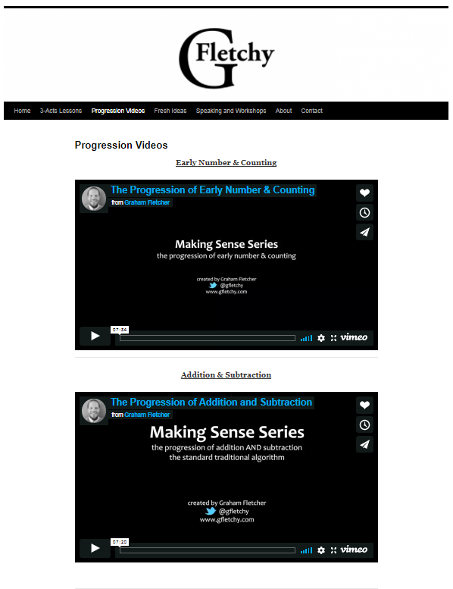
Videos by
Graham Fletcher
https://gfletchy.com/progression-videos/

Slide 6
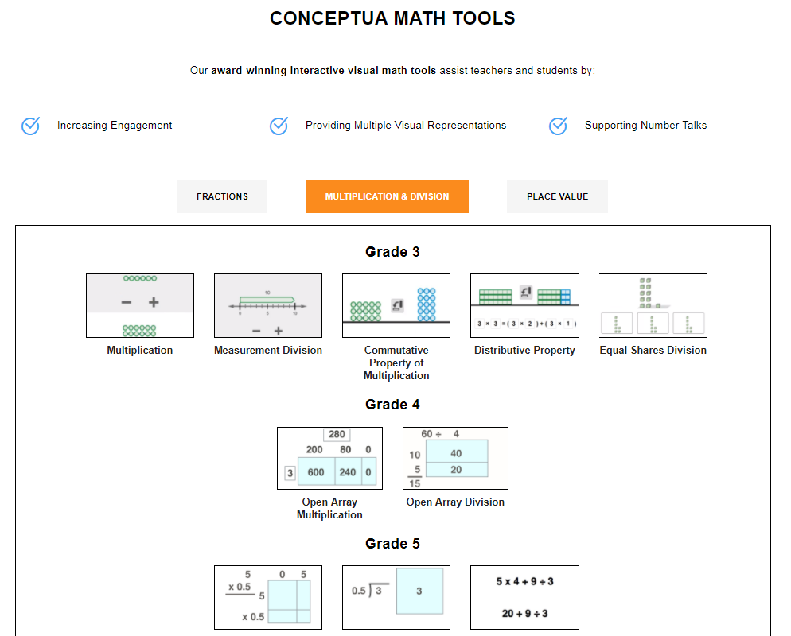
Math Tools from Conceptua Math
Excellent graphics used in this presentation came from these tools and their authors.
Free, online, and interactive tool
www.conceptuamath.com/math-tools/

Slide 7
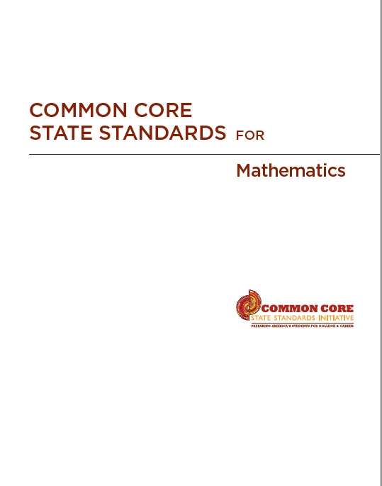

Common Core State Standards for Math
http://www.corestandards.org/

Slide 8
Counting and Cardinality

Slide 9
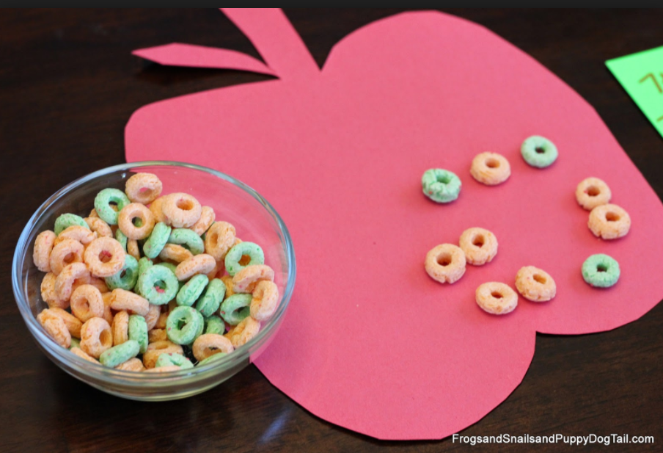
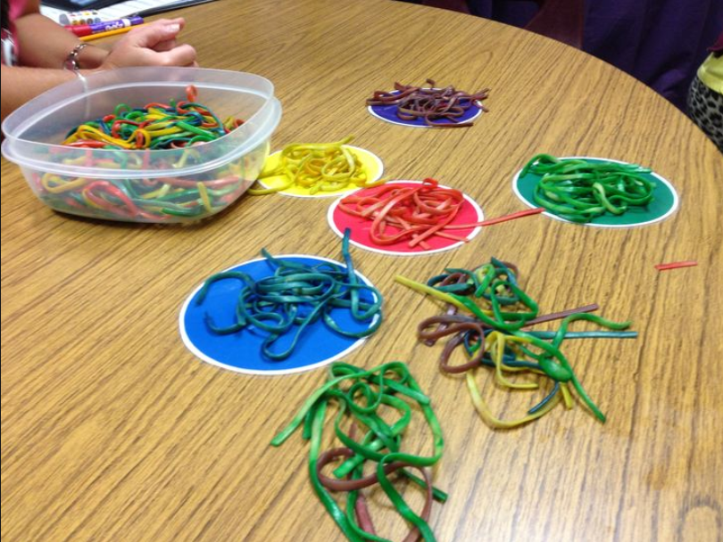
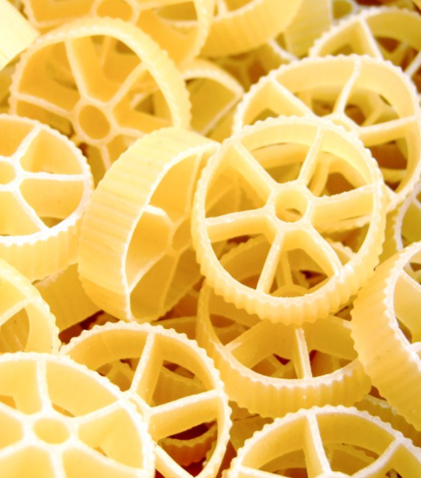
Recognizing and Building Quantities

Slide 10
Recognizing and Building Quantities
Counting Collections

Slide 11
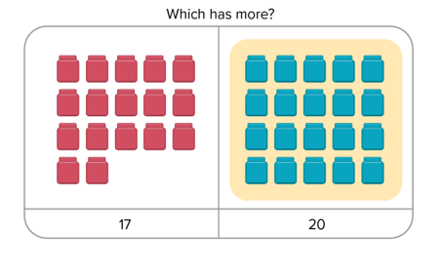
Comparing Numbers

Slide 12
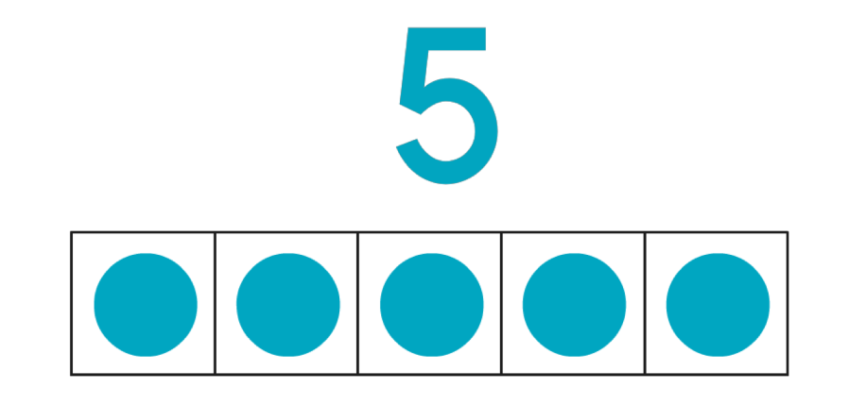
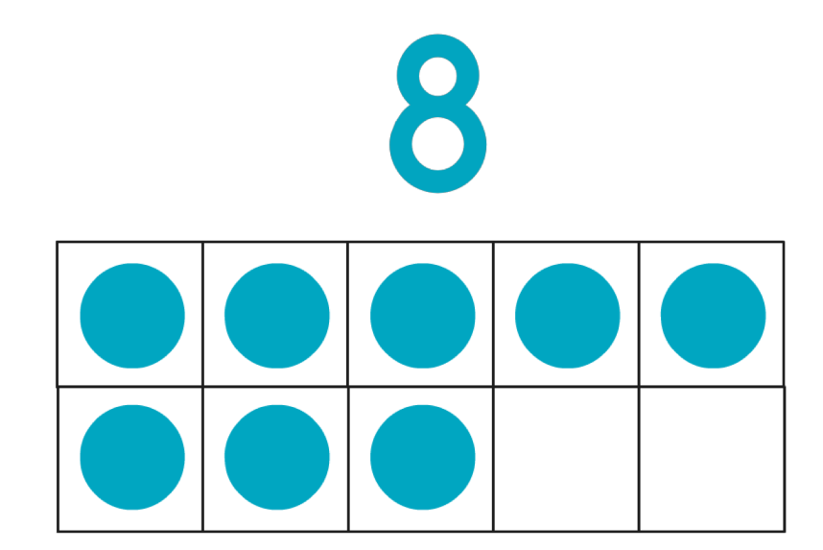
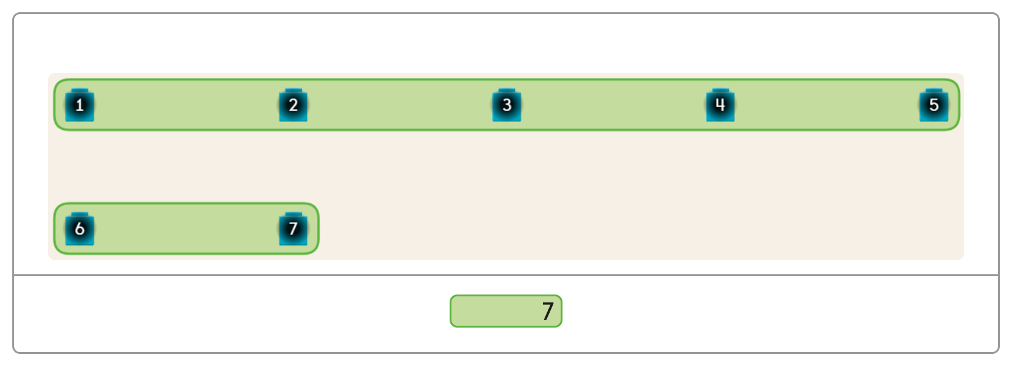
Number Names, Numerals, and Cardinality
One-to-one correspondence

Slide 13
Comparing Numbers

Slide 14
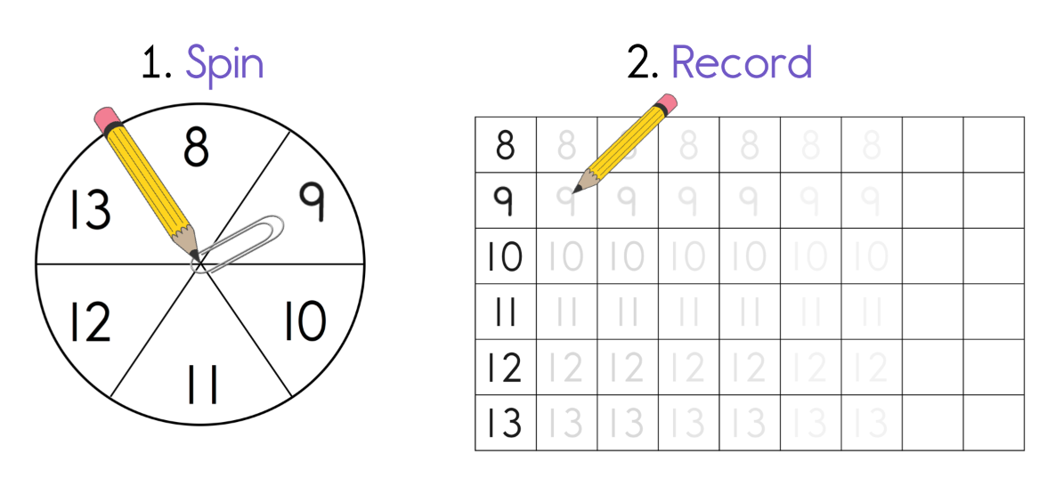
Writing Numbers

Slide 15
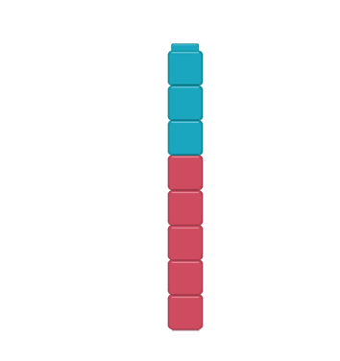
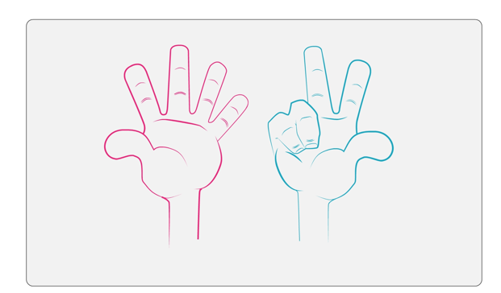
Compose Numbers
Ten Frames - Fingers
Linking Cubes
Hierarchical inclusion

Slide 16
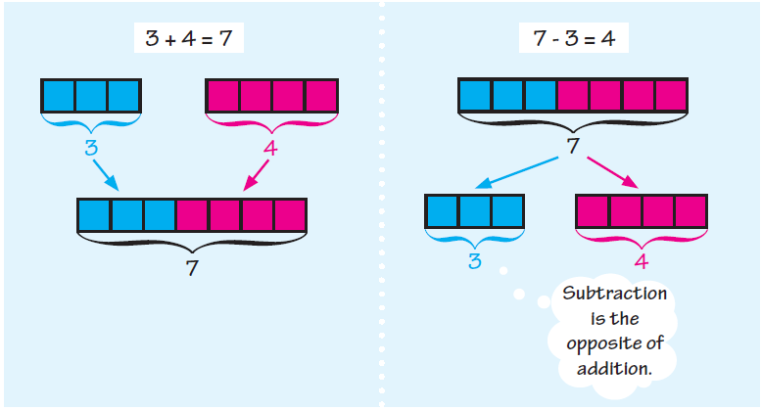
Composing and Decomposing Numbers
Number Conservation

Slide 17
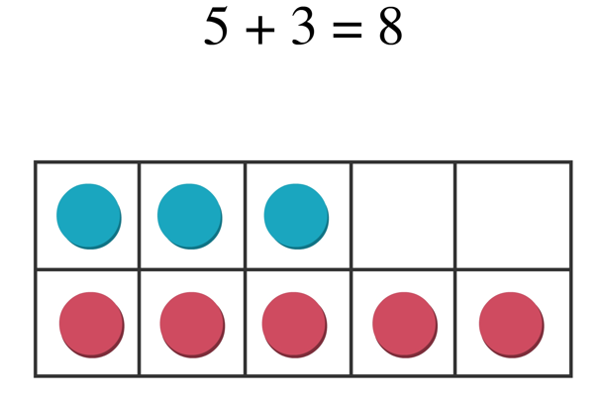
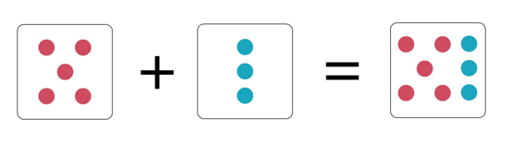
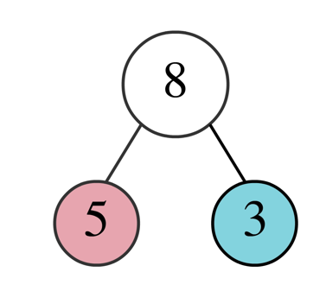
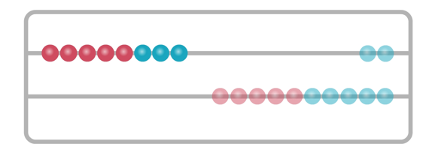
Seeing a Number
Ten Frames
Dot Cards
Number Bonds – Numerals!
Rekenrek

Slide 18
Numbers and Operations in Base 10

Slide 19
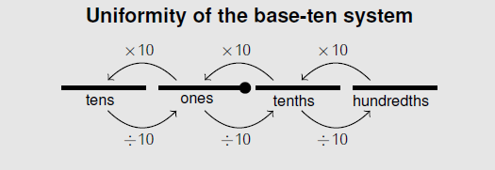
We have a GREAT number system!

Slide 20
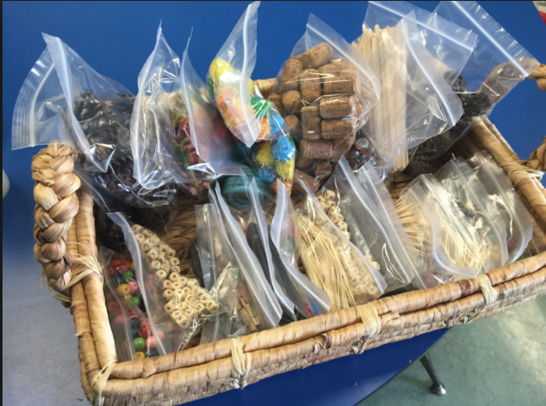
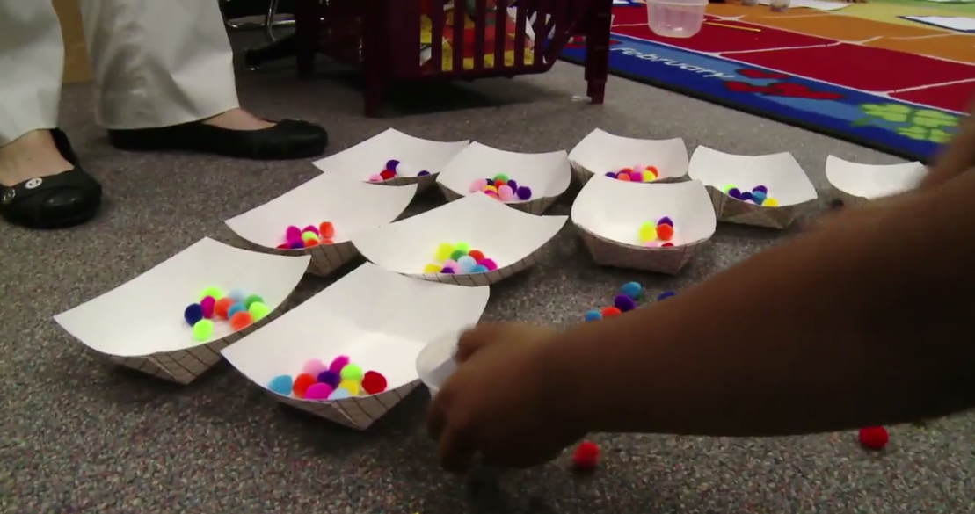
Kindergarten – It’s all about 10 Units
The Teaching Channel

Slide 21
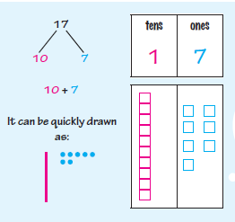
First Grade – It’s All About a Unit Called 10

Slide 22
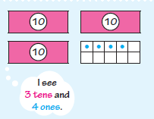
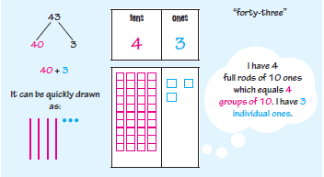
Ten
Frames
Ten Frames, Ten Rods,
and Visual Representations

Slide 23
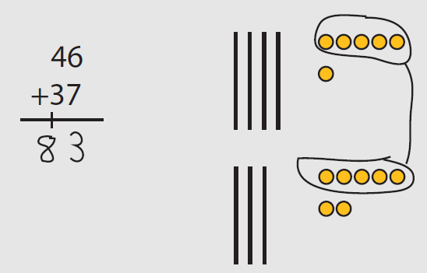
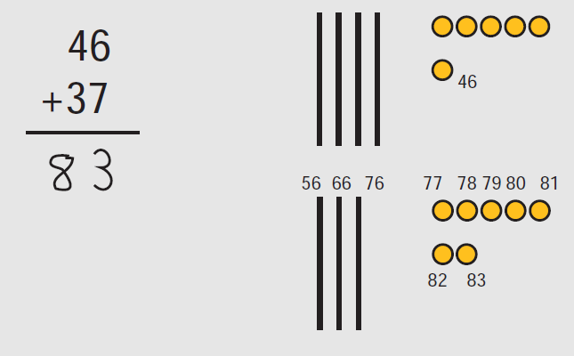
Grade 1 – Adding Within 100, Strategies around the Units of 10

Slide 24
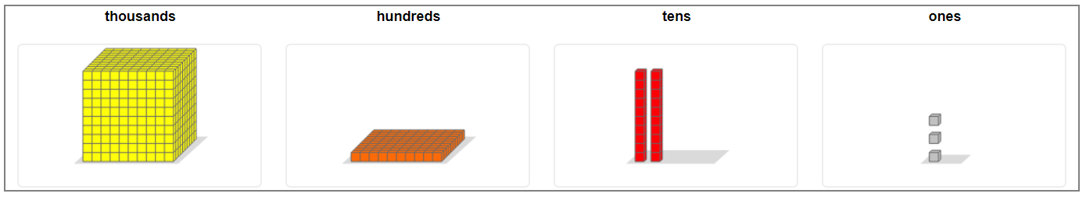
Grade 2 – Fluent within 100, and Working with Hundreds

Slide 25
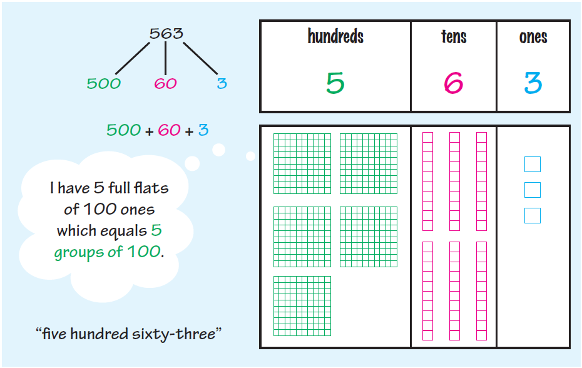

Slide 26
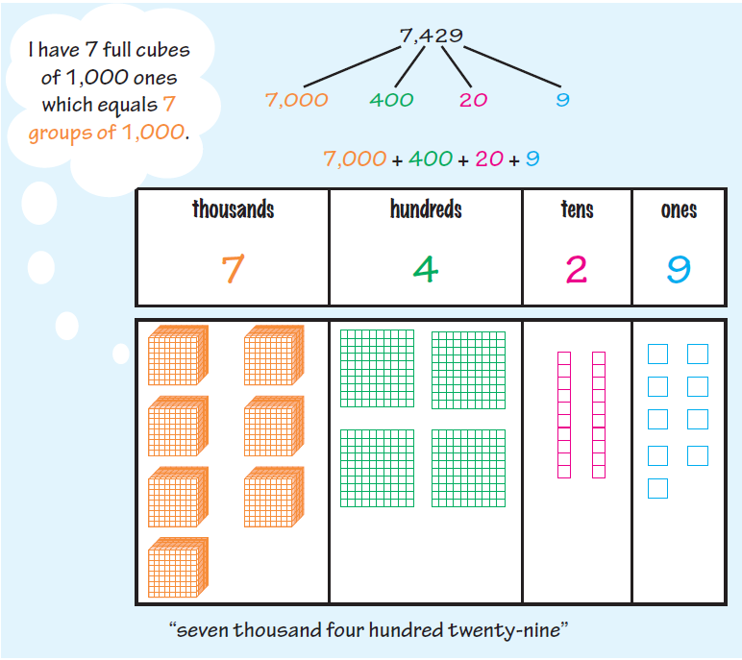
Grade 3 – Fluency with 1000, Working with Larger Numbers
The major focus is multiplication

Slide 27
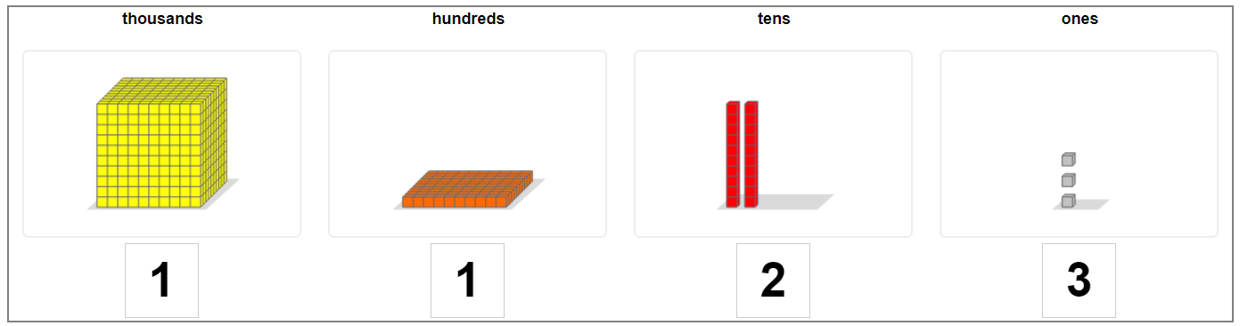
Place Value with Larger Numbers

Slide 28
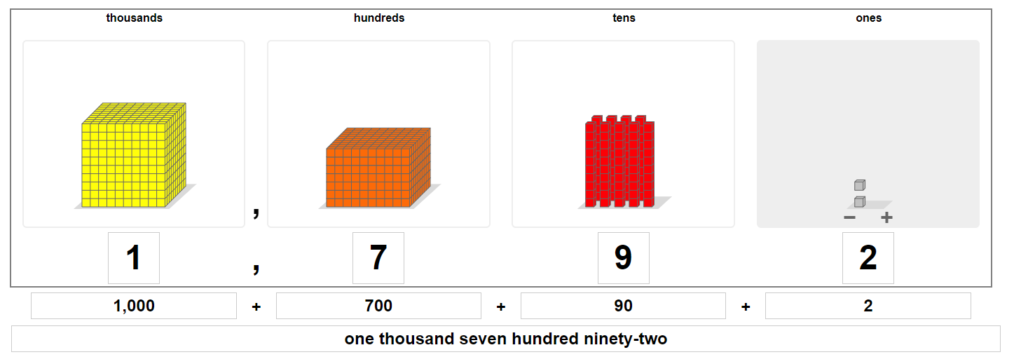
Grade 4 – Values to 1,000,000 with all Forms of Notation

Slide 29
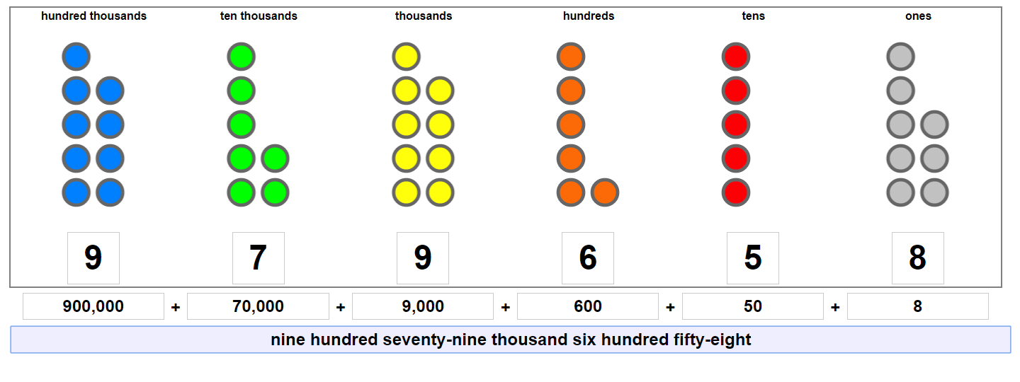
Heading Towards 1,000,000

Slide 30
Nine hundred seventy-nine thousand six hundred fifty-eight

Slide 31
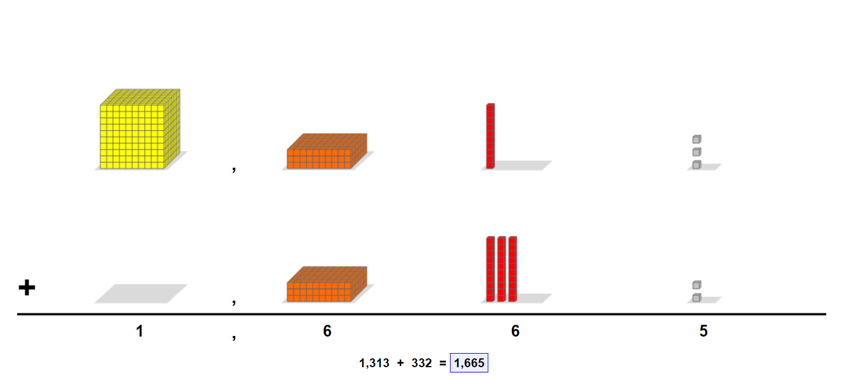
Place Value Addition

Slide 32
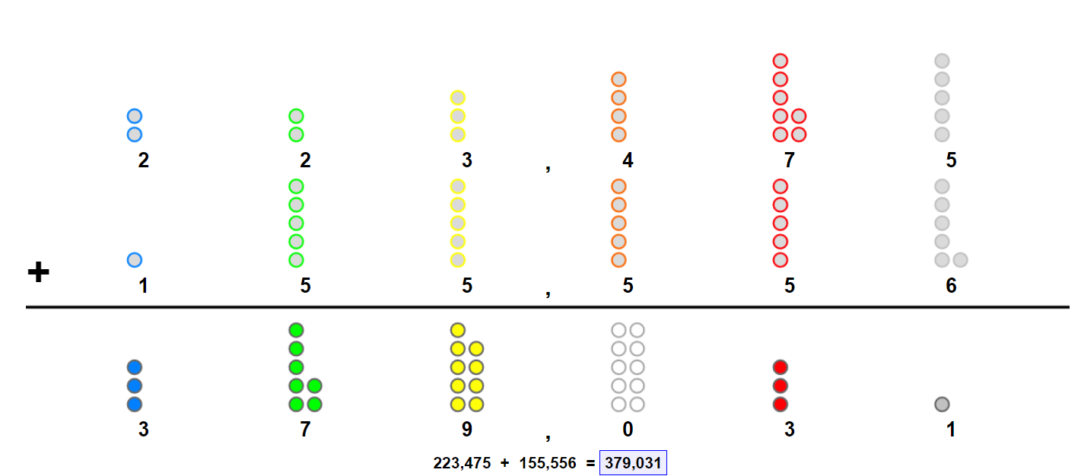
Place Value Addition with Large Numbers

Slide 33
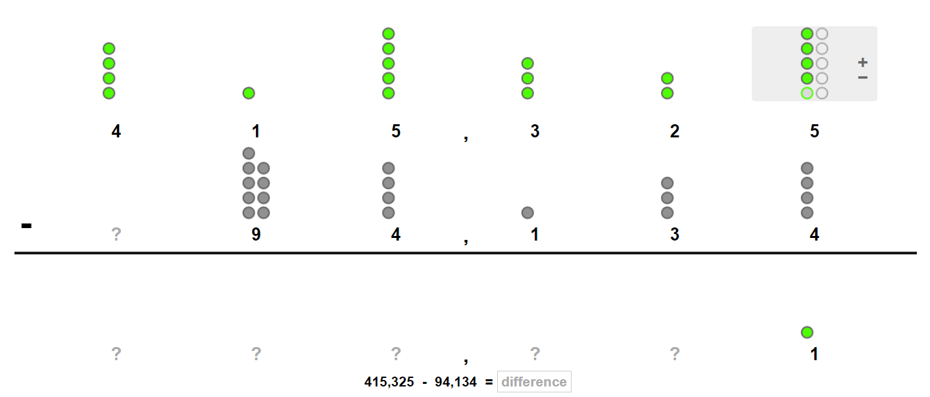
Place Value Subtraction with Large Numbers

Slide 34
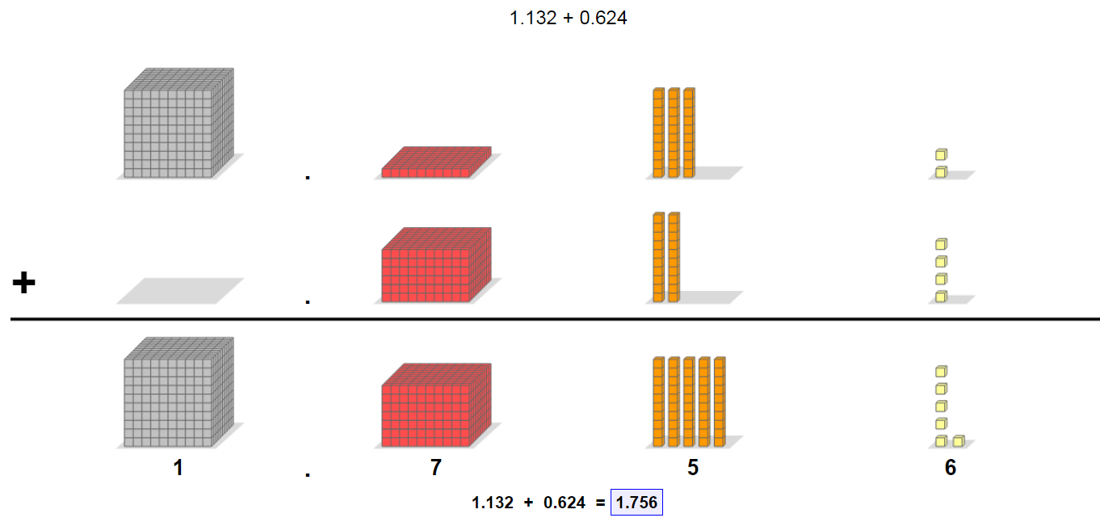
Grade 5 - Place Value Addition and Subtraction with Decimals

Slide 35
Operations and Algebraic Thinking
Bears

Slide 36
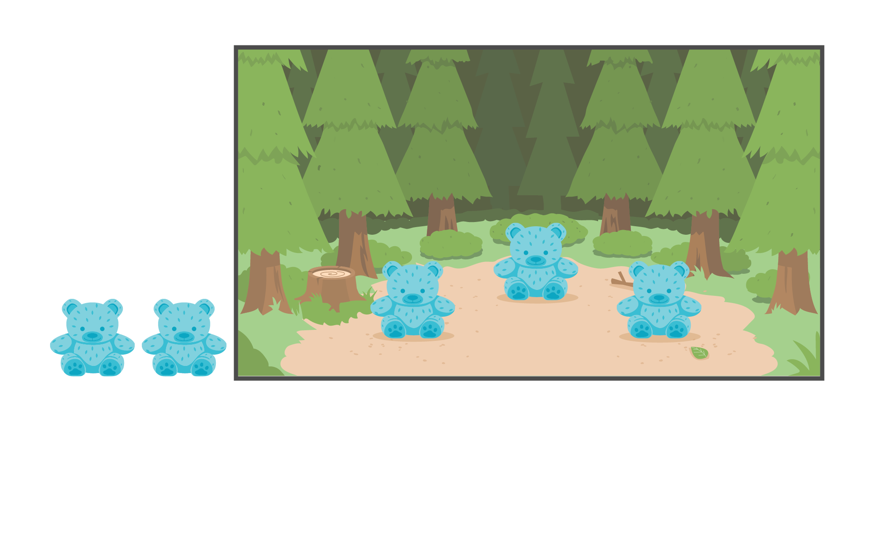
Three bears are sitting in the forest. Two more bears join them. How many bears are sitting in the forest now?

Slide 37
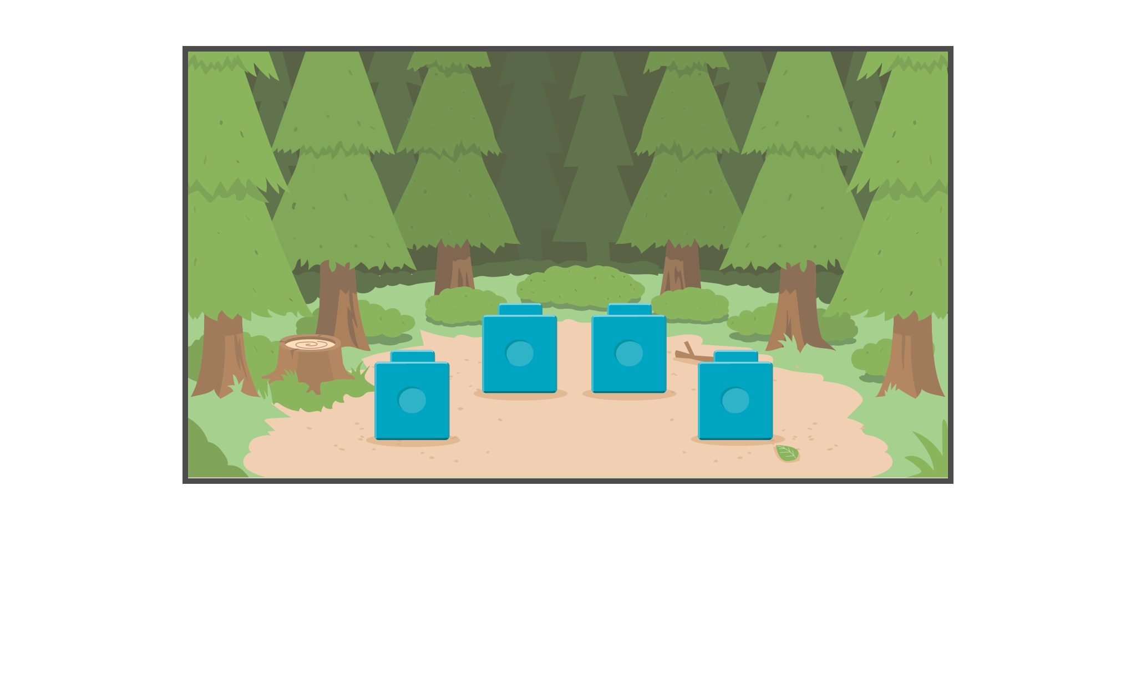
4 bears are playing in the forest. 2 bears leave.
How many bears are playing in the forest now?

Slide 38
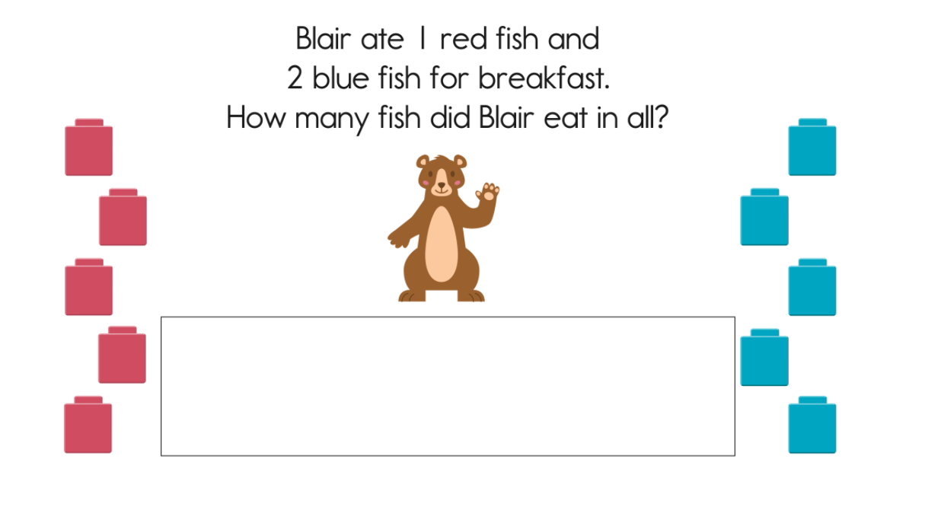
Blair ate 5 red fish and 2 blue fish. How many more red fish did Blair eat than blue fish?

Slide 39
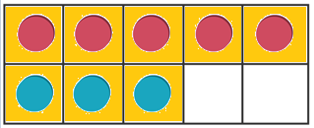
Put Together – Take Apart
There are 8 bears by the lake. 5 are on the shore. The rest are in the water. How many are in the water?
8 – 5 = ?
8 – 5 = 3
5 + ? = 8
5 + 3 = 8
8 – 3 = ?
8 – 3 = 5
3 + 5 = ?
3 + 5 = 8

Slide 40
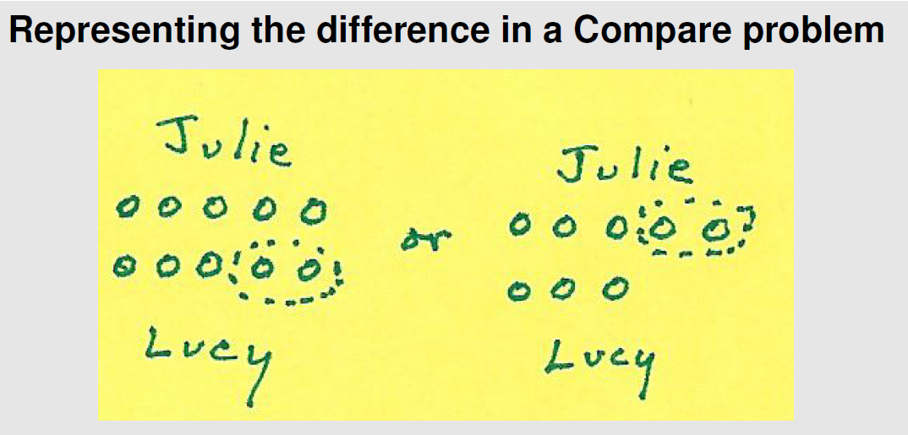
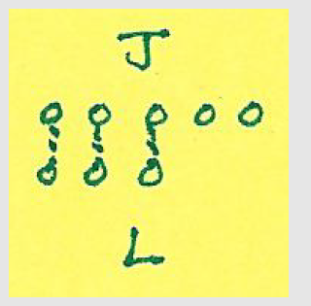
First Grade

Slide 41
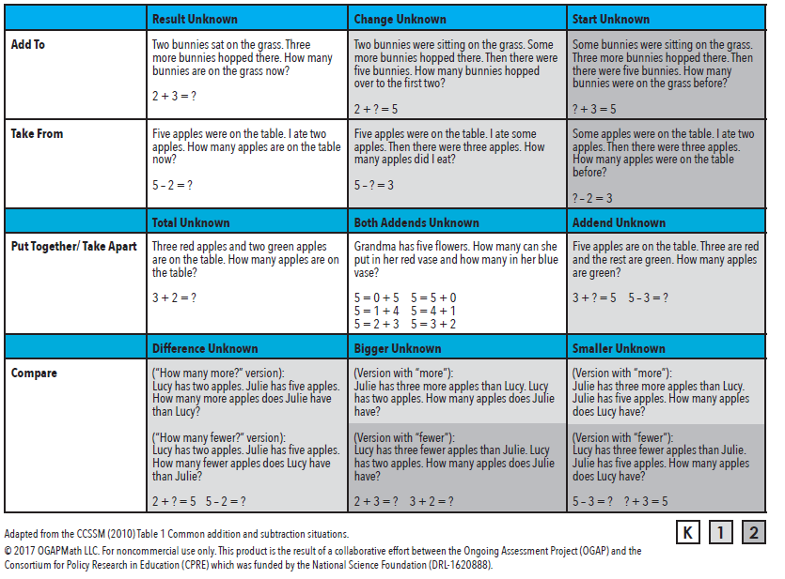
Ongoing Assessment Project (OGAP)
https://ogapmathllc.com/

Slide 42
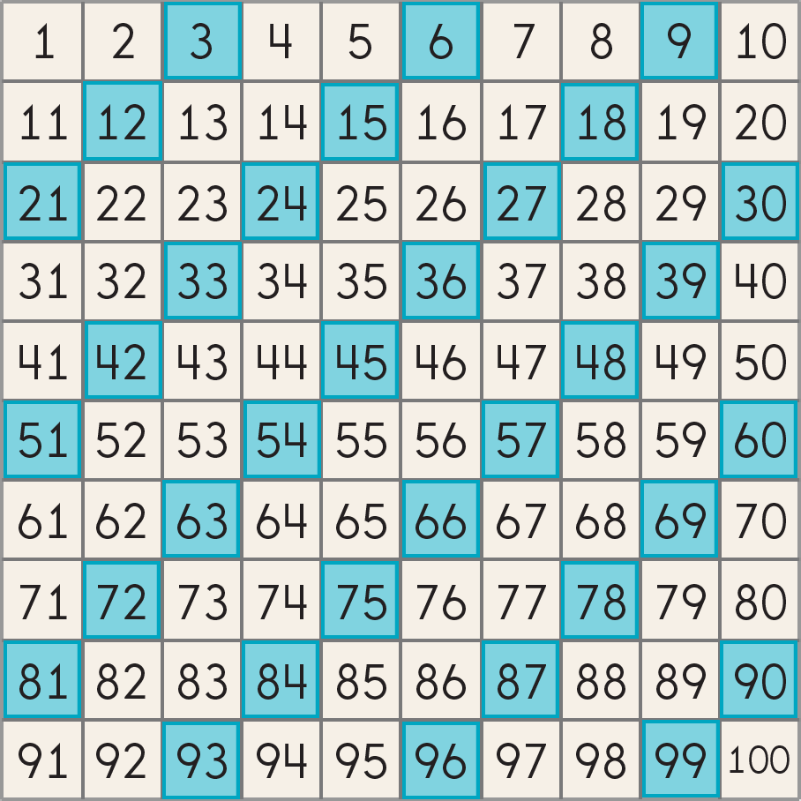
Grade 2 – Patterns in addition and subtraction to 100

Slide 43
Grade 2 – Patterns in addition and subtraction to 100
Repeated Addition
and
Repeated Subtraction
Multiplication and Division

Slide 44
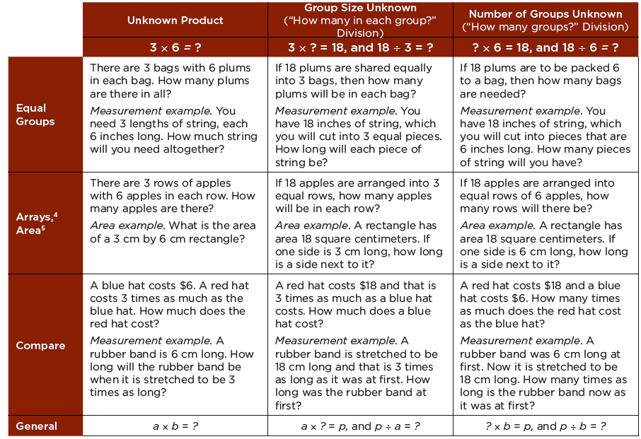

Slide 45

Multiplication

Slide 46

Division

Slide 47

Grade 3 – Multiplication and Division

Slide 49

40
35
30
8 x 5
25
20
15
10
5

Slide 50

4
36 ÷ 9
9

Slide 51

Grade 4 – Multiplication, Larger Numbers

Slide 52

Grade 4 – Division, Larger Numbers

Slide 53
A Difficult 5th Grade Problem
8.4 ÷ 1.4 = ?
Division

Slide 54





Slide 55
Addition is all about base ten

Slide 56
Multiplication is repeated addition.

Slide 57
Multiplication and division are the same.

Slide 58
Division is repeated subtraction.

Slide 60

8.4 ÷ 1.4 = ?

Slide 61
8.4 ÷ 1.4 = ?
Let’s call this 1.4.

Slide 62
8.4 ÷ 1.4 = ?
Now we have 2.8.

Slide 63
8.4 ÷ 1.4 = ?
4.2!

Slide 64
8.4 ÷ 1.4 = ?
Voila!

Slide 65
8.4 ÷ 1.4 = ?
6
5
7
4
3
8
2
1
.4
Voila!

Slide 66



Slide 67
Rules That Expire
When you multiply a number by 10 just add a zero to the end of the number.
Use keywords to solve word problems.
You can’t take a bigger number from a smaller number.
Addition and multiplication make numbers bigger.
Subtraction and division make numbers smaller.
You always divide the larger number by the smaller number.

Slide 68


Beliefs about teaching and learning Mathematics
Unproductive beliefs | Productive belief
Mathematics learning should focus on practicing procedures and memorizing basic number combinations. | Mathematics learning should focus on developing understanding of concepts and procedures through problem solving, reasoning, and discourse.
Students need only to learn and use the same standard computational algorithms and the same prescribed methods to solve algebraic problems. | All students need to have a range of strategies and approaches from which to choose in solving problems, including, but not limited to, general methods, stan- dard algorithms, and procedures.
Students can learn to apply Mathematics only after they have mastered the basic skills. | Students can learn Mathematics through exploring and solving contextual and Mathematical problems.
The role of the teacher is to tell students exactly what definitions, formulas, and rules they should know and demonstrate how to use this information to solve Mathematics problems. | The role of the teacher is to engage students in tasks that promote reasoning and problem solving and facilitate discourse that moves students toward shared understanding of Mathematics.
The role of the student is to memorize information that is presented and then use it to solve routine problems on home- work, quizzes, and tests. | The role of the student is to be actively involved in making sense of Mathematics tasks by using varied strategies and representations, justifying solutions, making connections to prior knowledge or familiar contexts and experiences, and considering the reasoning of others.
An effective teacher makes the Mathematics easy for students by guiding them step by step through problem solving to ensure that they are not frustrated or confused. | An effective teacher provides students with appropriate challenge, encourages perseverance in solving problems, and supports productive struggle in learning Mathematics.

Slide 69
Beliefs
An effective teacher makes the Mathematics easy for students by guiding them step by step through problem solving to ensure that they are not frustrated or confused.
An effective teacher provides students with appropriate challenge, encourages perseverance in solving problems, and supports productive struggle in learning Mathematics.
Discussion

Slide 70



Writing and Formative Assessment

Slide 71


Slide 72


Slide 73

Discuss -> Lunch

Slide 74
Informing RtI Practices for
Mathematics in the
Common Core Era
Arjan Khalsa
STEM Advocate, Activate Learning
@ArjanKhalsa
akhalsa@activatelearning.com

Slide 75



Productive Discourse
3-Act w/Rubric

Slide 76

5 Practices
Anticipate
Monitor
Select
Sequence
Connect
Margaret Smith
Open Middle Math
Robert Kaplinsky

Slide 77


You Do, We Do, I Do?
Important discussion
Paper by prior NCTM President, Dana Center
Book by Popular Figure from Mt. Holyoke Program
Discussion

Slide 78
What is the relationship between RtI screeners and continuous formative assessment?
Consider:
Mathematical practices
Skills being measured

Slide 79
RTI Essential Components
Clear Vision of Learning for ALL
BIT Meets Regularly
Principal Attends RTI Meetings
Decision Rules
Intervention Placement
Intervention Review
Core Review
SLD Decision Making
Initial and Ongoing PD
Ongoing Coaching
Observe & Actionable Feedback
Progress Monitoring
Interventions
Universal Screening
Core Materials and Instruction
Leadership
Teaming
& DBDM
Professional Learning
Culture
Growth Mindset &
High Expectations For ALL Students
Culture of
Collaboration to
Improve Outcomes
Notes:
Culture: High expectations for all student populations, belief that all student populations can learn, belief that the measurement of how well I teach is how well they learn
Leadership:
Teaming/DBDM: Disaggregate data,
Professional Learning & Support:d
Core: Sheltered instruction, implicit, opportunities to respond,

Slide 80


The It’s Time Framework

Slide 81
Areas of Focus for Oregon RtI Project

Slide 82
Areas of Focus for Oregon RtI Project

Slide 83
Areas of Focus for Oregon RtI Project

Slide 84
Areas of Focus for Oregon RtI Project

Slide 85
RTI Essential Components
Clear Vision of Learning for ALL
BIT Meets Regularly
Principal Attends RTI Meetings
Decision Rules
Intervention Placement
Intervention Review
Core Review
SLD Decision Making
Initial and Ongoing PD
Ongoing Coaching
Observe & Actionable Feedback
Progress Monitoring
Interventions
Universal Screening
Core Materials and Instruction
Leadership
Teaming
& DBDM
Professional Learning
Culture
Growth Mindset &
High Expectations For ALL Students
Culture of
Collaboration to
Improve Outcomes
Notes:
Culture: High expectations for all student populations, belief that all student populations can learn, belief that the measurement of how well I teach is how well they learn
Leadership:
Teaming/DBDM: Disaggregate data,
Professional Learning & Support:d
Core: Sheltered instruction, implicit, opportunities to respond,

Slide 86


Notes:
Culture: High expectations for all student populations, belief that all student populations can learn, belief that the measurement of how well I teach is how well they learn
Leadership:
Teaming/DBDM: Disaggregate data,
Professional Learning & Support:d
Core: Sheltered instruction, implicit, opportunities to respond,

Slide 87
Standards for Mathematical Practice
Make sense of problems and persevere in solving them
Reason abstractly and quantitatively
Construct viable arguments and critique the reasoning of others
Model with mathematics
Use appropriate tools strategically
Attend to precision
Look for and make use of structure
Look for and express regularity in repeated reasoning
Notes:
This organization of the Standards for ematical Proficiency was developed by one of the principal authors of the Common Core State Standards for Mathematics, Dr. William McCallum, University of Arizona. His rationale for this organization given at the website below is as follows:
“In the progressions project, we’ve been discussing how best to represent the Standards for ematical practice. The practices are signposted throughout the documents, but we’ve also been thinking about how to provide some structure for the practice Standards that will help people avoid fruitless tagging exercises in their efforts to integrate the practice Standards into the content Standards. If you think about it long enough you can associate just about any practice standard with any content standard, but this sort of matrix thinking can lead to a dilution of the force of the practice Standards—if you try to do everything all the time, you end up doing nothing. This diagram is an attempt to provide some higher order structure to the practice Standards, just as the clusters and domains provide higher order structure to the content Standards.”
http://commoncoretools.me/2011/03/10/structuring-the- ematical-practices/

Slide 88
Informing RtI Practices for
Mathematics in the
Common Core Era
Arjan Khalsa
STEM Advocate, Activate Learning
@ArjanKhalsa
akhalsa@activatelearning.com

