Slide 1
Developing & Strengthening your Intervention System
Intervention failure should be a rare event*
*VanDerHyden & Tilly
Notes:
Lisa: 1-12
31-39
54-63

Slide 2
RTI Essential Components
Standards of
Practice
Data-Based Decision Making with Decision Rules
Training Coaching
Fidelity
SLD Decision Making
Progress Monitoring
Interventions
Screening
Core
Leadership
Teaming/Data-Based Decision Making
Professional Learning & Support
Culture
Notes:
In the nine features of RTI implementation, this presentation covers the standards of practice of leadership and the core.

Slide 3
Standards of Practice must be put into place to make your intervention system successful.
This is hard work!
Notes:
Link to time, materials and effective instruction

Slide 4

But it’s the Right Work

Slide 5
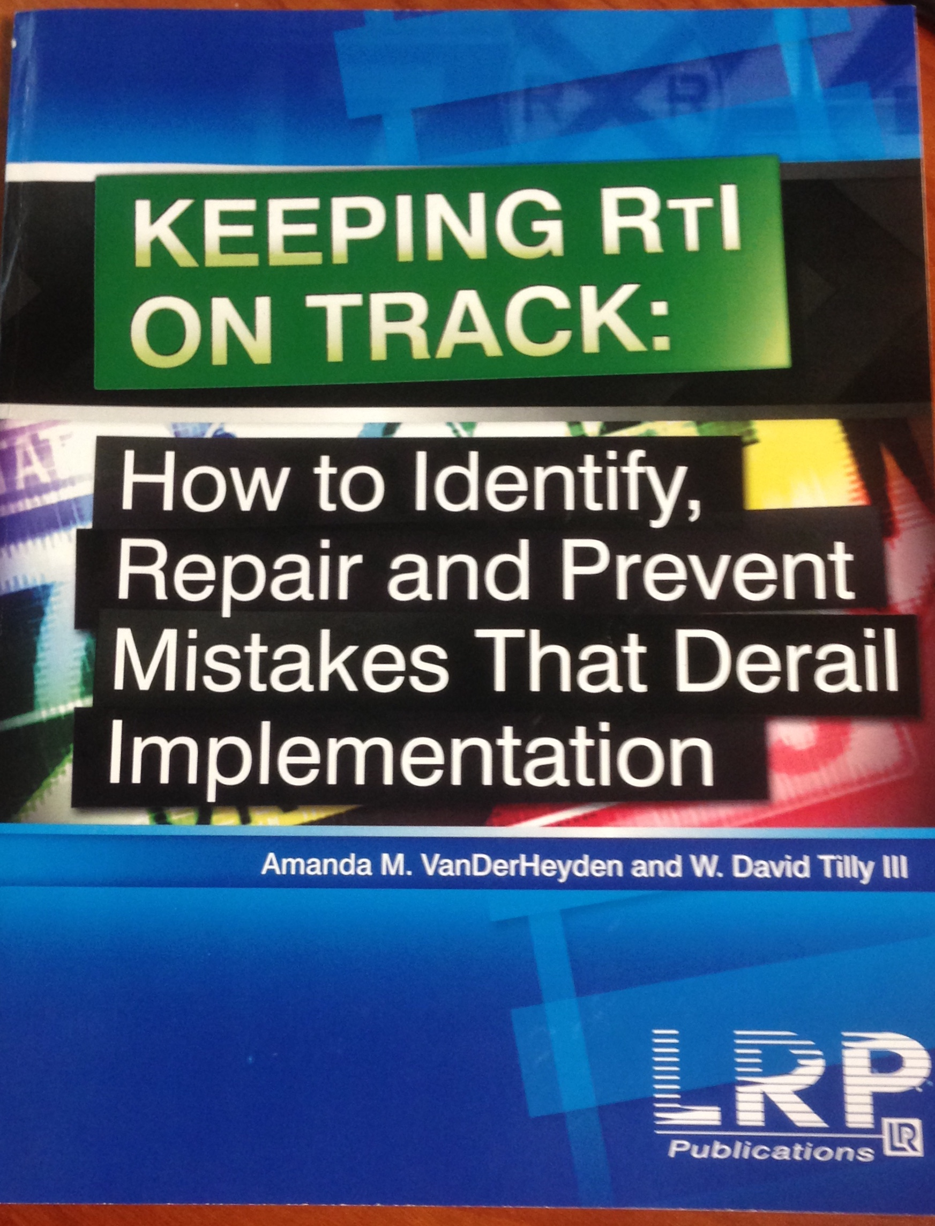
Purpose of the Session
Develop Standards of Practice for defining & selecting Tier 2 & 3 Interventions
Begin to develop your Standard Reading Protocol
Intervention Failure Should Be a Rare Event
Chapter 2: “Our Model is Too Loosely Defined”

Slide 6
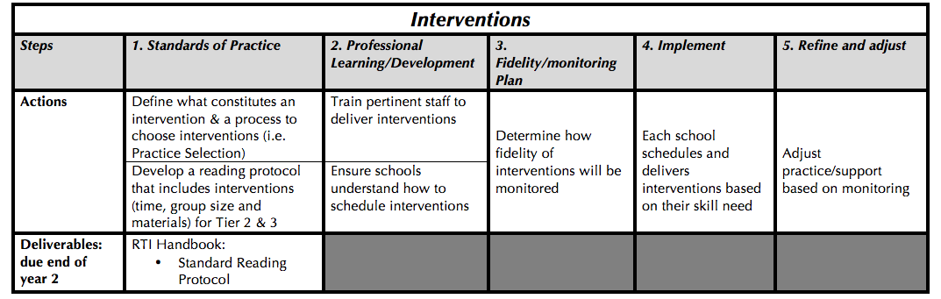
District Work…..

Slide 7
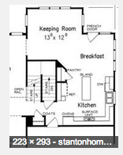

How do you set up your intervention system to make interventions work?
Standardizing
Customizing
Notes:
Standardizing is to identify the critical elements needed for a process to work…. And ensuring that they do work…. What is absolutely critical…. Hospital standardizes surgeries by counting the instruments that are used pre and post surgery…..
Floor plan is standardized… helps know resources , inventory, personnel needed….

Slide 8
District work/School work
District Standardizes……
School customizes……
Interventions
Intervention Placement Meetings
Progress Monitoring
Intervention Group Meetings
How many students receive interventions
  Based on the school’s resources
Intervention schedule
Who teaches the interventions

Slide 9

What does the district standardize?
Interventions
Understanding of what constitutes an intervention
Standard Reading Protocol
  What interventions
  How much time
  Group size
Fidelity (who, how, when)

Slide 10
What does the district standardize?
Intervention Placement Meetings
Percentage of students who receive interventions
Placing students into the appropriate intervention to match their skill need
Student Intervention Profile (intervention tracking sheet)

Slide 11
What does the district standardize?
Progress Monitoring
Progress Monitoring (who, how, when)

Slide 12
What does the district standardize?
Group Intervention Review Meetings
Criteria for changing an intervention
What constitutes an intervention change
Meetings: who, how, when

Slide 13
Think Time: Standardizing
What it is….
What it is not…
Notes:
Private think time……whip around after think time 1 example of what it is and 1 example of what it is not.

Slide 14
Talk Time
Why is standardizing important for your intervention system?
How can you communicate what it is & why it is important to staff?
What barriers have you encountered and how have you overcome some of them in regards to “standardizing?”

Slide 15
What does the district standardize?
Interventions
Understanding of what constitutes an intervention
Standard Reading Protocol
  What interventions
  How much time
  Group size
Fidelity (who, how, when)

Slide 16
District Work…..

Slide 17
What is an intervention?
Scientifically, research based instructional intervention
An intervention matched to student need that has been demonstrated through scientific research and practice to produce high learning rates for most students (NASDSE, 2008)
Notes:
In federal regs……

Slide 18

We need to catch them up!

Slide 19
Interventions
An intervention is…..
An intervention is not….
Provided to students who are below benchmark
Provided OUTSIDE of core instruction time
Provided to address foundational skills
  mastery
Differentiated instruction using small groups within the core reading block/reading program.
Programs/materials developed by teachers/specialists on staff

Slide 20
Reading Skills Build on Each Other
Reading Comprehension
Foundational Skills
Vocabulary
Fluency
Accuracy, Prosody & Rate
Phonics and Word
Recognition
Phonemic Awareness
Notes:
Print concepts in Kindergarten and 1st includes the basic functions of text such as left to right, spacing, word, capital, and ending punctuation
Phonemic Awareness in Kindergarten and 1st includes the knowledge of sounds of our langague such as hearing the difference between long and short vowels, initial sounds, segmenting words and phoneme additional and deletion.
Phonics and Word Recognition (the langague of CCSS) also known as the Alphabetic Principal has standards Kindergarten through 5th grade includes 1 to 1 sound correspondence, high frequency words, and decoding words to construct meaning. By 5th grade students should be able to use syllabication and morphology to read multisylabic words to read words for meaning.
Fluency in Kindergarten through 5th grade includes reading at a rate that sounds like talking so that they may construct meaning. First, and most importantly, students must read accurately, they must read in a way that is interesting to hear and the rate must be appropriate for the task.
Vocabulary (found in the Language Standards: Vocabulary Acquisition and Use) in Kindergarten through 12th grade include both receptive vocabulary and expressive vocabulary. Students use word knowledge to understand meaning within context as well as morphology to decode meanings.
Comprehension in Kindergarten through 12th (found in the anchor standards) grade includes reading to construct meaning. Reading is ALWAYS about meaning. This includes the informational and fiction text.

Slide 21
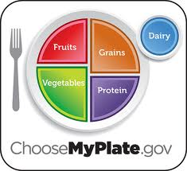

How do interventions support growth?
Healthy, balanced diet to ensure good physical health
Adapted from
Notes:
Connect to the cows.

Slide 22
Literacy Diet
Powerful literacy diet to ensure good literacy health
Reading
Comp
Oral Reading
Fluency &
Accuracy
Phonemic
Awareness
Phonics
(Alphabetic
Principle)
Vocabulary

Slide 23
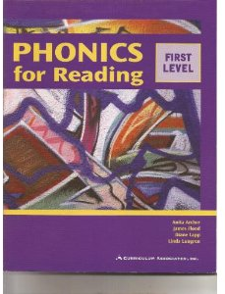

Some will need more
Reading
Comp
Oral Reading
Fluency &
Accuracy
Phonemic
Awareness
Phonics
(Alphabetic
Principle)
Vocabulary

Slide 24
Differences Between Tier 2 & 3 Interventions
Tier 2: Intervention
Tier 3: Intervention
Programs and materials designed to support the core program by addressing specific skill areas such as phonemic awareness or reading fluency.
Programs and materials are designed to accelerate student growth by addressing multiple skill needs of students who are far below grade level.
Kame'enui, Simmons, Coyne, & Harn © 2003

Slide 25
Differences between Tier 2 & 3
Instructional Factors
  Instructional intensity
  Skills addressed (materials)
  Opportunities to Respond
Organizational Factors
  Time allotted for instruction
  Group size
  (Who delivers)
Assessment Factors
  Frequency of progress monitoring
  Use of diagnostic assessment

Slide 26
Differences between Tier 2 & 3
Factor | Tiers of Instructional Support
Instructional/Materials | Tier 2 | Tier 3
Instructional focus | More focused on single skills, supports core | More comprehensive (2-3 skills)
scaffolding | Uses I do, we do, you do | More time/explicitness spent in I do, we do, you do
Organization | Tier 2 | Tier 3
Time allotted for instruction | Suggested 30 minutes | Suggested 45 minutes – 120 minutes
Group size | 5-8 students | 1-3 students
Assessment | Tier 2 | Tier 3
Frequency of progress monitoring | Biweekly/monthly | Twice a week/weekly
Diagnostic assessment | Group assessments | Individual diagnostic assessment

Slide 27
Tiers of Support vs. Number of Interventions
Tiers of Support
Number of Interventions
All students get Tier 1 support
Students receive Tier 2 or Tier 3 Support based on their level of need
Don’t have to go through Tier 2 to get Tier 3 support
Students can receive at least 3 interventions prior to being referred for special education
  2 group interventions
  1 intensified, individualized intervention
Based on their progress

Slide 28
Examples
Andrew
Annika
DIBELS Next Composite: Well Below Benchmark
Intervention #1: Tier 3
  Limited progress
Intervention #2: Tier 3
  Limited progress
Intervention #3: intensified Tier 3
easyCBM: Some Risk
Intervention #1: Tier 2
  Limited progress
Intervention #2: Tier 3
  Good progress, but not yet grade level
Intervention #3: Tier 2

Slide 29
Talk Time
What were some of the differences you noticed between the two interventions?

Slide 30
Typical interventions at each Tier
Tier 2
Tier 3
Read Naturally
Triumphs
Road to the Code
Journey’s Write-in Reader
Phonemic Awareness in Young Children
Reading Mastery
Corrective Reading
Horizons
ERI
Note: Some intervention placements into Tier 2 or 3 are dependent upon grade level

Slide 31

Interventions with ELL Learners
IES Guide recommends….
Provide intensive small-group
reading instruction
  Starting in grade 1
  Students low on early reading skills
  Matched to intensity of need
  Develop oral language skill

Slide 32
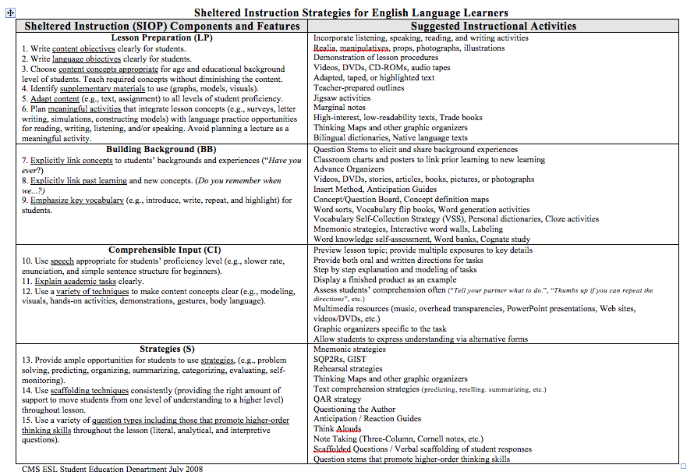
Enhancing Language Development

Slide 33
District Work…..

Slide 34
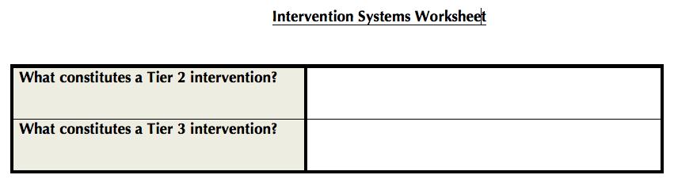
Team Time
Define what the differences are between a Tier 2 vs Tier 3 intervention in your district?
Use the Intervention Worksheet Form
Notes:
10 minutes with your team

Slide 35
District Work…..

Slide 36
What does the district standardize?
Interventions
Understanding of what constitutes an intervention
Standard Reading Protocol
  What interventions
  How much time
  Group size
Fidelity (who, how, when)

Slide 37
What is a Standard Reading Protocol?
For each Tier, it lists the…..
programs/interventions available for common student needs
  Thoroughly trained
recommended group size
duration that the intervention should be provided each day

Slide 38
Standard Reading Protocol
Advantages
Challenges
Interventions can be provided with a high degree of fidelity if staff is trained adequately.
Students in need of intervention can receive immediate access to the intervention
SLD Identification
Staff buy-in to follow the protocol
Lack of interventions for each foundational skill
Limited capacity to sufficiently train and support each intervention

Slide 39
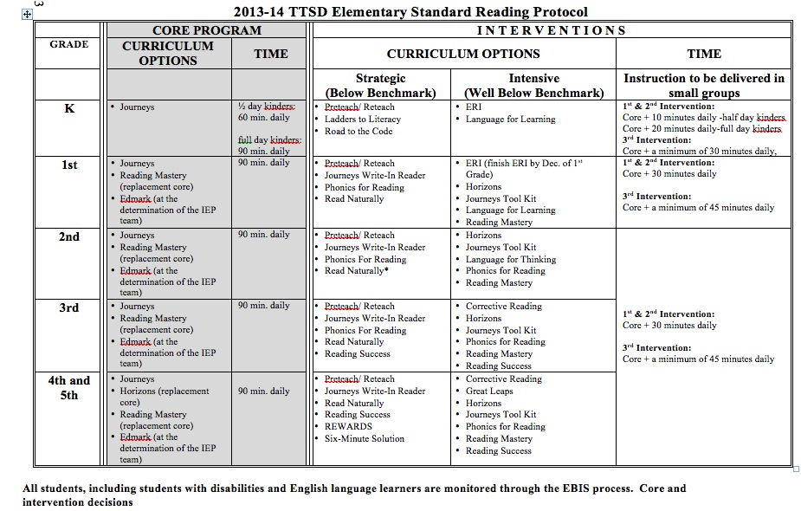
What do Standard Reading Protocols look like?

Slide 40
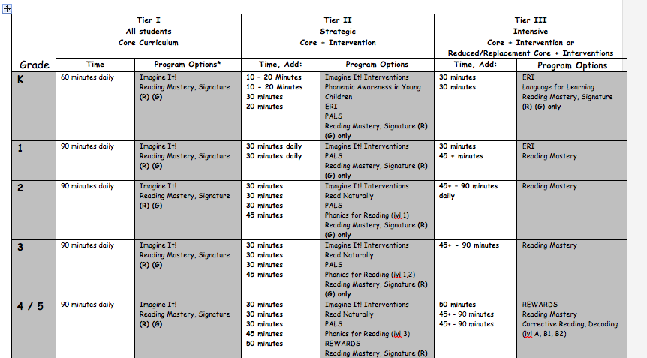
Sample Standard Reading Protocol

Slide 41
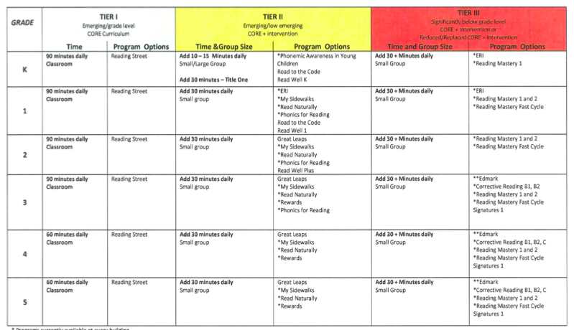
Sample Standard Reading Protocol

Slide 42
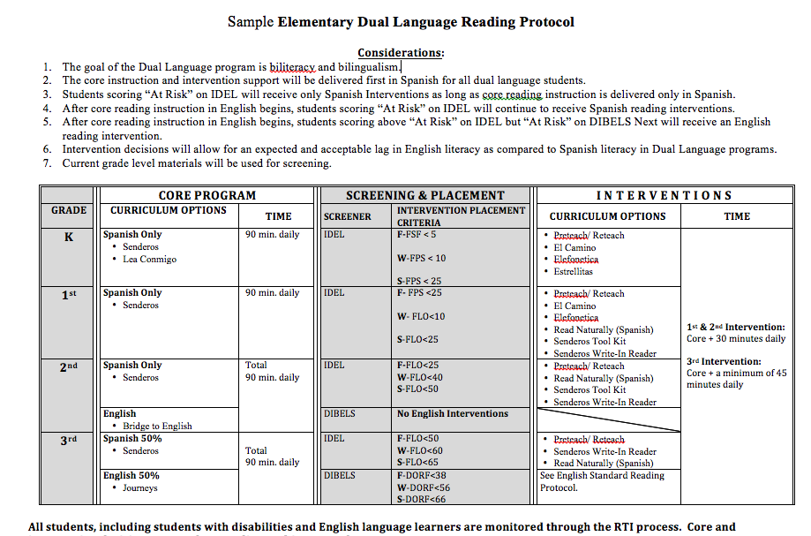
Sample Dual Language Reading Protocol

Slide 43
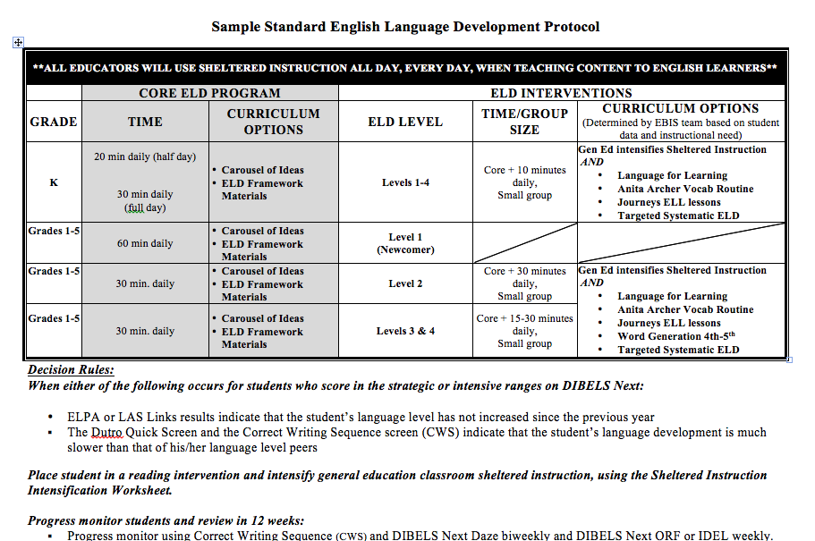
Sample Standard ELD Protocol

Slide 44

Reviewing Intervention Capacity
  Does your district have the capacity to manage the interventions that you are using?

Slide 45
How do you determine your capacity?
Conduct an intervention audit
  An official inspection of the materials and trainings used for interventions in your district.

Slide 46
Why conduct an
Intervention Audit?
To begin to develop a Standard Reading Protocol
To ensure that the interventions will work for your population of students!

Slide 47
Intervention Audit Questions
Are your interventions evidenced-based?
Do you have all the materials/funds to purchase materials?
Have staff teaching the interventions been provided with adequate training
  Do you have the ability to provide refresher trainings & coaching?
Notes:
15 minutes

Slide 48
Intervention Audit Form

Slide 49
Intervention Audit Questions
Are your interventions evidenced-based?
Do you have all the materials/funds to purchase materials?
Have staff teaching the interventions been provided with adequate training
  Do you have the ability to provide refresher trainings & coaching?
Notes:
15 minutes

Slide 50
What are “evidenced-based” programs?
Reliable, trustworthy and valid evidence
  Peer reviewed journal
Records of success
Must be done with fidelity!
Sources
  What Works Clearinghouse?
  National Center on Intensive Interventions
  Reading First
  Florida Center for Reading Research
  *Often Publishers’ reports do not provide sufficient evidence
Notes:
Keep in mind that new programs are out that have not had time to be validated…. ODE approved core programs have intervention components that are ok to add at this point in time.
Look up a program from one the sites that you are not as familiar with…

Slide 51
List of Commonly used
Evidence-Based Programs
 | Phonemic Awareness | Phonics | Oral Reading Accuracy & Fluency
Phonics for Reading |  | ☑
Read Naturally |  |  | ☑
Corrective Reading |  | ☑ | ☑
Reading Mastery | ☑ | ☑ | ☑
Phonemic Awareness for Young Children | ☑
Horizons | ☑ | ☑ | ☑
REWARDS |  | ☑ | ☑
ERI | ☑

Slide 52
What if it’s not on the “list”?
If you have a program that is not on the list…..look it up on one of the sites.

Slide 53
Intervention Audit Questions
Are your interventions evidenced-based?
Do you have all the materials/funds to purchase materials?
Have staff teaching the interventions been provided with adequate training
  Do you have the ability to provide refresher trainings & coaching?
Notes:
15 minutes

Slide 54
Intervention Audit Questions
Are your interventions evidenced-based?
Do you have all the materials/funds to purchase materials?
Have staff teaching the interventions been provided with adequate training
  Do you have the ability to provide refresher trainings & coaching?
Notes:
15 minutes

Slide 55
What is adequate training?
Did an adequate initial training occur?
Is the program being delivered as designed?
  How do you know?
Are follow-up supports provided?

Slide 56
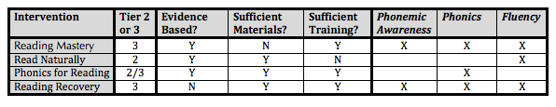
What might a completed form look like?

Slide 57
Begin to Conduct Your Intervention Audit

Slide 58
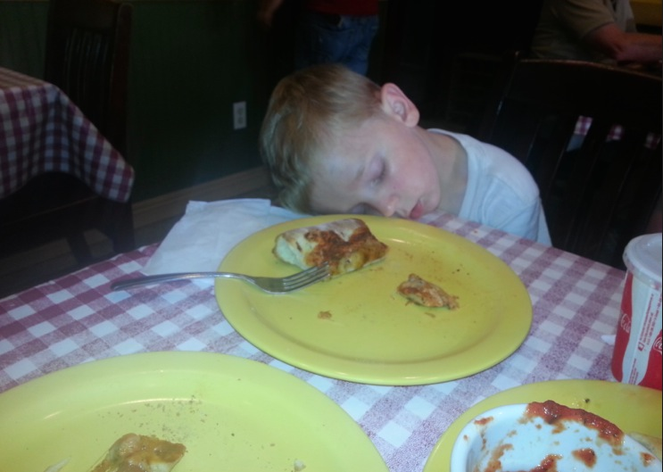
Break

Slide 59
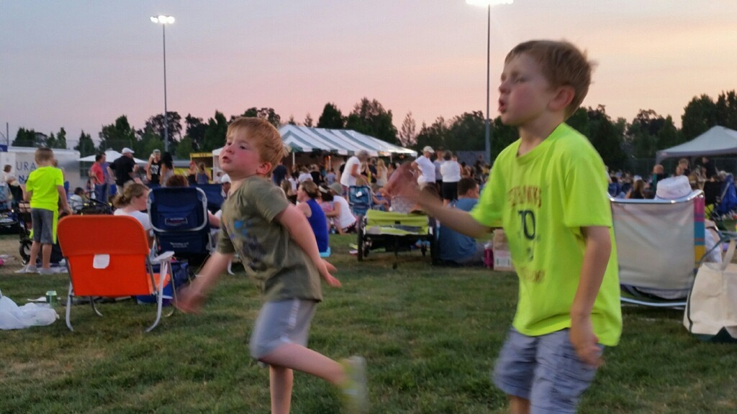
Next steps: Work on your protocol!

Slide 60
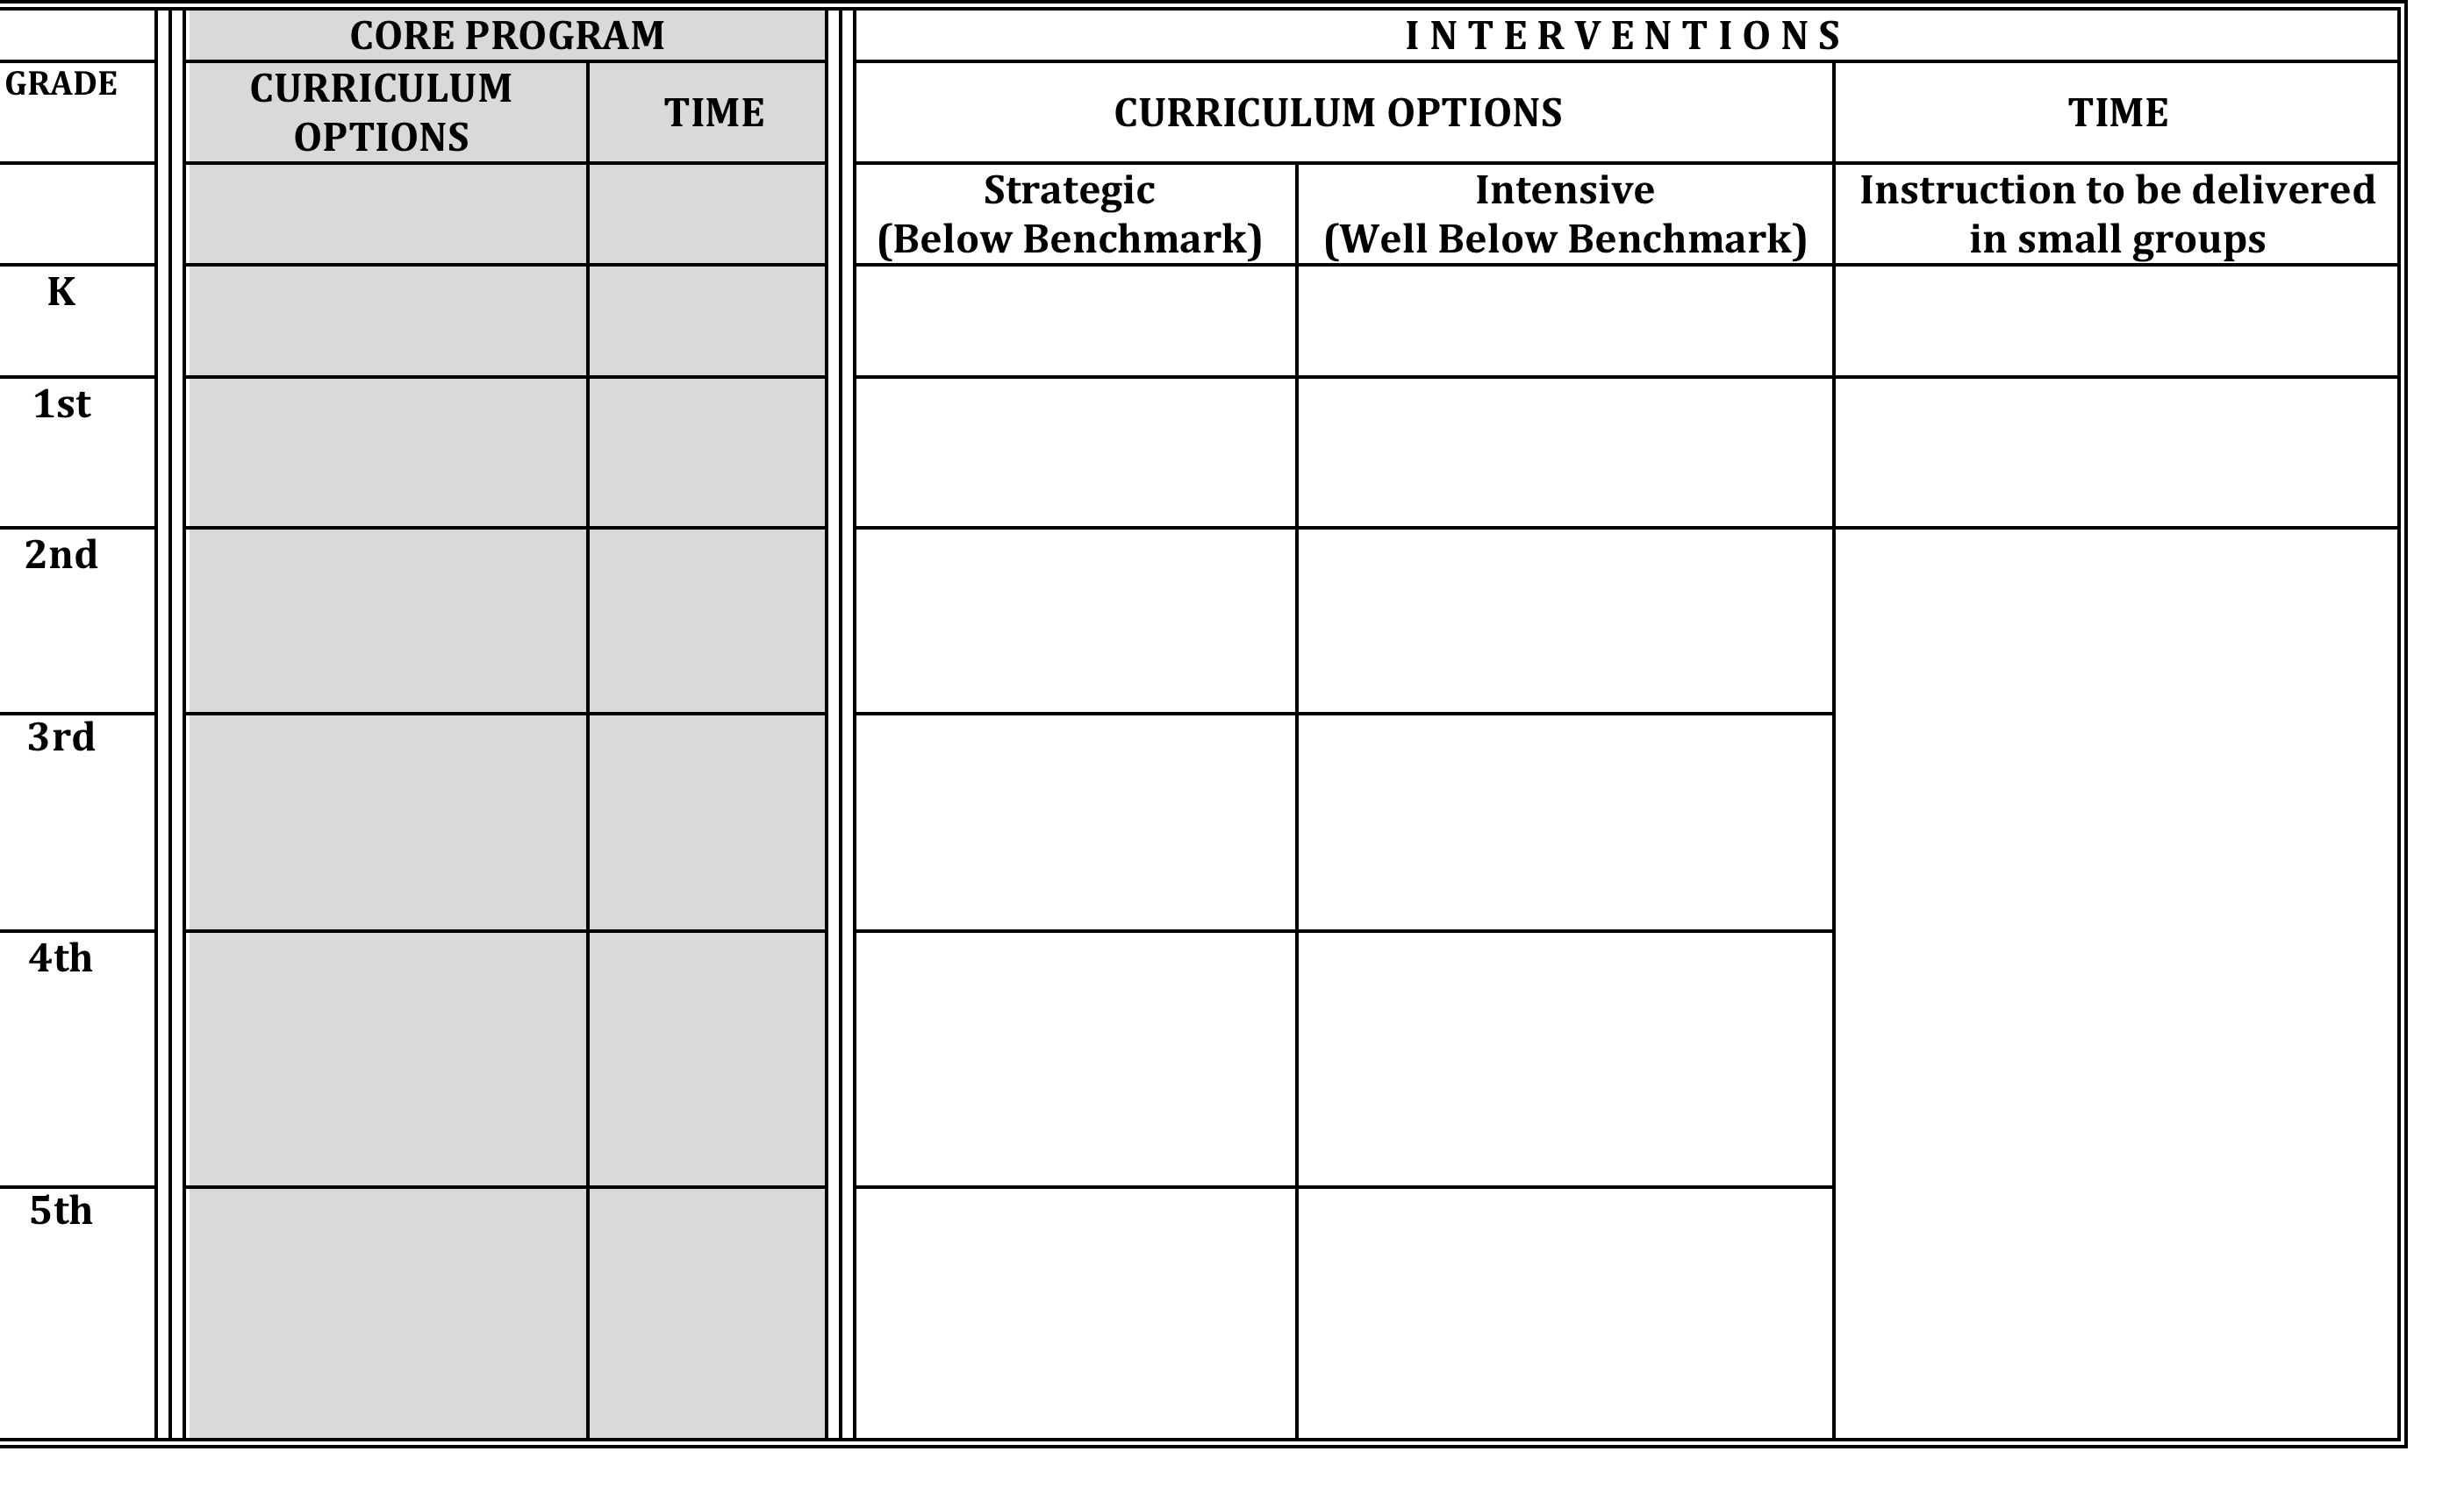
Sample Elementary Reading Protocol

Slide 61
Choose Appropriate Interventions
Which programs should you keep?
  (have evidence, training, materials)
Which programs need additional support/refinement?
Which programs should you no longer use?

Slide 62
Other Considerations
Time
Group Size
Recommendation
  Tier 2: 30 minutes
  Tier 3: 45 minutes
Consider
  How much time does it take to deliver the program?
  Scheduling
Recommendation
  Tier 2: 5-8
  Tier 3: 3-5
Consider
  How many staff do you have to deliver the interventions compared to the need?
  Training capacity?
  Material capacity?

Slide 63
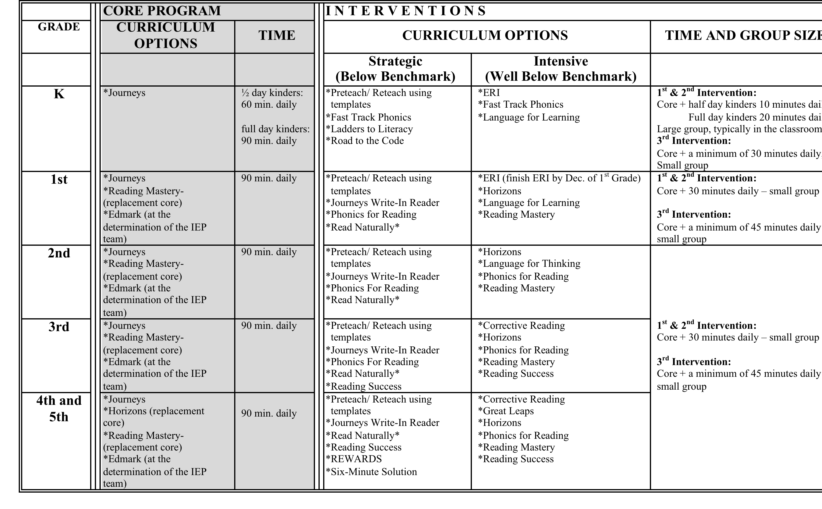
List your chosen interventions, time, and group size on your protocol.
Notes:
Give them time to do this work.

Slide 64
Professional Learning/Development

Slide 65
Professional Learning/Development
Questions
Possible Solutions
Is staff trained and provided refreshers on how to deliver interventions?
How do you know staff is proficient?
National Direct Instruction Conference: July 27-31, 2015 Eugene Hilton and Conference Center
http://nifdi.org/videos/reading-mastery-training-series
ESDs
Publishers (SRA, Sopris West, Scott Foresman)
Develop on-site coach

Slide 66
Fidelity/Monitoring

Slide 67
Fidelity/Monitoring
Questions
Possible Solutions
What fidelity tools will be used?
Who will monitor fidelity?
How often will fidelity be monitored?
How will the information be used?
Observation with feedback
  Literacy Reading/Specialist/Principal
    Daily, weekly, once a month?
    Intervention fidelity & Student outcome data
    Meetings three times a year to review fidelity data?
Self Report
Permanent Product Review

Slide 68
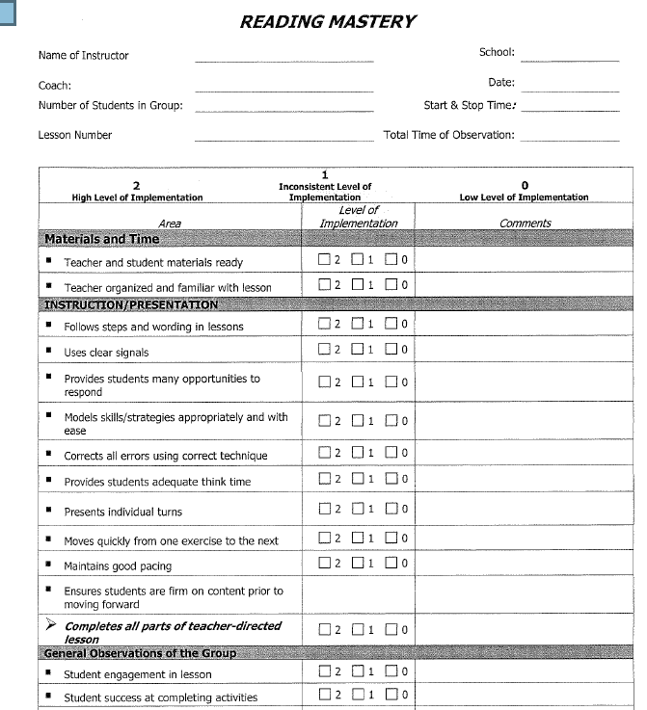
Intervention Fidelity Checklists

Slide 69
Talk Time: Professional Development
What are your next steps for PD & Fidelity for interventions?
What resources do you need?

Slide 70
Implement
When do you expect schools to begin interventions?

Slide 71
Refine & Adjust

Slide 72
Adjust
Questions
Possible Solutions
What do your results say…
  What percentage of your Tier 2 & Tier 3 interventions are “unsuccessful”?
    > 20% of Tier 2 Interventions
    > 10% of Tier 3 Interventions
How will you know when adjustments need to occur?
Review percentages of students making progress in interventions
Examine intervention fidelity
Provide professional development (training, coaching, feedback)

Slide 73

What does a school customize for interventions?

Slide 74
What do schools customize?
Percentage of students receiving interventions
Intervention scheduling
Who teaches interventions
Who/how intervention monitoring
Group size
Notes:
Write down one or two questions per question…..
How would you tackle this… and what are barriers….

Slide 75
Next Steps
Continue to:
  Develop Standards of Practice for defining & selecting Tier 2 & 3 Interventions
  Work on your Standard Reading Protocol
Determine how you will share this information with staff and get staff buy-in?
Ensure your model is not too “loosely defined.”

Slide 76

Intervention Failure Should Be a Rare Event

