Slide 1
Implementing Intensive Intervention:
Integrating Behavior and Academics Through Data-Based Individualization
  T. Chris Riley-Tillman, Ph.D.
  Sarah Benz, Ph.D.
  April 2018

Slide 2
Agenda
Background on Evidence-Based Practice
National Center on Intensive Intervention (NCII)
  What is NCII’s mission?
Data-Based Individualization (DBI)
  What is Intensive Intervention?
  Intensive intervention in behavior and academics
Case studies
  DBI for behavior
  DBI for integrating academics and behavior
NCII resources

Slide 3
The Current Dilemma for Educational Professionals
Problem Solving models (RTI) essentially mean interventions for everyone in need
No Child Left Behind and IDEA mandate accountability, or that we have defensible outcome data on all interventions
Traditional models have focused on spending a great deal of time coming up with recommendations about a child's needs
  Assessment orientation – Hours of assessment and report writing followed but meeting time
  Traditional Consultation orientation – A number of consultation sessions allowing a consultee to come up with intervention idea

Slide 4
The Current Dilemma For Educational Professionals
So…
  More cases
  Higher levels of accountability
  And traditional methods assume there is lots of time…

Slide 5
Selecting Interventions Quickly:
“The Reasonable Hypothesis"
Educators need to be efficient when problem solving.
  Often the most efficient thing to do is to test the easiest hypothesis first, implement an intervention, and monitor and evaluate outcomes.
If that approach fails to improve student performance, then something progressively more time intensive can be attempted
  Also, easier solutions are more likely to be implemented consistently while solutions which are more time consuming or technically difficult for teachers and support personnel are less likely to be implemented correctly (Gresham, 1989).
Notes:
Time is a precious commodity. Educators need to be efficient when problem solving.
Under many circumstances, the most efficient thing to do is to test the easiest hypothesis first, implement an intervention, and monitor and evaluate outcomes.
If that approach fails to improve student performance, then something progressively more time intensive can be attempted until the probable cause of failure is identified.
Also, easier solutions are more likely to be implemented consistently while solutions which are more time consuming or technically difficult for teachers and support personnel are less likely to be implemented correctly (Gresham, 1989).

Slide 6
What are Evidence Based Interventions (EBI) in Schools?
Tier 3 (5%)
Functionally Based EBI
Tier 2 (15%)
Functionally Related Small-Group and Individual EBI
Tier 1 (80%)
Evidence-Based Curricula
Tier I EBI – Whole school best practices
Tier II EBI – Functionally Related Small Group Practices
Tier III - Individually Functionally Based EBI
NOTE – EBI are a very different thing in Tiers 1 and 2 than Tier 3! This is a critical and not well understood issue…

Slide 7


Tier 2 and 3: EBI Fine Print I
EBI are validated to solve a specific problem
Notes:
EBI are validated for a specific purpose with a specific population
Implication. EBI are only useful for a range of problems and as such, must be paired up with the right situation. A hammer is an effective tool, but not with a screw

Slide 8
Tier 2 and 3: EBI Fine Print III
EBI are typically validated with large group research, or a series of small group studies
Implication
  EBI have been documented as likely effective, not always.
  Even the most effective interventions are often ineffective with a specific case
  As such, you can’t assume an EBI will always work

Slide 9
Tier 2 and 3:EBI Fine Print II
EBI assumes implementation integrity
Implications
Notes:
***CRT: Rebecca mentioned that this could be confusing because we want them to change the intervention at Tier 3. So I threw this here and figured you could talk your way through it.
Changing parts of an intervention- while typical- can invalidate the EBI
Ways to change an intervention
Frequency
Materials
Target
Style
On and on and on….

Slide 10
Implications of the Fine Print
A list of EBI is just a nice place to start
Additional steps
  Need to select EBI that make sense for the current case
  Need to implement the EBI with integrity
  Need to evaluate the effectiveness in some manner to see if it worked

Slide 11
General Goal of Intervention Selection
Make a sound decision quickly
Try the selected intervention
Evaluate the intervention
Recycle/escalate if necessary

Slide 12
National Center on
Intensive Intervention
Data-Based Individualization

Slide 13
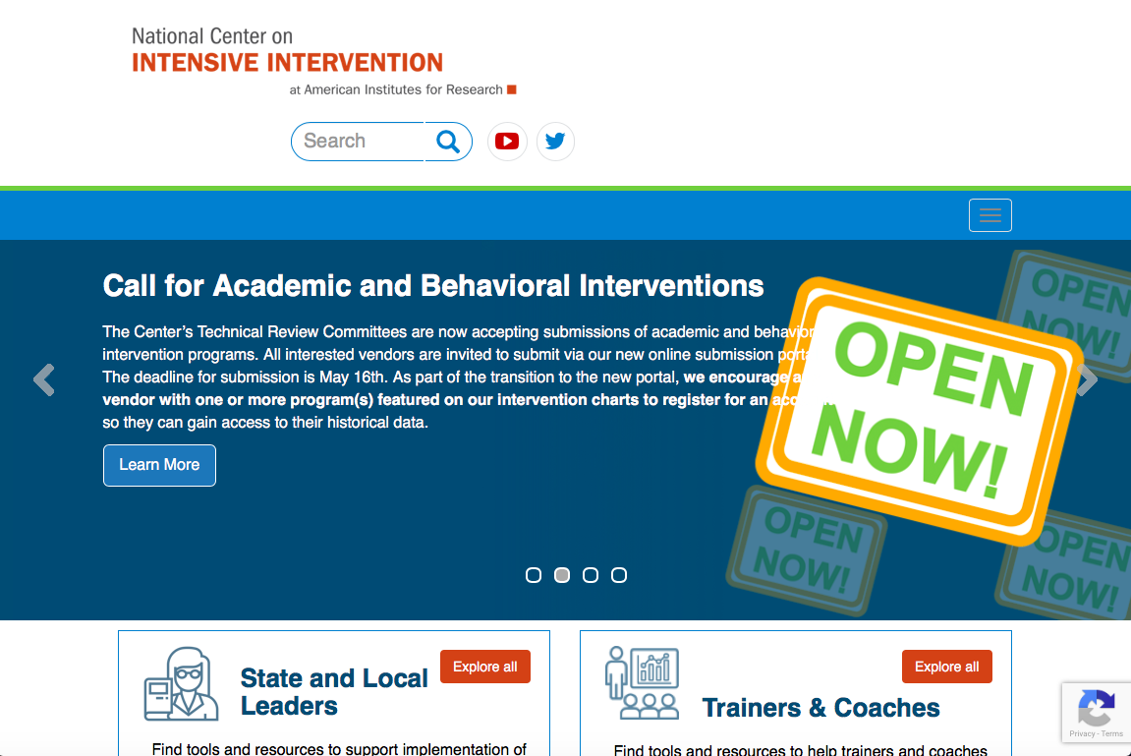
National Center on
Intensive Intervention
NCII’s mission is to build district and school capacity to support implementation of data-based individualization in reading, mathematics, and behavior for students with severe and persistent learning and behavioral needs.

Slide 14

NCII’s Approach
Data-Based Individualization (DBI) is a systematic method for using data to determine when and how to provide more intensive intervention.
Origins in data-based program modification/experimental teaching were first developed at the University of Minnesota (Deno & Mirkin, 1977).
It is a process not a single intervention program or strategy.
It is not a one-time fix but an ongoing process comprising intervention and assessment adjusted over time.

Slide 15
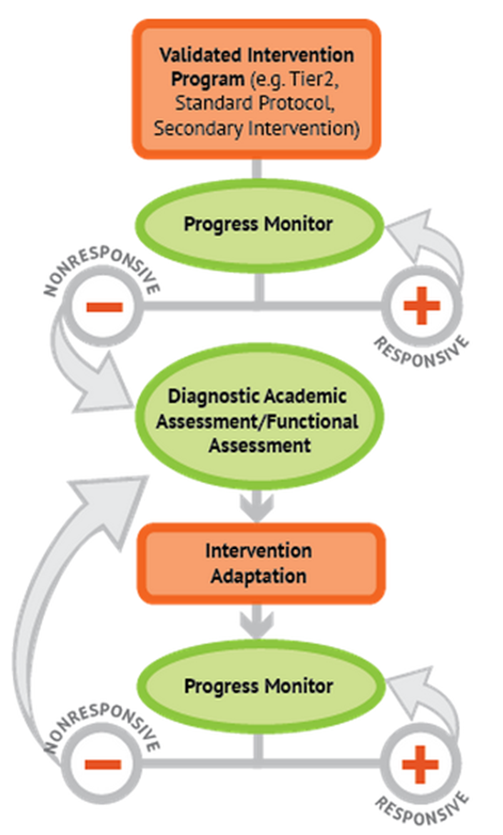
NCII’s Approach
DBI: Integrating data-based decision making across academics and social behavior

Slide 16
Five DBI Steps
Secondary intervention program, delivered with greater intensity
Progress monitoring
Informal diagnostic assessment
Adaptation
Continued progress monitoring, with adaptations occurring whenever needed to ensure adequate progress
Notes:
Throughout the DBI process, we use progress monitoring data to evaluate a student’s response to intervention, moving to the next component as needed:
Secondary intervention program, delivered with greater intensity. We usually begin by intensifying the secondary intervention already being used.
Progress monitoring data are used to evaluate the student’s response to the intensified intervention. If the student is still not showing enough progress, we collect and review additional data to determine specific skill deficits.
Informal diagnostic assessment data are used to identify skill deficits, which tell us how the intervention needs to be changed.
Adaptation. Based on data, we may choose to adapt the current intervention or try a new intervention.
Continued progress monitoring, with adaptations occurring whenever needed to ensure adequate progress.

Slide 17
Key Elements
Staff commitment
Student plans
Student meetings
Valid and reliable data
Inclusion of students with disabilities

Slide 18
DBI Steps: Start With Secondary Intervention

Slide 19
Before We Begin DBI
Start with a standardized secondary program.
Progress monitor to evaluate the student’s response to the secondary intervention.
Notes:
In most cases, we want to give students the chance to respond to a secondary intervention appropriate to their needs before we determine that they need intensive, individualized interventions. After we go over the DBI steps, we will talk more about what we mean by secondary interventions.

Slide 20
What Are Secondary Interventions?
Standardized, evidence-based interventions designed for at-risk students
Often referred to as
  Tier 2 or strategic intervention
  Remedial curriculum
Common examples
  Leveled Literacy Intervention (LLI)
  Check-in/Check-out
  Corrective Math
Notes:
Secondary interventions are standardized, evidence-based interventions designed for at-risk students. They are sometimes scripted and involve detailed lesson components and a specific scope and sequence.

Slide 21
Key Questions About the
Secondary Intervention
Has the student been taught using an evidence-based secondary intervention program (if available) that is appropriate for his or her needs?
Has the program been implemented with fidelity?
  Content
  Dosage or schedule
  Group size
Has the program been implemented for a sufficient amount of time to determine response?
Notes:
In most cases, we would not determine that a student requires data-based individualization until we have evidence that she or he is not responding to secondary intervention. Key questions in reviewing this evidence include—
Has the student been taught using an evidence-based secondary intervention program (if available) that is appropriate for his or her needs? The secondary intervention should match the student’s identified needs.
Has the program been implemented with fidelity? Fidelity addresses whether or not the intervention is being delivered as planned.
Content. Are all key components being delivered per instructions?
Dosage or schedule. Has the intervention been delivered as intended in terms of frequency and length of sessions?
Group size. Is the group the size recommended by the intervention developer? You might also want to consider the group composition—do these students have similar needs that match the intervention? Do any students have competing behavior issues?
Has the program been implemented for a sufficient amount of time to determine response? Consider this question in terms of how long the intervention is intended to be implemented and also in terms of having enough data to detect a change in performance.

Slide 22
Thinking About Intervention
Levels or Tiers
 | Primary (T1) | Secondary (T2) | Intensive (T3)
Instruction or Intervention Approach | Comprehensive research-based curriculum | Standardized, targeted small-group instruction | Individualized, based on student data
Group Size | Classwide (with some small-group instruction) | Three to seven students | No more than three students
Monitor Progress | Once per term | At least once per month | Weekly
Population Served | All students | At-risk students | Significant and persistent learning needs
Notes:
When we talk about DBI we are talking about a process applied at the student-level for those who did not respond to Tier 2 instruction. These students often require instruction that is intensified beyond what standards-based programs might provide.
Review table. Highlight the differences between the tiers in terms of:
Increasingly focused/tailored approach
Decreasing group size
Increasing frequency of progress monitoring
Increasing student need

Slide 23

Why Start With a Standardized,
Evidence-based Program?
When properly aligned to students’ needs, they tend to work—teachers do not need to “reinvent the wheel.”
They are efficient—teachers can plan instruction for groups rather than individual students.
Many require only a modest amount of training—often, paraeducators can help with delivery.
These programs are often inexpensive.
Notes:
Read slide.

Slide 24
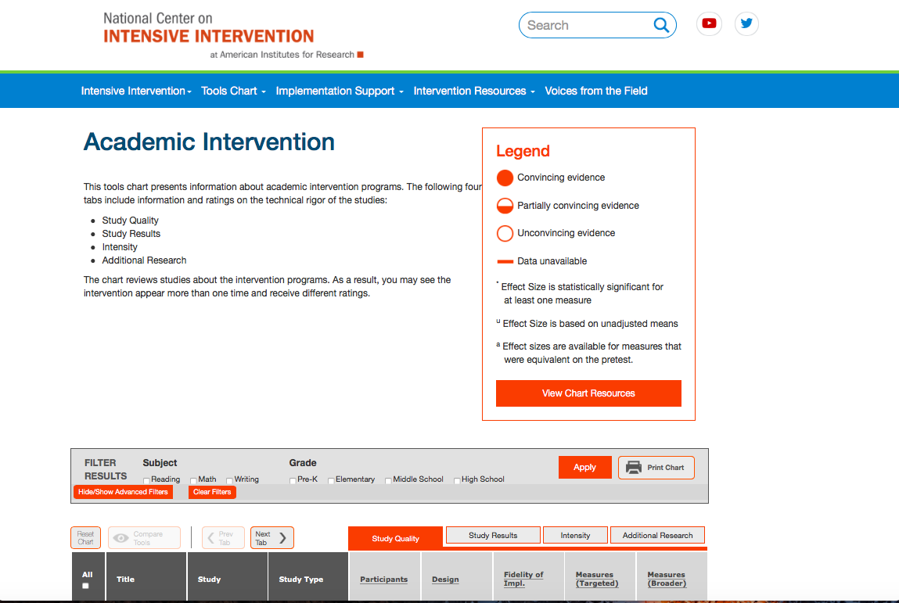
NCII’s Intervention Tools Chart Provides Reviews of Secondary Intervention Programs
Visit: http://www.intensiveintervention.org/resources/tools-charts
Notes:
See the NCII website for training resources for using the tools charts. Tools charts are updated annually, so check the website for changes and new content.

Slide 25
Can I Still Implement DBI If I Do Not Have a Complete Menu of Standardized Programs?
Yes! Use them when available and consider augmenting
current offerings if there are content areas where you have insufficient resources.
Also consider—
  Using remediation materials that came with your core program
  Employing expert recommendations (if evidence-based programs are not available) from Institute of Education Sciences (IES) practice guides, reputable professional organizations, etc.
  Using standards-aligned materials
  Collecting data to determine whether most students are profiting
Notes:
Sources for recommendations include:
What Works Clearing house http://ies.ed.gov/ncee/wwc/, which includes IES practice guides

Slide 26
Bringing It Together:
The Integrated Relationship Between Academics and Behavior

Slide 27


Academic and Behavioral Interventions
More Help
Validated programs are not universally effective programs with 3 to 5% of students need more help (Fuchs et al., 2008; NCII, 2013).
More Practice
Students with intensive needs often require 10–30 times more practice than peers to learn new information (Gersten et al., 2008).
Notes:
Not all students respond to standardized, evidence-based interventions…
Analysis of student response data from controlled studies suggests that approximately 3-5 percent of students or 20 percent of at-risk students do not respond to standard, evidence-based intervention programs (Fuchs et al., 2012; Wanzek & Vaughn, 2009; Conduct Prevention Problems Research Group, 2002).
Despite interventions being generally effective for students demonstrating difficulty
These students may demonstrate BOTH related academic and behavioral needs

Slide 28
Academic and Behavior Intervention
There is likely no single intervention program(s) that will meet the needs of all students, especially those who have significant and persistent academic and/or behavior challenges.
For some students, individualized, intensive intervention will be necessary to facilitate progress.
  Student data and guiding principles for intensifying intervention should drive these decisions.

Slide 29



Students With Disabilities
Low academic achievement
High dropout rates
High arrest rates
Notes:
Students with disabilities typically have lower academic achievement, high drop out rates, and higher rates of incarceration than students without disabilities

Slide 30
Students With Disabilities
The school completion rate for youth with emotional disturbances (56%) is lower than the rate for all other categories, with the exception of youth with multiple disabilities or intellectual disabilities.
More than one-third of students with disabilities who dropout have spent a night in jail.
Dropouts are 10 percent more likely to have been arrested than youth with disabilities who finished high school.
Notes:
Concept Paper: The second National Longitudinal Transition Study (NLTS-2) reported that one of every three students with disabilities has had a disciplinary problem at school (Wagner et al., 2003), one in four dropped out of high school without graduating, and four in five were either unemployed or working in low-paying (minimum wage) jobs as young adults (Wagner et al., 2005).
NLTS-2
NCLD- The State of Learning Disabilities (Cortiella, 2011).

Slide 31
Context
Schools face a set of difficult challenges.
Problem behavior continues to be the primary reason why individuals in our society are excluded from school, community, and work.
Schoolwide behavioral systems often provide a culture within which both social and academic success is more likely.
Notes:
Schools face a set of difficult challenges: Including high-stakes accountability, providing safe learning environments, and meeting College & Career Ready Expectations.

Slide 32
Integrated Relationship
  Integrating intensive behavioral intervention into tiered systems is complicated work.
  For students with both academic and behavioral needs, the relationship is most likely connected.
  Students who lack proficiency in academic skills may demonstrate avoidance behaviors as a mechanism to avoid assigned tasks.
Skill deficit
Avoidance behavior
Removal from task

Slide 33
Intensification for Behavior and Academics

Slide 34
Our approach to intensive intervention is Data-Based Individualization
Intensification
Evidence
Notes:
This DBI graphic leverages the work of the National Center on Intensive Intervention, www.intensiveintervention.org
Adapting interventions to make them more intense lies at the heart of the data-based individualization (DBI) process. (Review other elements of the graphic as needed.) The strategies we’ll discuss today provide you with methods for adapting your secondary intervention platforms when you find they are insufficient for specific students. As we’ll also discuss, use of precise progress monitoring data (note lower “Evidence” arrow) to determine the impact of these instructional adaptations is also an essential part of effective intensive intervention. These data provide the evidence base to help teachers/teams determine whether or not the intervention program is effective for the individual student and when changes may be needed.
For a more complete overview of the DBI process, visit: http://www.intensiveintervention.org/resource/introduction-data-based-individualization.
Credit- Center on Intensive Intervention, DBI Document

Slide 35
What Can We Learn From Research About Intensive Intervention?
Monitoring progress is essential to determine impact and intensity required for individual students.
  Progress monitoring allows decisions to be made about how to customizing the intervention for the student
  Example

Slide 36
How Can We Intensify Interventions?
Change dosage or time
Change the learning environment to promote attention and engagement
Combine cognitive processing strategies with academic learning
Modify delivery of instruction
Notes:
Let’s talk about ways to intensify intervention along the following four dimensions. You may notice that the first and second dimensions already occur frequently in your school. These are typically the most common methods of intensification. We’ve called these quantitative changes to instruction in prior modules. Quantitative changes typically refer to changes that increase the amount of instruction a student receives. The third and fourth dimensions are consistent with qualitative changes, or adaptations that change the method or content of instruction/intervention delivered. We’ll spend time discussing each of four dimensions now, but will spend most of the time on dimensions three and four because you may be less familiar with them.
To read more, see: Vaughn, S., Wanzek, J., Murray, C. S., & Roberts, G. (2012). Intensive interventions for students struggling in reading and mathematics: A practice guide. Portsmouth, NH: RMC Research Corporation, Center on Instruction. Retrieved from http://www.centeroninstruction.org/files/Intensive%20Interventions%20for%20Students%20Struggling%20in%20Reading%20%26%20Math.pdf

Slide 37
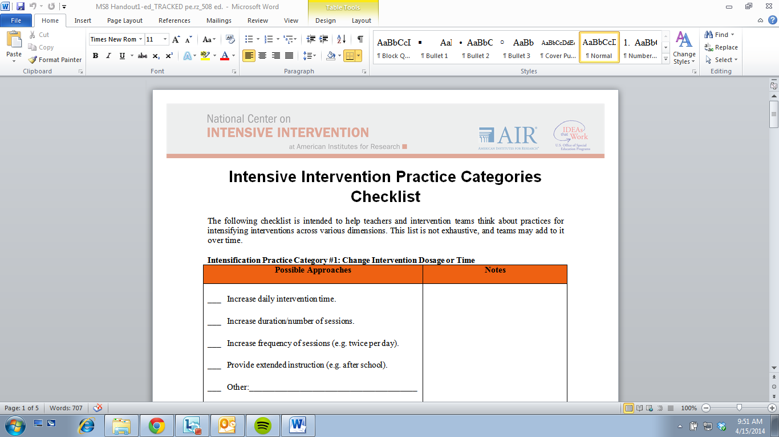
Handout: Intensive Intervention Practice Categories Checklist
Notes:
Today’s conversation will be organized about ways to intensify intervention along the following four dimensions. You may notice that the first and second dimensions already occur frequently in your school. These are typically the most common methods of intensification. We’ve called these quantitative changes to instruction in prior modules. Quantitative changes typically refer to changes that increase the amount of instruction a student receives. The third and fourth dimensions are consistent with qualitative changes, or adaptations that change the method or content of instruction/intervention delivered. We’ll spend time discussing each of four dimensions now, but will spend most of the time on dimensions three and four because you may be less familiar with them.
To read more, see: Vaughn, S., Wanzek, J., Murray, C. S., & Roberts, G. (2012). Intensive interventions for students struggling in reading and mathematics: A practice guide. Portsmouth, NH: RMC Research Corporation, Center on Instruction. Retrieved from http://www.centeroninstruction.org/files/Intensive%20Interventions%20for%20Students%20Struggling%20in%20Reading%20%26%20Math.pdf.

Slide 38
Intervention Adaptation:
Quantitative Changes
Quantitative adaptations
  Increase intervention frequency, length of sessions, or duration.
  Decrease group size.
  Decrease heterogeneity of the intervention group.
Note: In many cases, quantitative changes may be necessary, but not sufficient, to facilitate progress for students with intensive needs.
Notes:
Read slide.

Slide 39
Intervention Adaptation:
Qualitative Changes
Qualitative adaptations alter—
  Instruction based on learner characteristics (e.g., addressing working memory, attention problems, or foundational skills required for target)
  Skill level of interventionist
  Content delivery
  The type or amount of adult feedback and error correction students receive
  Frequency and specificity of checks for retention
  The materials, curriculum, or whole intervention (could be a complete change in program)
Notes:
Read slide.

Slide 40
Intensification Example:
Tier 2 Intervention Academics and Behavior
Behavior
  Jenna checks in each morning with her teacher using check in/check out (CICO).
  They review expectations.
  Jenna receives at the end of each hour on a 3-point scale reflecting her behavior.
  Jenna checks out with her teacher each afternoon.
  Jenna takes her point sheet home to review with her mother and returns signed the next day.
Mathematics
  Jenna receives Tier 2 mathematics intervention using the school curriculum materials (i.e., connecting mathematics concepts, etc.).
  Jenna’s intervention is three times per week for 30 minutes in a group of six students.
  Jenna is progress monitored twice per month to check on her mathematics scores.
Notes:
Jenna is a 5th grader that struggles with mathematics and behavior.

Slide 41
Tier 2 Progress Monitoring:
Jenna’s Data
CICO
Progress monitoring data indicate that Jenna is not meeting her CICO target points and is far below the goal line for her performance on mathematics assessment.
Intervention staff may want to consider intensifying Jenna’s intervention and starting the DBI process.
Note. Graphs are for illustrative purposes only.
Mathematics

Slide 42
Next Steps: Individualized Assessment-Based Intervention
Because Jenna was not responsive to Tier 2 interventions, the intervention team conducted a series of academic and behavioral diagnostic assessments to try and answer WHY she continued to struggle.
These assessment data will drive the intensification strategies and interventions she receives next.

Slide 43
Assessment Results and
Intensification Strategies: Behavior
Behavior
  An FBA indicated Jenna demonstrated frequent behavior in the afternoon.
  Problem behavior occurred during seat work.
  Problems with engagement precede disruptive behaviors.
Intensification Strategies
  Move mathematics intervention to earlier in the day.
  Minimize independent seat work.
  Provide Jenna a “help me” card and prompt its use every
  5 minutes.

Slide 44
Assessment Results and
Intensification Strategies: Academics
Academics
  An error analysis indicated Jenna frequently missed multistep multiplication problems.
  Jenna demonstrated fatigue on lengthy assignments.
Intensification Strategies
  Provide increased feedback on multistep problems.
  Explicitly teach Jenna to self-monitor her work at each step.

Slide 45
Iterative Process: Assessment, Adaptation, Progress Monitor
Jenna’s intervention staff will continue to provide her with the newly, intensified interventions and will progress monitor.
If Jenna does not demonstrate responsiveness to the adaptations, then staff will begin the iterative process of additional assessment, adaptation, and progress monitoring.
Notes:
Now that we have reviewed the steps of the DBI process and discussed how interventions can be adapted and intensified across the tiers, let’s look at two sample DBI case studies on behavior and academics and behavior.

Slide 46
DBI Case Studies:
Integrating Academics and Behavior for Students With Intensive Needs

Slide 47
Intensive Intervention: Behavior Case Study

Slide 48
Behavior Case Study: Robert
Robert is a kindergarten student who demonstrates severe and persistent aggressive behavior.
Robert’s behaviors have a negative impact on his school day.
He is removed from class and sent to site administrators for discipline with an office discipline referral (ODR) two or three times per day.

Slide 49
Intervention History: Robert
In October, Robert’s teacher began using a CICO system as a mechanism to provide Robert with some behavioral support in class.
Robert’s CICO was individualized for his particular behaviors and to provide him support and feedback regarding his displays of aggressive behavior.

Slide 50
CICO and DBI
In Robert’s case, the initial CICO processes are part of the secondary intervention at the top of the DBI graphic.
Robert’s teacher will implement CICO and collect progress monitoring data to determine whether Robert responds sufficiently.

Slide 51
CICO Process: Robert
Just before each school day, Robert would meet individually with his teacher to check in.
Together they would review Robert’s goals of reducing aggression for that day (i.e., “Be kind to others”) and his contingent rewards (i.e., sitting by his peers during classroom instruction).

Slide 52
CICO: Robert
Robert’s teacher keeps a CICO card at his desk to keep track of the points Robert earned each day.
Robert earns points when he demonstrates nonaggressive behavior and on days when he is given less than two ODRs.
Robert Checks in with his teacher at the end of each day to track the points he earns.
On days when Robert earns 80 percent or more of his points, he receives a reward (i.e., sitting by his peers).

Slide 53
What Do The Data Tell Us?
CICO

Slide 54
Next Steps
Data indicate that Robert is not sufficiently responding to the CICO intervention alone.
The next steps in the DBI process include:
  Implementation of an intervention adaptation
  Continued progress monitoring

Slide 55
Intervention Adaptation
After initial data collection, Robert’s teacher decided to meet with the intervention team to discuss his progress.
At that time, the team reviewed Robert’s data and made the following adaptations to his intervention:
  Adapt the CICO card for more frequent check ins during the school day, especially during transition times in class.
  Provide explicit feedback on goals and progress with Robert at each check in.
  Change reward from sitting with peers to a highly desired, tangible reward chosen by Robert each day.

Slide 56
What Do the Data Tell Us?
Modified Behavior Chart

Slide 57
Next Steps
Although data indicate Robert reached his goal of 80 percent with increased frequency, he is still exhibiting aggressive behaviors.
The next steps in the DBI process are as follows:
  Conduct functional assessment.
  Continue progress monitoring.

Slide 58
Functional Assessment Results
The FBA results indicated:
  Robert was exhibiting attention-seeking behaviors, primarily from his peers.
  The frequency of Robert’s behaviors increased at the end of an activity or transition to new subject in class.
  Robert seemed to work harder for a tangible reward rather than sitting by his classmates.

Slide 59
FBA-Based Intervention
In addition to the adaptations made to Robert’s CICO intervention, support staff agreed to make the following changes:
  Modify CICO rewards so he earns tangible.
  Provide consistent, regular responses to his misbehaviors to reduce attention.
  Provide high rate of praise, particularly at the end of activities.
  Begin social skills instruction along with in-class prompting.

Slide 60
What Do the Data Tell Us?
CICO
Modified Behavior Chart
Modeling Added

Slide 61
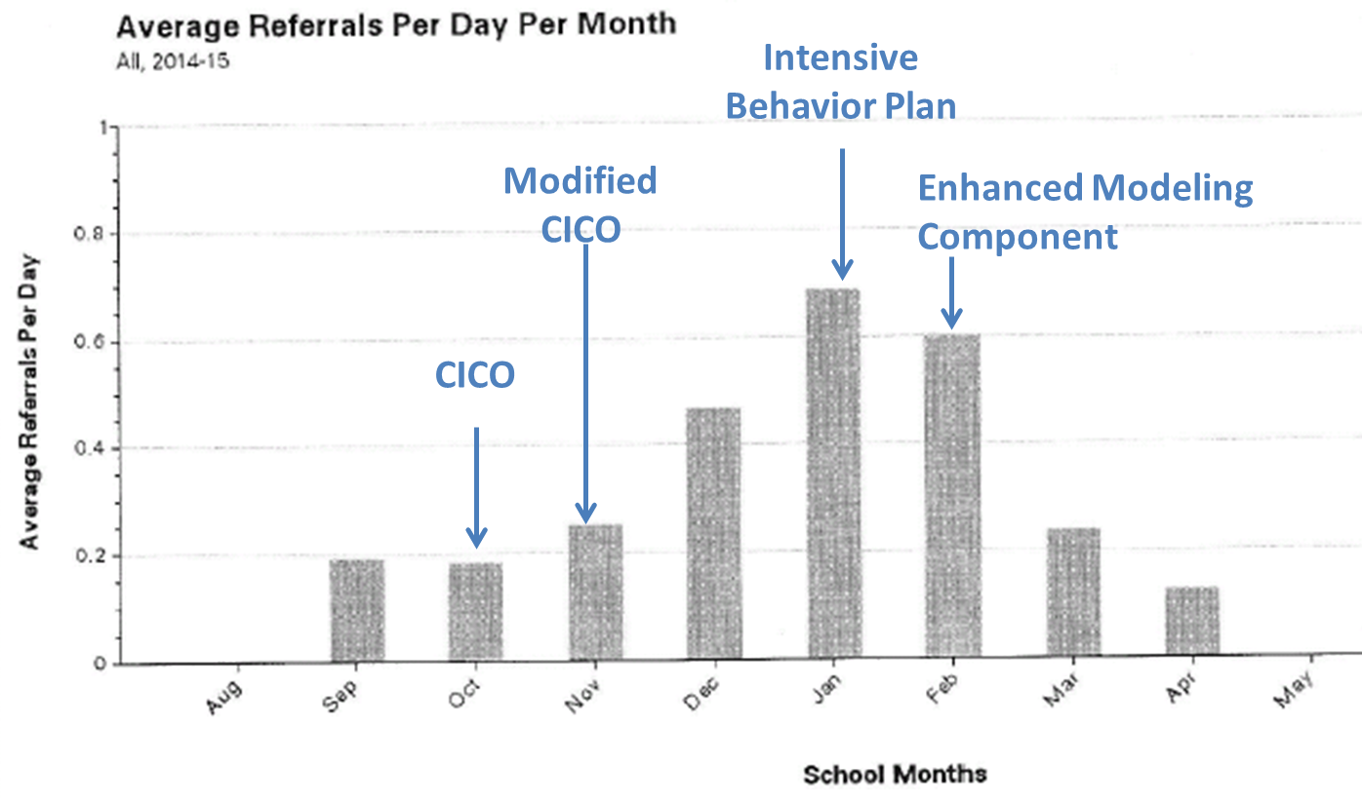
Robert’s ODR Data

Slide 62
DBI
After the intervention adaptations, Robert exhibited a few intense displays of aggression.
At that time, teachers and the school psychologist met with Robert and provided him with some modeling of appropriate behaviors and prevention strategies.

Slide 63
DBI
With the addition of modeling strategies, Robert met his goal of 80 percent with increased frequency.
Data also indicated that ODRs decreased.
Intervention staff continued to progress monitor and implement intervention adaptations with fidelity.

Slide 64
In Summary
DBI is an ongoing process that comprises ongoing assessment, intervention, evaluation, and adjustment to maximize student outcomes.
Intensive interventions will not look the same for all students. They are individualized based on unique needs.
Students requiring intensive intervention are likely to need it for a significant amount of time.
Notes:
Read slide.

Slide 65
Intensive Intervention: Integrating Behavior and Academics

Slide 66
Academics and Behavior: Lindsay
Lindsay is a sixth-grade student with an individualized education program.
Lindsay’s interventions are as follows:
  Corrective Mathematics, 50-minute session five times per week
  Mathematics intervention in small-group setting with three other students
  No current behavioral interventions at this time
Lindsay has recently begun struggling with fluency, performing on timed tests, and consistency on mastery assessments.

Slide 67
Lindsay’s Scores:
Baseline Data FAST Math
Lindsay’s FAST Mathematics benchmarks are shown on this graph.
Progress is monitored weekly.
Goal line is based on fourth-grade scores.
Goal line

Slide 68
DBI for Lindsay
Data indicate Lindsay is at risk of not meeting her academic goals.
Lindsay’s teachers are becoming increasingly concerned with her inconsistency and distractibility.

Slide 69
DBI for Lindsay
The next steps in the DBI process are as follows:
  Diagnostic assessment
  Error analysis to glean further understanding of Lindsay’s mathematical skills
  Implementation of an intervention adaptation
  Continued progress monitoring

Slide 70
Lindsay’s Current Performance
Initial data collection and analysis revealed the following:
  An error analysis revealed that Lindsay was making errors on mathematics concepts she had previously demonstrated mastery with including long division skills.
  Teachers predicted Lindsay was struggling with the increased length and intensity of mathematics assessments in sixth grade.
  Lindsay demonstrated off-task behaviors and high levels of distractibility mainly in the late afternoon and final periods of the day.
  Lindsay also exhibited off-task behavior and high levels of distractibility during unstructured time and when she was not provided with regular, explicit feedback on her performance.

Slide 71
Intervention Adaptation
The intervention team met and made the following decisions about Lindsay’s intervention:
  Break lengthy mathematics assignments and assessments into smaller chunks to avoid issues with stamina and distractibility.
  Move Lindsay into a mathematics intervention period earlier in the school day to help with distractibility.
  Provide increased feedback and opportunities to practice, especially with long division problems.

Slide 72
What Do the Data Tell Us?
Baseline
Academic Adaptation #1
Goal Line

Slide 73
Next Steps
Although data indicate Lindsay approached her goal with increased frequency, she continues to have multiple scores that fall below the
goal line.
Staff are concerned Lindsay continues to exhibit high levels of distractibility, even during morning period of intervention.

Slide 74
Intervention Adaptation: Behavior
Lindsay’s teachers met and decided to make the following adaptations to her current intervention to include a behavioral component:
  Add a self-regulation or behavior monitoring component to the intervention to be tracked by Lindsay.
  Add weekly check-ins with Lindsay and her intervention teacher to assess behavior progress monitoring data.

Slide 75
Intervention Adaptation: Academics
The intervention team decided to continue previous adaptations to address Lindsay’s academic needs.
  Maintaining Lindsay’s intervention period earlier in the school day.
  Continuing to provide Lindsay with modified fluency assessments in small, manageable chunks and increased feedback and practice opportunities.

Slide 76
Lindsay’s Self-Regulation
Lindsay used the following strategies:
  Planning and setting goals for learning
  Self-monitored “I was paying attention” at 5-minute intervals
Notes:
Self-regulation is a learner’s ability to take ownership of his or her learning. (paraphrase or read slide)
Self-regulation comprises:
Planning and setting goals for learning
Monitoring learning and progress toward goals
Regulation of language and memory to support learning (e.g., self-talk, use of strategies)
Attention

Slide 77
What Do the Data Tell Us?
Academic adaptation 1
Baseline
Goal line
Self-regulation tracking

Slide 78
Lindsay’s Case
Lindsay began to show progress after her intervention teachers integrated individualized supports for both her academic and behavioral needs.
Although Lindsay is making progress, she continues to perform below grade level and will need continued observation, intervention, and individualized adaptations.

Slide 79
In Summary
Remember, DBI is an ongoing process that comprises ongoing assessment, intervention, evaluation, and adjustment to maximize student outcomes.
Students with the most severe and persistent needs often demonstrate integrated academic and behavioral difficulties.
Although Lindsay’s scores on her mathematics assessments have begun to increase, staff will want to continually monitor her levels of distractibility and individualize her interventions as needed.
Notes:
Read slide.

Slide 80
NCII Behavior Resources to Support Implementation
Notes:
Dan

Slide 81
Find Out What NCII Has to Offer
www.intensiveintervention.org
Notes:
Briefly summarize some of the resources available through the website and note that we will be focusing on two today in greater depth.

Slide 82
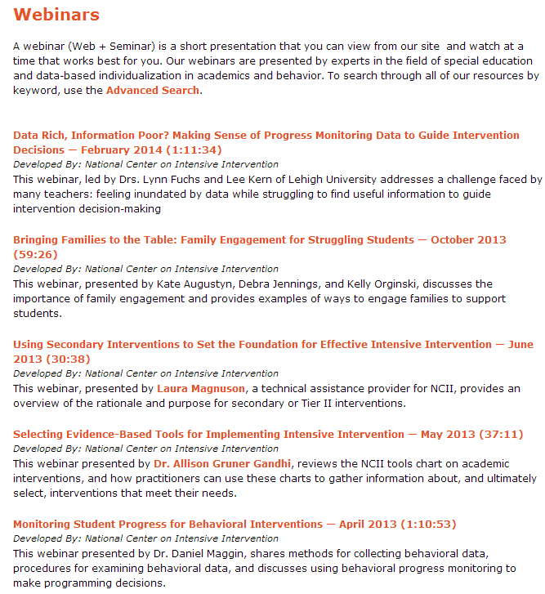
Webinars
View archived webinars and look for
announcements about the next live webinar:
http://www.intensiveintervention.org/resources/
webinars
What Is an Evidence-Based Behavior
Intervention? Choosing and Implementing
Behavior Interventions that Work—
June 2014 (1:16:20)
Monitoring Student Progress for Behavioral
Interventions—April 2013 (1:10:53)
Support Systems for Intense Behaviors: Conducting a School-wide Needs Assessment—February 2013 (52:28)
Providing Intensive Intervention Using Data-Based Individualization in Behavior—January 2013 (54:49)
Notes:
Dan

Slide 83
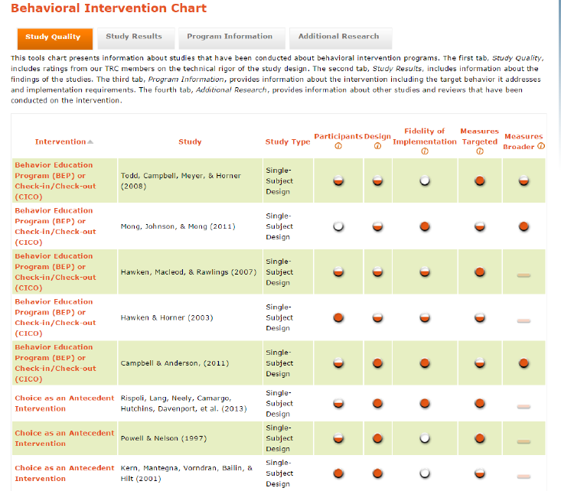
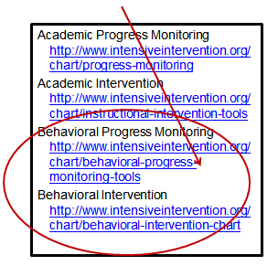
Tools Charts
Audio Tour of Behavioral Progress Monitoring Tools Charts http://www.intensiveintervention.org/video-resource/audio-tour-behavioral-progress-monitoring-tools-charts
Notes:
Dan
For our purposes today, we only want to highlight the two behavior tools charts—Behavioral Progress Monitoring and Behavioral Intervention. NCII also has academic versions of the tools charts.

Slide 84
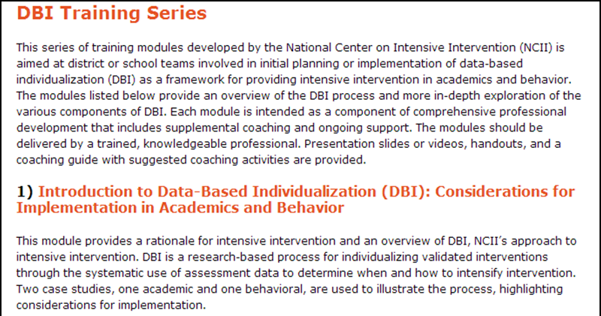
DBI Training Series
Eight training modules focused on components
of DBI for academics and behavior.
One module focused on
readiness and action planning.
The training series includes the
following:
  Slides and speaker notes
  Activities
  Coaching guides
http://www.intensiveintervention.org/content/dbi-training-series
Notes:
Dan
Monitoring Student Progress for Behavioral Interventions (Module 3)
Using Functional Behavior Assessment (FBA) for Diagnostic Assessment in Behavior (Module 6)
Designing and Delivering Intervention for Students with Severe and Persistent Behavior Needs (Module 8)

Slide 85
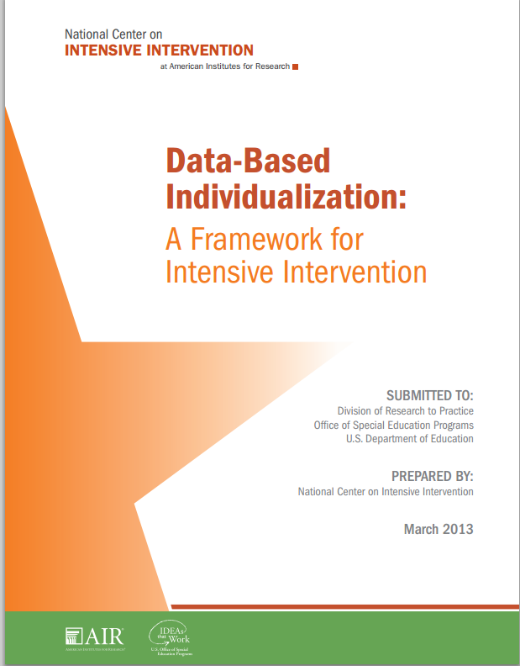
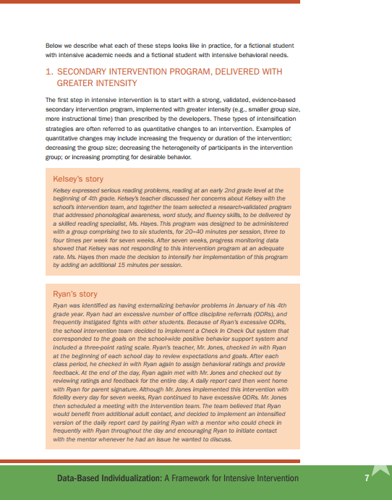
DBI Framework Document
NCII Website Link to the DBI Framework Document
Notes:
This document lays out the Center’s approach to DBI
Includes description of each step in the DBI process
Provides Case Study Examples
Academic
Behavior

Slide 86

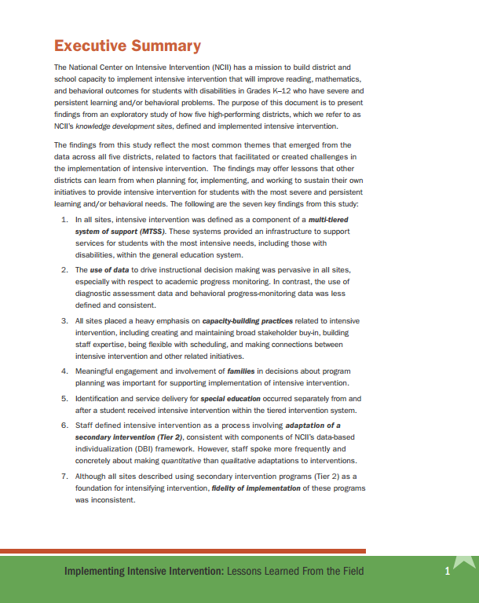
Lessons Learned From the Field
NCII Website Link to Lessons Learned From the Field Document
Notes:
Exploratory study
5 districts selected for high performance
Describes findings and lessons learned
Planning
Implementation
Sustaining

Slide 87
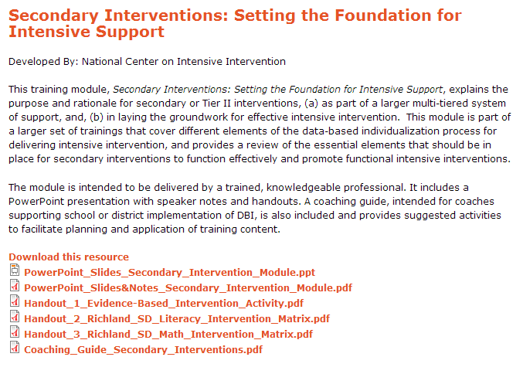
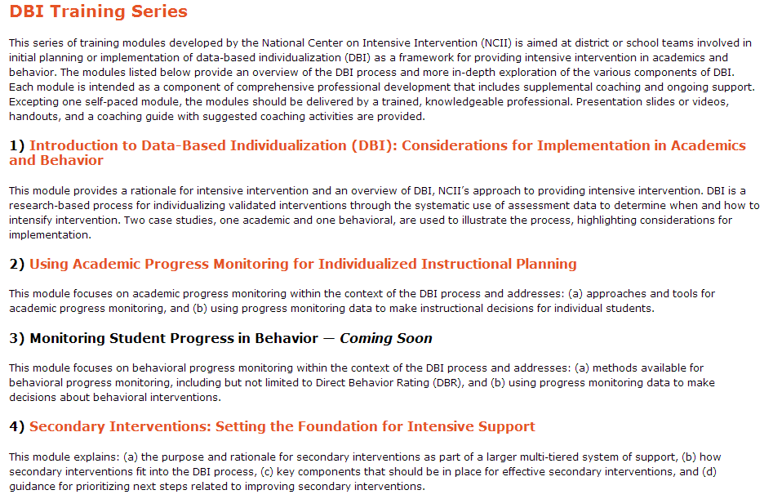
DBI Training Series
NCII Website Link to DBI Training Series
Notes:
Series includes 9 modules.
Each module contains slides with speaker notes
Include parts of training module in courses
Review agenda to see what pieces might work in your classes
Use handouts and coaching guides

Slide 88
Tools Charts
Academic progress monitoring
Academic interventions
Behavior progress monitoring
Behavior interventions (coming soon)
Notes:
Selecting evidence-based programs
Understanding technical rigor
Analyzing data

Slide 89

Connect to NCII
Sign up on our website to receive our newsletter and announcements
Follow us on YouTube and Twitter
  YouTube Channel: National Center on Intensive Intervention
  Twitter handle: @TheNCII

Slide 90
Contact US
National Center on Intensive Intervention
1000 Thomas Jefferson Street NW
Washington, DC 20007-3835
866-577-5787
www.intensiveintervention.org
ncii@air.org
@TheNCII
Notes:
Rod

Slide 91
Disclaimer
This presentation was produced under the U.S. Department of Education, Office of Special Education Programs, Award No. H326Q110005. Celia Rosenquist serves as the project officer.
The views expressed herein do not necessarily represent the positions or polices of the U.S. Department of Education. No official endorsement by the U.S. Department of Education of any product, commodity, service or enterprise mentioned in this website is intended or should be inferred.

Slide 92
References
Chafouleas, S. M. (2011). V2.1 DBR: Use in assessment of student behavior [Slides]. Storrs, CT: University of Connecticut. Retrieved from http://www/directbehaviorratings.com/cms/files/pdf/dbr_for_assessment.pdf
Chafouleas, S. M., Riley-Tillman, C., & Christ, T. J. (2010). V1.3 DBR standard form – fill-in behaviors. Storrs, CT: University of Connecticut. Retrieved from http://www.directbehaviorratings.org/cms/files/pdf/V%201.3%20DBR%20Standard%20Form%20-%20Fill-in%20Behaviors.pdf
Chafouleas, S. M., Riley-Tillman, C., Christ, T. J., & Sugai, G. (2009). V1.4 DBR standard form. Storrs, CT: University of Connecticut. Retrieved from http://www.directbehaviorratings.com/cms/files/pdf/V%201.4%20DBR%20Standard%20Form%20with%203%20Standard%20Behaviors.pdf

Slide 93
References
Cooper, J. O., Heron, T. E., & Heward, W. L. (2007). Applied behavior analysis (2nd ed.). Upper Saddle River, NJ: Pearson.
National Center on Intensive Intervention. (2013a). Data-based individualization: A framework for intensive intervention. Washington, DC: Office of Special Education, U.S. Department of Education. Retrieved from http://www.intensiveintervention.org/resource/data-based-individualization-framework-intensive-intervention
National Center on Intensive Intervention. (2013b). Introduction to data-based individualization (DBI): Considerations for Implementation in academics and behavior. Washington, DC: U.S. Department of Education, Office of Special Education Programs, National Center on Intensive Intervention. Retrieved from http://www.intensiveintervention.org/resource/introduction-data-based-individualization

