Slide 1
20% Meetings a.k.a Group Intervention Review Meetings
Is what WE are doing working?
Data Day
February 9, 2016
Notes:
Intervention Review Process
This presentation will lead participants through the nuts and bolts of meetings to look at the effectiveness of interventions. The presentation will look at ways that staff can work together to reduce curricular chaos for students through wise data based decision making. Decision rules will be discussed and how they help to standardize the intervention process for staff and students alike.

Slide 2
RTI Essential Components
Standards of
Practice
Data-Based Decision Making with Decision Rules
Training Coaching
Fidelity
SLD Decision Making
Progress Monitoring
Interventions
Screening
Core
Leadership
Teaming/Data-Based Decision Making
Professional Learning & Support
Culture

Slide 3
RTI Team Structures
Meetings | Purpose | Students | Data
100% Meetings | Review effectiveness of tiered systems of support and make adjustments Fall/Winter/Spring | ALL | Screening (CBM), Attendance, ODRs, SBAC
Intervention Placement | Place students in interventions matched to area of need and intensity | 20% | Progress Monitoring Data, Placement tests
Group Intervention Review Meetings | To make changes for students in interventions | Some students | Progress monitoring (CBM)
Individual Problem Solving Meetings | To further intensify interventions for those in need | Few Students | Progress Monitoring (CBM)
20%
Todays focus

Slide 4
Purpose of these meetings…
Is what WE are doing working?
What will WE do to improve?
Do WE need to make changes?

Slide 5
Purpose for the Session
Review essential components for effective Group Intervention Review,20% meetings
Observe an effective 20% meeting
Practice with data!
Is this a group problem or an individual problem?

Slide 6
What are Group Intervention Review Meetings, 20% Meetings?
Grade level teachers and specialists
Meet every 4-8 weeks to use data
Standardized decision rules to:
determine if interventions are working or need to be modified.
GOAL:
“Is what we are doing working?”

Slide 7
Do your teams problem admire?

Slide 8
Do your teams problem admire?

Slide 9
The Problem Solving Process
How is it working?
1. Problem Identification
What is the problem?
Improved Student Achievement
4. Plan Implementation & Evaluation
2. Problem Analysis
What are we going to do about the problem?
Why is the problem occurring?
3. Plan Development
Notes:
Jon

Slide 10
Logistics: What do you need to do this work?
Standard Reading Protocol with intervention menu
Decision rules
Progress monitoring graphs
Scheduled time, space and team
In curriculum assessments
A Growth mindset!

Slide 11
Logistics: Teaming is hard!!
Having strong and effective teams is the MOST DIFFICULT thing to pull together!
Who meets?
How often?
How do we organize meetings?
When do we meet?
Who completes the paperwork?
How do we communicate decisions?
How do we assess our systems?

Slide 12
Logistics: Who sits at the table?
Literacy Specialist/
Title I
Grade Level Teacher
Grade Level Teacher
Grade Level Teacher
Principal
SPED
Teacher
May also include:
ELL Teacher
School Psych/Counselor
Others?

Slide 13
Logistics: How often and When do we meet?
How often:
Every 6-8 weeks, depending on…
Your decision rules
Your weekly schedule
When:
After school?
Before school?
During school?

Slide 14
Logistics: Sample Meeting Schedule: 6 Week Cycle
Sunday | Monday | Tuesday | Wednesday | Thursday | Friday
Week 1 |  | Kinder |  |  | 1st Grade Data due
Week 2 |  | 1st Grade | Professional Development |  | 2nd Grade Data due
Week 3 |  | 2nd Grade | Staff Meeting |  | 3rd Grade Data due
Week 4 |  | 3rd Grade | PBIS Meeting |  | 4th Grade Data due
Week 5 |  | 4th Grade |  |  | 5th Grade Data due
Week 6 |  | 5th Grade |  |  | Kinder Data due

Slide 15
Logistics: Use an Agenda, Guiding Questions Document
The agenda will:
Guide your team’s decision making
Establish pacing and process
Ensure data-based, equitable decisions are made
Keep the team focused on decision rules
Keep the team focused what we can control
Help to avoid storytelling

Slide 16
20% Meeting Focus
How is it working?
1. Problem Identification
Improved Student Achievement
4. Plan Implementation & Evaluation
2. Problem Analysis
3. Plan Development
Notes:
The group made decisions on where to place students….now we examine those decisions…Was it a group problem or an ind. Problem? Did we decided to do work?

Slide 17
Group Intervention Review process
Use Decision Rules
Group or Individual problem?
1. Problem Identification
What’s the problem
GROUP
INDIVIDUAL
2. Problem Analysis
Why is the problem occurring?
Check ICEL
for GROUP
Start with FIDELITY
Check ICEL
for INDIVIDUAL
3. Plan Development
What are we going to do about the problem?
Make a change for the GROUP
Make a change for the INDIVIDUAL
4. Plan Implementation & Evaluation
How it it working?
Implement for 6-10 weeks
Notes:
YOUR DIT has established or will establish decision rules for tier2-3.

Slide 18
Sample Agenda/Guiding Questions Document

Slide 19
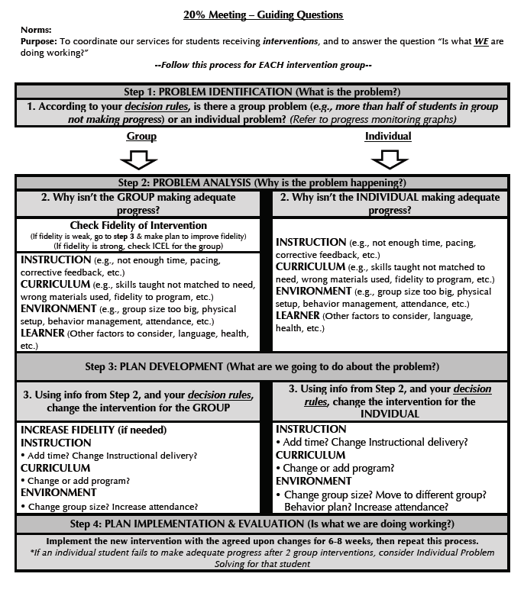
Sample Agenda/Guiding Questions Document

Slide 20
Activity
Locate the two sample agendas/guiding questions documents in your packet. As a team answer these questions…
Has your district decided on an ORTIi approved agenda?
If yes,
has training occurred? Has the agenda been distributed and in use? Can the agenda be found in district RTI Handbook? Has it been distributed?
If no,
Does one agenda or the other agenda fit your needs? What factors do you need to consider in selecting an agenda?
When will initial training occur? What follow up support will be provided?

Slide 21
Data-Based Decision Rules…
…help us decide if what WE are doing is working
Using your progress monitoring data
…create consistency across grade levels and schools
…determine how to intensify interventions
…standardize the process for eligibility decision making

Slide 22
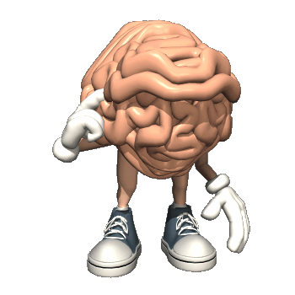
RTI = TIR
TIR = Thinking Is Required
Decision rules should trigger us to stop and think.
Decision rules won’t make the decision for you, but they will tell you when you need to make a decision.

Slide 23
Thinking is Required
Video

Slide 24
Decisions Rules for Group Intervention Review Meetings
When to modify interventions for the group versus the individual student
When to exit individual students from intervention
When to modify interventions for an individual student
When to intensify interventions for individual students

Slide 25
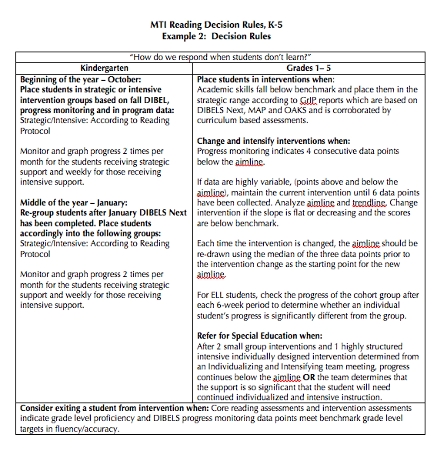
Sample Decision Rules

Slide 26
Team Time
How will you explain to your staff the importance of having decision rules AND following them when making decisions?

Slide 27
EL Considerations: Principal’s can support effective Decision making Processes for ELs
“Begin assessing the instructional program prior to assessing the child.” Spinelli 2008
Include classroom teachers
Support with data management
Support interpreting data
Model instructional practices
Create resources for sharing tier 2-3 interventions across schools
Ensure parents are valued as partners
English Language Learners:
Differentiating Between Language Acquisition and Learning Disabilities 2014

Slide 28
Compare EL students to a peer group based on the 5 L’s
Language (native)
Level of native language proficiency
Level of English language proficiency
Length of time in school
Length of time in country
Not all EL students are the same!

Slide 29
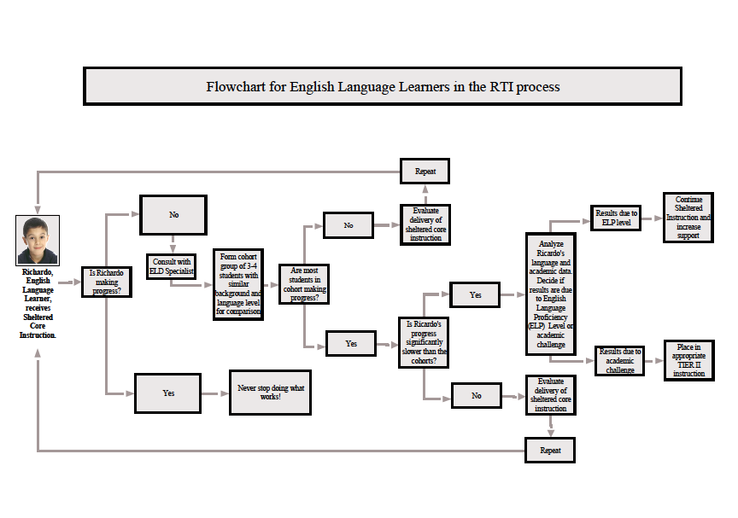
EL Protocol

Slide 30
Logistics: Communication, Tracking Forms are Critical
Who will complete the forms, where will the forms be kept?
What is the communication plan?

Slide 31
Logistics: Notifying Parents

Slide 32
Logistics: Tracking Attendance

Slide 33
“intervention failure should be an exceedingly rare event…”
“Overemphasis of intervention selection and under emphasis of intervention management is probably the most common error we in RTI that we see.
Again, we remind that intervention failure should be an exceedingly rare event. Where it is not a rare event implementation errors are at work.” VanderHeyden and Tilly III 2010
Notes:
It is fascinating how persistent and and intractable this error can be…
People are trained, they have materials etc.

Slide 35
Group Intervention Review process
Use Decision Rules
Group or Individual problem?
1. Problem Identification
What’s the problem
GROUP
INDIVIDUAL
2. Problem Analysis
Why is the problem occurring?
Check ICEL
for GROUP
Start with FIDELITY
Check ICEL
for INDIVIDUAL
3. Plan Development
What are we going to do about the problem?
Make a change for the GROUP
Make a change for the INDIVIDUAL
4. Plan Implementation & Evaluation
How it it working?
Implement for 6-10 weeks
Notes:
YOUR DIT has established or will establish decision rules for tier2-3.

Slide 36
Starting with intervention groups helps to…
Increases your efficiency
Can discuss more kids in less time
Identify a group vs. individual problem
Requires different solutions
Keep the focus on what we are doing

Slide 37
Group Intervention Review process
Group or Individual problem?
1. Problem Identification
What’s the problem

Slide 38
20% Meeting Agenda/Guiding Questions Document

Slide 39
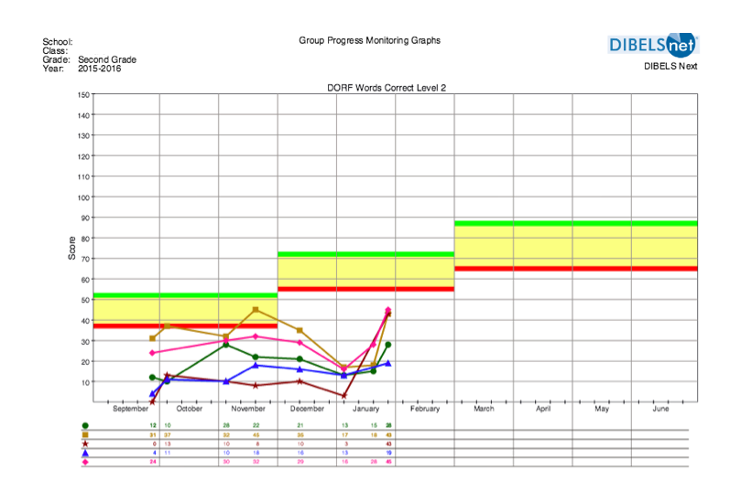
Group or Individual Problem?

Slide 40
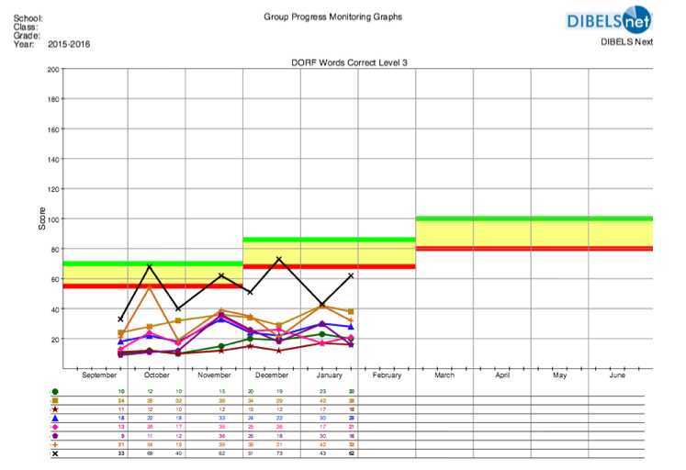
Group or Individual Problem?

Slide 41
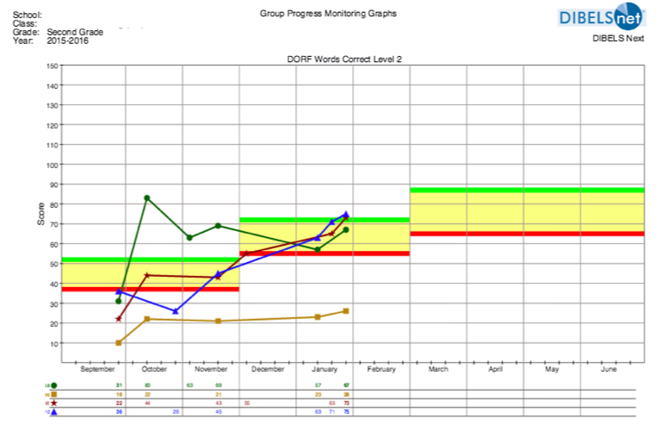
Group or Individual Problem?

Slide 42
Group or Individual Problem?
Notes:
Sometimes you may have to lay the PM graphs nxt each other to determine if it I sa group or individual problem

Slide 43
Practice Time
Group or Individual Problem?
Examine your own group data and decision rules
Determine if it is a group or individual problem.

Slide 44
Group Intervention Review process
Use Decision Rules
Group or Individual problem?
1. Problem Identification
What’s the problem
GROUP
INDIVIDUAL
2. Problem Analysis
Why is the problem occurring?
Check ICEL
for group
Start with FIDELITY
3. Plan Development
What are we going to do about the problem?
4. Plan Implementation & Evaluation
How it it working?

Slide 45
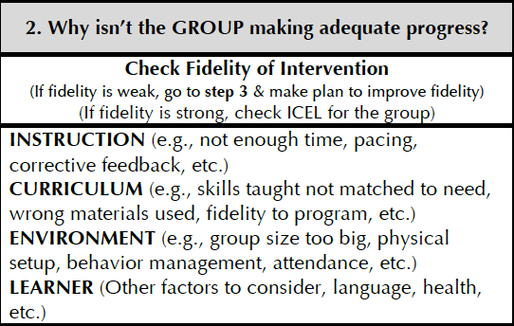
Why isn’t the group making progress?
FIDELITY

Slide 46
What Is Fidelity?
What constitutes an intervention?
Degree to which the evidenced based curriculum is implemented the way it was intended
Fidelity = Consistency and Accuracy
Fidelity = Integrity
Gersten et al., 2005; Mellard & Johnson, 2007; Sanetti & Kratochwill, 2009

Slide 47
Why Is Fidelity Important?
Ensures that instruction has been implemented as intended
Allows us to link student outcomes to instruction
Helps in the determination of intervention effectiveness and instructional decision-making
National Center on Intensive Intervention
(Pierangelo & Giuliani, 2008)

Slide 48
Why isn’t the group making progress when fidelity is in place?

Slide 49
Why might the problem be occurring?
Instruction: | Curriculum:
Environment: | Learner:
How you teach
What you teach
Where you teach
Who you teach
Notes:
Jon

Slide 50
Why might the problem be occurring? The Group
Instruction: | Curriculum:
Environment: | Learner:
Not explicit enough?
Not enough student opportunities to respond?
Not enough instructional time?
Not enough corrective feedback?
Wrong lesson placement?
Wrong focus skill?
FIDELITY
Distracting setting?
Group size too large?
Behavior management needs?
Other things to consider?
Notes:
Jon

Slide 51
Video Study: Examining ICE for the Group…

Slide 52
Group Problem:
size reduced, pre-teach added, feedback examined, core instruction aligned, behavior procedures added

Slide 53
Group Intervention Review process
Use Decision Rules
Group or Individual problem?
1. Problem Identification
What’s the problem
GROUP
INDIVIDUAL
2. Problem Analysis
Why is the problem occurring?
Check ICEL
for GROUP
Start with FIDELITY
3. Plan Development
What are we going to do about the problem?
Make a change for the GROUP
4. Plan Implementation & Evaluation
How it it working?

Slide 54
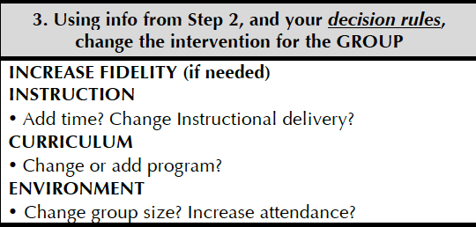
Plan Development

Slide 55
Why might the problem be occurring? The Group
Instruction: | Curriculum:
Environment: | Learner:
Not explicit enough?
Not enough student opportunities to respond?
Not enough instructional time?
Not enough corrective feedback?
Wrong lesson placement?
Wrong focus skill?
FIDELITY
Distracting setting?
Group size too large?
Behavior management needs?
Other things to consider?
Notes:
Jon

Slide 56
Active Engagement Rates
Materials | Accuracy Rate | Opportunities to Respond (OTRs)
New Material | 80% | 4 to 6 per minute
Previously Learned Material | 90% | 8 to 12 per minute

Slide 57
Practice Time
Group in your school
Scenario Group
Review groups in your school
Identify if you have a group problem?
For group problem: Review ICE and identify the needs for the group
Identify possible actions
Group is second grade in PFR
They are on lesson 10 in Dec.
Observations revealed on average 75% of accuracy in group responses
Four students in the group
Staff received initial training
What questions do you have?
What additional information would you want to gather?
Can you come up with a hypothesis?

Slide 58
Document Your Changes

Slide 59
Document Changes

Slide 60
20% Meeting Focus
How is it working?
1. Problem Identification
Improved Student Achievement
4. Plan Implementation & Evaluation
2. Problem Analysis
3. Plan Development
Notes:
Was it a group problem or an ind. Problem? Did we decided to do work?

Slide 61
Individual Students

Slide 62
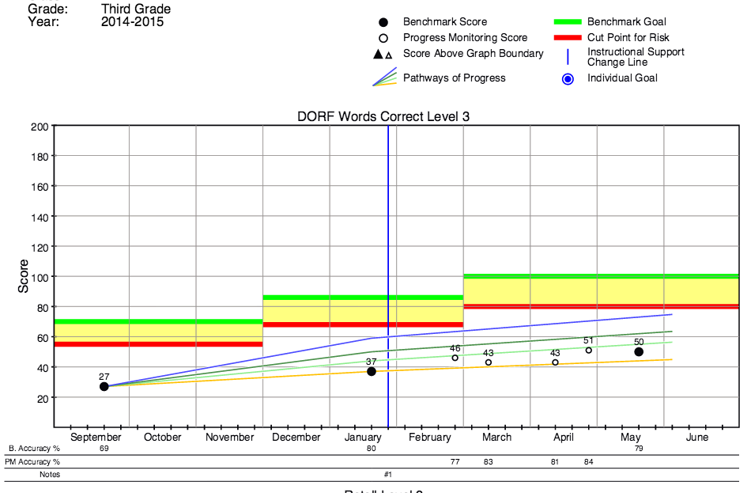
DIBELS Next (Pathways of Progress)
Based on a comparison to other students with similar beginning skills (i.e., other 3rd graders reading around 27 cwpm in the Fall)
Well Above Typical
Above Typical
Typical
Below Typical
Well Below Typical

Slide 63
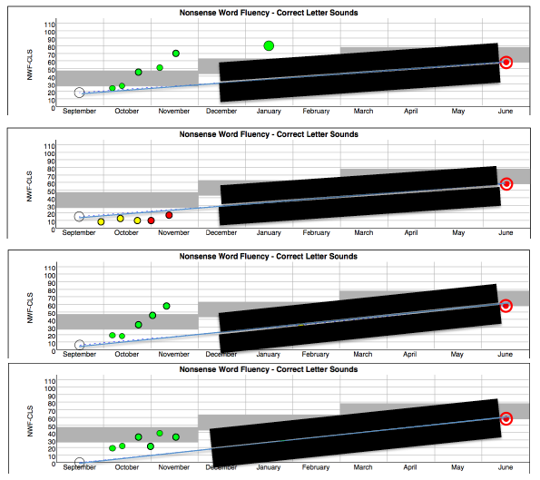
Individual Problem

Slide 64
Practice Time
Using your data or fourth grade scenario data
Identify individual students not making progress

Slide 65
Group Intervention Review process
Use Decision Rules
Group or Individual problem?
1. Problem Identification
What’s the problem
GROUP
INDIVIDUAL
2. Problem Analysis
Why is the problem occurring?
Check ICEL
for GROUP
Start with FIDELITY
Check ICEL
for Individual
3. Plan Development
What are we going to do about the problem?
4. Plan Implementation & Evaluation
How it it working?

Slide 66
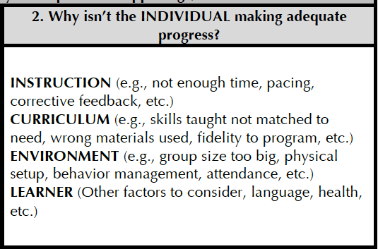
Problem Analysis

Slide 67
Why might the problem be occurring? The Individual
Instruction: | Curriculum:
Environment: | Learner:
Not explicit enough?
Not enough student opportunities to respond?
Not enough instructional time?
Not enough corrective feedback?
Wrong lesson placement?
Wrong focus skill?
Intervention program placement match?
FIDELITY
Other things to consider?
Cultural?
Social, emotional, medical?
Language?
Distracting setting?
Group size too large?
Behavior management needs?
Notes:
Jon

Slide 68
Intervention Matched to Student Need
Reading Comprehension
Reading Comprehension
Vocabulary
Foundational Skills
Oral Reading
Accuracy & Fluency
Phonics
(Alphabetic Principle)
Phonemic Awareness

Slide 69
Additional Diagnostic Assessment
Look to your Assessment Protocol
Assessments to consider
Intervention Placement Test
Phonics Screener
CORE Assessments
DRA
QRI
Informal observations of the intervention
Not needed
for EVERY child

Slide 70
Intervention Matched to Student Need: ELL Considerations
Did they also receive a language intervention?
“Not all currently used interventions in literacy (especially for primary grade students) include adequate attention to these areas [listening & reading comprehension], and thus they may need to be augmented for English learners.”
Institute for Education Sciences, 2004
Is there a high degree of “fluidity” of instruction for ELL’s across the day?
Do we have decision rules for placement and movement of ELL’s in interventions?
Did we follow them?

Slide 71
Group Intervention Review process
Use Decision Rules
Group or Individual problem?
1. Problem Identification
What’s the problem
GROUP
INDIVIDUAL
2. Problem Analysis
Why is the problem occurring?
Check ICEL
for GROUP
Start with FIDELITY
Check ICEL
for INDIVIDUAL
3. Plan Development
What are we going to do about the problem?
Make a change for the GROUP
Make a change for the INDIVIDUAL
4. Plan Implementation & Evaluation
How it it working?

Slide 72
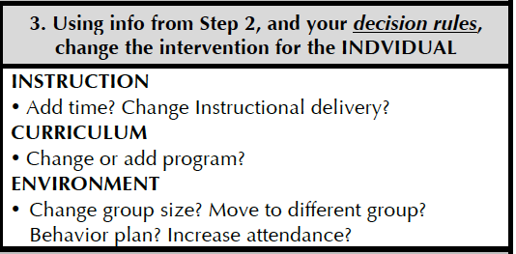
Plan Development

Slide 73
Why might the problem be occurring? The Individual
Instruction: | Curriculum:
Environment: | Learner:
Not explicit enough?
Not enough student opportunities to respond?
Not enough instructional time?
Not enough corrective feedback?
Wrong lesson placement?
Wrong focus skill?
Intervention program placement match?
FIDELITY
Other things to consider?
Cultural?
Social, emotional, medical?
Language?
Distracting setting?
Group size too large?
Behavior management needs?
Notes:
B for d and g example…
EL example good with cohort group

Slide 74
What Can We Change? The Individual
Instruction: | Curriculum:
Environment: | Learner: Language? Culture? Social-emotional? Physical? Other?
Modeling & guided practice?
Opportunities to respond?
Performance feedback?
Other?
Lesson difficulty?
Focus skill match?
Accelerating learning?
Other?
Physical setup?
Classroom management?
Other?
Notes:
Jon

Slide 75
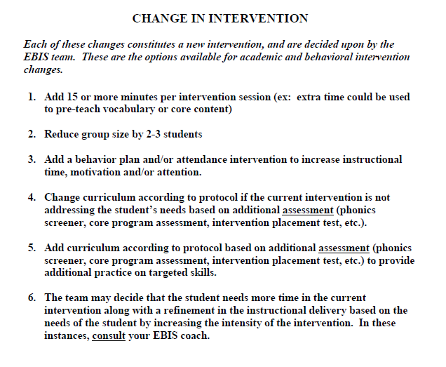
Example from TTSD: What do we change?
INSTRUCTION
ENVIRONMENT
CURRICULUM
INSTRUCTION

Slide 76
A change of intervention does not necessarily mean a change of intervention curriculum.
It means a change in intensity matched to need.

Slide 77
Match the intensity of the change to the intensity of the need
29
24
31
17

Slide 78
Changing the curriculum
If you have placed a student in a research-based intervention that is appropriately matched to their instructional need, delivered with fidelity
AND
They are not making adequate progress…
…, then changing to a different intervention curriculum has a very low likelihood of increasing student success.
Notes:
Are you changing or chasing?

Slide 79
Group Intervention Review process
Use Decision Rules
Group or Individual problem?
1. Problem Identification
What’s the problem
GROUP
INDIVIDUAL
2. Problem Analysis
Why is the problem occurring?
Check ICEL
for GROUP
Start with FIDELITY
Check ICEL
for INDIVIDUAL
3. Plan Development
What are we going to do about the problem?
Make a change for the GROUP
Make a change for the INDIVIDUAL
4. Plan Implementation & Evaluation
How it it working?
Implement for 6-10 weeks

Slide 80
Document Your Changes

Slide 81
Document Changes

Slide 82
Notify Parents
Inform parents of student’s placement & progress in intervention
Call parent
Progress reports

Slide 83
Group Intervention Review process
Use Decision Rules
Group or Individual problem?
1. Problem Identification
What’s the problem
GROUP
INDIVIDUAL
2. Problem Analysis
Why is the problem occurring?
Check ICEL
for GROUP
Start with FIDELITY
Check ICEL
for INDIVIDUAL
3. Plan Development
What are we going to do about the problem?
Make a change for the GROUP
Make a change for the INDIVIDUAL
4. Plan Implementation & Evaluation
How it it working?
Implement for 6-10 weeks

Slide 84
Purpose of these meetings…
Is what WE are doing working?
Is it a group problem or individual problem?
What will WE do to improve?
Do WE need to make changes?

Slide 85
Use your tools for Success!
Decision Rules
20% Meeting Agenda
Team
Tracking forms
Data:
Implementation integrity data
Cohort group data
Individual data
Other data

Slide 86
Practice Time!
Choose:
Facilitator
Note Taker
Reporter
Use:
Sample Agenda and Decision Rules and Change in Intervention
Decide:
Is it a group problem or a individual problem?
Complete Steps 1 and 2 from the Sample Agenda
Record decisions made by the team on paper provided
Time permitting: Report out

