Slide 1
GAP ATTACK!
Hawthorne Attacking The Achievement GAP!
Sweet Home Sch. Dist #55
Terry Augustadt – Hawthorne Principal
Delise Rose – Title 1 Teacher, GAP Director

Slide 2
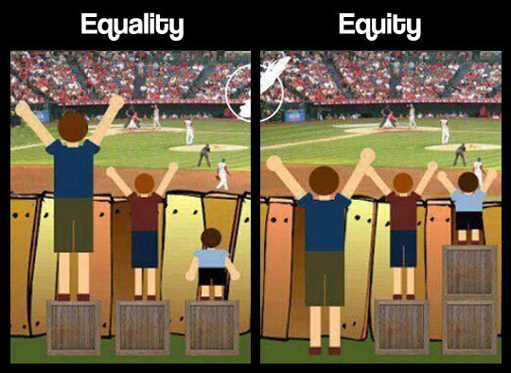
OR RTI Spring Conference Agenda April 28th/29th
We Are Hawthorne …
Excuses have you heard ? ...
The Rule vs Reality …
Our Belief System 2012
Tough Questions Asked
Our Belief System 2016
ODE Evidence Based Strategies
7 Keys to “Attacking” the Achievement GAP!
Keys We Use
Our Data: Then & Now
HW Literacy Program
What works for us ...
Q & A

Slide 3
Hawthorne Elementary Sweet Home, Or. Home of the Hornets
We Are … Hawthorne where ‘It’s About The Kid’s”
Demographics: 2015-16
Enrollment 361 students K-6th
*Selected Demographics:
Economically Disadvantaged *** (+74%)
Students w/ Disabilities 26%
Mobile Students 24.1%
*** indicates that this school offered lunch at no charge to all students
Belief System ... These are OUR kids.
Goals: 1-3 “Bee” the Best at these 3 things
1. Increase Academic Standings (reading scores)
2. Increase Community/Parent Involvement
3. Create Hawthorne PRIDE Campaign

Slide 4
Excuses … have you heard this one? (show of hands)
Our kids are rough & they have generational poverty…
These families don’t care about education …
I taught them, they didn’t get it ...
I don’t have time for changing the way I teach...
I got a really low batch of kids...
I can’t work any harder ...
It’s a tradition I continue my “butterfly” unit...
We have always done it this way...
… you need to go look down the hall and look at that classroom

Slide 5
The Rule vs Reality ... Take a look at the numbers - they don’t lie...
Excuses continued … My CORE isn’t the problem, if you would just take “THOSE” kids to your room and fix them.
“Those” students are Title 1 and/or Special Ed. kids …
Rule vs Reality:
Rule: (80% Green, 15% Yellow, 5% Red)
In 2012 this was Hawthorne’s Reality:
{*30%G, 56%Y, 14%R}
(n=293) [88/165/40]
Our System was broken and THINGS HAD TO CHANGE

Slide 6
Hawthorne Belief (Excuse) System in 2012
We believed in Excuses!
“It’s not my fault, it’s …(insert excuse here); attendance, behaviors, parents, district initiatives, ODE requirements etc etc.
What Tier system? Those low kids are the Title 1/Sped problem.
Benchmark Testing is a Title 1 thing – has nothing to do with me!
What is this data, I don’t even know what this means!
I’m a good teacher – just leave me alone to do my thing.
I’ll take care of my class, just worry about the one down the hall

Slide 7
Tough Questions We Asked & Answers We Discovered
Shift our Thinking: Move from “Blaming to Claiming” In the beginning we looked to blame that “Test” or “Those” kids as the reasons for our low numbers.
“No Blame, No Shame, Move On …”
Take Ownership: Who’s responsible for these kids, this data and our daily teaching practices? What “product” do we want to pass on?
“They Will Value, What We Give Value Too …”
Challenge To Change: We Work too hard for these results ...
Gentle Relentless Pressure

Slide 8
Hawthorne Belief System 2016 “If we only do 1 thing well …” & “If we have only $1 to spend?
We Teach Reading, It’s the foundation of everything we do…
Improved Master Schedule: Protected Core Time
Create our GAP Attack! & “Booster” Lessons
Established “Locker room” created DATA Charts on every student
Visual Branding: Pyramid’s Everywhere …
All KIDS are Mine Mentality:

Slide 9
ODE Evidence-Based Strategies for Closing the Achievement GAP

Slide 11
KEYS we use for Attacking the Achievement GAP! Reference 7 keys of achievement gap by ODE
#1 High Expectations: Laser Focus on yellows and reds … interventions please! Pyramid Charts/Locker room
#3 High Quality Teaching: Pop-Ins and Tap Outs, rolling subs used
#4 Accountability: 100% Meetings/Data Digs 3X per year, Weekly 20% Mtgs w/running notes, (google docs)
#5 Professional Development: Anita Archer / Marsha Tate / EBISS / RTI / RSNW / PBiS Systems
#7 Commitment to Action: RTI Tuesday’s: rotation every 7th week, every grade
If it’s Important, Measure It, Post It and Chart It!

Slide 12
HW Dibels 2012-Current*

Slide 13
HW Dibels 2012-Winter 16’

Slide 14
Hawthorne Literacy Program
Focus on Core Instruction: Benchmark Literacy
Daily 105 minutes of reading
Non-negotiable
No interruptions
prep lessons
bell to bell instruction
protected GAP time
Booster Lessons
Explicit Instruction
Weekly PLC’s
Rotation of RTI
Changed Roll of Title 1 Teacher: to be part time instructional coach part time intervention specialist

Slide 15
Systems We Use They Will Value, What We Give Value Too…
Locker Room Data … CHARTS and more CHARTS
Pop-In’s / TAP-Outs / Rolling Subs / Coaching Moments
GAP Attack – daily reading Minions
Caught-you/Gotch-you “Booster” Lessons
Phonic Screeners / the BIG 5 of reading

Slide 16
“Pyramid” Posted in Staff Room
The Rule: 80% Green, 15% Yellow and 5% Red
Our Current Reality:
Green is 65%
Yellow is 17%
Red is 18%
*through winter term 2016
Green = 216
Yellow = 56
Red = 61
Student Total N=333

Slide 17
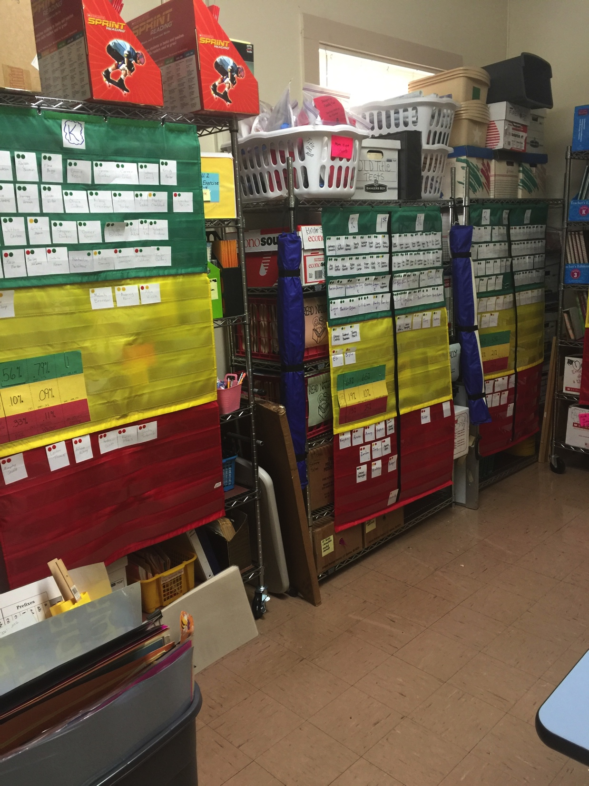
Pyramid Charts in our “Locker-Room” (data room)

Slide 18
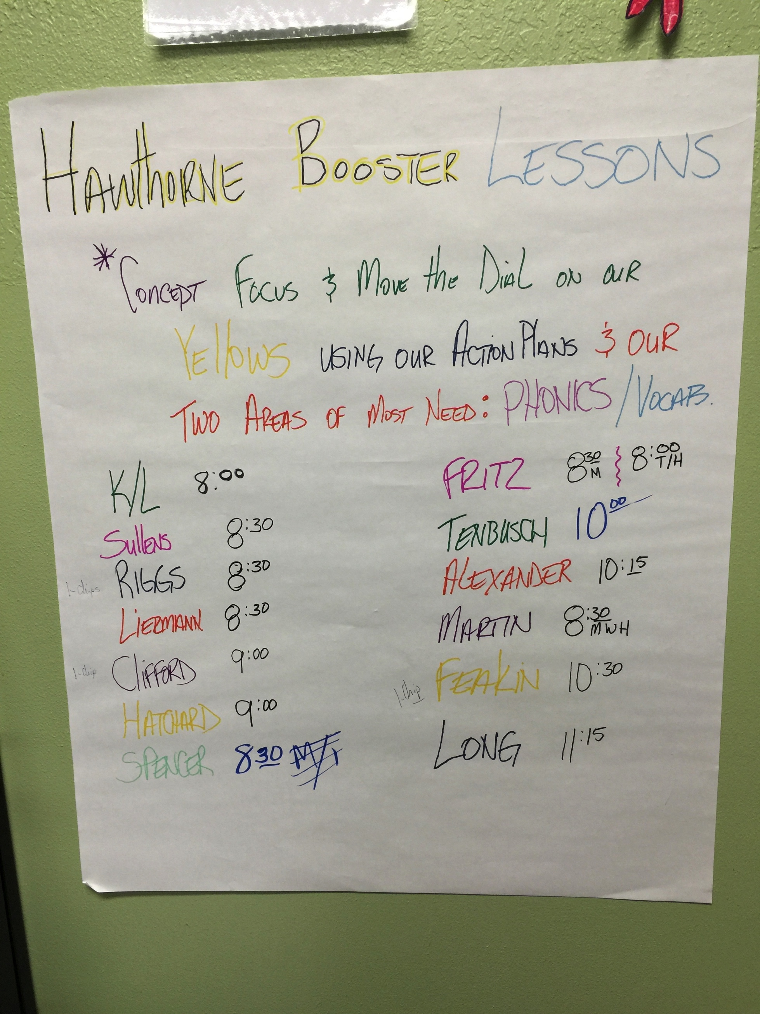
GAP ATTACK … This WORKS for us!
Master Schedule: Rolling “GAPS” w/ Reading Minions
WE VALUE Protected Time: DON’T TOUCH my GAP...
“Booster” Lessons / Gotcha Caughtcha Lessons
Pyramid Branding Everywhere

Slide 19
Hawthorne “Booster” Lessons Catch You Moving The Dial
Teachers “Tell” us when they are doing the Booster Lessons each day …
Teacher/Time/Days:
We Keep Score & Pull Winners
K-3rd: Booster Lessons – Phonics
4th-6th Gr: Booster Lessons – Vocabulary Focused

Slide 21
Q & A

