Slide 1
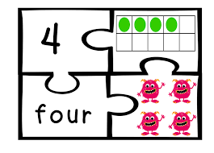
Developing Math Language and Conceptual Understanding through the Math Practices
Jane Osborne
K-12 Math Coach
Hood River County School District

Slide 2
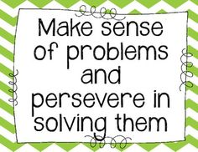
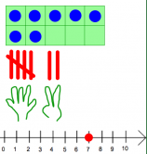
Today’s Agenda...
Math Practices
Strategies for Math Talk
Multiple Representations
Notes:
Learn more about the math practices and how to help students persevere, reason, and model with math.
Participants will learn strategies for eliciting math talk to develop number thinking such as Number Talks, questioning prompts and multiple models.

Slide 3
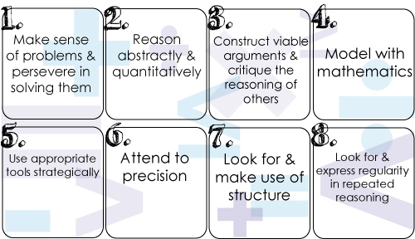
Math Practices
Notes:
Rate familiarilty Five--teach others-------3 get them, just not implemented------fist just heard of them

Slide 4
Math Practices
Content
“Owning the Math Practices”
Process
The what and the how...
Notes:
Video 2 min.
Content standards and process standards

Slide 5
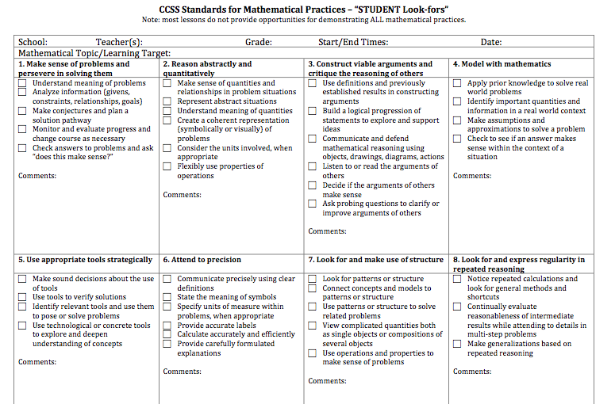
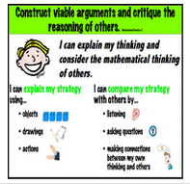
Math Practices
http://www.hoodriver.k12.or.us/Page/7459
Notes:
Video 2 min.
Take to site K-2 Math Practices

Slide 6
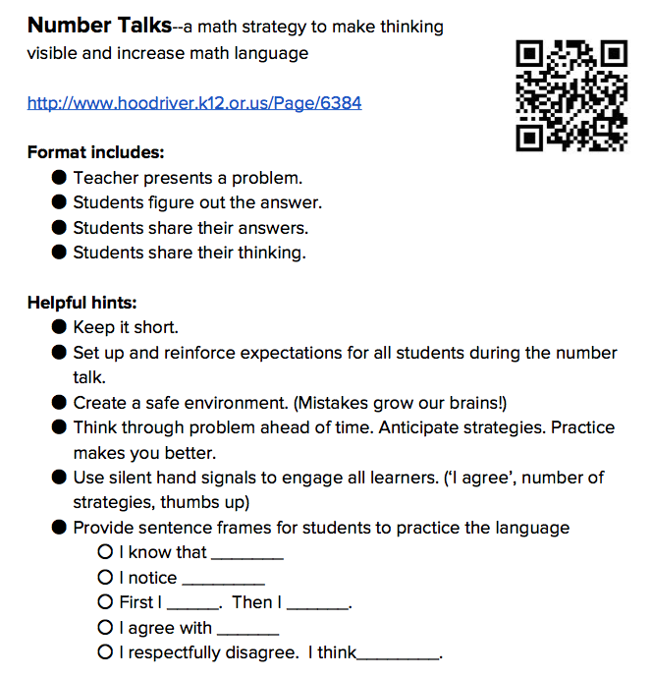
Number Talks
What are they?
Strategy to make thinking visible
Strategy to increase math language
https://www.youtube.com/watch?v=la3_trsAnMs
Notes:
Video 1:26

Slide 7
Number Talks
“Quick Images”
(Kindergarten) (5:50)
https://www.teachingchannel.org/videos/visualizing-number-combinations

Slide 8
What did you notice?
What’s the teacher doing?
What are the students doing?

Slide 9
Number Talks
“First Grade Number Talk”
(8:34)
https://www.youtube.com/watch?v=ssfT0GMM7Oo

Slide 10
What did you notice?
What’s the teacher doing?
What are the students doing?

Slide 11
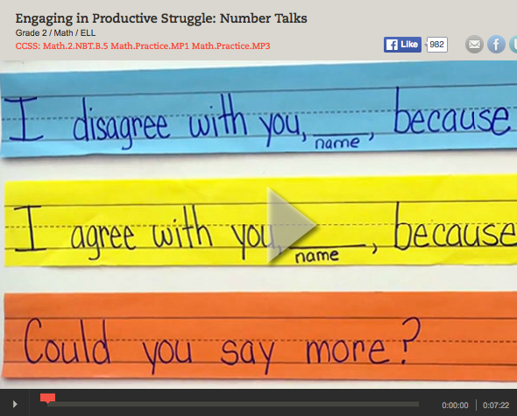
Number Talks
“Engaging in Productive Struggle”
(Grade 2)
(7:22)
https://www.teachingchannel.org/videos/subtraction-math-lesson-ousd

Slide 12
What did you notice?
What’s the teacher doing?
What are the students doing?

Slide 13
Strategies to Elicit Math Talk
Precision Partnering
https://www.teachingchannel.org/videos/third-grade-mental-math

Slide 14
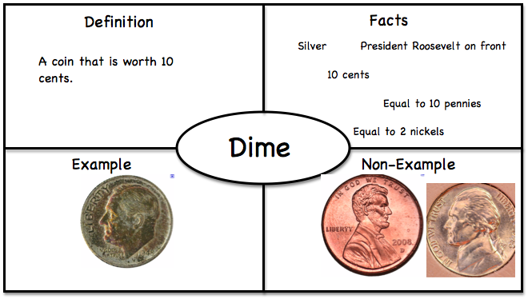
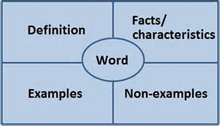
Strategies to Elicit Math Talk
Explicit Vocabulary development

Slide 15
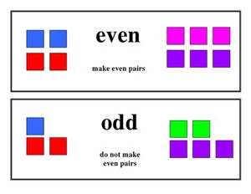
Strategies to Elicit Math Talk
Explicit Vocabulary development

Slide 16
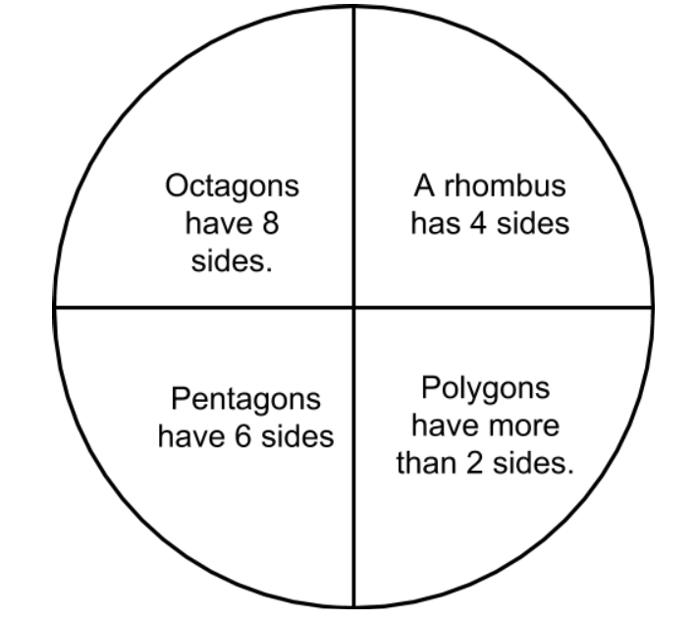
“Three Facts and a Fib”

Slide 17
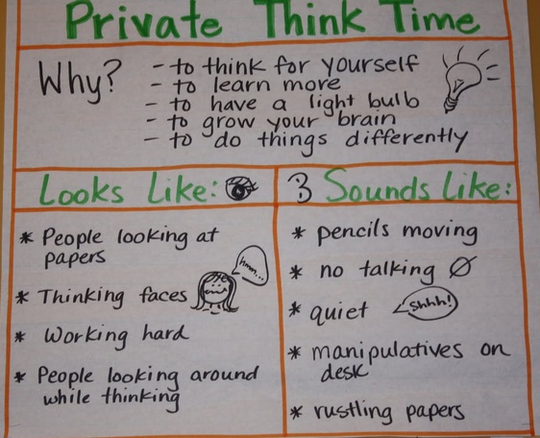
Strategies to Elicit Math Talk
Think, pair, share
https://goo.gl/mEZuJF

Slide 18
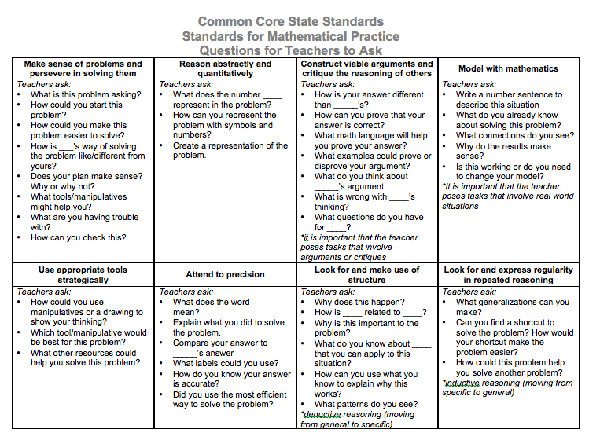
Questioning
Prompts to elicit each Math Practice

Slide 19
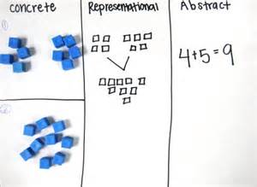
Multiple Representations to Build Understanding

Slide 20
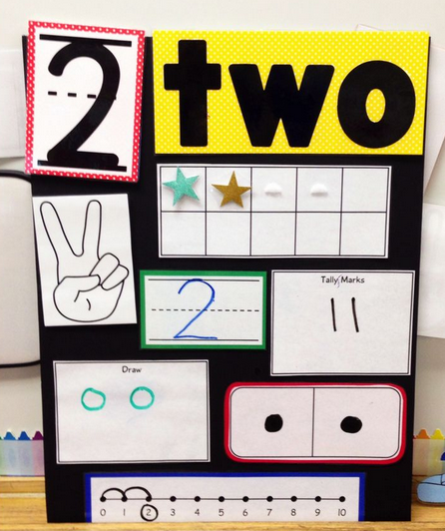
Multiple Representations

Slide 21
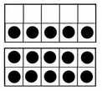
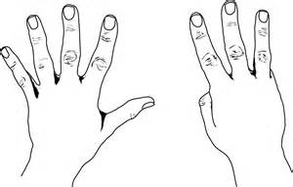
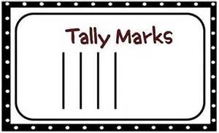
Models
Ten frames
Tallies
Fingers

Slide 22
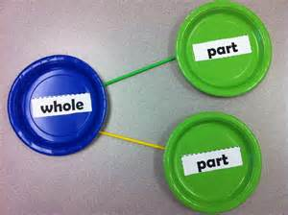
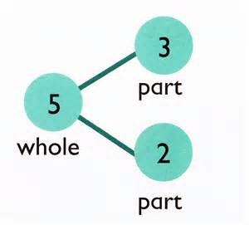
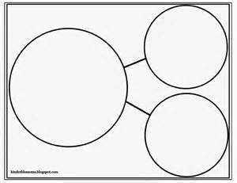
Models
Number bonds

Slide 23
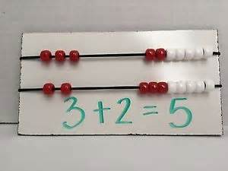
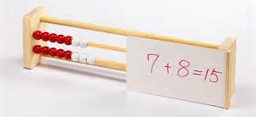
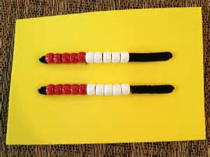
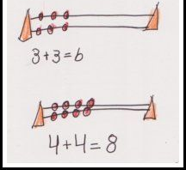
Models
Rekenrek

Slide 24
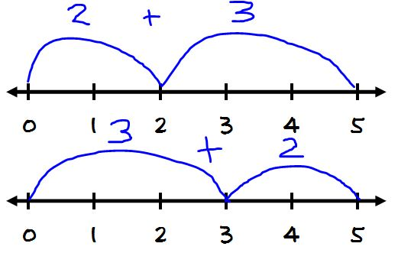
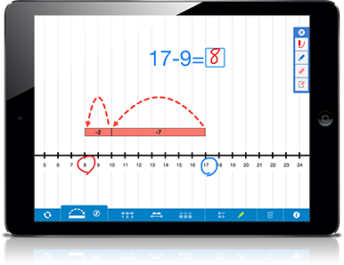
Models
Number Line

Slide 25
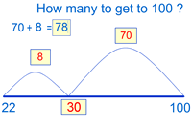
Using a Number Line Model think about:
100 - 22 = ____

Slide 26
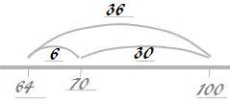
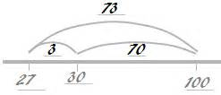
Try these...
100 - 64 = ___
100 - 27 = ___

Slide 27
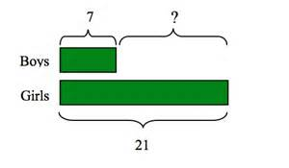
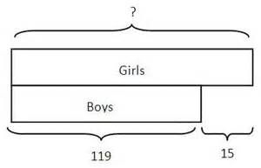
Bar Model or Tape Diagram

Slide 28
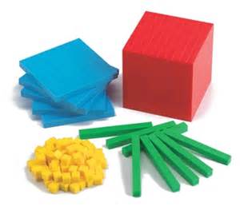
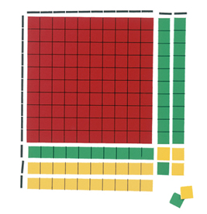
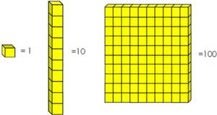
Models
Base ten pieces

Slide 29
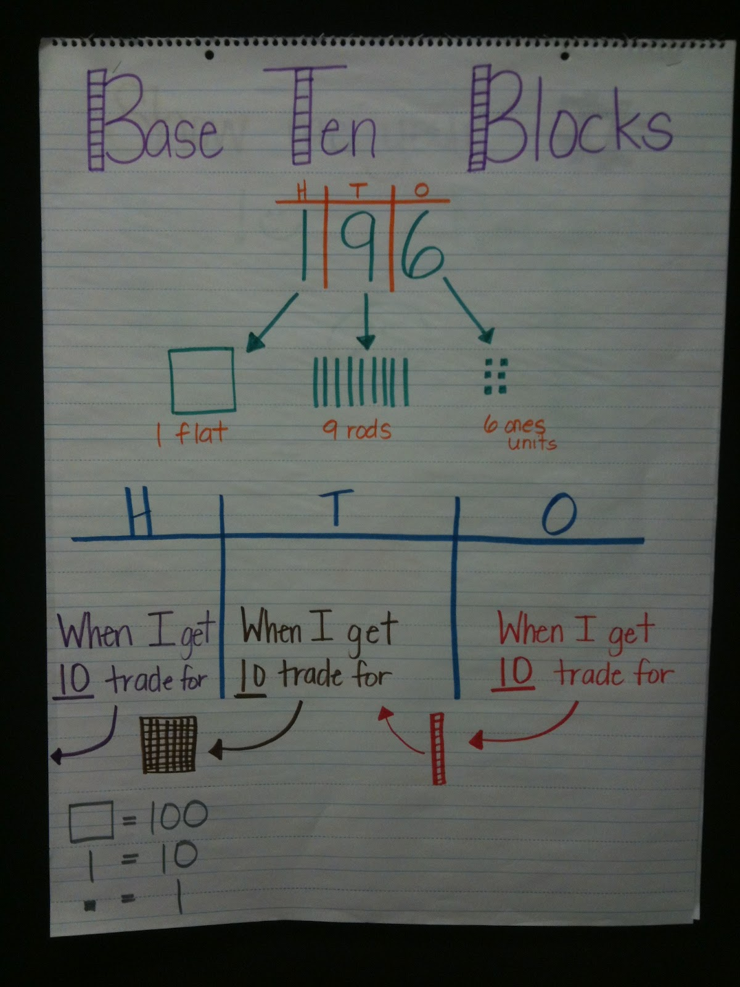
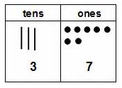
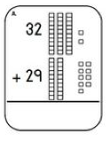
Models
Base ten pieces

Slide 30
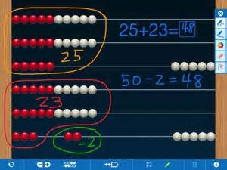
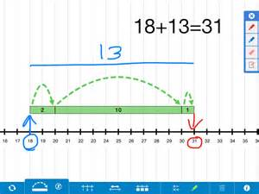
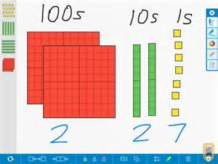
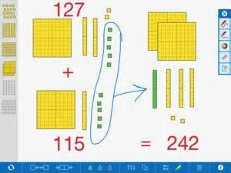
Math Learning Center Apps

Slide 31
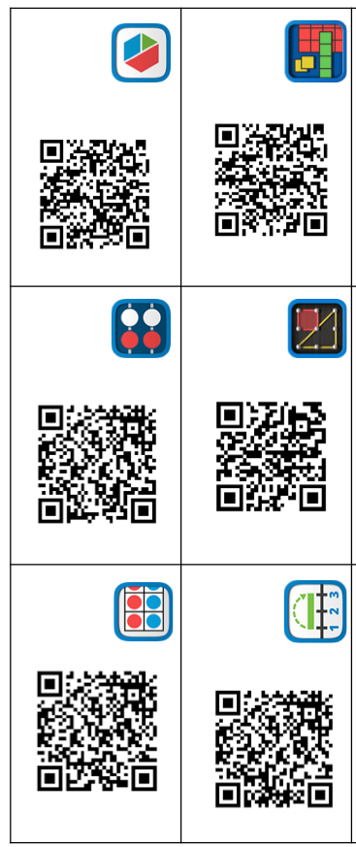
http://catalog.mathlearningcenter.org/apps

Slide 32
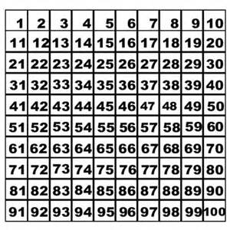
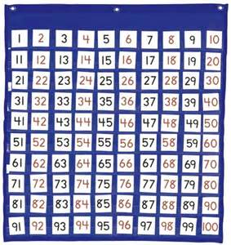
Models
100 chart

Slide 33
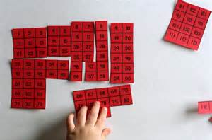
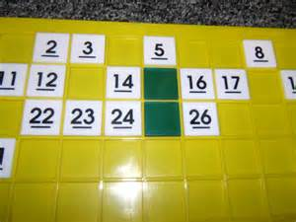
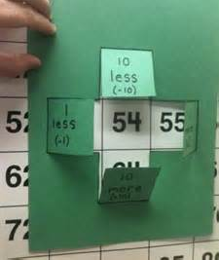
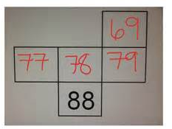
Look for patterns…
Make use of structure...

Slide 34
Let’s Practice…

Slide 35
Math Practices
Notes:
Rate familiarilty Five--teach others-------3 get them, just not implemented------fist just heard of them

Slide 36
Today’s Agenda...
Math Practices
Strategies for Math Talk
Multiple Representations
Notes:
Learn more about the math practices and how to help students persevere, reason, and model with math.
Participants will learn strategies for eliciting math talk to develop number thinking such as Number Talks, questioning prompts and multiple models.

