Slide 1
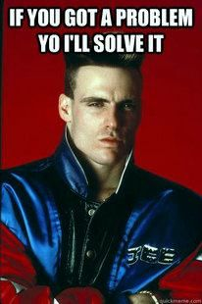
Going Deeper with Individual Problem Solving: Evaluating ICE
Spring Conference
April 2015

Slide 2
Today’s information
Some information will be new
Some information will be review
?
?
Some information may challenge what you currently know

Slide 3
ASSESSMENT
INSTRUCTION
DATA-BASED DECISION MAKING
SPED referral?
Individual Problem Solving Team
6-8 weeks
Formal Diagnostic
As needed
Tier 3 Individualized Intervention
Individual Problem Solving Team
Progress Monitoring
Weekly-Monthly
Tier 2/3 Supplemental Intervention
Tier 2/3 Supplemental Intervention
Intervention Review Team
6-8 weeks
Universal Screening
3 times/year
Research-Based Core Curriculum w/ Strong Instruction
Schoolwide Screening reviewed
3 times/year
Notes:
Parent notified at every red flag

Slide 4
Before Individual Problem Solving, consider…
Has core instruction been purposely addressed? (e.g. 100% meetings, etc.)
Have Tier 2 interventions been delivered with fidelity? How do you know?
Have decision rules been created AND followed?

Slide 5
(Brief) Overview of Individual Problem Solving

Slide 6
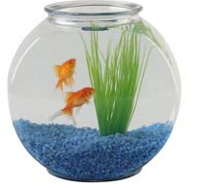
The Water…
Focus on “the water”-
Instruction
Curriculum
Environment
E
I
C
Notes:
THE WATER ANALOGY COMES FROM OUR DEAR FRIENDS IN PASCO COUNTY FLORIDA. AMELIA HAS EMBEDDED IN HER TRAINING THE VISUAL OF CLEAR/HEALTHY WATER THAT ALLOW “FISH” TO GROW… THE BALANCES WITHIN THE WATER MUST REMAIN JUST RIGHT, FOR THE FISH TO HAVE A HEALTHY “ENVIRONMENT”… CHILDREN ARE THE SAME WAY… INSTEAD OR WORRYING ABOUT THE INDIVIDUAL “FISH” , ONE SHOULD FIRST START WITH THE “WATER” TO MAKE SURE IT IS BALANCED AND CONTAINS EVERYTHING IT SHOULD! :) IN MY OPINION, THE IOWA CORE CURRICULUM IS GOING TO HELP US CONCENTRATE ON THE WATER! :)

Slide 7
ICEL
I – Instruction
C – Curriculum
E – Environment
L – Learner

Slide 8
Student Learning
Instruction: | Curriculum:
Environment: | Learner:
How you teach
What you teach
Where you teach
Who you teach

Slide 9
We can control the how, what, and where.
We don’t have much control over the who.

Slide 10
The Problem Solving Process
How is it working?
1. Problem Identification
What is the problem?
Improved Student Achievement
4. Plan Implementation & Evaluation
2. Problem Analysis
What are we going to do about the problem?
Why is the problem occurring?
3. Plan Development
Notes:
Tell your neighbor the 4 steps of the problem solving process

Slide 11
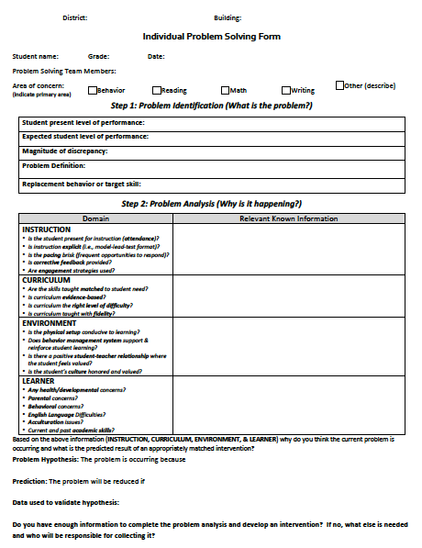
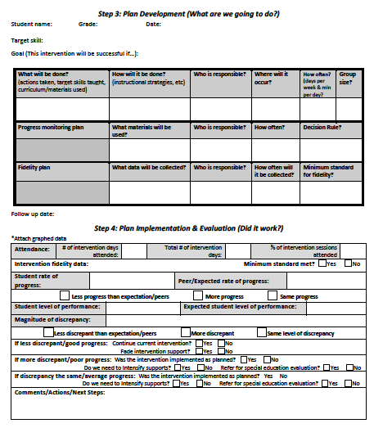
Problem Solving Form

Slide 12
The Problem Solving Process
How is it working?
1. Problem Identification
What is the problem?
Improved Student Achievement
4. Plan Implementation & Evaluation
2. Problem Analysis
What are we going to do about the problem?
Why is the problem occurring?
3. Plan Development

Slide 13
Step 1: Problem Identification
Calculating magnitude of discrepancy
Expected performance
90 WCPM
Difference
-15 WCPM
-45 WCPM
-70 WCPM
75 WCPM
45 WCPM
Current performance
20 WCPM

Slide 14
Step 1: Problem Identification
Calculating magnitude of discrepancy
Expected performance
90 WCPM
% of Expected Performance
83% of expected
50%
of expected
22%
of expected
75 WCPM
75 ÷ 90
45 WCPM
Current performance
45 ÷ 90
20 WCPM
20 ÷ 90

Slide 15
Step 1: Problem Identification
Survey Level Assessment
Expected performance
4th Grade
Difference
1 Instructional level
2 Instructional
levels
3 Instructional levels
3rd Grade
2nd Grade
Current performance
1st Grade
Notes:
Survey Level Assessment

Slide 16
The Problem Solving Process
How is it working?
1. Problem Identification
What is the problem?
Improved Student Achievement
4. Plan Implementation & Evaluation
2. Problem Analysis
What are we going to do about the problem?
Why is the problem occurring?
3. Plan Development

Slide 17
Hypothesis Development
Instruction: | Curriculum:
Environment: | Learner:
?
?
?
?

Slide 18
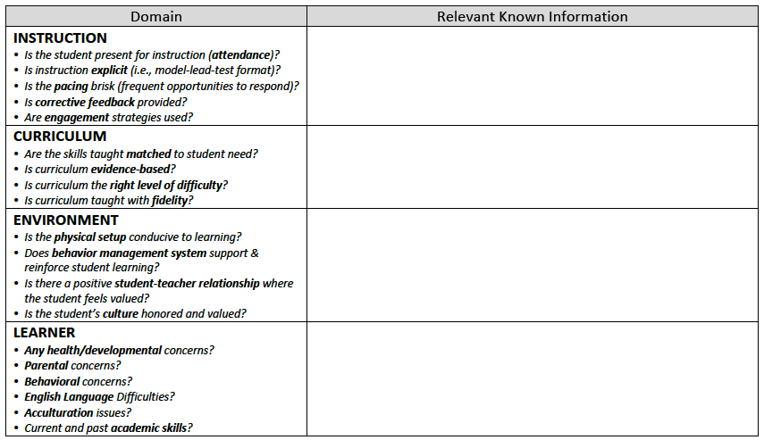
ICEL

Slide 19
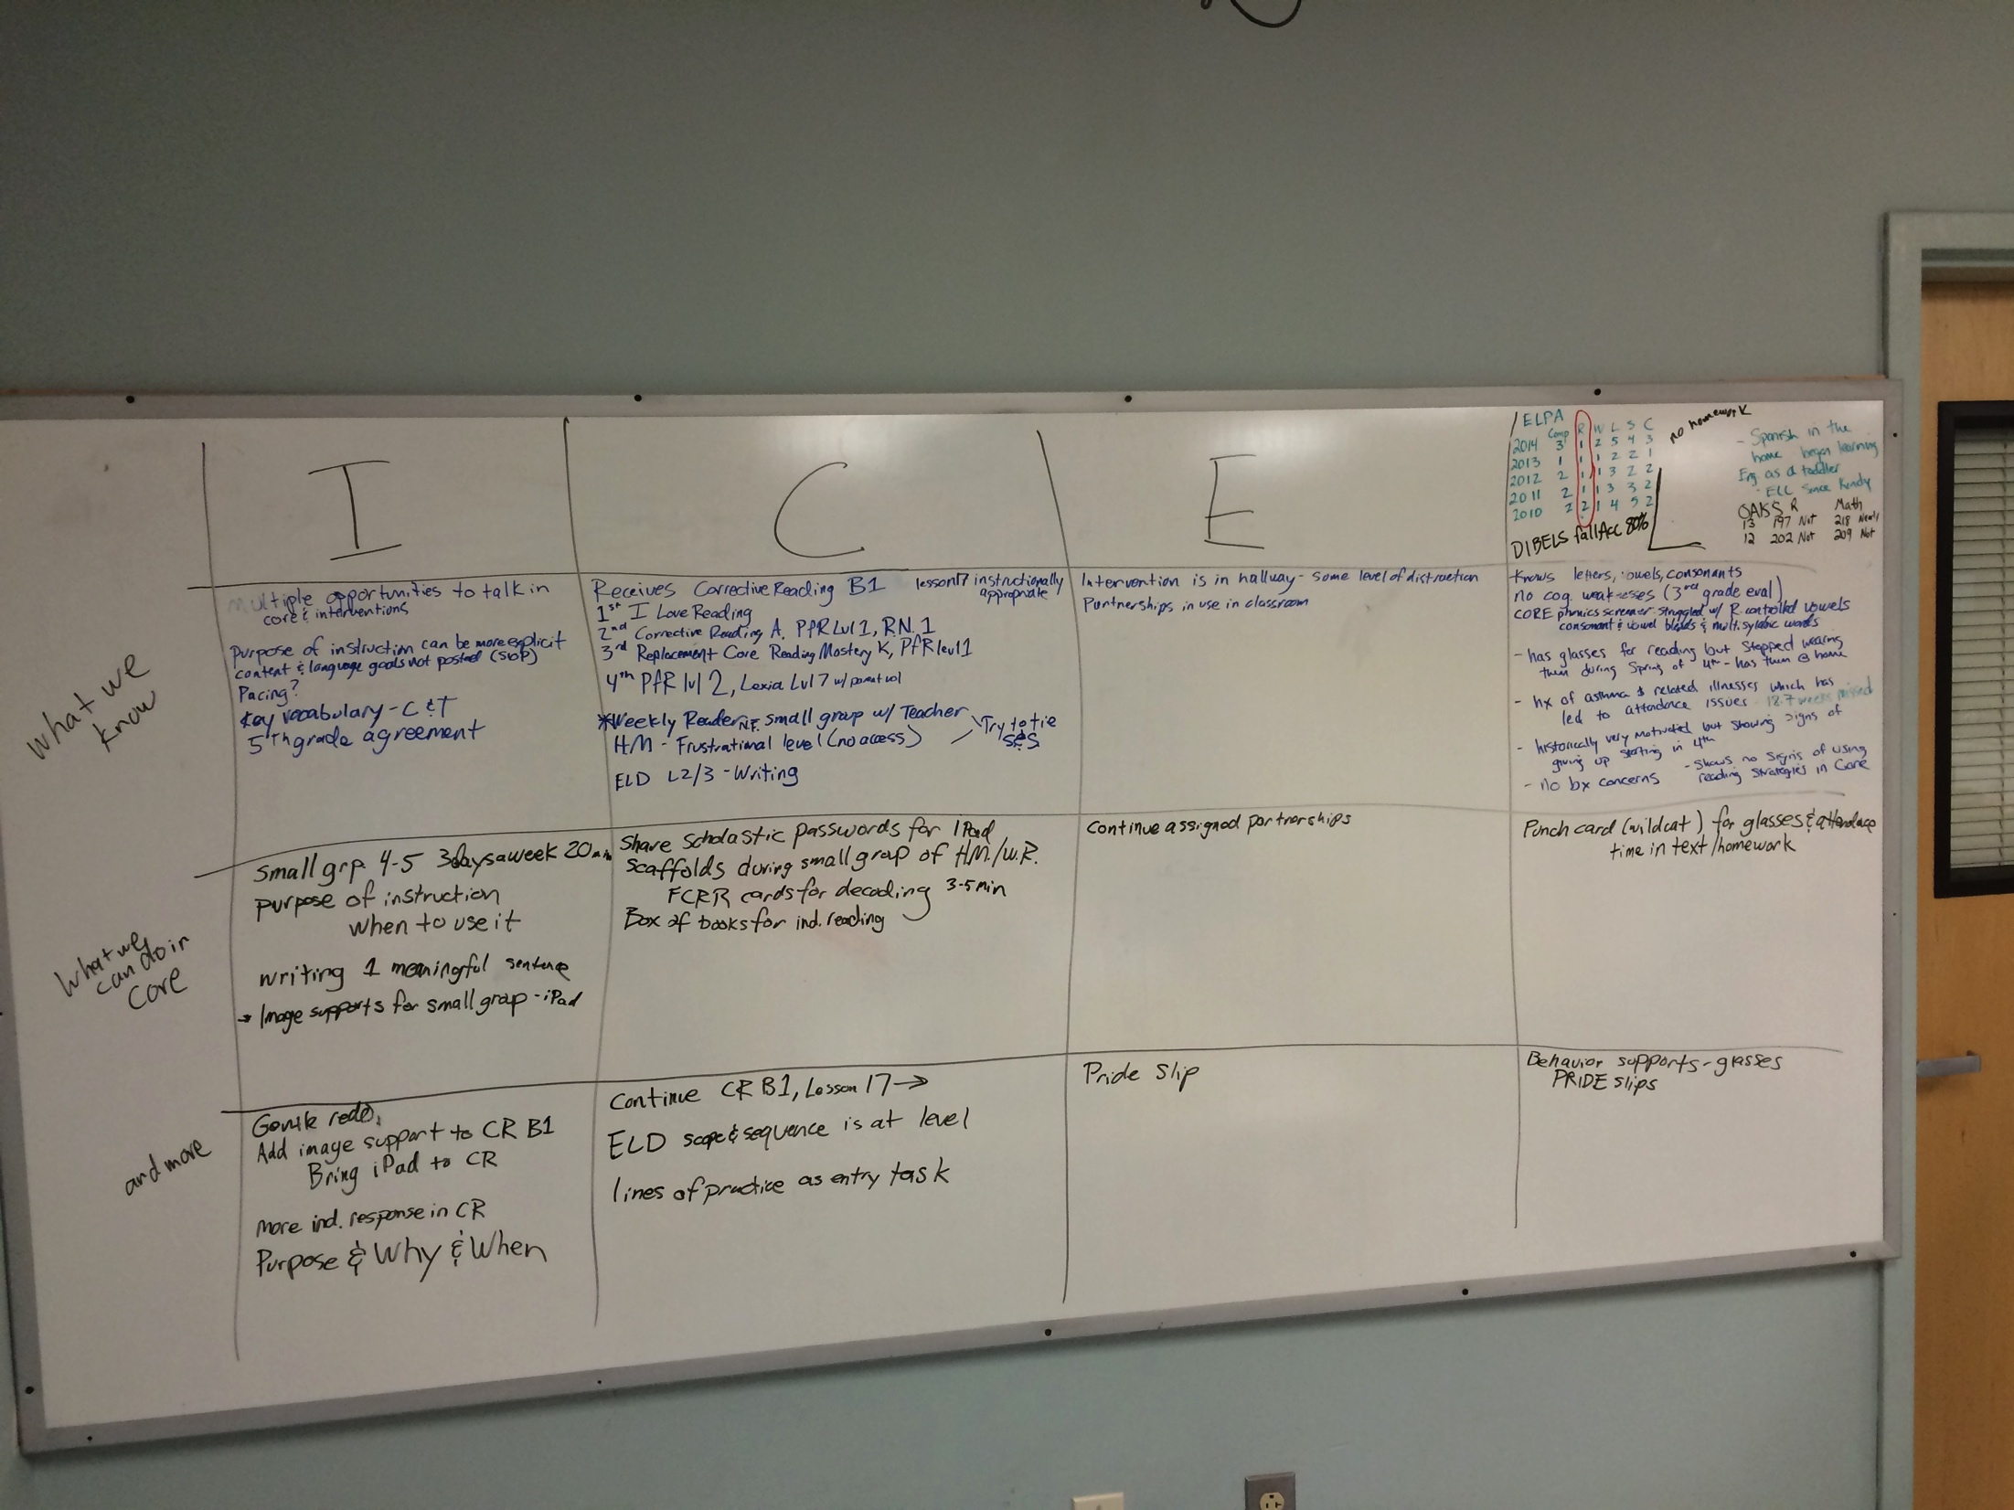
The plan is a group effort
I
C
E
L
What we know
What we can do in core
And more
What we need to know

Slide 20
Collecting Information: RIOT
R
I
O
T
- Review
- Interview
- Observe
- Test

Slide 21
Hypothesis Development
Instruction: | Curriculum:
Environment: | Learner:
RIOT
RIOT
RIOT
RIOT

Slide 22
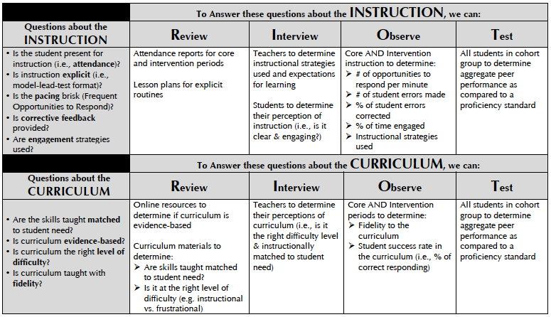
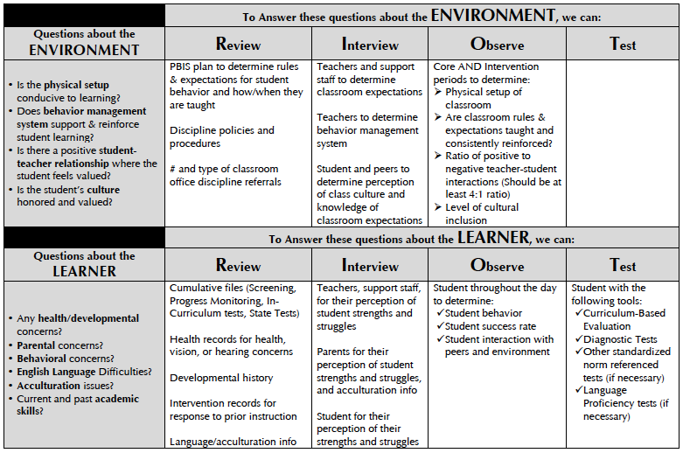

Slide 23
INSTRUCTION
Instruction: | Curriculum:
Environment: | Learner:
?
?
?
?

Slide 24
When it comes to interventions…
“It is clear that the program is less important than how it is delivered, with the most impressive gains associated with more intensity and an explicit, systematic delivery”
Fletcher & colleagues, 2007

Slide 25
Instruction: Examples
Targets for Intervention
Explicitness
Who knows…? |  | I do, we do, y’all do, you do
Pacing
1-2 OTR’s/min |  | 8-12 OTR’s/min
Corrective Feedback
<50% errors corrected |  | 95-100% errors corrected
Notes:
OTR = Opportunity to respond

Slide 26
Evaluating INSTRUCTION
REVIEW
Is attendance consistent?
Is instruction explicit?
Is there a high rate of student opportunities to respond?
Is corrective feedback consistently provided?
OBSERVE
REVIEW
INTERVIEW
OBSERVE
TEST

Slide 27
Evaluating INSTRUCTION
REVIEW
Is attendance consistent?
Students cannot benefit from instruction they do not receive.
How many instructional sessions (core & interventions) have students attended?
Core | 28/30 = 93%
Intervention Sessions | 22/30 = 73%
REVIEW

Slide 28
Evaluating INSTRUCTION
Pacing
1-2 OTR’s/min |  | 8-12 OTR’s/min
Is instruction explicit?
Is there a high rate of student opportunities to respond?
Is corrective feedback consistently provided?
OBSERVE

Slide 29
Evaluating INSTRUCTION
Activity Observed (Total time) | Student Opportunities to Respond | Student Errors | Errors Corrected
Intervention – small group direct instruction 10 minutes | IIII IIII IIII IIII IIII IIII IIII IIII IIII IIII IIII IIII IIII IIII IIII IIII II 82 | IIII IIII IIII IIII III 23 | IIII 4
Notes: Lots of explicit modeling and guided practice. Pacing: 82 OTR’s in 10 minutes = 8.2 OTR’s per minute Corrective Feedback: 4 out of 23 errors corrected = 17% of errors corrected
OBSERVE
Notes:
Make example of 72%

Slide 30
Video Practice
Activity Observed (Total time) | Student Opportunities to Respond | Student Errors | Errors Corrected
Watch the video and record:
Opportunities to Respond – student opportunities to say, do, or write in response to a question
Student Errors
Errors Corrected – The error is corrected relatively immediately (within 3-5 seconds)

Slide 31
Targets for Intervention (INSTRUCTION)
More opportunities to respond in the core
More corrective feedback
Is the student present for instruction (attendance)?
Is the instruction explicit (model-lead-test)?
Is the pacing brisk (Frequent Opportunities to Respond)?
Is corrective feedback provided?
Are engagement strategies used?
Core – 97%
Intervention – 97%
Core – Good
Intervention – Good
Core – @2 per min
Intervention – @8 per min
Intervention – 1 out of 5 errors corrected (20%)
Core & Interventions – High engagement

Slide 32
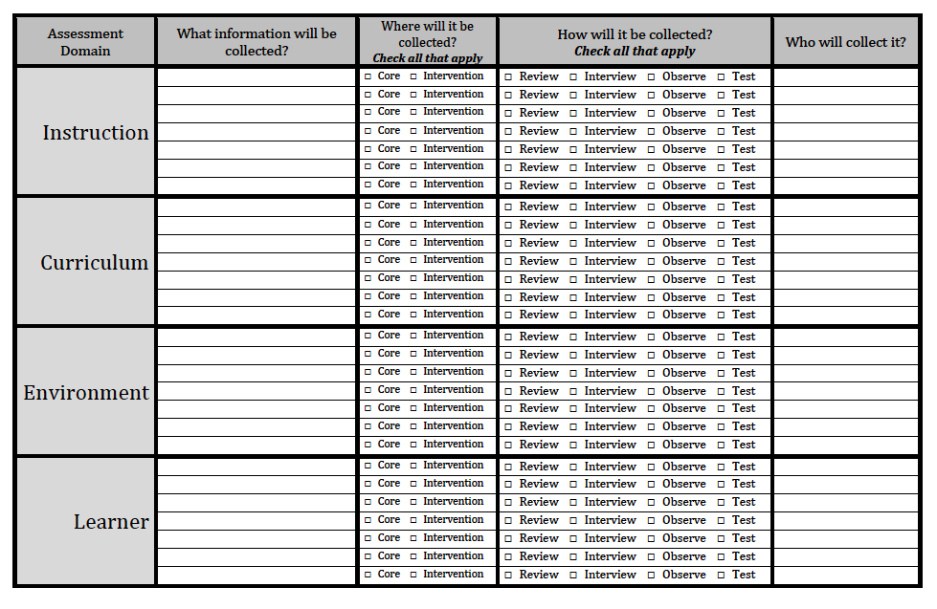
What are you already doing? What do you need to add?
Attendance
Counselor
Pacing, Feedback, Explicitness
Lit Specialist
Pacing, Feedback, Explicitness
Principal (walkthroughs)
???

Slide 33
CURRICULUM
Instruction: | Curriculum:
Environment: | Learner:
?
?
?
?

Slide 34
Curriculum: Examples
Targets for Change
Skills Taught
Not matched to need |  | Matched to need
Level of Difficulty
Frustrational (<80%) |  | Instructional (>80-90%)
Fidelity to the core
Weak (<80%) |  | Strong (>80%)

Slide 35
Evaluating CURRICULUM
Is it matched to the student’s skill need?
Is it at the right difficulty level for the student to learn (accuracy)?
Is it being delivered with fidelity?
REVIEW
REVIEW
INTERVIEW
OBSERVE
TEST

Slide 36
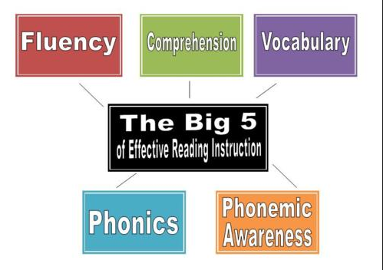
1. Matching data to skill need......
Core instruction/Small group
Curricula
Intervention

Slide 37
Reading Comprehension
Vocabulary &
Language Comprehension
Foundational Skills
Oral Reading
Accuracy & Fluency
Phonics
(Alphabetic Principle)
Phonemic Awareness

Slide 38
Burns and Hall (2013) examined 24 studies of K-8 small-group reading interventions
Intervention Type | Effect Size
Targeted (comprehension, fluency, vocabulary, decoding, phonemic awareness) | .65
Comprehensive | .26
*Anything over .40 could be interpreted as significant

Slide 39
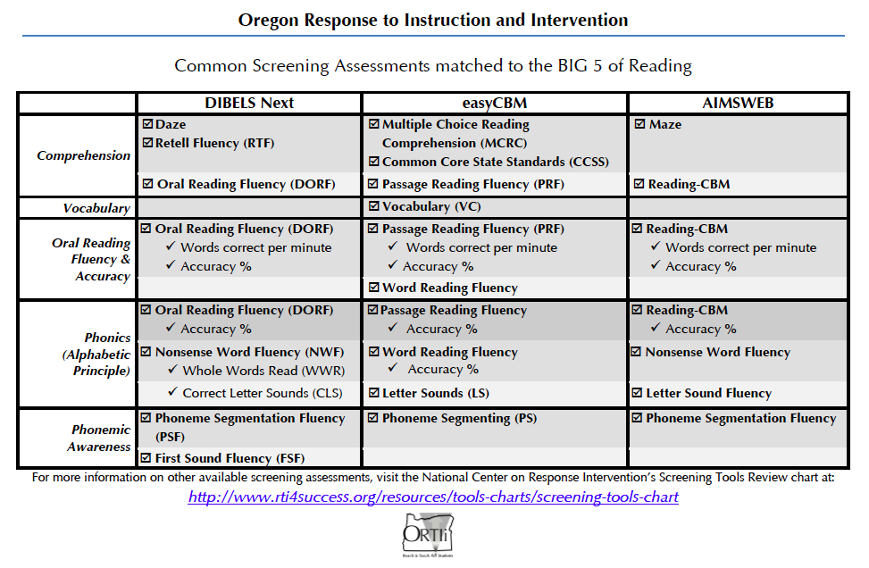
How do data match to the Big 5?

Slide 40
The Big 5 & Interventions
 | Phonemic Awareness | Phonics | Oral Reading Accuracy & Fluency | Vocab | Reading Comp
Triumphs | ☑ | ☑ | ☑ | ☑ | ☑
Phonics for Reading |  | ☑
Read Naturally |  |  | ☑
STARS |  |  |  |  | ☑
SFA Tutoring | ☑ | ☑
Reading Mastery | ☑ | ☑ | ☑ | ☑ | ☑
Language for Thinking |  |  |  | ☑
Horizons | ☑ | ☑ | ☑ | ☑ | ☑

Slide 41
Evaluating CURRICULUM
Is it matched to the student’s skill need?
Is it at the right difficulty level for the student to learn (accuracy)?
Is it being delivered with fidelity?
OBSERVE
REVIEW
REVIEW
INTERVIEW
OBSERVE
TEST

Slide 42
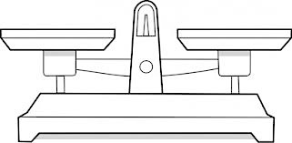
Right Difficulty Level?
Frustrational Level
(<80%)
Independent Level
(>90%)
Instructional Level (>80-90%)
Core instruction (small group)
Intervention

Slide 43
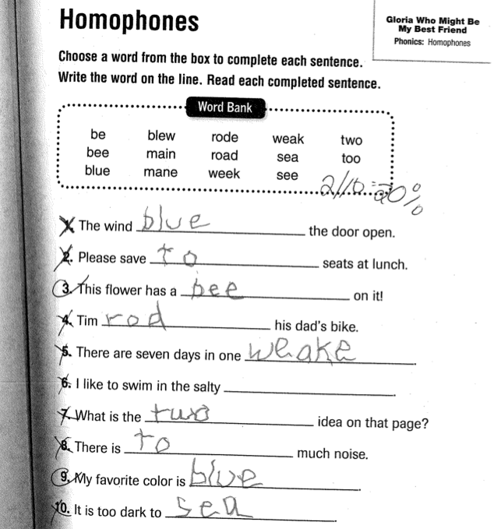
Student Accuracy: Work Sample
REVIEW

Slide 44
Student Accuracy: Observation
Activity Observed (Total time) | Student Opportunities to Respond | Student Errors | Errors Corrected
Intervention – small group direct instruction 10 minutes | IIII IIII IIII IIII IIII IIII IIII IIII IIII IIII IIII IIII IIII IIII IIII IIII II 82 | IIII IIII IIII IIII III 23 | IIII 4
Notes: Lots of explicit modeling and guided practice. Pacing: 82 OTR’s in 10 minutes = 8.2 OTR’s per minute Corrective Feedback: 4 out of 23 errors corrected = 17% of errors corrected Student Accuracy: 59/82 answers correct = 71%
OBSERVE
Notes:
Make example of 72%

Slide 45
Right Difficulty Level
If the student is not accurate, determine if the cause is the INSTRUCTION, the CURRICULUM or both.
The cause may be INSTRUCTION if:
Student errors are not consistently corrected (Goal = over 90% of errors corrected)
The cause may be CURRICULUM if:
Student errors are consistently corrected, and they continue to make a lot of errors.

Slide 46
Student Accuracy: Observation
Activity Observed (Total time) | Student Opportunities to Respond | Student Errors | Errors Corrected
Intervention – small group direct instruction 10 minutes | IIII IIII IIII IIII IIII IIII IIII IIII IIII IIII IIII IIII IIII IIII IIII IIII II 82 | IIII IIII IIII IIII III 23 | IIII 4
Notes: Lots of explicit modeling and guided practice. Pacing: 82 OTR’s in 10 minutes = 8.2 OTR’s per minute Corrective Feedback: 4 out of 23 errors corrected = 17% of errors corrected Student Accuracy: 59/82 answers correct = 71%
OBSERVE
Notes:
Make example of 72%

Slide 47
Evaluating CURRICULUM
Is it matched to the student’s skill need?
Is it at the right difficulty level for the student to learn (accuracy)?
Is it being delivered with fidelity?
OBSERVE
REVIEW
INTERVIEW
OBSERVE
TEST

Slide 48
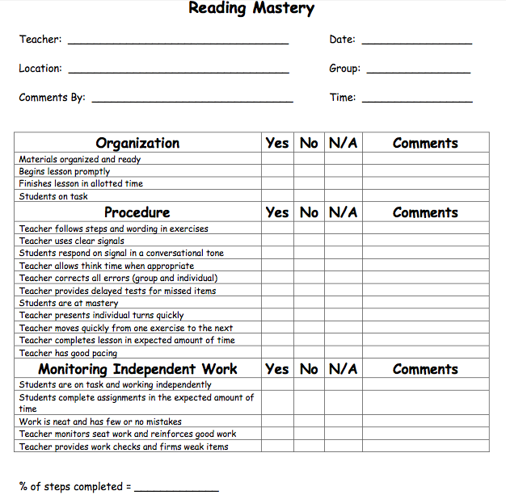
Fidelity
Core (small group)
Interventions
Extra practice

Slide 49
Targets for Intervention (CURRICULUM)
More small group during core (focused on phonics)
Follow error correction procedure in curriculum
Ensure appropriate instructional level of curriculum placement
Are skills taught matched to student need?
Is the curriculum evidence-based?
Is curriculum right difficulty level?
Is curriculum taught with fidelity?
Core (small group) – None
Intervention – Phonics
Intervention – Yes
Core – low student success
Intervention – 70% correct responding
Core – no small group
Intervention – 85% (no error corrections)

Slide 50
What are you already doing? What do you need to add?
Attendance
Counselor
Pacing, Feedback, Explicitness
Lit Specialist
Pacing, Feedback, Explicitness
Principal (walkthroughs)
???
Intervention match to need
Lit Specialist
Student success rate, fidelity
Lit Specialist
Student success rate, fidelity
Principal (walkthroughs)

Slide 51
ENVIRONMENT
Instruction: | Curriculum:
Environment: | Learner:
?
?
?
?

Slide 52
Environment: Examples
Targets for Intervention
Behavior
Expectations/Management
Not defined |  | Explicitly taught & reinforced
Teacher-student
interactions
Low rate of reinforcement |  | Mostly positive (4:1)
Physical setup
Chaotic & distracting |  | Organized & distraction-free
Notes:
Sarah

Slide 53
Evaluating ENVIRONMENT
Is the physical setup of the instruction area conducive to learning?
Does the behavior management system support student learning?
Is there a positive student-teacher relationship?
Is the student’s culture honored and valued?
OBSERVE
INTERVIEW

Slide 54
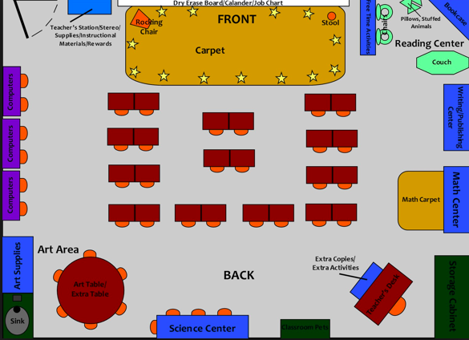
Physical Arrangement
Can the teacher easily monitor the students?
Is the instructional area free from distractions?
Can students easily share answers with each other?
Notes:
Can the teacher easily monitor the students?
Is the instructional area free from distractions?
Can students easily share answers with each other?

Slide 55
Evaluating ENVIRONMENT
Is the physical setup of the instruction area conducive to learning?
Does the behavior management system support student learning?
Is there a positive student-teacher relationship?
Is the student’s culture honored and valued?
INTERVIEW
OBSERVE
INTERVIEW
OBSERVE
INTERVIEW
OBSERVE

Slide 56
Environment
Are the expectations clear?
Are expectations followed through?
Are students receiving enough reinforcement (at least 4:1 positive ratio)?
Are we inclusive of all our students and provide opportunities for students to share their experiences?

Slide 57
Targets for Intervention (ENVIRONMENT)
Create behavior management system to improve student motivation
Physical Setup conducive to learning?
Behavior Management System
Positive Student-Teacher Relationship?
Student’s culture honored & valued?
Core & Interventions – Organized, no distractions
Core – Schoolwide PBIS
Intervention – None
Core – Lots of positive
Intervention – 8:1
Student feels valued and included at school

Slide 58
What are you already doing? What do you need to add?
Attendance
Counselor
Pacing, Feedback, Explicitness
Lit Specialist
Pacing, Feedback, Explicitness
Principal (walkthroughs)
???
Intervention match to need
Lit Specialist
Student success rate, fidelity
Lit Specialist
Student success rate, fidelity
Principal (walkthroughs)
Physical setup of room
School Psych
Behavior Management
School Psych
Student inclusion
School Psych

Slide 59
LEARNER
Instruction: | Curriculum:
Environment: | Learner:
?
?
?
?

Slide 60
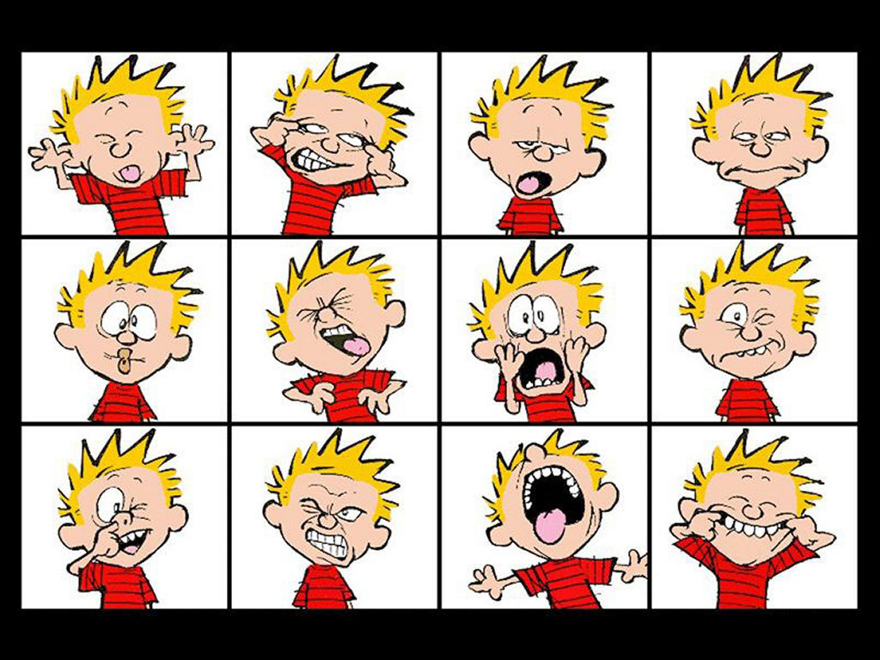
LEARNER

Slide 61
Learner: Examples
Language Skills
No English |  | Advanced English speaker
Academic Achievement
Well below benchmarks |  | At benchmarks
Student behavior
Off-task, disruptive, disengaged |  | Focused & attentive

Slide 62
Evaluating LEARNER
Are there health/developmental concerns?
Parental concerns? Behavior issues?
English language difficulties?
Current and past academic skills?
REVIEW
INTERVIEW
TEST
TEST
REVIEW
INTERVIEW
OBSERVE
TEST

Slide 63
Evaluating LEARNER
Are there health/developmental concerns?
Developmental history
Health and vision records
REVIEW
REVIEW

Slide 64
Evaluating LEARNER
Parental Concerns? Behavior issues?
What are the parents concerned about? What can they tell you about the student’s history?
Do significant behavioral issues interfere with student learning?
Is a Functional Behavior Assessment needed?
INTERVIEW
INTERVIEW

Slide 65
Evaluating LEARNER
English language difficulties?
What is the student’s native language? Primary language spoken at home? Level of acculturation?
TEST

Slide 66
When Problem Solving for an ELL student
A peer analysis is critical in determining if the student’s performance is atypical.
The ideal peer group are ELLs, same language background, same time in program, same grade of entry in school.
Scour district longitudinal data and find as large a peer group as possible
WA OSPI, 2009

Slide 67
5 L’s
Language (native)
Level of native language proficiency
Level of English language proficiency
Length of time in school
Length of time in country
Not all ELL students are the same!

Slide 68
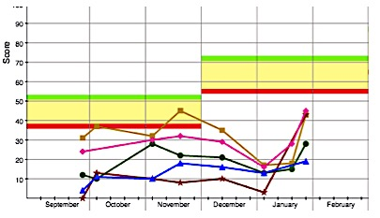
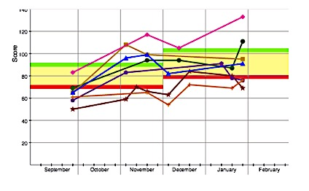
Using Cohort Data
Language issue? Instruction issue?
Individual issue

Slide 69
Evaluating LEARNER
Current and past academic skills?
What skills does the student have and what skills are they missing?
TEST
Diagnostic Assessments
Curriculum-Based Evaluation
(Next Session)

Slide 70
Target instruction on identified missing skills
Accelerate progress by providing “more” of current intervention
Health/Developmental Concerns?
Parental Concerns?
Behavioral Concerns?
English Language Difficulties? Acculturation?
Academic Skills?
None
No Preschool or Consistent Kindergarten
None significant
None
Consistent reading deficits, with foundational skills lacking

Slide 71
What are you already doing? What do you need to add?
Attendance
Counselor
Pacing, Feedback, Explicitness
Lit Specialist
Pacing, Feedback, Explicitness
Principal (walkthroughs)
???
Intervention match to need
Lit Specialist
Student success rate, fidelity
Lit Specialist
Student success rate, fidelity
Principal (walkthroughs)
Physical setup of room
School Psych
Behavior Management
School Psych
Student inclusion
School Psych
Developmental History
Counselor
Health Records
Counselor
Student Behavior
School Psych
Academic Skills
School Psych

Slide 72
The Problem Solving Process
How is it working?
1. Problem Identification
What is the problem?
Improved Student Achievement
4. Plan Implementation & Evaluation
2. Problem Analysis
What are we going to do about the problem?
Why is the problem occurring?
3. Plan Development

Slide 73
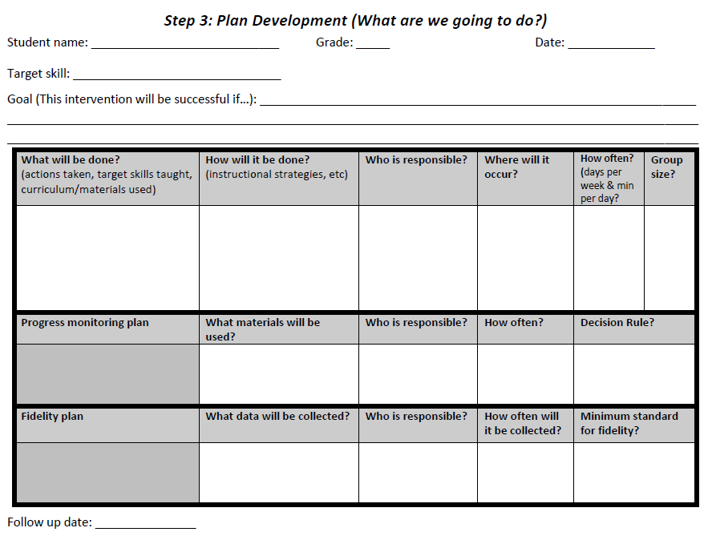
Intervention Plan

Slide 74
Instruction
Consistent corrective feedback
More opportunities to respond during Core
Curriculum
More small group during core (focused on phonics)
Follow error correction procedure in curriculum
Ensure appropriate instructional level of curriculum placement
Environment
Create behavior management system to improve student motivation
Target instruction on identified missing skills
Accelerate progress by providing “more” of current intervention
Learner

Slide 75
Have a plan for data collection
Attendance
Counselor
Pacing, Feedback, Explicitness
Lit Specialist
Pacing, Feedback, Explicitness
Principal (walkthroughs)
???
Intervention match to need
Lit Specialist
Student success rate, fidelity
Lit Specialist
Student success rate, fidelity
Principal (walkthroughs)
Physical setup of room
School Psych
Behavior Management
School Psych
Student inclusion
School Psych
Developmental History
Counselor
Health Records
Counselor
Student Behavior
School Psych
Academic Skills
School Psych

