Slide 1
Catch Up Growth: Intensifying Small Group Instruction (The Explicit Phonics Lesson K-2)
Notes:
Lisa: intro (slides 1-12) 25 minutes
Teresa: Explicit Phonics Lesson (slides 13-45) 30 minutes
Lisa: activity and closing (slides 46-48)
Explicit Phonics Lesson:
Slides 16-20: 4 mins
21-24: 3 mins
25-28: 7 mins
30-33: 4 mins
34-37: 7 mins
39-41: 1 mins
42-44: 2 mins
Model: 5-6 mins

Slide 2
Decision Making Process for Small Group
What is the skill need?
How much time should you spend teaching the skill need versus grade level skill/strategy?
What materials should you use?
What is the best approach to teach these needs?

Slide 3
What you will learn…
How to “catch students up” by teaching an Explicit Phonics Lesson during small group

Slide 4
General Types of Small Group Instruction
Guided Reading
Skill Focused Instruction
Teacher supports student’s development of effective strategies for processing and make meaning of text
Monitor student reading
Helps to ensure mastery of letter-sound knowledge, phonemic decoding strategies, critical vocabulary, or reading comprehension strategies

Slide 5
Types of Skill Focused Small Group Instruction
2. Increase Grade Level Skill/Strategy use
1. Reduce Deficit Skill/s
Catch students up!
Provide focused instruction & practice on skills that are missing
May not be within the scope of that grade level’s instruction
Ex. Third grade students needs basic phonics (continuous blending with CVC words)
Practice the skill/strategy that was taught during the whole group during small group
Ex. Summarizing is taught in whole group....review summarizing with accessible text during small group
Notes:
Use assessment data and groups are flexible

Slide 6
vocabulary/comprehension (leveled readers)
Some PA, phonics review, fluency practice
Practice grade level skills
Reteach & practice grade level or slightly lower skills
Core small group program materials with additional
skill focus practice, enhancements, explicit phonics lesson
Catch students
up
Explicit phonics lesson, enhancements, supplemental, replacement core

Slide 7
Gallery Walk of Materials
Core Materials
Enhancement Materials
Anthology/Anchor Text
Leveled Readers
Decodable readers
Sound Spelling cards
Lines of practice
Templates
FCRR
Resources
Alternatives to Round Robin reading
Purposes of text types
Explicit Phonics Lesson
PA sequence
Phonics sequence
Blending routine chart
PA activities
Continuous Sound Blending Activities

Slide 8
Gallery Walk Questions
What was something new to you?
How can it help your instruction?
What was something that you knew or have used before?
How did it help your instruction?

Slide 9
How do we sort it all out?

Slide 10
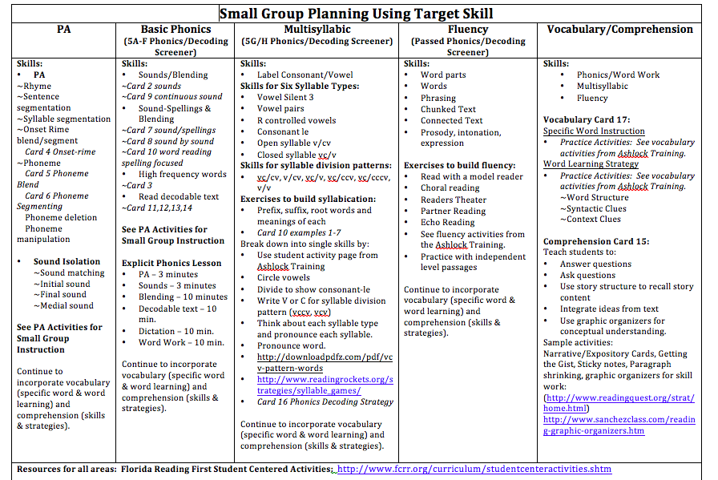
Oregon Reading First: http://oregonreadingfirst.uoregon.edu/

Slide 11
Miranda & Miles
What is the skill need?
What is the Big 5 area of need?
phonics
What is the targeted skill/strategy?
Long vowel and silent e
Sounds-spelling/ sound by sound blending
What is the intensity level?
intensive
How much time should you spend teaching the skill need versus grade level skill/strategy?
4 days on skill need and 1 day on grade level skill/strategy?
What materials should you use?
Decodable text containing long vowel/silent e from first grade core
What is the best approach to teach these needs?
Explicit Phonics Lesson

Slide 12
Oregon Reading First: http://oregonreadingfirst.uoregon.edu/

Slide 13
How do we do it?

Slide 14
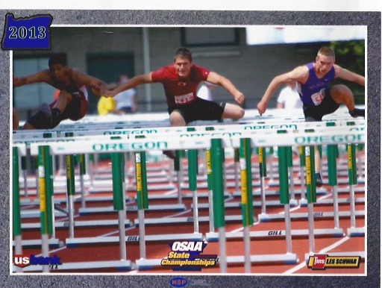
Explicit Phonics Lesson
PA
Sound or sound spellings
Blending
Regular/irregular word reading
Decodable text
Dictation
Word work
Notes:
Add Garrett picture
Built into the core program

Slide 15
Setting the Purpose
State what students get to learn
say it, reference it, & post it
Get kids excited…hook them in!
Connect/Review to previous learning and set purpose
Yesterday, you…. Today we are going to learn…
State what you will be doing before each activity
Today we get to use our sound by sound blending routine to read words

Slide 16
Explicit Phonics Lesson
Phonological awareness
Sound or sound spellings
Blending
Regular/irregular word reading
Decodable text
Dictation
Word work
Notes:
Add Garrett picture

Slide 17
Phonological Awareness (auditory only)
A brief warm-up activates students’ phonological processor and prepares them to make the connection to print
Warm up for the brain
Should be connected to phonics skill being taught/reviewed
Time: 2-3 minutes

Slide 18
Phonological Awareness Sequence

Slide 19
PA Materials
Templates
PA Activities for Small Groups
Cards
4, 5, 6

Slide 20
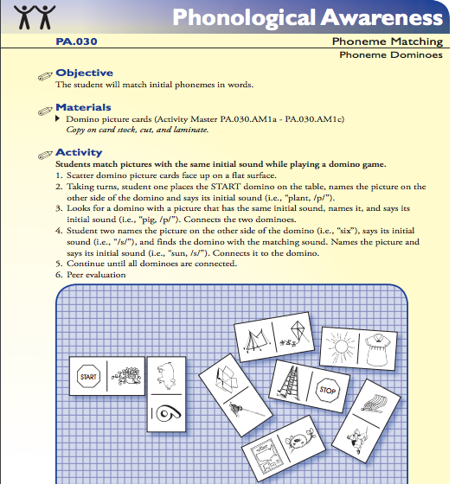
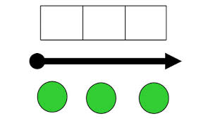
PA: Practice
FCRR
PA Activities

Slide 21
Explicit Phonics Lesson
Phonological awareness
Sound or sound spellings
Blending
Regular/irregular word reading
Decodable text
Dictation
Word work
Notes:
Add Garrett picture

Slide 22
Sound or sound spelling
Use effective instructional practices to connect phoneme to grapheme
Sound to print
Time: 3-4 minutes

Slide 23
Sound/Sound Spelling: Materials
Sound or Sound/Spelling Card
Templates
Single sounds
(card 2)- kindergarten
Sound/spellings
(card 7)- first grade +
Lines of Practice
Sounds
Sound/spellings

Slide 24
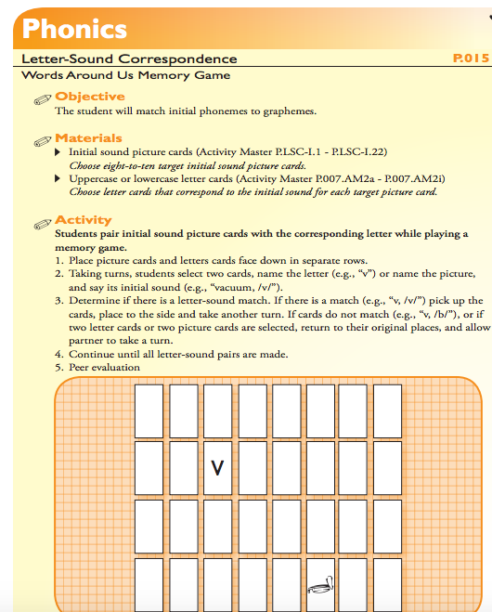
Sounds/Sound Spellings: Practice
FCRR

Slide 25
Explicit Phonics Lesson
PA
Sound or sound spellings
Blending
Regular/irregular word reading
Decodable text
Dictation
Word work
Notes:
Add Garrett picture

Slide 26
Blending
Students are involved in a variety of activities that help them to accurately decode and recode new words using the focus phonics element/s
Continuous sound blending (K-1st grades)
Sound by sound blending (1st grade)
Word reading spelling focused (2nd grade)
Single syllable
Two syllable
Multisyllabic
Time: 10 minutes

Slide 27
Blending: Materials
Templates
Continuous Sound Blending Activities
Sounds/blending
Continuous blending (9)
Sounds-Spelling/Blending
Read sound spelling (7)
Sound by sound blending (8)
Lines of Practice
words

Slide 28
Blending

Slide 29
Talk Time
What have you been currently doing in your lessons to support blending?
What would you change in your lessons to support blending?

Slide 30
Explicit Phonics Lesson
PA
Sound or sound spellings
Blending
Regular/irregular word reading
Decodable text
Dictation
Word work
Notes:
Add Garrett picture

Slide 31
Reading Regular and Irregular Words
Using systematic relationships between letters and phonemes (letter-sound correspondence) to retrieve the pronunciation of unknown printed string or to spell words
Practice reading irregular words
Say it, spell it, say it
Identify regular words to be read
within 1-3 seconds
Time: 5-10 minutes

Slide 32
Reading Irregular Words
Teacher: word….said… word?
Students: said
Teacher: spell said
Students: s…a…i…d
Teacher: word?
Students: said

Slide 33
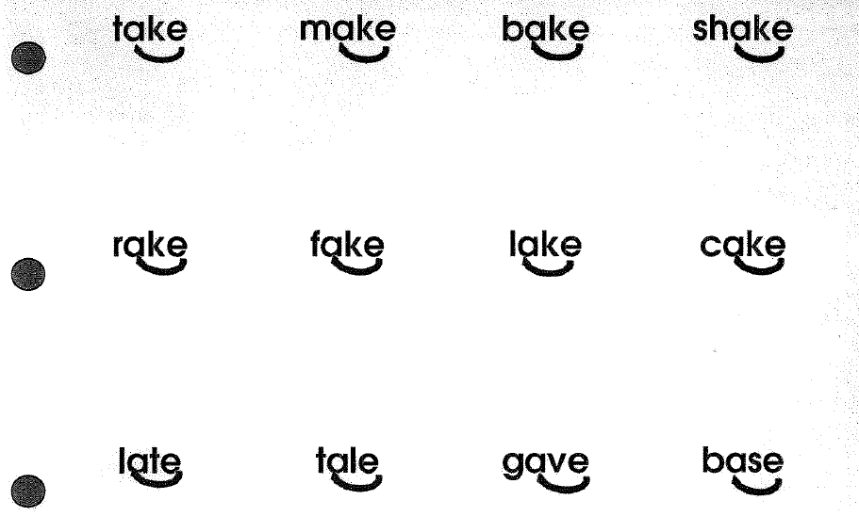
Regular/Irregular Word Reading: Materials
Templates
Lines of Practice
Card 3
Irregular words
Regular words

Slide 34
Explicit Phonics Lesson
PA
Sound or sound spellings
Blending
Regular/irregular word reading
Decodable text
Dictation
Word work
Notes:
Add Garrett picture

Slide 35
Decodable Text
Students apply the newly learned phonics element in text that is controlled for high-frequency words and sound-spelling correspondence
Practice sound or sound/spellings in text (application)
Time: 10 minutes

Slide 36
Decodable Text
Read three times
Do not do a picture walk
Ensure first read is at instructional level
(94-97% accurate)
Last read should be at independent level
(98%-100% accurate)

Slide 37
Decodable Text: Materials
Templates
Lines of Practice
Phrases
Sentences

Slide 38
Talk Time
What are you currently doing in your lessons to support reading decodable text?
What would you change to support reading of decodable text?

Slide 39
Explicit Phonics Lesson
PA
Sound or sound spellings
Blending
Regular/irregular word reading
Decodable text
Dictation
Word work
Notes:
Add Garrett picture

Slide 40
Dictation
After having the opportunity to decode words using the lesson objective, students match speech to print through a word, phrase or sentence dictation
Sound or word writing to reinforce sound or sound spelling
Auditory to grapheme
Time: 10 minutes

Slide 41
Dictation: Materials
Dictation Routine

Slide 42
Explicit Phonics Lesson
PA
Sound or sound spellings
Blending
Regular/irregular word reading
Decodable text
Dictation
Word work
Notes:
Add Garrett picture

Slide 43
Word Work Application
Students knowledge of words is expanded through concise practice and application
Apply learning of the sound or sound spellings
Differentiated to the level and need of the group
Game like activities
Short, fast paced and “monitored”
Time: 10 minutes

Slide 44
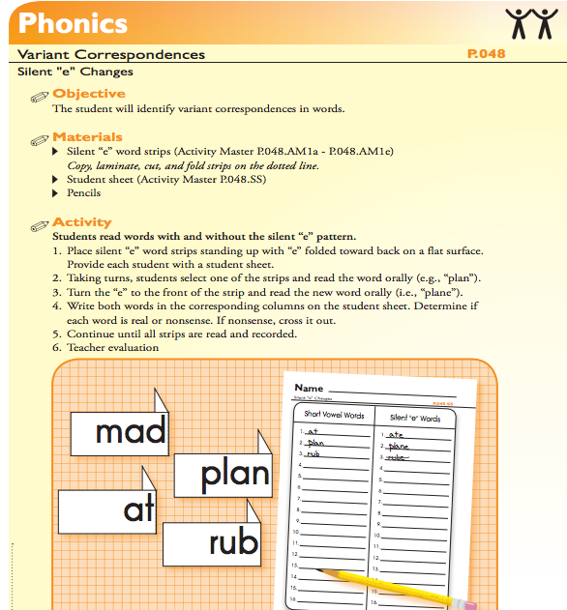
Word Work Materials
FCRR
Activities

Slide 45
Model Lesson
Plan
…What you need to teach
Observe
…It be delivered
Reflect
…On what you observed

Slide 47
Now watch a model lesson

Slide 48
Lesson Plan

Slide 49
Explicit Phonics Lesson

Slide 50
Instructional Routine Resources
Templates
https://www.cde.state.co.us/sites/default/files/documents/coloradoliteracy/clf/downloads/instructional_templates.pdf
Journeys
Grab and Go Resource box
Additional Resources
Wonders
http://treasures.macmillanmh.com/assets/extras/0001/2063/InstructionalRoutine_CA_B.pdf

