Slide 1
Building and Maintaining a Healthy School Culture
2019 ORTIi Annual Conference
Jon Potter

Slide 2
Overview
Why is school culture important?
What does a healthy school culture look like?
How can we cultivate a more healthy, productive school culture?

Slide 3
Why is school culture important?

Slide 4
RTI Essential Components
Clear Vision of Learning for ALL
BIT Meets Regularly
Principal Attends RTI Meetings
Decision Rules
Intervention Placement
Intervention Review
Core Review
SLD Decision Making
Initial and Ongoing PD
Ongoing Coaching
Observe & Actionable Feedback
Progress Monitoring
Interventions
Universal Screening
Core Materials and Instruction
Leadership
Teaming
& DBDM
Professional Learning
Culture
Notes:
Culture: High expectations for all student populations, belief that all student populations can learn, belief that the measurement of how well I teach is how well they learn
Leadership:
Teaming/DBDM: Disaggregate data,
Professional Learning & Support:d
Core: Sheltered instruction, implicit, opportunities to respond,

Slide 5
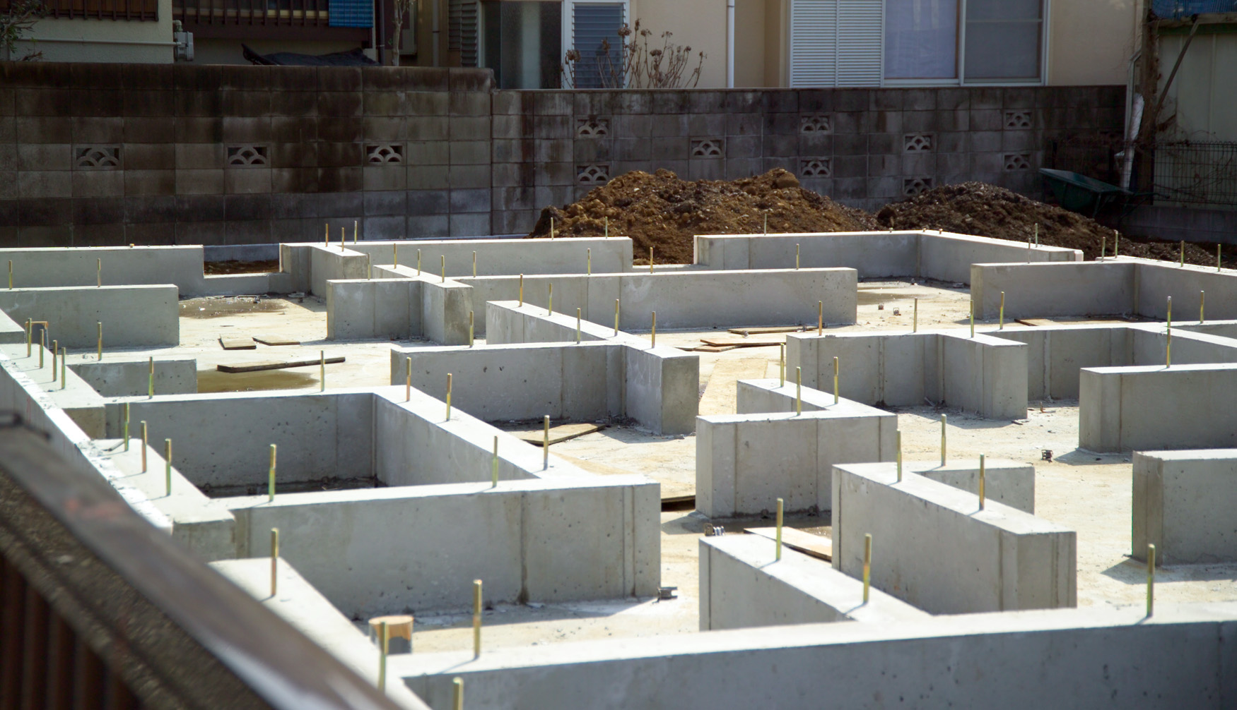

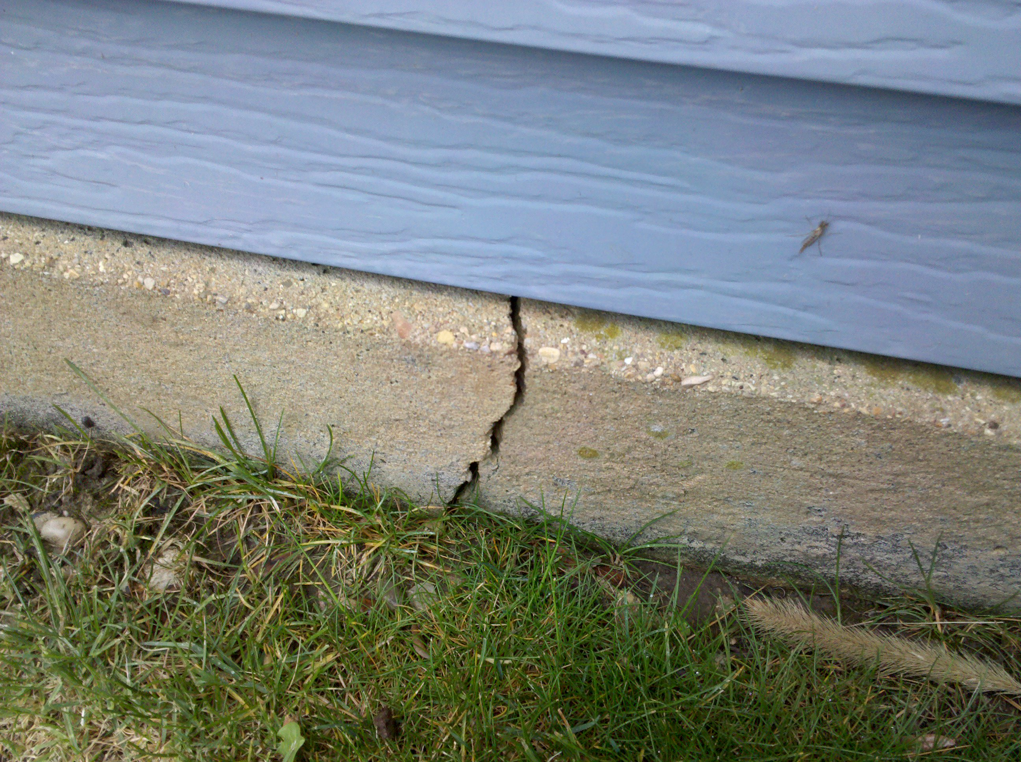
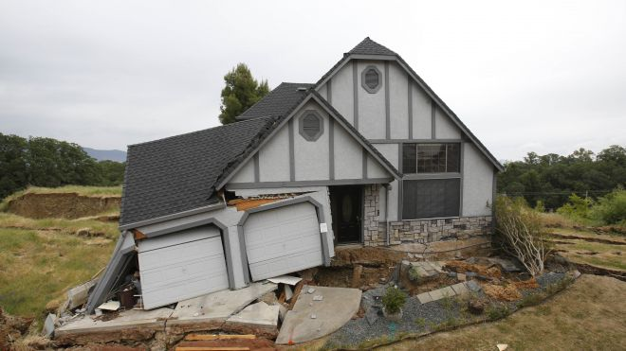
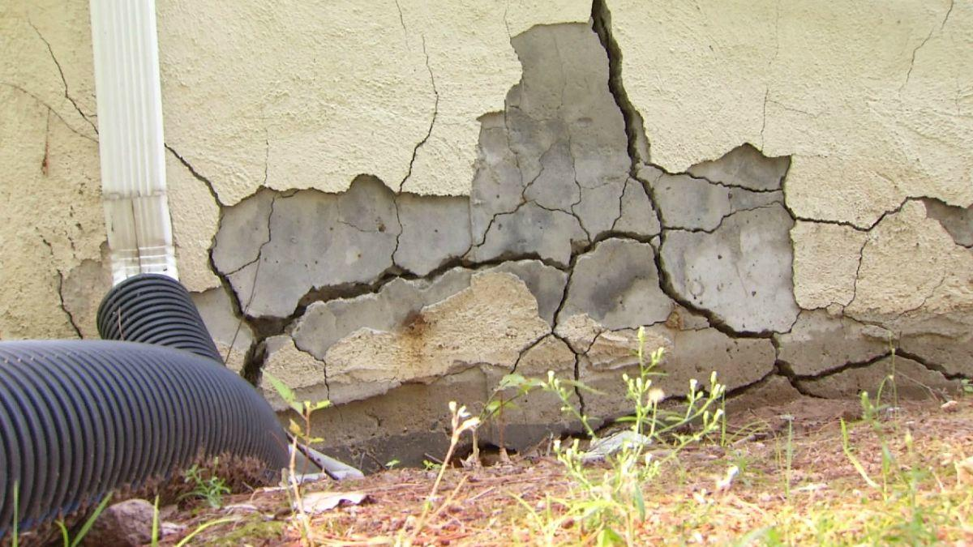

Slide 6
“You can have the best plan in the world, and if the culture isn’t going to let it happen, it’s going to die on the vine”
Mark Fields (former CEO of Ford)

Slide 7
School Culture Matters…
At or Above Benchmark
Below Benchmark
Well Below Benchmark
Average % of 1st – 3rd Graders in each DIBELS Next Benchmark Category
Spring 2016
Spring 2017
Schools with STRONG Culture
Schools with
UNHEALTHY
Culture
Schools with STRONG Culture
Schools with
UNHEALTHY
Culture
Notes:
School Culture measured through staff survey asking staff if they believe 80% of kids can be successful with core instruction alone, if they can impact powerful education outcomes for their kids, if their staff is collaborative and work together well, and if school leadership values and uses feedback from staff

Slide 8
Healthy school cultures have…
A shared responsibility and belief that ALL students can learn

Slide 9
1. Shared responsibility and belief that ALL kids can learn
As a school, we must share…
…The belief that all kids can learn
…The responsibility to make that happen
…The accountability to change our practices when it does not happen

Slide 10
Collective Teacher Efficacy
“Collective self-perception that teachers in a given school make an educational difference to their students over and above the educational impact of their homes and communities."
“The success of the school, as indicated by levels of student achievement, depends on the collective belief that the teachers in the building can improve student achievement.”
    Tschannen-Moran & Barr (2004)

Slide 11
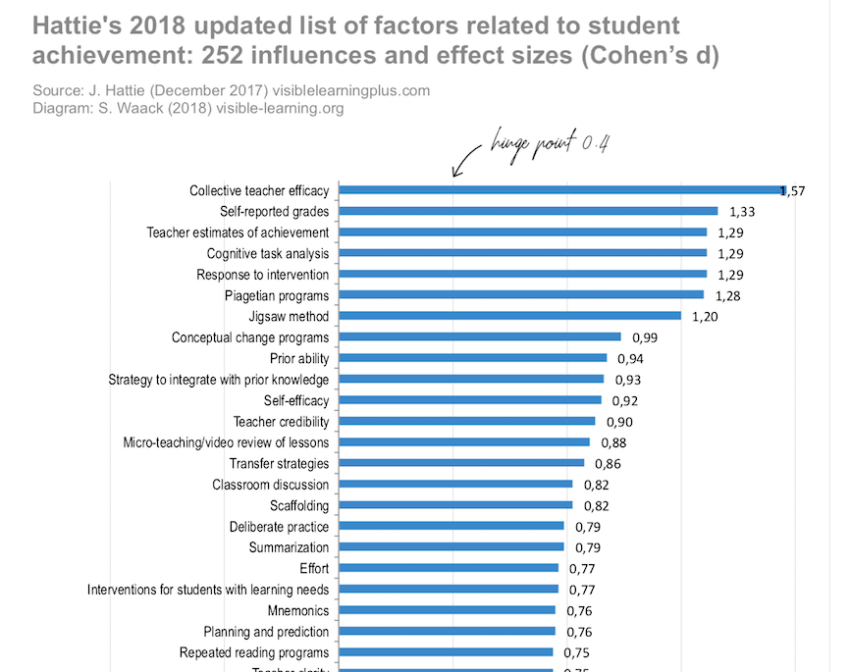
”School staff that believes it can collectively accomplish great things is vital for the health of a school and if they believe they can make a positive difference then they very likely will”

Slide 12
Four Sources of Efficacy
Mastery Experiences
Vicarious Experiences
When we experience success and attribute that success to things within our control, we begin to expect success
When we see someone else in a similar situation experiencing success, we believe we can experience that same success
Live it
See it
Social Persuasion
Affective States
When trusted educators persuade us to innovate and overcome challenges, we are more likely to implement new practices
When we are excited about our capability to implement new, effective practices we are more likely to do so
Hear About it
Feel it
Albert Bandura

Slide 13
Which 2 sources of efficacy are most impactful for you?
slido.com Code: #ortii2019 Room: Potter
Mastery Experiences
Vicarious Experiences
Live it
See it
Social Persuasion
Affective States
Hear About it
Feel it
Albert Bandura

Slide 14
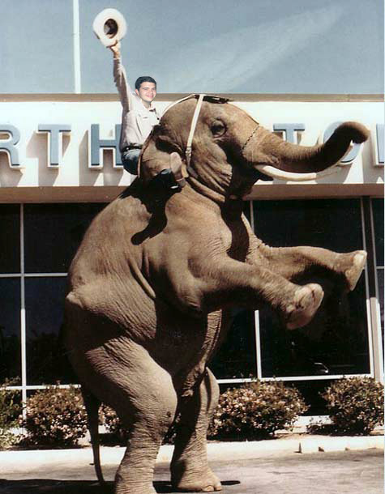
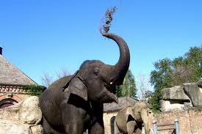
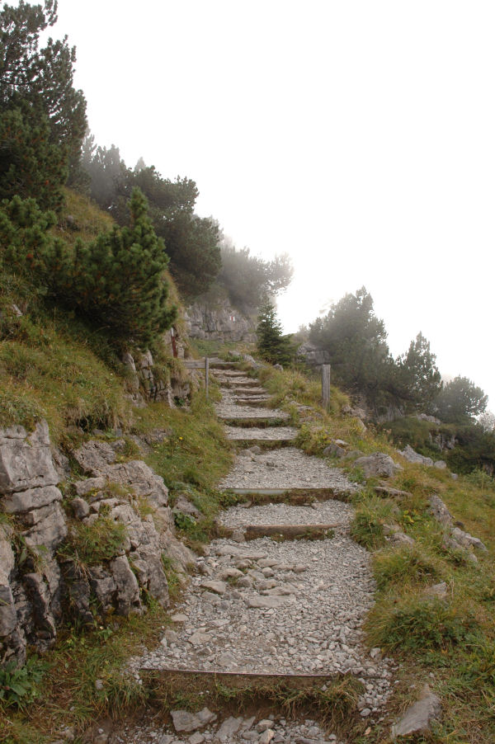

People change for different reasons
Rational side
  “Show me the data!”
Emotional side
  “Tell me the story about it”
The path
  “Just show me how to do it”
Win their minds
Win their hearts
Make it easier to do
Notes:
Sometimes you don’t need to win their minds or hearts. Just make it easier to do.

Slide 15

Learning together builds excitement
Mastery Experiences
Vicarious Experiences
Live it
See it
Social Persuasion
Affective States
Hear About it
Feel it
Albert Bandura

Slide 16
How will you build efficacy with your colleagues?
Mastery Experiences
Vicarious Experiences
Live it
See it
Social Persuasion
Affective States
Hear About it
Feel it
Albert Bandura

Slide 17
Healthy school cultures have…
A shared responsibility and belief that ALL students can learn
A growth mindset, and desire for continuous improvement through feedback

Slide 18

2. A Growth Mindset, and desire for continuous improvement through feedback
“Growth Mindset” – We can improve, grow, and get better at the things we put our efforts into.
“Fixed Mindset” – You’re either born with the talent to achieve or not
Growth Mindset = RTI, PBIS, MTSS
Notes:
http://www.youtube.com/watch?v=45mMioJ5szc

Slide 19

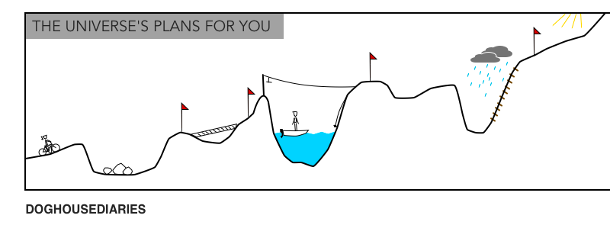

“Progress is built, in effect, upon the foundations of necessary failure”
  Matthew Syed, Bounce

Slide 20
What this means for educators
There is no such thing as ineffective instructors, but there is ineffective instruction.
As educators, it is not who we are, but what we DO that truly matters for our students.

Slide 21
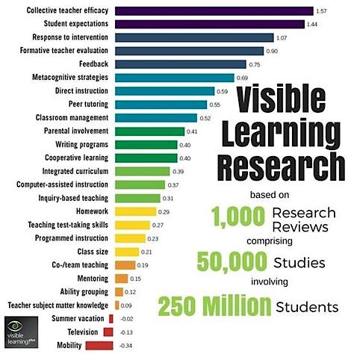

2. A Growth Mindset, and desire for continuous improvement through feedback
Feedback

Slide 22
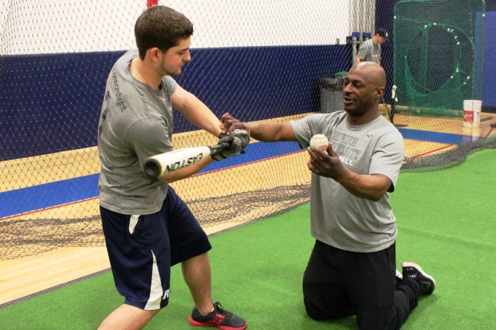
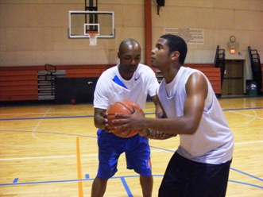

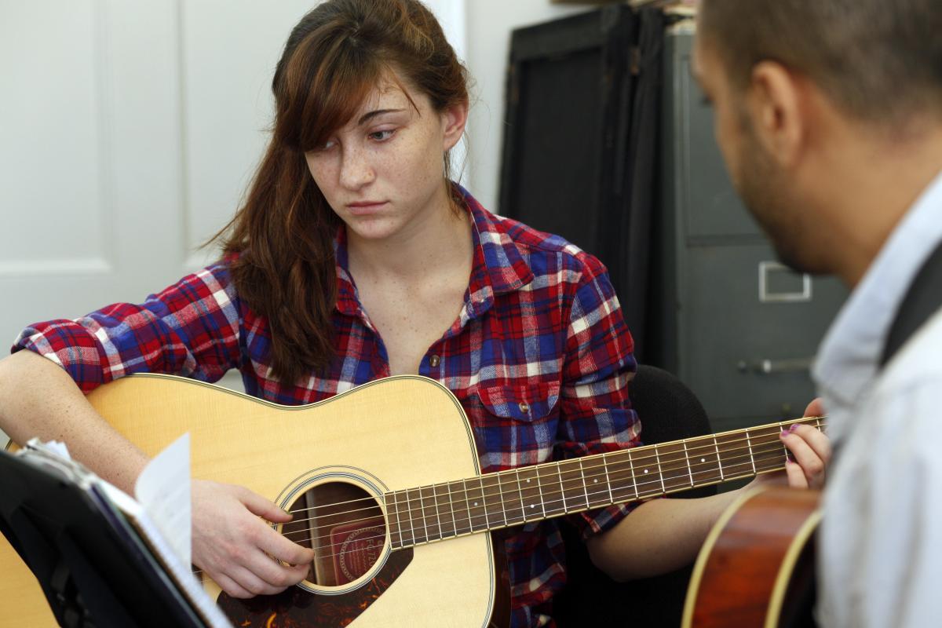
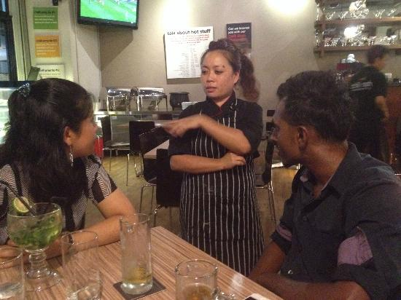
Feedback is everywhere

Slide 23
Effective feedback goes both ways
Classroom Level
System Level
Grades,
Formative data,
Corrective & Affirmative Feedback (verbal or written)
Walkthroughs, Coaching, Staff Meetings
School/District Leadership
Staff
Teacher
Student
Surveys,
RTI implementation data, Walkthroughs, Grade Level meetings
Accuracy of responses, Student behavior, Formative evaluation

Slide 24
Healthy school cultures have…
A shared responsibility and belief that ALL students can learn
A growth mindset, and desire for continuous improvement through feedback
A healthy, positive, and collaborative atmosphere amongst staff

Slide 25
3. A healthy and positive atmosphere of collaboration amongst your staff
People will work harder for (and with) people who they like and trust
Real change does not happen on the macro level, it happens over and over at the personal, micro, level

Slide 26
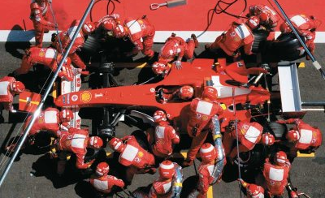
Our teams are like…

Slide 27
“Groups are powerful, which means they can be powerfully wrong. Getting together without the discipline and specificity of collective deliberation can be a grand waste of time.”
  Michael Fullan & Joanne Quinn

Slide 28


Procedures, Protocols, and Checklists
Ensure teaming processes are focused & efficient
Give everyone the same outcome to work towards
Provide a reminder of things that get forgotten

Slide 29
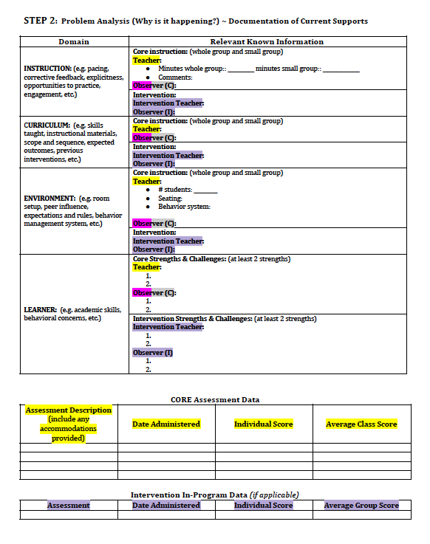
Notes:
ELISE

Slide 30
Healthy school cultures have…
A shared responsibility and belief that ALL students can learn
A growth mindset, and desire for continuous improvement through feedback
A healthy, positive, and collaborative atmosphere amongst staff
Cultural Responsiveness, equitable practices, and awareness of Implicit Bias

Slide 31
4. Cultural Responsiveness, equitable practices, and awareness of Implicit Bias
Beliefs - Do we have high expectations for ALL students from ALL backgrounds?
Behavior - Are we implementing culturally responsive practices?
How do you know?
Have you looked at your disaggregated data?

Slide 32
Are we CLOSING the achievement gap?
Or are we CREATING the achievement gap?
Notes:
# of students meeting
2011-2012: 24 Latino kids, 38 white kids
2012-2013: 21 Latino kids, 46 white kids
2013-2014: 29 Latino kids, 46 white kids

Slide 33
Created Achievement Gaps
A third of SES Achievement Gap is due to school practices (http://hechingerreport.org)
Significant disparities in discipline (U.S. GAO, March 2018)
  Black students make up 15.5% of student population in US public schools, but make up 39% of all students who are suspended
Significant disparities in referral rates

Slide 34
Teacher Referral by Race
Most referrals for SPED evaluation come from teachers
Between 73% and 90% of students referred are found eligible (Harry & Klingner, 2007)
Probability of being referred for eligibility testing
(Fish, 2016)
Notes:
Provided vignettes to teachers of male, low income students showing signs of 1) Academic Difficulties, 2) Behavior Difficulties or 3) Giftedness. Asked them to determine how likely they would refer them for testing. Results indicate differences when the race/ethnicity of the sample student was changed.
Carlos, Jacob, Demetrius

Slide 35
Our decision making is flawed
Confirmation Bias – We are more likely to believe (and to remember) information that confirms our views rather than information that disagrees with it, regardless of the accuracy of the information
Availability Bias – We’re biased towards information that is more readily available
In percentages, how much do you contribute to the upkeep of your home?
  How would your spouse/significant other answer this same question?
Notes:
Confirmation Bias – We prefer programs and assessments that fit into our philosophical approach to education, or see failures of an intervention as more salient when we don’t like the intervention.
Availability Heuristic – If we’ve had a good (or bad) experience with a program or assessment, that will bias what we think about it, regardless of how good or bad it is.

Slide 36
Overcoming our biases
It’s normal to try to simplify complex issues & intuitive errors cannot be avoided
“Learn to recognize situations when mistakes are likely and try harder to avoid significant mistakes when the stakes are higher.” -Daniel Kahneman
Notes:
When we have a difficult question to answer, we automatically try to make it into an easier question to answer.

Slide 37
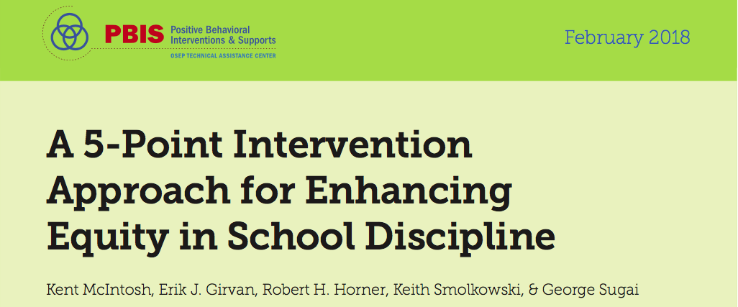
Collect, use and report disaggregated discipline data
Implement a behavior framework that is preventive, multi-tiered, and culturally responsive
Use engaging instruction to reduce the opportunity (achievement) gap
Develop policies with accountability for disciplinary equity
Teach strategies for neutralizing implicit bias in discipline decisions

Slide 38
Healthy school cultures have…
A shared responsibility and belief that ALL students can learn
A growth mindset, and desire for continuous improvement through feedback
A healthy, positive, and collaborative atmosphere amongst staff
Cultural Responsiveness, equitable practices, and awareness of Implicit Bias

Slide 39
How do we enhance our general school culture?

Slide 40
Always start with the WHY
Why
How
What
Healthy Cultures start here
Unhealthy Cultures start here
A compelling WHY creates ownership
Simon Sinek

Slide 41
How can we create change?
(Schein, 2010)
We must learn something new
AND
We must unlearn old habits
The most difficult part is the unlearning because previous habits, no matter how dysfunctional, still serve some positive function
Notes:
This is why people are “resistant to change”

Slide 42
“Ineffective but comfortable”
In order to change:
It has to be easier to change than it is to stay the same
Instead of just making it harder to stay the same, we have to make it easier to change
Lasting change doesn’t happen by making people more uncomfortable

Slide 43
Make it easier for your staff:
Remove the barriers
Instead of asking this question:
“How can we get our staff to do ‘X’?”
Try asking this question:
  “Why aren’t they already doing ‘X’.”
Not enough time
Not enough training
Not enough materials
An influential teacher doesn’t like it
“I can’t do everything”
Kurt Lewin
Notes:
Driving forces vs Restraining forces

Slide 44
How do we create strong teacher collective efficacy?
Create opportunities for meaningful collaboration
Empower teachers
Establish goals and high expectations
Help teams interpret results and provide feedback
Well implemented
Core Review/
100% Meetings
Collective Efficacy, Donohoo, 2017

Slide 45
Continuum of collegial relations
Independence
Interdependence
Joint Work
Informal asking for help from fellow teachers
Casual stories and sharing ideas in the staffroom or social settings
Sharing
Working together on common practices for a common goal
Aid & Assistance
Sharing specific teacher practices (e.g., peer walkthroughs, etc.)
Storytelling & Scanning
Increasing demands for collective autonomy and teacher-to-teacher initiative
from Judith Little, 1990
Notes:
Storytelling and Scanning – Casual stories and sharing ideas in the staffroom or in social settings
Aid and Assistance – Asking for help when needed. Limited to who is willing to ask. The person asked may not have the best ability to answer. “Are we filling potholes, resurfacing the road, or inventing new forms of transportation?”
Sharing – Peer walkthroughs, talking about teachers’ practices
Joint Work - Working on a common practice or initiative towards a common goal. Realizing that systemic positive student outcomes can only be achieved together

Slide 46
How do we create strong teacher collective efficacy?
Create opportunities for meaningful collaboration
Empower teachers
Establish goals and high expectations
Help teams interpret results and provide feedback
Well implemented
Core Review/
100% Meetings
Collective Efficacy, Donohoo, 2017

Slide 47

Examples of our Vision and Mission Posters
Kennedy Elementary, Keizer, Oregon
WHY
WHAT
HOW

Slide 48

Resources/Acknowledgements
Growth Mindset (Carol Dweck)
Organizational Culture & Leadership (Edgar Schein)
Switch (Chip and Dan Heath)
Bounce (Matthew Syed)
The Checklist Manifesto (Atul Gawande)
Visible Learning (John Hattie)
Collective Efficacy (Jenni Donohoo)

