Slide 1

Building Complex Multi-Tiered Systems:
Implementing Intensive Intervention in Mathematics
Sarah Arden, American Institutes for Research
William Rasplica, Franklin Pierce Schools
Kelly Glick, Franklin Pierce Schools
Notes:
Introduction to the module
This is the first in a series of training modules developed by the National Center on Intensive Intervention (NCII) and adapted as part of an i3 Development Grant, aimed at district or school teams involved in initial planning for using DBI as a framework for providing intensive intervention in academics and behavior. The audience for this module may include the behavior support team, interventionists, special educators, school psychologists, counselors, and administrators, as appropriate. Subsequent modules will provide additional information about specific components of the DBI process. More information about NCII’s approach to intensive intervention can be found in the NCII concept paper Data-Based Individualization: A Framework for Intensive Intervention. The concept paper is available at http://www.intensiveintervention.org/sites/default/files/Data-based_Individualization_A_Framework.pdf.
Instructions for using the speaker notes
Text formatted in standard font is intended to be read aloud or paraphrased by the facilitator.
Text formatted in bold is excerpted directly from the presentation slides.
Text formatted in italics is intended as directions or notes for the facilitator; italicized text is not meant to be read aloud.
Text formatted in underline indicates an appropriate time to click to bring up the next stage of animation in an animated slide.
Speaker notes for Title Slide
Welcome participants to the training on Data-Based Individualization (DBI). Introduce yourself (or selves) as the facilitator(s) and briefly cite your professional experience with regard to intensive intervention and DBI
Please note that pen and paper will be required for the Think-Pair-Share activity (Slide 24).
The following handouts should be provided to participants:
“Handout 1: Instruction and Intervention Inventory” for Activity 1 (see Slide 34)
“Handout 2: Academic Intervention Progression” visual to accompany Academic Illustration (see Slide 36)
“Handout 3: Behavioral Progression” visual to accompany Behavior Illustration (see Slide 59)
While permission to reprint this publication is not necessary, the citation should be:
National Center on Intensive Intervention (July, 2013). Introduction to Data-Based Individualization (DBI): Considerations for Implementation in Academics and Behavior, DC: U.S. Department of Education, Office of Special Education Programs, National Center on Intensive Intervention.

Slide 2
Agenda
Brief overview of the i3 grant
What is intensive intervention ?
  Data-based Individualization approach
Building Complex Systems
  Implementing DBI
  Non-linear implementation
Franklin Pierce Case Study
Lessons Learned
Questions & Discussion

Slide 3
I3:
Implementing Intensive Intervention in Mathematics

Slide 4
Using Intensive Interventions to Improve Mathematics Skills of Students with Disabilities
Priority area: Students with disabilities
Investing in Innovation (i3) Development Grant
  Data-Based Individualization (DBI) in mathematics for students with disabilities and other at-risk learners
  Leverages the work of the National Center on Intensive Intervention (NCII, www.intensiveintervention.org)

Slide 5

Where are we now?
Cohort 1
Jan–Sept 2015: Planning and Readiness
2015–16
DBI Year 1
Cohort 2
Jan–Sept 2015: No DBI
2015–16 Readiness
2016–17
DBI Year 2
2017–18 DB1 Year 3 (follow-up)
2016–17
DBI Year 1
2017–18
DBI Year 2
Spring 2017
Middle School Pilot
2017-2018
Middle School Pilot
This design allows us to make three primary comparisons:
DBI Year 1 in Cohort 1 and No DBI in Cohort 2
DBI Year 2 in Cohort 1 and No DBI in Cohort 2, and
DBI Year 3 (i.e., the follow-up) and No DBI in Cohort 2
Middle School Cohort used for pilot data

Slide 6

i3: Using Intensive Interventions to Improve Mathematics Skills of Students with Disabilities
System Specific Outcomes
Develop of a system to support intensive intervention in mathematics
Improve MTSS structures at the school and district level

Slide 7
i3: Using Intensive Interventions to Improve Mathematics Skills of Students with Disabilities
DBI Specific Outcomes
Increased structures and systems to support data-based decision making around mathematics instruction and intervention
Individualized, student-level planning resulting in documented intensive intervention plans for at least10 students at each site

Slide 8


Why Franklin Pierce?
Prior experience and success with MTSS/RTI
Strong core programming
Diverse student population
Interest and support from leadership
Large enough district for evaluation
Implementation work in the i3 may help to guide the process of state-wide SSIP roll out
Notes:
Bill- explain the district

Slide 9
What is Intensive Intervention?

Slide 10
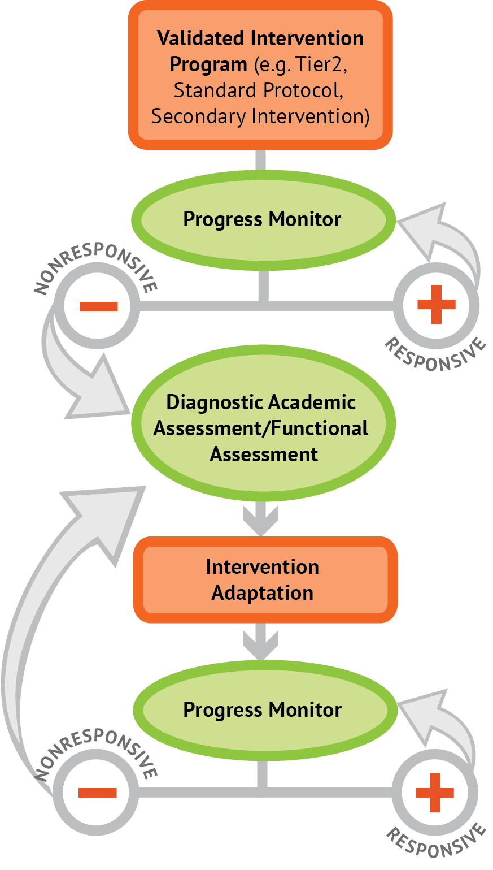
What is intensive intervention?
Intensive intervention is designed to address severe and persistent learning or behavior difficulties. Intensive interventions should be—
Driven by data
Characterized by increased intensity (e.g., smaller group, expanded time) and individualization of academic instruction and/or behavioral supports

Slide 11


Why Do We Need Intensive Intervention?
More Help
Validated programs are not universally effective programs; 3 to 5 percent of students need more help (Fuchs et al., 2008; NCII, 2013).
More Practice
Students with intensive needs often require 10–30 times more practice than peers to learn new information (Gersten et al., 2008).

Slide 12
Who needs intensive intervention?
Students with disabilities who are not making adequate progress in their current instructional program
Students who present with very low academic achievement and/or high-intensity or high-frequency behavior problems (typically those with disabilities)
Students in a tiered intervention program who have not responded to secondary intervention programs delivered with fidelity
Notes:
Note for second bullet:
The decision to move a student directly to an intensive intervention should be made on an individual and case-by-case basis. In most cases, data should be collected over time to help demonstrate that the student’s low achievement/behavior challenges are both significant AND persistent.

Slide 13
What does the data suggest?
On average, students with disabilities continue to have low academic achievement.
Despite improvements over the past two decades, students with disabilities continue to drop out of school at unacceptably high rates.
Low postsecondary completion rates suggest many students with disabilities lack the skills and supports (social/emotional, financial, and academic) needed to graduate.
Our current K–12 system may not adequately prepare students with disabilities for school, work, and life.
Notes:
(Sanford et al., 2011)
Read slide.

Slide 14
What can we do?
Positive outcomes are possible!
What does the research say?
Intervention
Research
Intervention
Implementation
Improved Outcomes
Notes:
While students with disabilities still face poorer outcomes on average, these outcomes can be improved.

Slide 15
Data-Based Individualization (DBI)
Learning the Basics
Notes:
Now that we have identified the challenges facing students with disabilities, and shown that positive outcomes are possible, we would like to introduce data-based individualization, NCII’s approach to intensive intervention.

Slide 16

Our approach to intensive intervention
  Data-Based Individualization (DBI): A systematic method for using data to determine when and how to provide more intensive intervention*:
  Origins in four decades of research on data-based program modification/experimental teaching programs that were first developed at the University of Minnesota (Deno & Mirkin, 1977) and expanded upon by others (e.g., Fuchs, Fuchs, & Hamlett, 1989).
  Starts with a research-validated instructional platform**
  Valid, reliable progress monitoring data** drive intervention decisions
  *See the 2014 special issue of Teaching Exceptional Children for illustrations.
  **Visit http://www.intensiveintervention.org/resources/tools-charts for examples.

Slide 17
Five DBI Steps
Secondary intervention program, delivered with greater intensity
Progress monitoring
Informal diagnostic assessment
Adaptation
Continued progress monitoring, with adaptations occurring whenever needed to ensure adequate progress
Notes:
Throughout the DBI process, we use progress monitoring data to evaluate a student’s response to intervention, moving to the next component as needed:
Secondary intervention program, delivered with greater intensity. We usually begin by intensifying the secondary intervention already being used.
Progress monitoring data are used to evaluate the student’s response to the intensified intervention. If the student is still not showing enough progress, we collect and review additional data to determine specific skill deficits.
Informal diagnostic assessment data are used to identify skill deficits, which tell us how the intervention needs to be changed.
Adaptation. Based on data, we may choose to adapt the current intervention or try a new intervention.
Continued progress monitoring, with adaptations occurring whenever needed to ensure adequate progress.

Slide 18
Before starting DBI…
Implement a standardized secondary (i.e., Tier 2) intervention program
Deliver with fidelity
Monitor progress to evaluate the student’s response to the intervention.
Notes:
In most cases, we want to give students the chance to respond to a secondary intervention appropriate to their needs before we determine that they need intensive, individualized interventions. After we go over the DBI steps, we will talk more about what we mean by secondary interventions.

Slide 19
What are secondary interventions?
Standardized, evidence-based interventions designed for at-risk students
Also known as…
  Tier 2, secondary, or strategic intervention
  Remedial curriculum
Are there any additional interventions which you use in your district? Let’s list other options…
Notes:
Secondary interventions are standardized, evidence-based interventions designed for at-risk students. They are sometimes scripted and involve detailed lesson components and a specific scope and sequence.

Slide 20

Why start intervention with a standardized, evidence-based program?
When properly aligned to students’ needs, they tend to work—teachers don’t need to “reinvent the wheel.”
They are efficient—teachers can plan instruction for groups rather than individual students.
Many require only a modest amount of training—often, paraeducators can help with delivery.
Often inexpensive.
Notes:
Read slide.

Slide 21
Is DBI the same as RTI? MTSS?
Special education?
Many components of DBI are consistent with elements of special education and tiered service delivery systems.
Tiered Interventions (RTI, MTSS, PBIS)
Universal, secondary, and tertiary interventions
Progress monitoring
Team-based decisions based on data
Special Education
Individualized intervention
Progress monitoring
Team-based decisions based on data
Notes:
When thinking of students with the most intense needs, it may be natural to think of students who qualify for special education services, or those students who require the most intensive services available in tiered intervention systems such as Response to Intervention (RTI), multi-tiered system of support (MTSS), or positive behavioral interventions and supports (PBIS).
Many components of DBI are consistent with elements of special education and tiered service delivery systems. The individualization aspect of DBI is aligned with the principles of serving students with diverse needs.
Progress monitoring and team-based decisions based on data are shared, key components of DBI, tiered interventions, and special education. Students who are likely to benefit from DBI may be, but are not necessarily, receiving special education.
DBI is often built upon tiered systems, with strong universal and secondary interventions serving as precursors to individualization.

Slide 22
Can I still implement DBI if I don’t have a complete menu of standardized programs?
Yes!
Use them when available and consider augmenting current offerings if there are content areas where you have insufficient resources.
Also consider—
  Remediation materials that came with your core program
  Expert recommendations (if evidence-based programs are not available) from Institute of Education Sciences (IES) practice guides, reputable professional organizations, etc.
  Standards-aligned materials
  Collect data to determine whether most students are profiting.
Notes:
Sources for recommendations include:
What Works Clearing house http://ies.ed.gov/ncee/wwc/, which includes IES practice guides

Slide 23
Think-Pair-Share
At your school, in what ways are intensive intervention and special education services similar and different?
Similar
Different
Intensive
Intervention
Special Education
Intensive Intervention
Special Education
Notes:
Think about how intensive interventions and special education services in your school are different and similar.
Give participants approximately 20 seconds.
Pair and share with your neighbor/table and jot down your answer.
Give participants approximately two to three minutes.
Allow two or three pairs/tables to orally share their answers.

Slide 24
Non-Linear Implementation & Building Complex Systems in Franklin Pierce

Slide 25

How do we build and sustain complex systems?
Start Small and Move Slowly
  Allow for learning
Engage Key Stakeholders
Embed Intensive Intervention within Existing Structures
  Adapt existing intervention programs and data sources
Target Professional Development
  Build internal capacity of existing staff
Build Long Term Capacity
  Checklist of Implementation Strategies (2014)
  McInerney, Zumeta, Gandhi, and Gersten, 2014)

Slide 26
Knowledge and skills are necessary but not sufficient
Getting beyond “programs”
Collection and appropriate use of data
Access to skilled interventionists
Professional development opportunities for staff to improve skills
Time to collaborate and plan

Slide 27

Confusion about the role of special education
Special education often separate from MTSS/RTI/PBIS
Inability of students with disabilities to access intensive intervention services in many schools
Avoiding referral because general education intervention services “are better than what s/he would get in special ed.”
Uncertainty about when/how identification occurs

Slide 28
Challenges with embedding intensive intervention within broader systems change
“We can’t afford to focus on a small number of kids.”
“Our data system won’t let us enter progress monitoring data.”
“But we have to teach the standards.”
“We don’t have time—we have to do teacher evaluation.”
Intensive Intervention
“We’re not allowed to use interventions because of Common Core.”
“We don’t progress monitor kids once they are in special ed.”

Slide 29

Defining implementation fidelity and evidence
At both system and student level
Intervention delivery
Appropriate assessment to validate individual interventions
Follow-through on student plans

Slide 30
Leadership Role in Sustaining Implementation

Slide 31

Harvard Elementary
Key Components of i3 Implementation
RTI/MTSS Support System in place (Reading, Math, and Behavior)
  Benchmark Testing (Aimsweb)
  Interventions (Reading, Math, and Behavior)
  Progress Monitoring (Strategic – Bi-weekly, Intensive – Weekly)
Interventions
  Reading – Lots of Programs Available
  Math – Need for More Programs (i3 Grant)
  Behavior – Highly Effective System – limited Office Referrals and Suspensions

Slide 32
Specific Components of RTI/MTSS System
Staff Belief in Need for System Implementation
Checkpoint Days (All Support Staff in Attendance with Grade Level PLCs)
Weekly Instructional Support Team Meetings during PLC Early Release Time
Problem-Solving Team Meetings (Academic and Behavior)

Slide 33
Maintaining Effectiveness of Systems
Continuous Focus on Instruction/Behavior Management
Relationship with University of Washington called Project RTI
Positive School Culture – Staff Perception of Behavior and Support (SPBD) Survey

Slide 34
Student-level Example of DBI

Slide 35
Agenda
Background on your selected student(s)
Student Data – including goals set using ROI or SROI, current progress monitoring, current services
Review of intervention decisions
Plan moving forward
Questions for the team
Notes:
Read slide.
The agenda may be changed to fit the time frame and the focus of the training.
This module takes 2.5–3.5 hours to complete (including the slide presentation and the integrated activities).

Slide 36
Student Background
Currently in 1st grade. Has attended Harvard since kindergarten.
Is an ELL student.
Has overall good attendance (5 missed days & 15 tardies in kindergarten and 1 missed day & 4 tardies so far this year).
Has no behavior concerns.
In math, student has difficulty recalling numbers & symbols accurately particularly multi-digit numbers.
In reading, student struggles to sound out words & has limited letter sound correspondence. She reads words backwards & has difficulty remembering words.
As a whole, student will make random guesses & seems to struggle with processing.
As the language in-program has intensified, her level of accuracy & understanding has decreased.
Eval process has started.

Slide 37
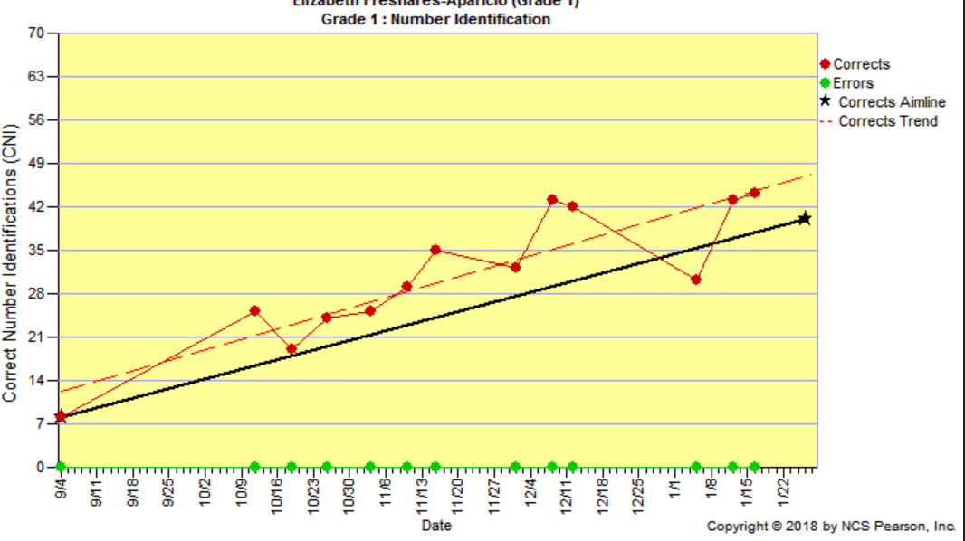
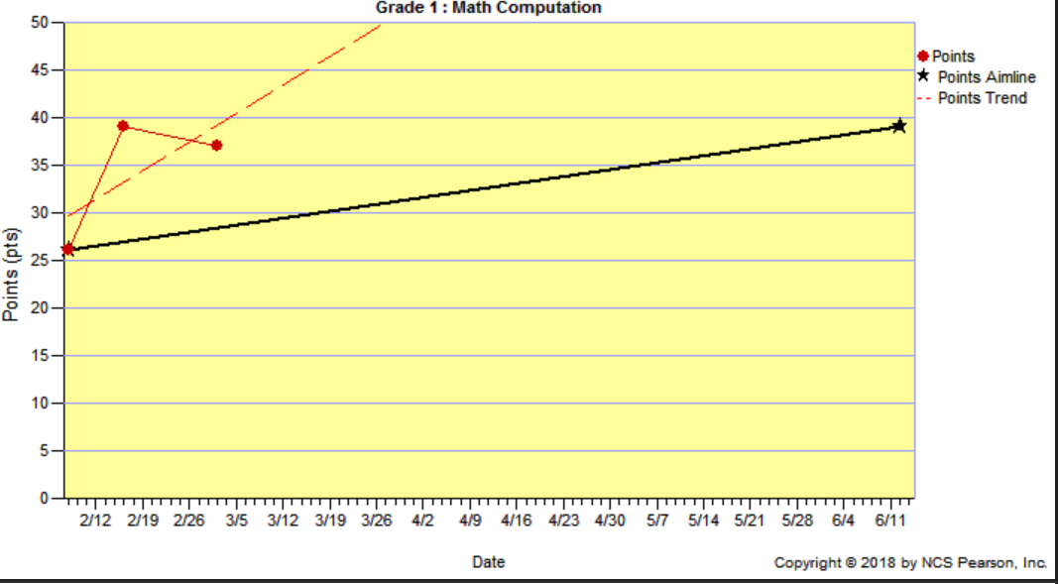
Current Data: 1st Grade Math
Math Benchmark Data
 | OC | NI | QD | MN | MCOMP
Fall | 68 | 8 | 26 | 2 | 7
Winter | 88 | 43 | 19 | 14 | 29
ROI | 1.33 | 2.33 | -0.47 | 0.80 | 1.47
Typical ROI | 0.61 | 0.64 | 0.39 | 0.25 | 0.83
Math Progress Monitoring

Slide 38
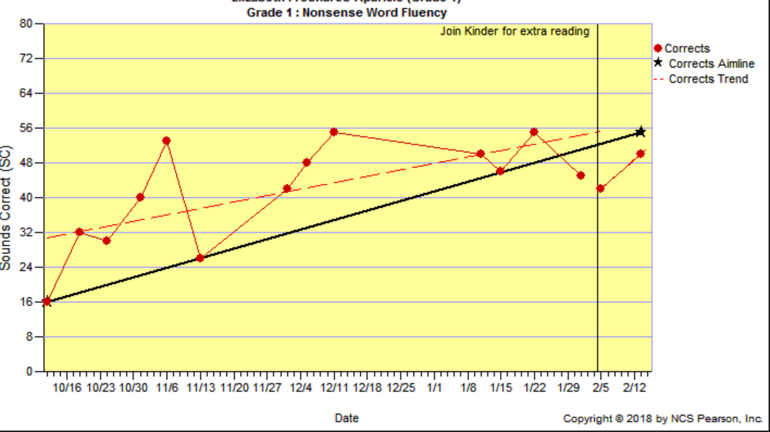
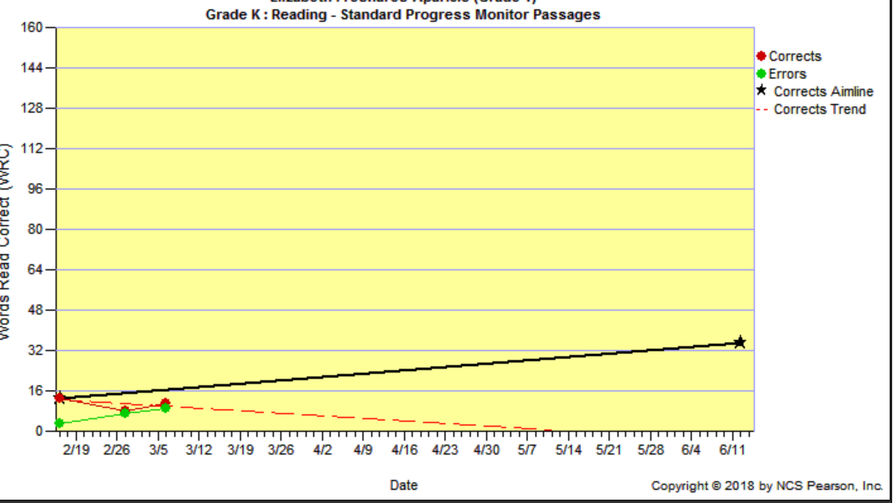
Current Data: 1st Grade Reading
Reading Benchmark Data
 | NWF | ORF
Fall | 16 | 1
Winter | 50 | 2
ROI | 2.13 | 0.06
Typical ROI | 0.9 | 1.5
Reading Progress Monitoring

Slide 39
Previous Data: Kindergarten
MATH
 | OC | NI | QD | MN
Fall | 24 | 1
Winter | 46 | 27 | 3 | 2
Spring | 58 | 55 | 24 | 12
ROI | 1.06 | 1.69 | 1.31 | 0.63
Typical ROI | 1.08 | 0.64 | 0.47 | 0.83
READING
 | LNF | LSF | PSF | NWF
Fall | 3 | 3
Winter | 8 | 14 | 2 | 13
Spring | 13 | 27 | 25 | 27
ROI | 0.31 | 0.75 | 1.43 | 0.87
Typical ROI | 0.86 | 0.94 | 1.14 | 0.83

Slide 40
Intervention Decisions
MATH | Core Program | Instructor | Time | Frequency | Duration | Group Size
1st Grade | CMC A | Cert (100%) | 60 min | 5x/week | 9/2017-present | 7:1 4:1
Kindergarten | CMC A | Cert (100%) | 60 min | 5x/week | 9/2016-6/2017 | 5:1
READING | Core Program | Instructor | Time | Frequency | Duration | Group Size
1st Grade | RM K | Cert (50%) Para (50%) | 70 min | 5x/week | 9/2017-present | 5:1
Kindergarten | RM K | Cert (100%) | 75 min | 5x/week | 9/2016-6/2017 | 5:1
Notes:
The learning objectives for this training are as follows:
Read bulleted points on slide to participants.

Slide 41
Plans Moving Forward
Already Put in Place
Implements flash card practice that address common number identification errors (e.g. 12, 21, 11, 20).
Provides additional examples & practice opportunities around number identification during lesson & workbook time.
Completes error analysis of in-program assessments in conjunction with a student interview. Uses data to target instruction and provide repeated practice around common errors.
Confers with student about progress monitoring graphs, learning behavior goals, & progress toward number identification mastery.
Provides a yellow tracking tool to support reversals in math and reading (reading & writing numbers & words backwards).
Draws 2 small lines for a two part number with a forward-facing arrow to facilitate proper number writing.
Provides preferred seating.
Plan to Try
Use lines of practice to increase practice opportunities.
Add in extra number identification practice before school during reading buddy time.
Provide additional opportunities around number writing during workbook time.

Slide 42
Lessons Learned: Towards Effective Implementation

Slide 43
Lessons Learned:
#1 Planning for Implementation
Start small and move forward one step at a time.
It is better to have initial successes than to overcommit and end up frustrated
Planning needs to take into account realistic challenges

Slide 44
Start Small & Expand
Select one or two schools and expand to more over time.
Select a specific content area and grow to other areas as you become more confident in the DBI process
Select a couple students to solidify the process before extending to additional students

Slide 45
Lessons Learned:
#2 Linear Implementation
We can not wait to implement DBI until Tier I and Tier II are perfect
However…….
instructional foundations and systemic processes for Tier I and Tier II should ideally be in place for intensive intervention to work best

Slide 46
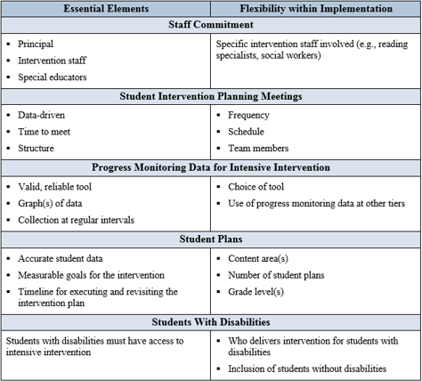
Highlight Key Features & Flexible Features
Clearly identify the essential elements for implementation and where there is room for flexibility

Slide 47
Lessons Learned:
#3 The role of Leadership
Strong administrator support from general and special education at the district and campus level is essential
Leadership support helps ensure DBI is ‘connected’ or ‘embedded’ in the district’s or school’s broader initiatives
District Leadership Teams
School Based Implementation Teams
Sustainable Complex Systems & Effective Implementation

Slide 48
Partner with Leadership
District Leaders and Site-Based Principals provide critical momentum to facilitate project success by…
Sending the message that “this is important” and reinforcing buy-in, readiness and commitment
Providing instructional leadership for the building
Allocating time and resources to support implementation and integration into the system
Reinforcing importance of use of data in instructional planning
Having awareness of critical elements of quality instruction/intervention

Slide 49
Lessons Learned:
#4 School Processes & Protocols
Strong standard programs and clear procedures helped sites focus more time on students’ response to intervention and problem solve needed adaptations
Established protocols (e.g., scripted meeting agendas) and systematized procedures helped when there was staff turnover

Slide 50
Lessons Learned:
#5 Trust the process
Implementation is hard work. It requires commitment and creative thinking
Commit to implementing the process for a given period of time and know that it will likely be bumpy along the way—so, don’t give up.

Slide 51
Allow for Customization & Be Flexible
Language:
  May need to adapt the language used to align with school/district terminology
Products, Tools, and Resources:
  Let sites customize and make products their own
  Don’t recreate the wheel if they already have something similar
Training:
  Use structures districts/schools have in place even if it means rearranging developed content
  Distance-based training can work & help build ownership at the site level
  Revisit training elements as sites progress

Slide 52
Use Formative Implementation Data
Formative implementation data can be used to:
  Reflect where sites are within the implementation process
  Identify challenges & successes
  Guide future planning and support

Slide 53
Stress the Intersection of Academics and Behavior
For students with both academic and behavioral needs the relationship is most likely connected.
Students who lack proficiency in academic skills may demonstrate avoidance behaviors as a mechanism to avoid assigned tasks.
Skill deficit
Avoidance behavior
Removal from task
This has been emphasized throughout our implementation work

Slide 54

Questions & Discussion?

Slide 55
Disclaimer
This module was produced under the U.S. Department of Education, Office of Special Education Programs, Award
No. H326Q160001. Celia Rosenquist serves as the project officer. The views expressed herein do not necessarily represent the positions or policies of the U.S. Department of Education. No official endorsement by the U.S. Department of Education of any product, commodity, service, or enterprise mentioned in this website is intended or should be inferred.
Notes:
NCII-1: H326Q110005
NCII-2: Grant #H326Q160001

Slide 56
Sarah Arden, American Institutes for Research
William Rasplica, Franklin Pierce Schools
Kelly Glick, Franklin Pierce Schools

